Slide 1
Making PNGs from Google Slides
And animated GIFs from EZGIF
https://docs.google.com/presentation
Set File / Page Setup to Custom X pixels x Y pixels.
Draw graphics on each slide and test the animation.
Set Background color to transparent.
Name slide presentation (anim-gif-xxx)
File / Download slides as PNGs.
Go to EZGIF.com/maker
Choose all files from a folder in your downloads folder. Look for the folder with the same name as your slide show. It will have all your PNGs.

Slide 2
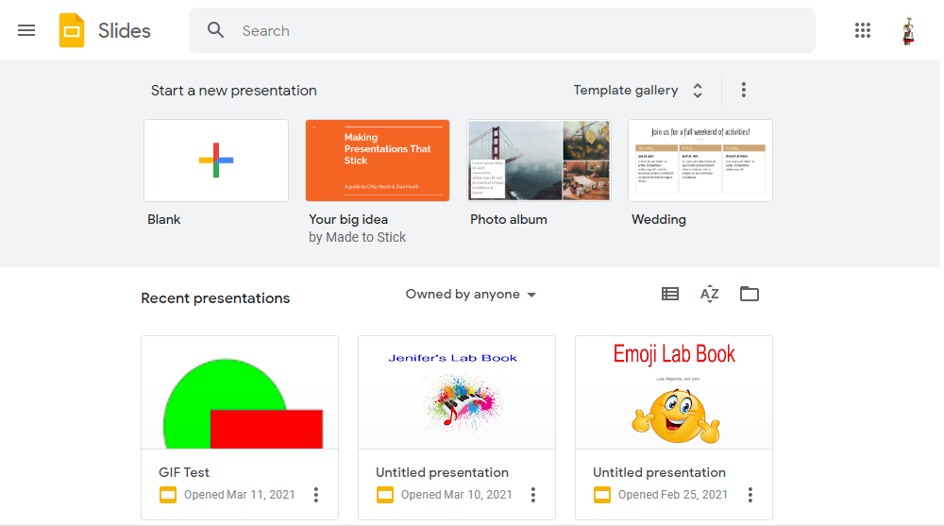
https://docs.google.com/presentation (Select blank slide.)

Slide 3
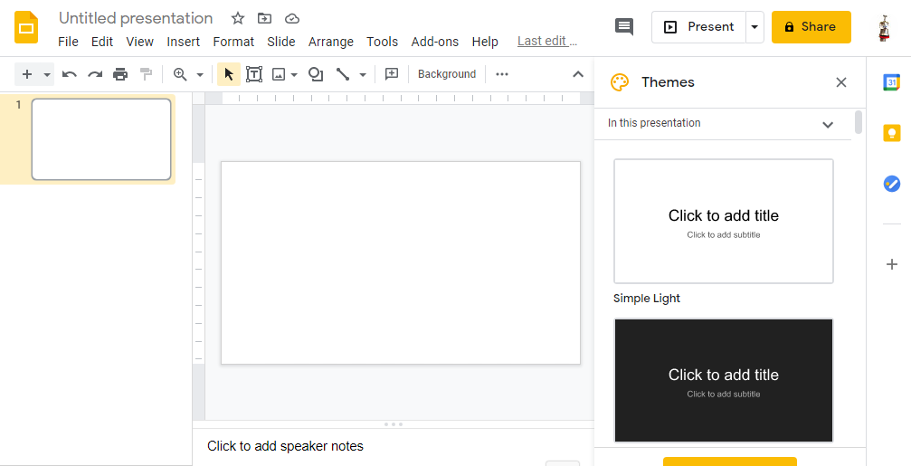
https://docs.google.com/presentation (Right click on slide background and Select blank slide.)

Slide 4
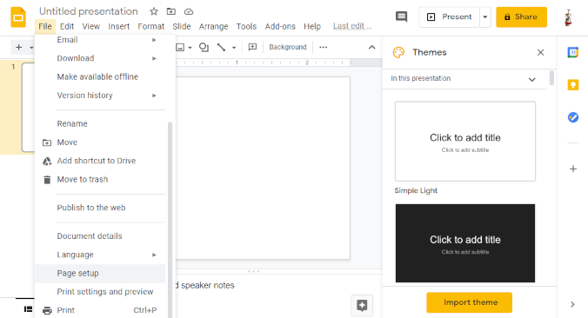
2) Set File / Page Setup to Custom X pixels x Y pixels.

Slide 5
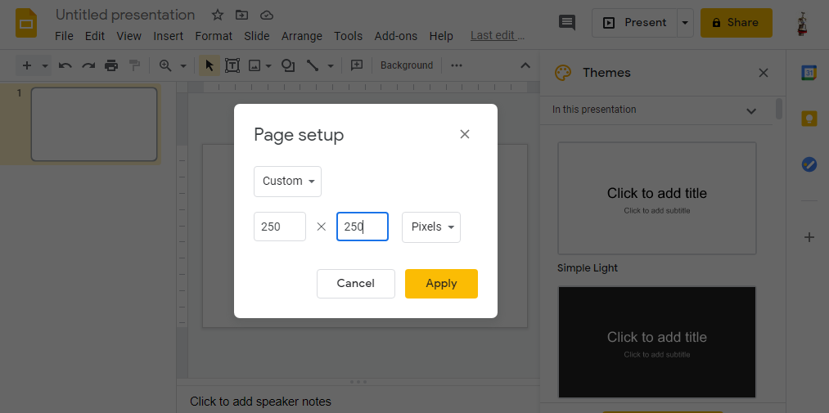
2) Set File / Page Setup to Custom X pixels x Y pixels.

Slide 6
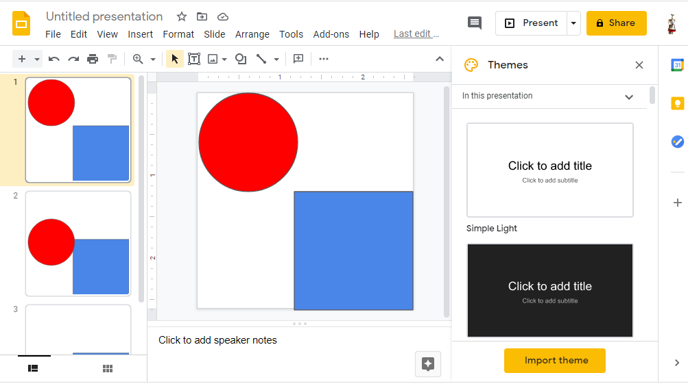
3) Draw graphics on each slide and test the animation.

Slide 7
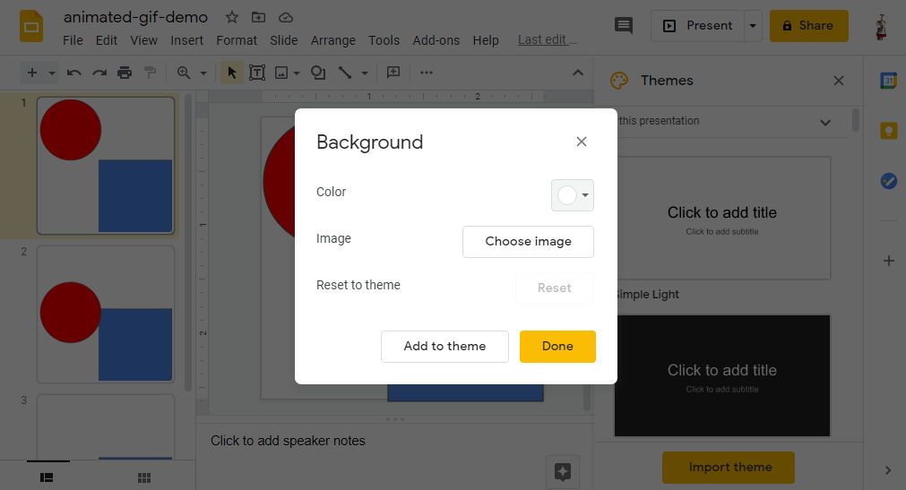
4) Set Background color to transparent. Right click on slide background. Do this for all slides.

Slide 8
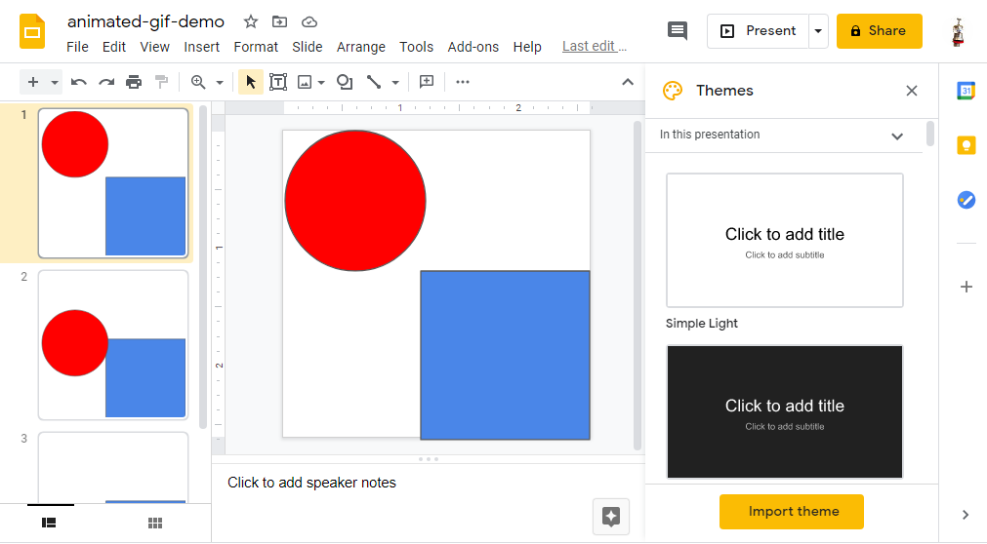
5) Name slide presentation (anim-gif-xxx)

Slide 9
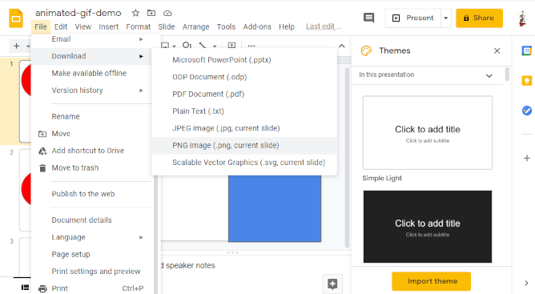
6) File / Download slides as PNGs. Do this for every slide.

Slide 10
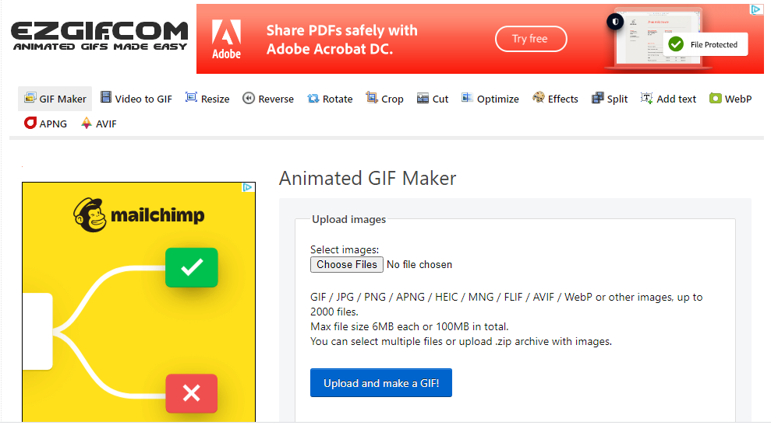
7) Go to EzGIF.com/maker

Slide 11
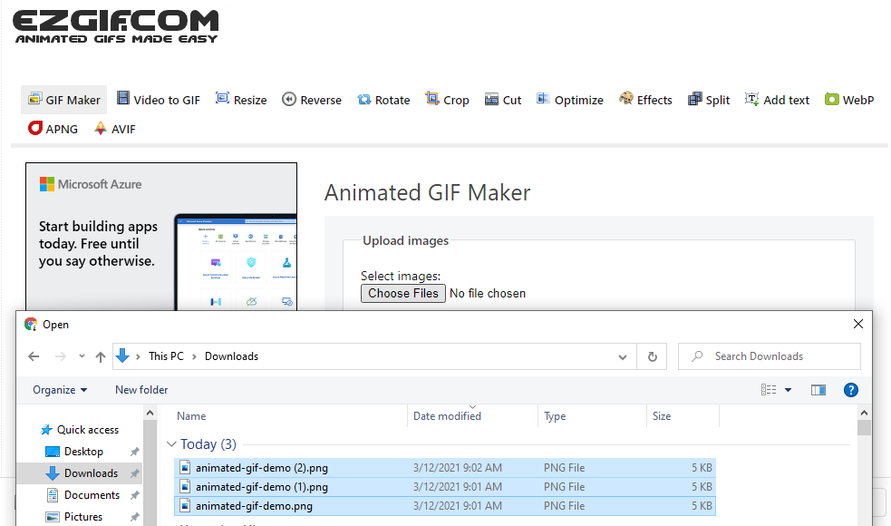
8) Choose all files from a folder in your downloads folder.

Slide 12
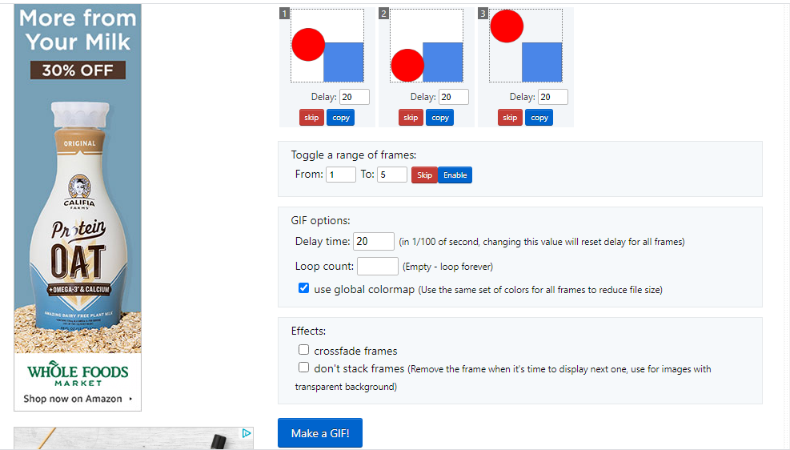
Experiment with various GIF attributes (timing, size, effects) Then click on Make a GIF.

Slide 13
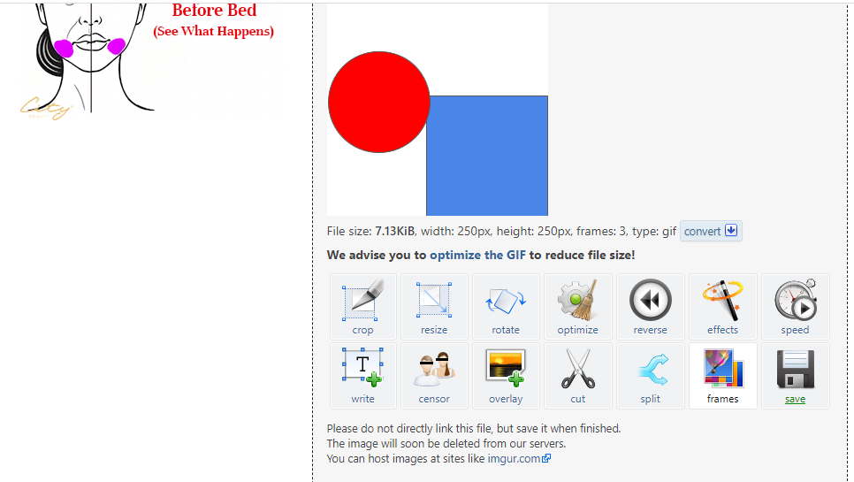
Save (Defaults to your Downloads folder.)

Slide 14
You’re done!

Slide 15
Making PNGs from PowerPoint MS Office 365 2019
Set Design / Slide Size to Custom X pixels x Y pixels.
Set Background color to transparent.
Draw graphics on each slide and test the animation.
File / Save As all slides as PNGs.
Go to EzGIF.com/maker
Choose all files from the folder you saved to. Look for the folder with the same name as your slide show. It will have all your PNGs.

