Slide 1
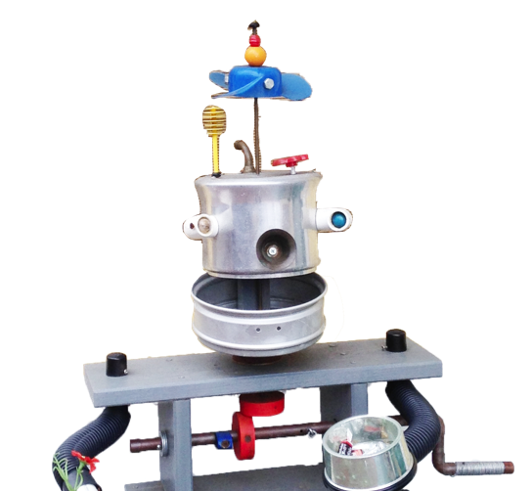
Creative STEAM Lab Book
Notes:
Welcome to the Build-It-Yourself Creative STEAM laboratory
Hi I'm John. I'm an electrical engineer out of Cornell and I'm the chief builder at Build-It-Yourself. Thank you for your interest in BIY.
May we know who is interested in (pick one)
1) education toward the goal of creating a sustainable future?
2) the integration of art and technology?
3) creativity and problem solving skills?
If you are, in the next 4 minutes we aim to recruit you to join our team.

Slide 2
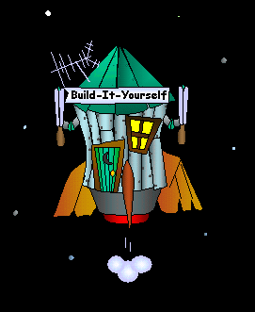
Creative STEAM Lab Book
The Problem:
The next generation of leaders and builders must use complex technology in creative ways to solve some very tough problems.
Notes:
The next generation of leaders and builders must use complex technology in creative ways to solve some very tough problems.

Slide 3
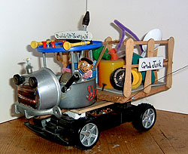
Creative STEAM Lab Book
The Mission:
Inspire and guide kids to use technology constructively and creatively.
Notes:
Our mission is to …
Inspire and guide kids to use technology constructively and creatively.

Slide 4
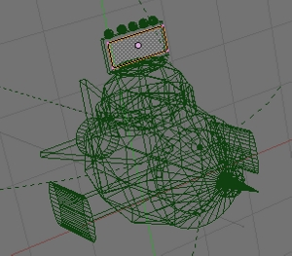
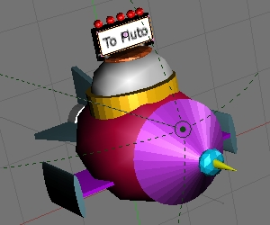
Creative STEAM Lab Book
The Results:
Projects that build confidence.
Notes:
One way of building confidence is to succeed at a complicated task.
We show kids how to make creative graphics using complex drawing tools .

Slide 5
Creative STEAM Lab Book
The Results:
Projects that drive teamwork
Notes:
How do you encourage kids to think about teamwork?
This animated WeChat emoji symbolizes teamwork.

Slide 6
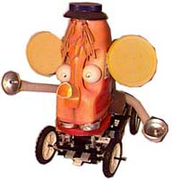
Creative STEAM Lab Book
The Results:
Projects that encourage recycling.
Notes:
Creativity and fantasizing is exercised at a high level when you build from recycled materials.

Slide 7
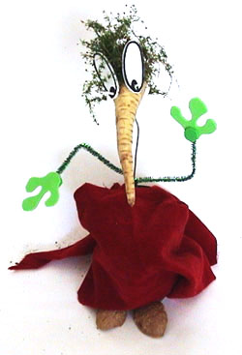
Creative STEAM Lab Book
The Results:
Projects that demonstrate passion.
Notes:
Even food is recycled in Build-It-Yourself projects.
This is a handsome turnip head is from our ‘Ugly Veggies’ project.
Projects like this tend to drive engagement and passion.

Slide 8
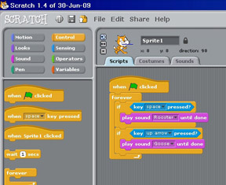
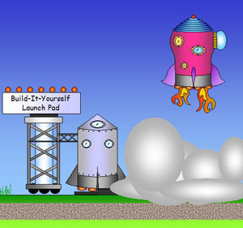
Creative STEAM Lab Book
The Results:
Projects that exercise problem solving skills
Notes:
MIT’s Scratch programming language is a powerful tool that enables kids to exercise problem solving skills.
Scratch is used in almost half of our 30 projects.

Slide 9
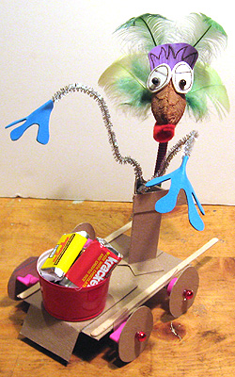
Creative STEAM Lab Book
The Results:
Projects that inspire playful creativity
Notes:
We encourage kids to build whimsical robots from common materials

Slide 10
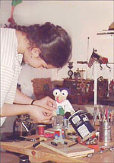
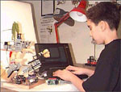
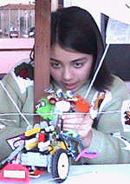
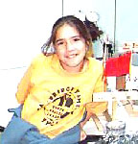
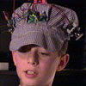
Creative STEAM Lab Book
The Results:
Notes:
The results:
30% of our Advanced Builders have gone to Stanford, MIT or an Ivy League school.

Slide 11
Creative STEAM Lab Book
Unique Online Global Laboratory:
Notes:
We invite you to join our unique online global laboratory.

Slide 12
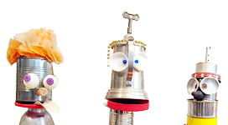
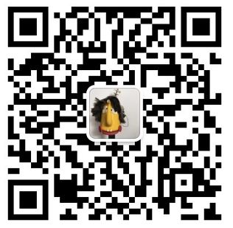
Creative STEAM Lab Book We invite you to join our team. john@build-it-yourself.com
Notes:
Build-It-Yourself contracts with artists and engineers to be online workshop leaders and to help us develop new projects.
I hope we may have the pleasure of inspiring and guiding the next generation of builders with you.
Please email or WeChat me if you would like to explore opportunities at Build-It-Yourself.

