Slide 1
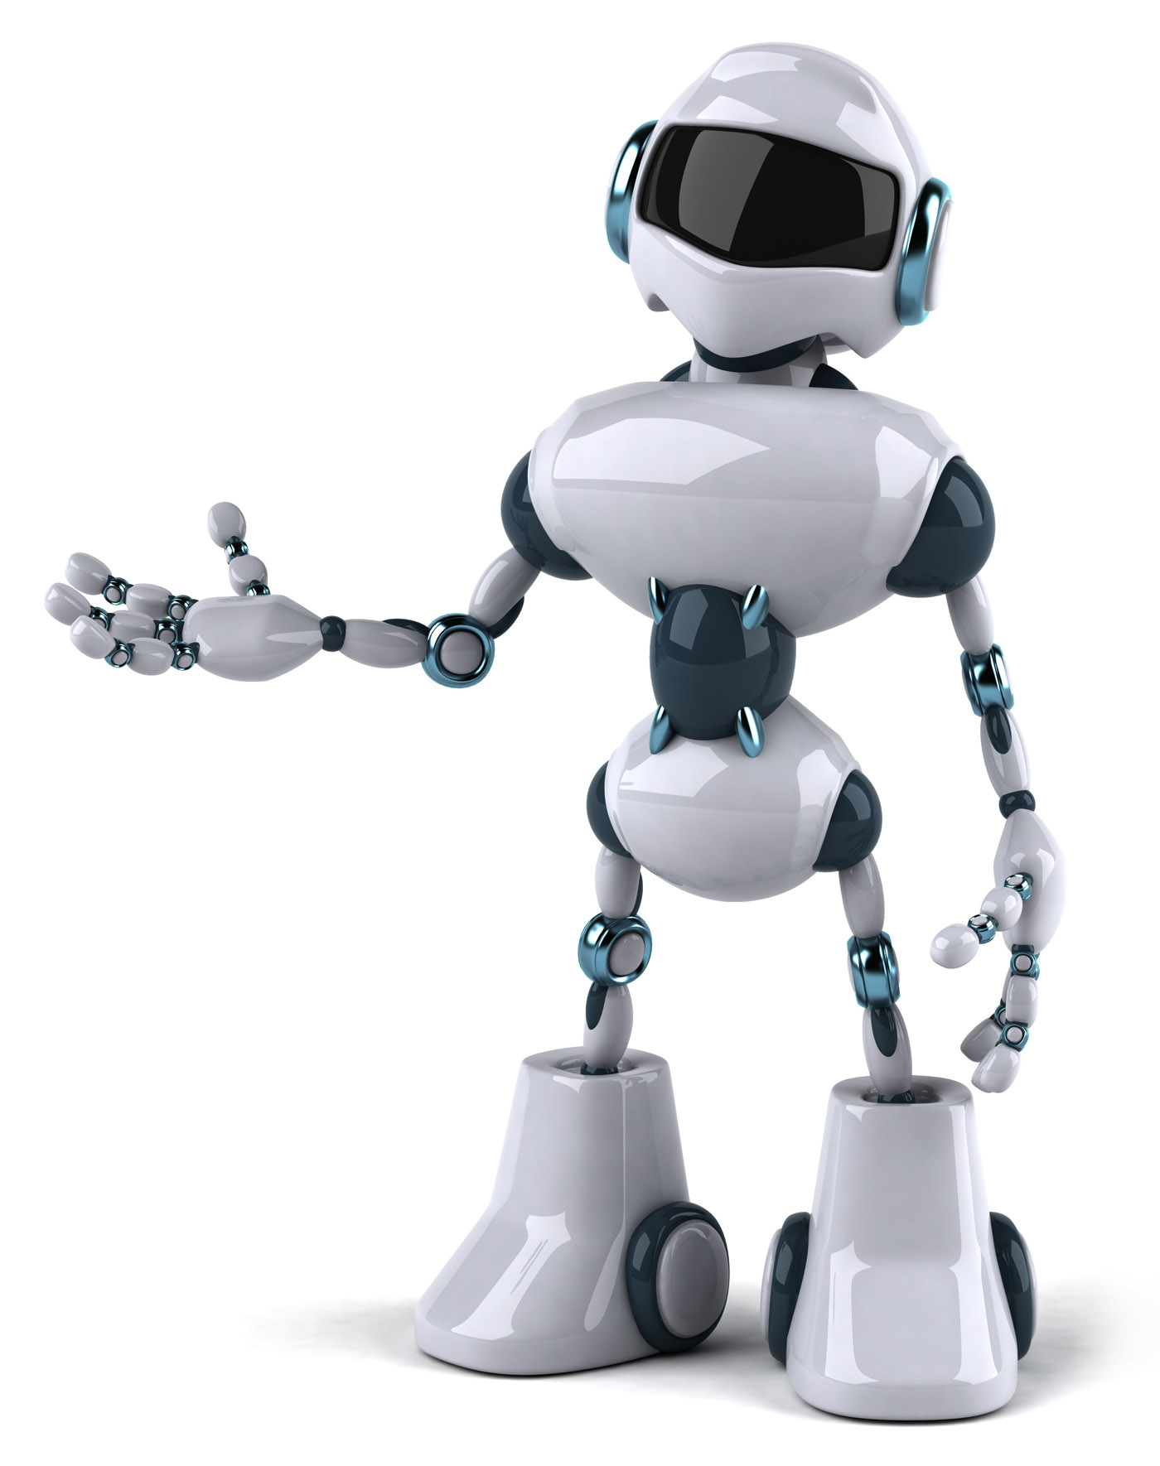
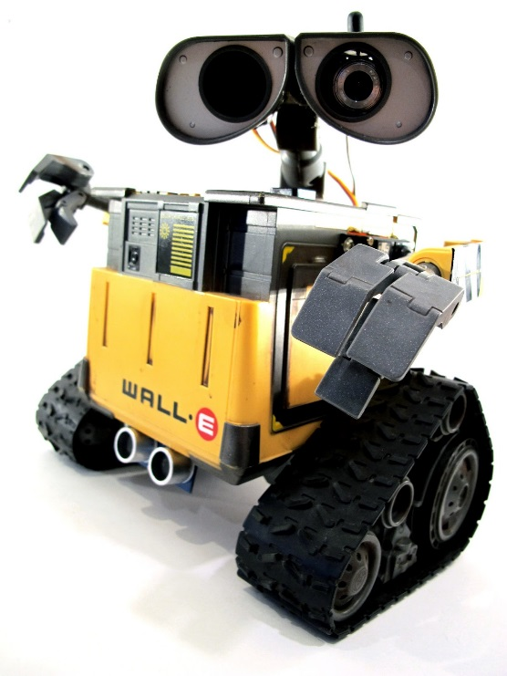
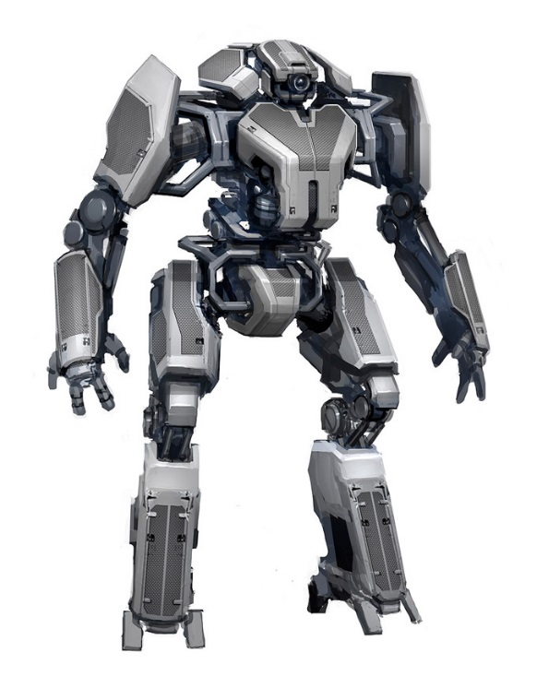
Lab Book
Team name: sky
Leader:Colin
2:Mike
3:Leo
4:Marvin
I love Robot

Slide 2
Problem:
Many TV programs and movies are booooooring.
Mission:
You mission is to produce and direct your super hero story or a way cool experimental, computer controlled robatic.

Slide 3
Problem Solving tricks
#1 Focus – Identify the problem and set goal.
#2 Research – Don’t re-invent the wheels.
#3 Teamwork – Share ideas.
#4 Simplify – Break your solution into simple parts.
#5 Document – Keep a lab book.

Slide 4
Program Primitives
(1) Sequence / Parallel
(2) Iteration
(3) Conditional
(4) Variables
(5) Messages
(6) Modular programming

Slide 5
Tool Rules
(1) Don’t cut your finger off
(2) Hold work firmly
(3) Wear goggles
(4) Think what happens if you slih
(5) Clean up

Slide 6
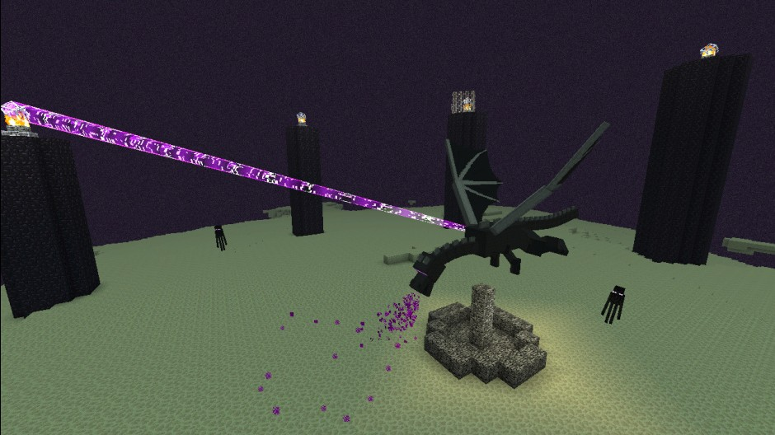
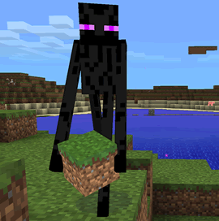
Story:Minecraft—Enderman and Steve
Problem:
Mission:
Many TV programs and movies are booooooring.
You mission is to produce and direct your super hero story or a way cool experimental, computer controlled robotic.
IN Minecrft: a Long a long ago ,there was Enderman. He liked to help people. Steve wanted to kill EnderDragon.
Steve looked at Enderman.
Steve say :“Where is Enderland? ” Enderman and Steve
were going to Enderland .Enderman killed one EnderDragon . The Enderman wanted to go minecraft ,
But Enderman revive the other Enderdragon. The other Enderdragon killed Steve. Steve go to day. Enderman was sad.

Slide 7
Solution:
In Minecraft people didn’t love Engerman.
Enderman put on the jetpack flying in the sky. Enderman Is going to day .Enderman was dying.

Slide 8
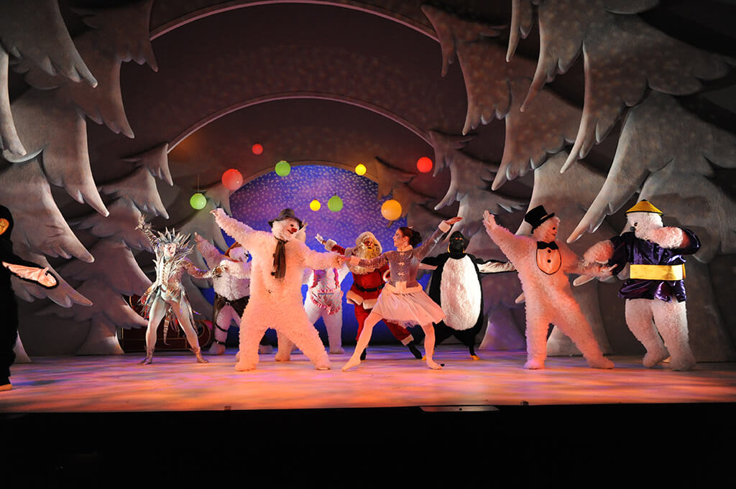
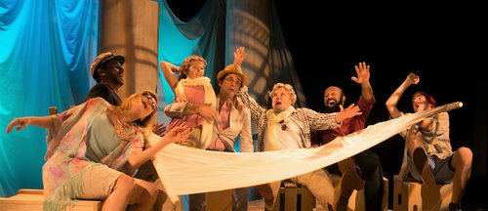
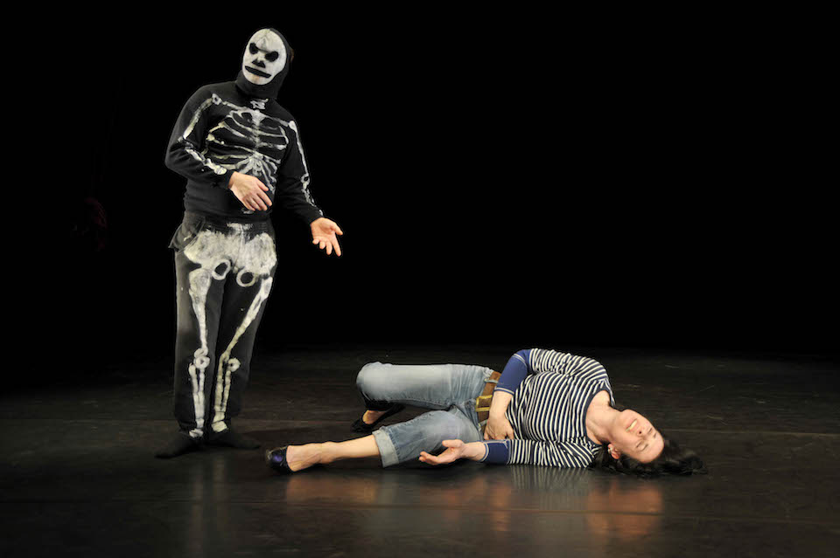
experimental theatre research

Slide 9
What I learned this week
Colin : I learned computer program and scratch program,
so I learned make bester robot and puppet.
Mike: I learned coding and how to keep a PPT lab book
Marvin: 1. the most important thing that I learned is programming 2. how to build a robot and to make more toys 3. how to use glue gun and new tools. 4. how to work with friends.
Leo: I learned about robot programs and make new robot idea.

