Slide 1
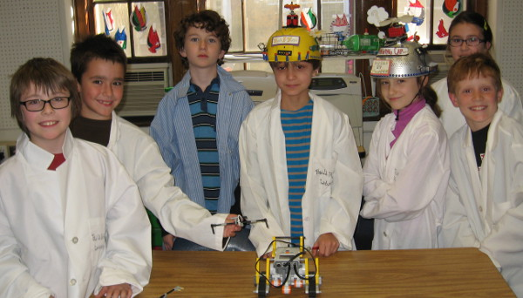
BB&N League Knights
Patrick, AJ, Ruddock, Tyler, Helen, Simru, Jack
Team #13218
Patrick

Slide 2
First Lego League Core Values
We are a team.
We do the work to find solutions with guidance from our coaches and mentors.
We know our coaches and mentors don't have all the answers; we learn together.
We honor the spirit of friendly competition.
What we discover is more important than what we win.
We share our experiences with others.
We display Gracious Professionalism® and Coopertition® in everything we do.
We have FUN!
Ruddock

Slide 3
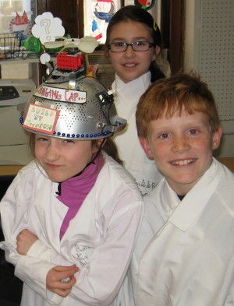
Goals
Have fun
Learn how to build robots
We are a rookie team
Patrick

Slide 4
Senior Citizen Problems
Robot Competition
Need medicine
Transportation
Sad and lonely
Physical disabilities
The Problem
Too many problems!
Too hard to solve all problems
Patrick

Slide 5
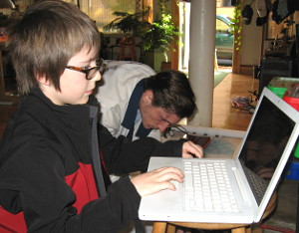
The Plan
Robot Competition
Focus and simplify
Repair chair
Fix quilt
Climb stairs
Patrick

Slide 6
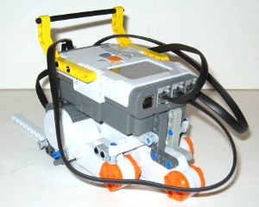
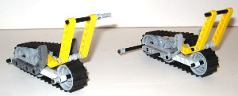
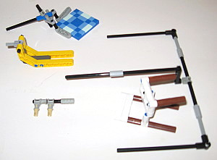
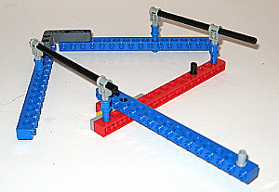
Our Solution Modular Construction
Robot Competition
Chassis
Treads
Arms
Jigs
Patrick

Slide 7
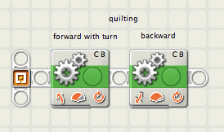
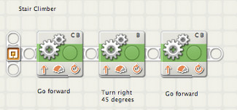
Robot Competition
Our Solution Modular Programming
Get chair
Put chair
Fix quilt
Climb Stairs

Slide 8
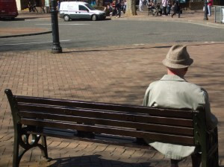
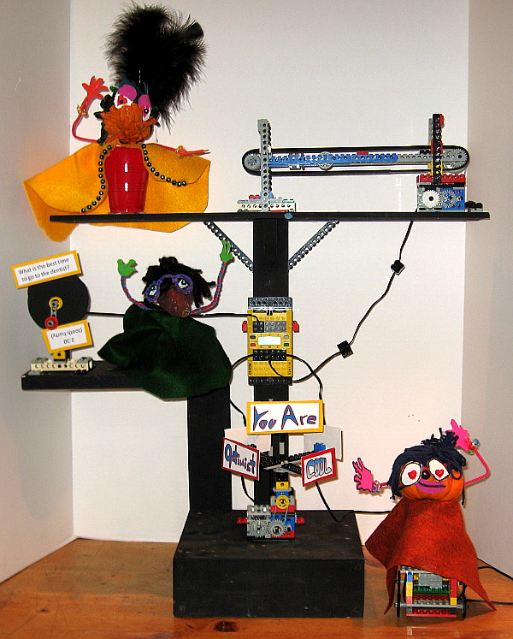
Research
The Problem
Some senior citizens are sad
The Mission
Build a robot that can make
senior citizens happy.
Helen

Slide 9
Senior citizen depression
Research
The majority of 51 to 61 year-old retirees
who are depressed were forced into retirement.
This may contribute to the finding
that only 4 percent of depressed retirees
find retirement satisfying.
NATIONAL ACADEMY ON AN AGING SOCIETY
Taken from: http://www.efmoody.com/images/16depressive.gif On 11/7/2012
Simru

Slide 10
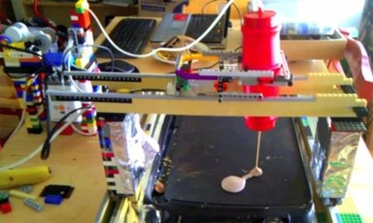
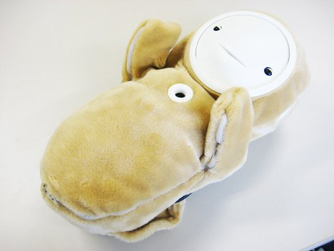
Entertainment for senior citizens
Research
Robot that cooks
Pancake-making
Robot
Robot that fights
depression
Baby-like robot
Simru

Slide 11
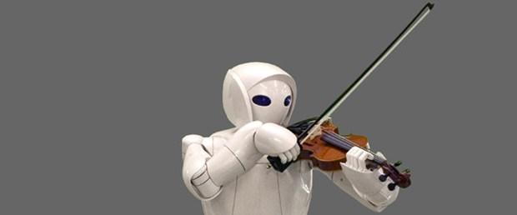
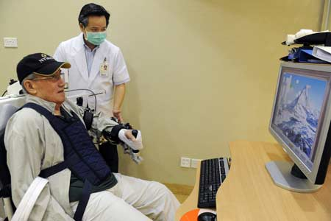
Research
Identifying the Problem
Our problem is entertainment. Here are some ideas…..
Majority of the elderly in both rural 50.78 % and urban 57.35 % areas are totally dependent on others for economic support.
Have good constructive hobbies like gardening, music, painting etc.
Teach them computer skills
Technology has advanced so fast in the past decades that senior citizens may have been left out in the cold. Start by showing your senior friend basic skills, such as turning on the computer (don't laugh). Advance to basic emailing techniques and load in their friends and family so that they can easily send emails of their own.
Cook with your senior citizen friend Ask your senior friend about foods of their childhood and come prepared with ingredients and recipes. Not only will you transport them to a time when comfort foods were really comforting but you just might add some great recipes to your repertoire
Ruddock

Slide 12
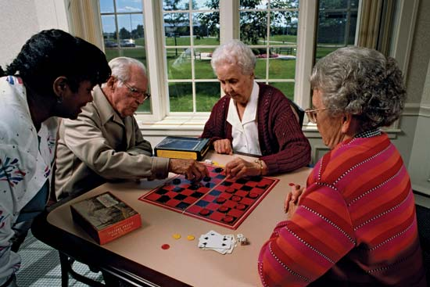
Our problem is entertainment. Here are some ideas…..
Research
The number of gamers over the age of 50 increased by 15 percent from 1999 to 2007, according to a survey by the Entertainment Software Association (Reference 1). With this increase in senior citizen gamers comes an increase in electronic games suitable for that age group. Of course, senior citizens are free to play any game they would like, but seniors new to gaming may prefer titles with motion controls, cognitive benefits and a familiar setting.
Ruddock

Slide 13
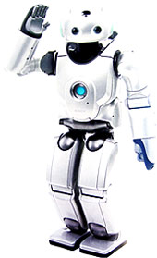
The Companion Robot
Research
SDR-4X II This robot can recognize faces, colors, and sounds.
It can even dodge obstacles and even have a conversation with you!!
You can also change its voice and other small features like that.
Ruddock

Slide 14
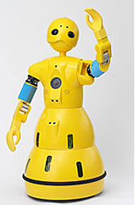
Robot Companion 2
Research
Wakamaru is a robot that can monitor your home and can have a conversation with you. It can have a male or female voice.
What’s up?
Ruddock

Slide 15
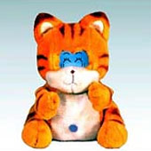
Pet Robot
Research
Tama Matsushita Electric announced its entry into the 'pet' robot
market with Tama, a robotic cat designed to be a conversation
partner for elderly people.
The idea behind it is animal therapy...
Tama can be connected via cell phone or ISDN line to a network
system center, allowing health or social workers to send local
news, medical information, and encouraging messages to
elderly people. It is endowed with 50 phrases, ranging from the
light-hearted (today is the karaoke party. let's sing a lot.)
to more practical information (Today is wednesday, it is your
day to go to the hospital.).
Ruddock

Slide 16
Our Solution
Research
Brainstorming:
Make a robot that tells jokes or riddles.
It might give you a cookie if you get it right.
It could be a memory challenge
We can track the syllables of the answer
We might have a time limit
Ruddock

Slide 17
Our Solution
Research
Wait for light sensor detection on joke teller
Turn on fortune wheel for 4 seconds
Turn on conveyor belt for 10 seconds.
Turn on puppet chassis
Start program
Ruddock

Slide 18
Thank you!

Slide 19
Some Jokes
Research
Q. What do you get from a pampered cow?
A. Spoiled milk.
Q. What's brown and sticky?
A stick
What dog can jump higher than a building? Any dog, buildings can't jump!
Question: Why are ghosts bad liars?Answer: Because you can see right through them
Q.how do you make seven an even number? A.take the s out!
Ruddock

Slide 20
Research - Graffiti Signs for Wheel of Fortune
Simru

Slide 21
The Thingamabobs!!
Roberta Robert Robbie
Ruddock

Slide 22
Research - Robot will tell this joke to start
What is the best time to go to the dentist?
2:30
(tooth hurty)
Helen

Slide 23
Research
Jackson
AJ
Tyler
Patrick
BB&N League Knights 13218
BB&N League Knights 13218
BB&N League Knights 13218
BB&N League Knights 13218
Helen

Slide 24
Research
BB&N League KINGHTS
Simru
Helen
Ruddock
BB&N League Knights 13218
BB&N League Knights 13218
BB&N League Knights 13218
Helen

