Slide 1
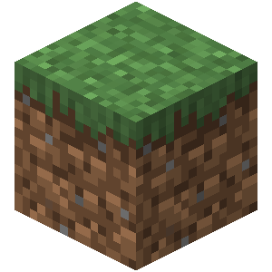
Minecraft 101
Lesson Plan

Slide 2
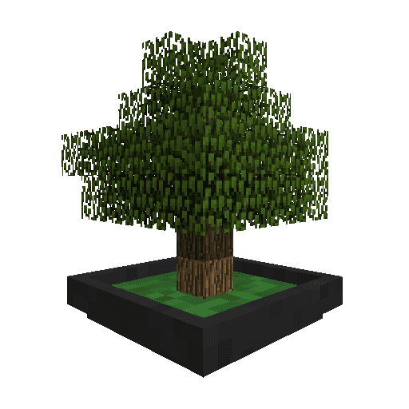
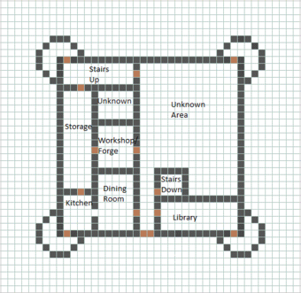



Minecraft 101
Lab 1
Lab 2
Lab 3
Lab 4
Measures of success
Presenting Ideas
Build monuments
Problem Solving Tricks
Landscaping
Create Floor Plan
Lab Book
Problem/Mission
Research
Lab 8
Lab 7
Lab 6
Lab 5
Presentation Day
Complete Minecraft civilization
Practice Presentations
Build entrance
Build Laboratory

Slide 3






Minecraft 101: Lab 1
“Establish passion for building”
Objectives:
Get to know teammates.
Exercise research skills.
Exercise teamwork skills.
Exercise PowerPoint skills.
Set up Lab Book.
BIY Presentation/ Introductions
Present Power Point Graphics
5 min
Save as: “school-date-project-name1-name2.ppt'
in a new folder under
documents called ‘BIY'
Create a Lab Book cover.
10 min
Project Introduction “Minecraft 101”
Tour server
5 min
Document Problem and Mission.
Power Point
Skills
10 min
Present the importance of Research.
5 min
Google image
search.
Copy and paste
into Lab Book.
Research/document, history, images, prior art, good and bad examples.
Researching
Skills
15 min
What do you like?
What could be better?
Show and tell.
Presentation
Skills
5 min
Notes:
Minecraft 101: Class 1

Slide 4
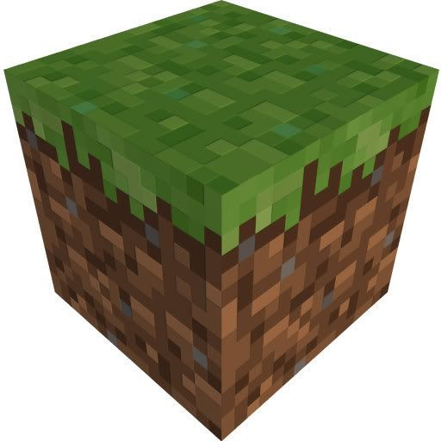
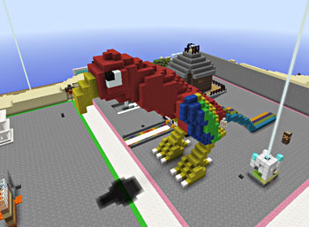
Minecraft 101: Lab 2
“Set measures of success/ Presenting ideas/ Build monuments”
Objectives:
Understand the importance of presenting ideas.
Learn controls and how to build in Mineraft.
Review Problem and Mission
Discussion / Goals
5 min
Present “Presenting Ideas”
(ugly, average, way cool)
5 min
Document Presenting Ideas in PPT
Power Point
Skills
Show basic Minecraft controls to newbies.
15 min
Additional Task:
Build interior to
monument like the
Statue of Liberty
in NY.
(To fill in time or
as challenge during
the week)
Exercise Minecraft Controls
5 min
Present Monuments
5 min
Build a monument worthy of your civilization!
Minecraft
Construction
Skills
Exercise – Start tower or statue.
15 min
What do you like?
What could be better?
Show and tell.
Presentation
Skills
5 min
Notes:
Minecraft 101: Class 1

Slide 5
Minecraft 101: Lab 3
“Problem Solving / Landscaping”
Objectives:
Document problem solving tricks.
Complete monuments.
To understand what is landscape.
Review Problem and Mission
Discussion / Goals
5 min
Present “Problem solving tricks”
5 min
Document the 5 Problem Solving Tricks
Power Point
Skills
15 min
Present Landscaping
5 min
Additional Tasks:
* Build interior to
monument like the
Statue of Liberty
in NY.
* List cool features
of laboratory.
(To fill in time or
as challenge during
the week)
Remember:
“Everything we should build should get landscaped”.
Exercise – Complete monuments.
10 min
Thinking like an architect skills.
Exercise – Landscape around monument.
10 min
What do you like?
What could be better?
Show and tell.
Presentation
Skills
5 min
Notes:
Minecraft 101: Class 1

Slide 6

Minecraft 101: Lab 4
“Create floor plan”
Objectives:
Learn how to plan projects.
To learn how good architects think.
Review Problem and Mission
Discussion / Goals
5 min
Present “Floor Plans”
5 min
List features/ functions for rooms, draw plan, share progress.
Exercise – Create floor plan in lab book.
Power Point
Skills
20 min
Present “Demonstrate laying out floor plan.”
5 min
Show how to extrude walls in Minecraft.
Exercise – Execute floor plan in Minecraft.
10 min
Additional Tasks:
* Finish laboratory.
(To fill in time or
as challenge during
the week)
Thinking like an architect skills.
Exercise – Start laboratory.
10 min
What do you like?
What could be better?
Show and tell.
Presentation
Skills
5 min
Notes:
Minecraft 101: Class 1

Slide 7
Minecraft 101: Lab 5
“Build laboratory”
Objectives:
To demonstrate the value of planning.
To understand how to use time limits to set building expectations.
Review Problem and Mission
Discussion / Goals
5 min
Review drawn floor plans to sync building goals and focus. If anyone began laying out floor plan share with the group.
Exercise – Review floor plans.
Power Point
Skills
5 min
Additional Tasks:
Practice Redstone.
Add Redstone
to laboratory.
(To fill in time or
as challenge during
the week)
Exercise – Complete laboratory structure.
Thinking like an architect skills.
40 min
What do you like?
What could be better?
Show and tell.
Presentation
Skills
5 min
Notes:
Minecraft 101: Class 1

Slide 8
Minecraft 101: Lab 6
“Build entrance”
Objectives:
Understand the importance of first impressions.
Practice values of presenting ideas.
Review Problem and Mission
Discussion / Goals
5 min
Present “Entrances”
5 min
Google image
search.
Copy and paste
into lab book.
Exercise – Research and brainstorm entrance ideas in Lab Book.
Power Point
Skills
10 min
Additional Tasks:
Use redstone in entrance (piston doors)
(To fill in time or
as challenge during
the week)
Thinking like an architect skills.
Exercise – Build entrance.
35 min
What do you like?
What could be better?
Show and tell.
Presentation
Skills
5 min
Notes:
Minecraft 101: Class 1

Slide 9
Minecraft 101: Lab 7
“Complete entrances / Practice presenting”
Objectives:
Understand the importance of first impressions.
Practice values of presenting ideas.
Review Problem and Mission
Discussion / Goals
5 min
Exercise – Finish entrances.
20 min
Describe format for presentations, set expectations.
Explain Presentations.
5 min
Practice Presenting.
25 min
Presentation
Skills
3 min max per person.
Last members practice next week.
What do you like?
What could be better?
Show and tell.
5 min
Notes:
Minecraft 101: Class 1

Slide 10
Minecraft 101: Lab 8
“Complete entrances / Practice presenting”
Objectives:
Learn how to sell your ideas in an elevator pitch.
Present project portfolio in less than 2 min video.
Review Problem and Mission
Discussion / Goals
5 min
Present Invention Universe.
5 min
Make Invention Universe Planet.
15 min
Introduce projects, present lab books, present solutions.
Presentation
Skills
3 min max per person.
Last members practice next week.
Show great sales presentations.
5 min
Record video of project presentation.
30 min
Notes:
Minecraft 101: Class 1

