Slide 1
Minecraft Pre-Workshop Guide
How to Set Up Minecraft for a Build-It-Yourself Workshop.
www.Build-It-Yourself.com

Slide 2
Minecraft Java Edition
For Build-It-Yourself workshops, we use the Java edition of Minecraft. This version costs $35 USD as of May 2020. We use this version as it works Windows and Mac.
This is not the same as the phone, tablet, console or Windows 10 edition.
“The original version of Minecraft! Java Edition has cross-platform play between Windows, Linux and macOS, and also supports user-created skins and mods. Includes a decade’s worth of updates, with much more to come!” ~Mojang
www.Build-It-Yourself.com

Slide 3
Minecraft Java Edition Instructions
Please carefully follow the instruction below to get the correct version of Minecraft.
Go to https://www.minecraft.net/en-us/store/minecraft-java-edition
Click 'BUY MINECRAFT'
Register for a Mojang account
Verify account via email
Purchase the license for the game
Download the installation file
Install the game
***Remember to check that you are on the Java edition before completing your purchase***
www.Build-It-Yourself.com

Slide 4
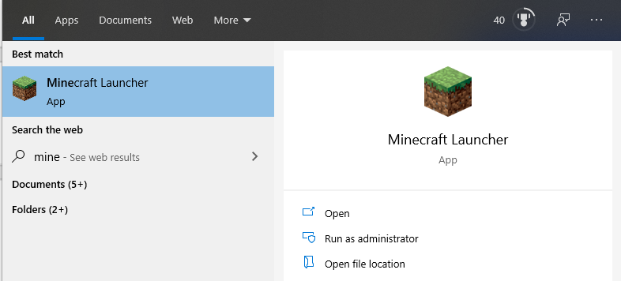
Launch Minecraft
Search 'Minecraft' on your computer and open the Minecraft app after installation.
www.Build-It-Yourself.com

Slide 5
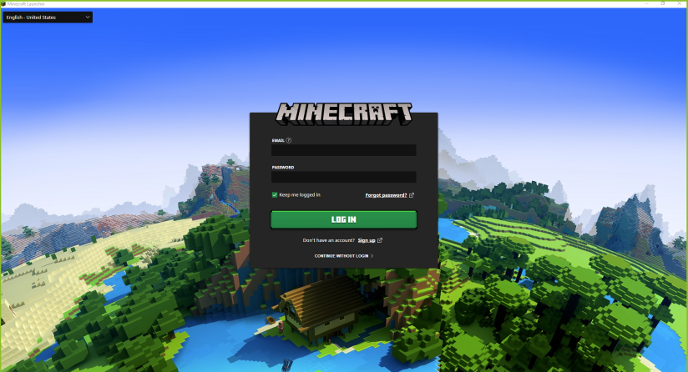
Login
Enter the email you signed up with and your password.
www.Build-It-Yourself.com

Slide 6
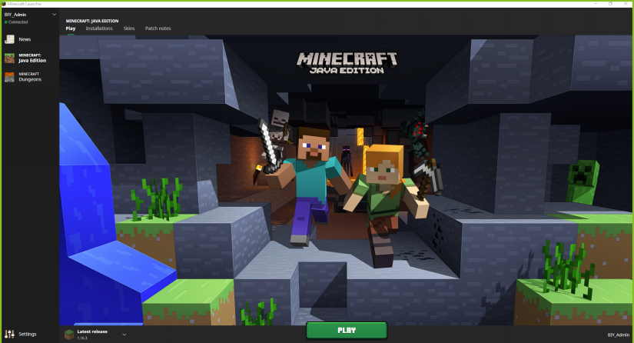
Click Play
www.Build-It-Yourself.com

Slide 7
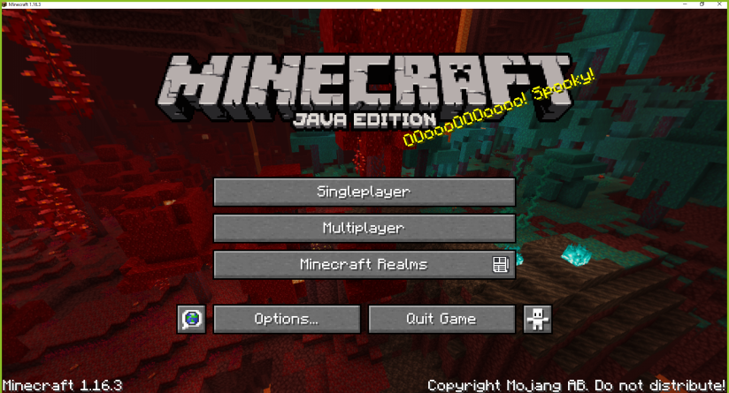
Click Single Player
www.Build-It-Yourself.com

Slide 8
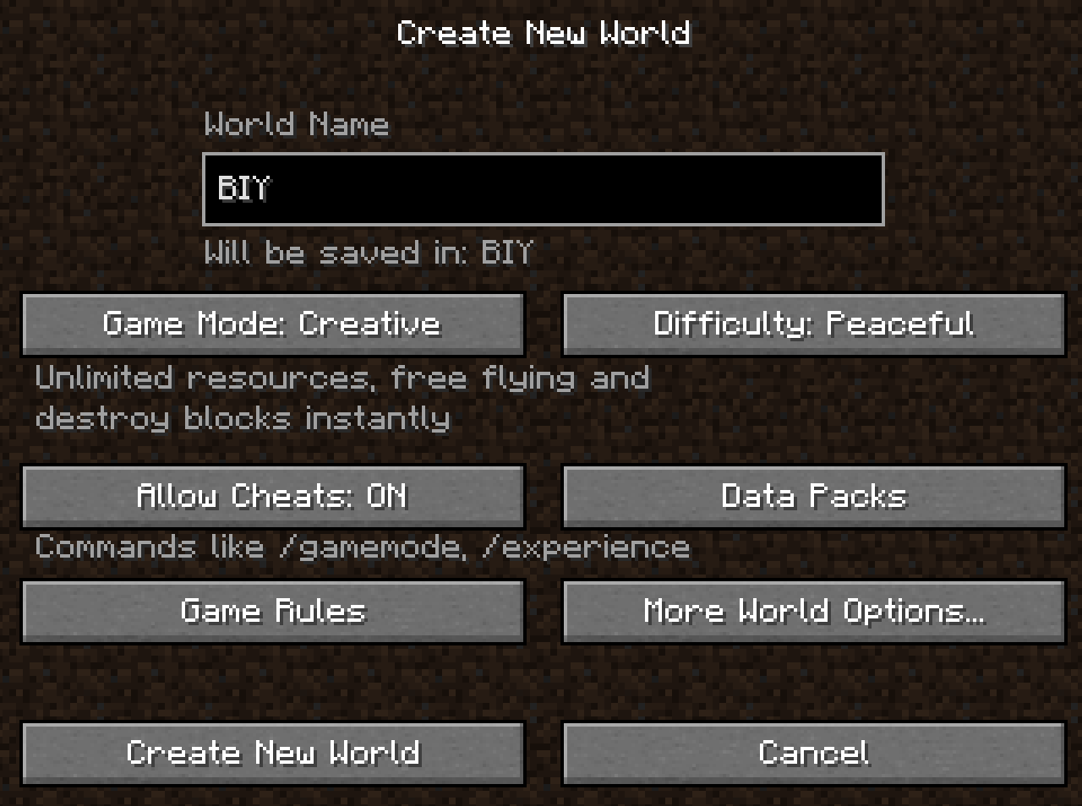
Name World
Enter a World Name you will remember. We recommend 'BIY' or 'Build-It-Yourself'.
www.Build-It-Yourself.com

Slide 9
Set Game Mode
Click on Game Mode until it displays “Game Mode: Creative”
www.Build-It-Yourself.com

Slide 10
Set Difficulty
Click on Difficulty until it displays “Peaceful”
www.Build-It-Yourself.com

Slide 11
More World Options
Click on More World Options...
www.Build-It-Yourself.com

Slide 12
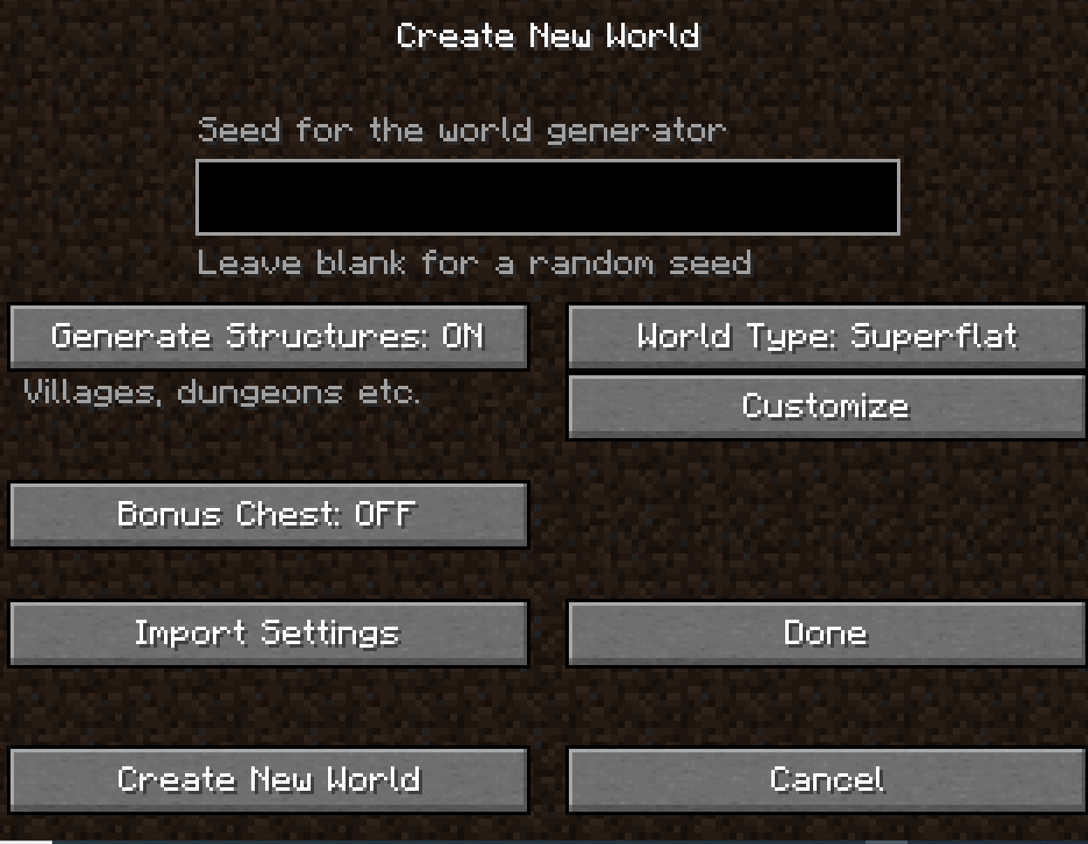
Set World Type
Click on World Type until it displays “World Type: Superflat”
www.Build-It-Yourself.com

Slide 13
Create New World
Click on Create New World
www.Build-It-Yourself.com

