Slide 1
Minecraft 103
Computer Architecture
Inputs
Oscillator
Or
Clock
Counter
Or
Memory
Decoder
Outputs
Build-It-Yourself.com
Notes:
In Minecraft 103, we will explore how a computer works.

Slide 2
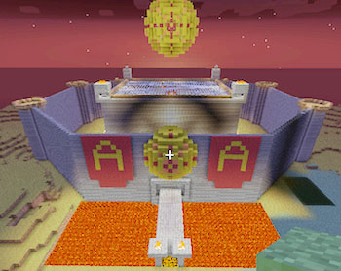
The Problem
As our civilization flourishes, there is a demand for playful and creative inventors who can build way cool machines.
Wanted:
Top notch Minecraft engineers

Slide 3
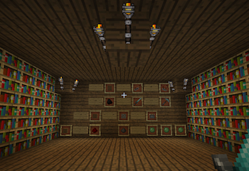
The Mission
Be part of the Minecraft Revolution!
Build the next generation of amazing machines that will transform life as we know it. Music machines, time machines, and mind-bending games and playlands.

Slide 4
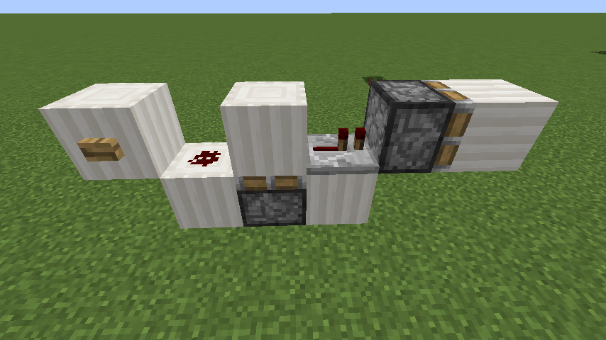
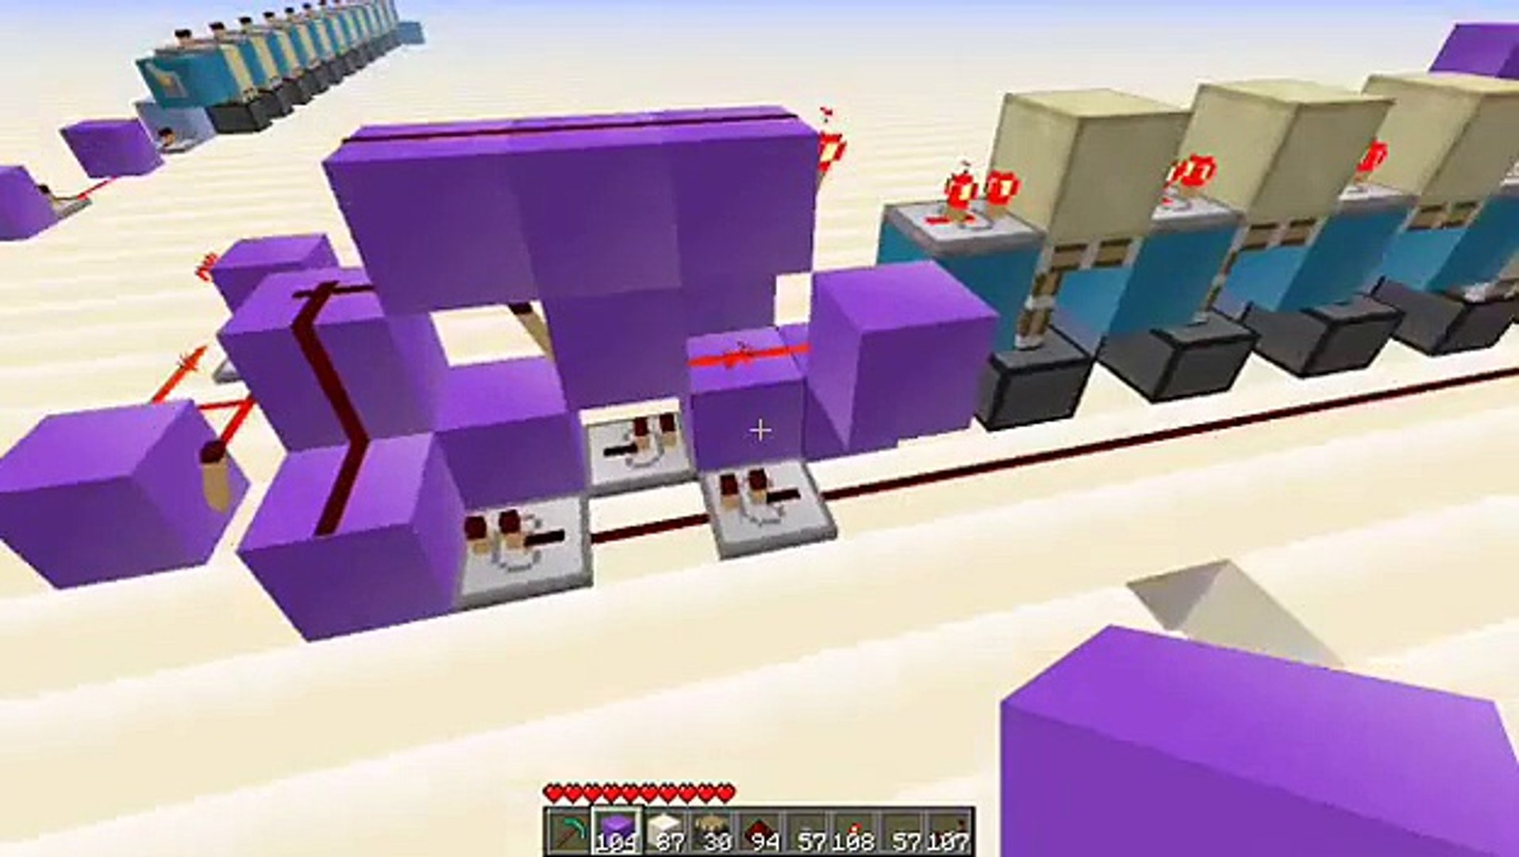
Research
Builds that inspire!

Slide 5
Cool Things You can do
WITH A COUNTER and Decoder
1) Control fireworks when it is 10PM at night.
2) Control a parkour game and score board.
3) Control a clock tower.
4) Control a ¾ beat in a music machine.
Build-It-Yourself.com
Notes:
Trigger a fireworks display.

Slide 6
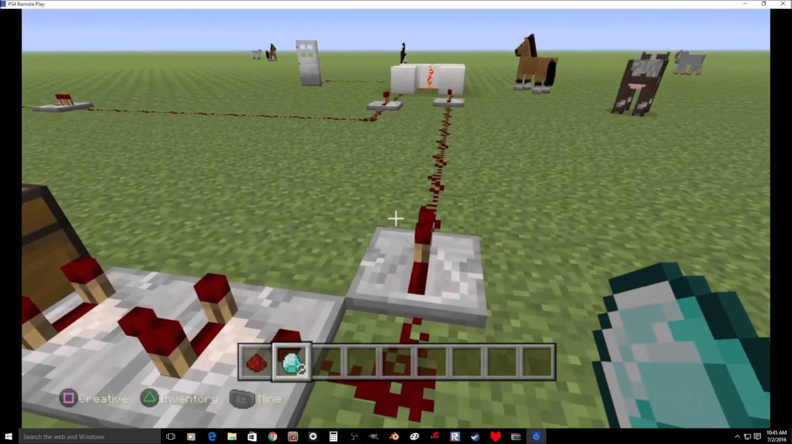
Cool Things You can do
WITH A COUNTER and Decoder
1) Control fireworks when it is 10PM at night.
2) Control a parkour game and score board.
3) Control a clock tower.
4) Control a ¾ beat in a music machine.
Build-It-Yourself.com
Notes:
Make a Parkour game with moving parts and keep track of your score.

Slide 7
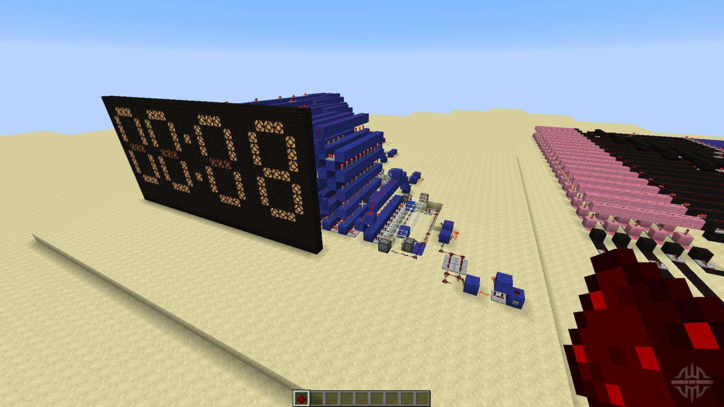
Cool Things You can do
WITH A COUNTER and decoder
1) Control fireworks when it is 10PM at night.
2) Control a parkour game and score board.
3) Control a clock tower.
4) Control a ¾ beat in a music machine.
Build-It-Yourself.com
Notes:
Control a high tech clock tower

Slide 8
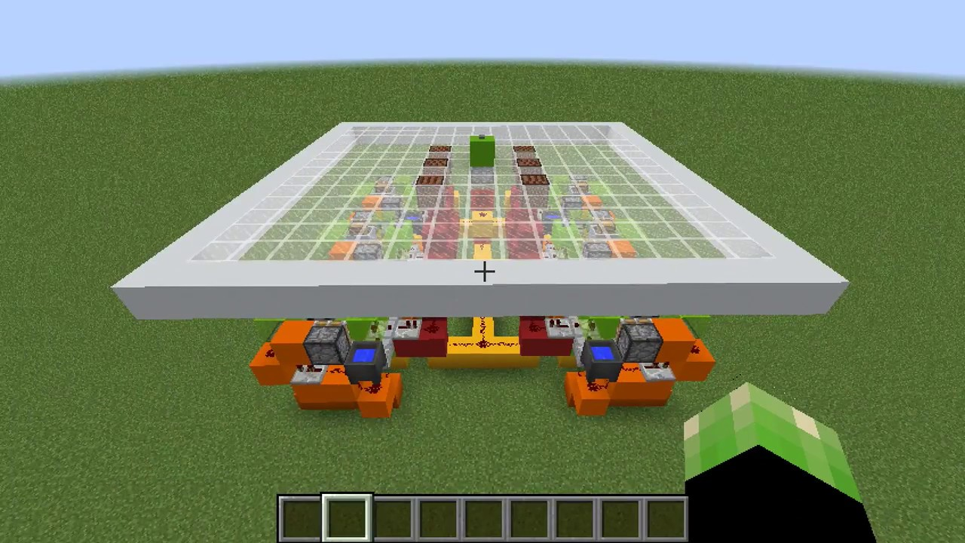
Cool Things You can do
WITH A COUNTER and decoder
1) Control fireworks when it is 10PM at night.
2) Control a parkour game and score board.
3) Control a clock tower.
4) Control a ¾ beat in a music machine.
Build-It-Yourself.com
Notes:
Control a ¾ beat music machine

Slide 9
Minecraft 103
Computer Architecture
Inputs
Oscillator
Or
Clock
Counter
Or
Memory
Decoder
Outputs
What are Minecraft inputs?
What are Minecraft outputs?
What is an oscillator?
What is a counter?
What is a register?
What is memory?
Build-It-Yourself.com
Notes:
In Minecraft 103, we will explore how a computer works.

Slide 10
Computer Architecture
Inputs
Oscillator
Or
Clock
Counter
Or
Memory
Decoder
Outputs
Build-It-Yourself.com

Slide 11
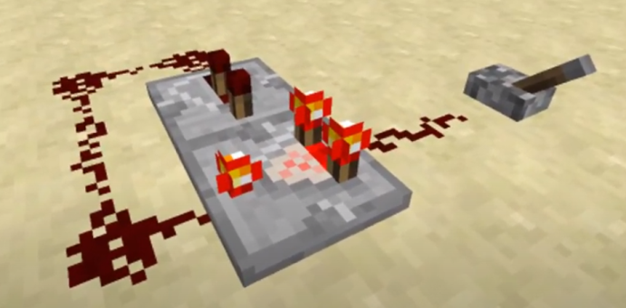
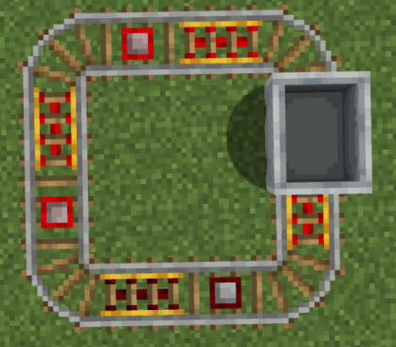
Computer Architecture
Inputs
Oscillator
Or
Clock
Counter
Or
Memory
Decoder
Outputs
A device that continuously repeats a pattern.
Build-It-Yourself.com

Slide 12
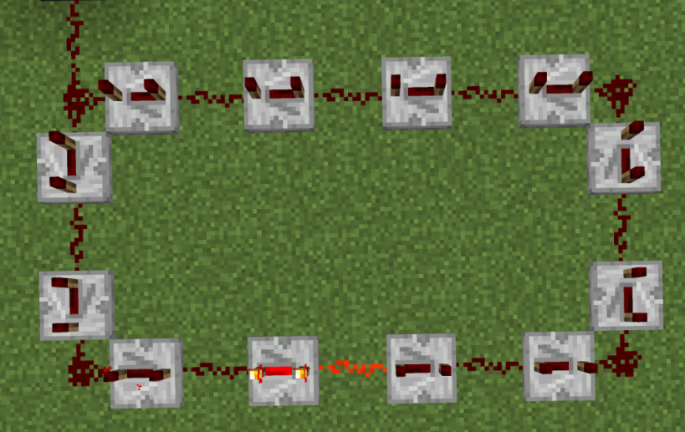
Computer Architecture
Inputs
Oscillator
Or
Clock
Counter
Or
Memory
Decoder
Outputs
This oscillator has a 1 second period
Build-It-Yourself.com

Slide 13
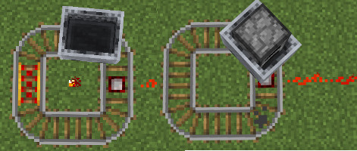
Computer Architecture
Inputs
Oscillator
Or
Clock
Counter
Or
Memory
Decoder
Outputs
Two oscillators connected.
Build-It-Yourself.com

Slide 14
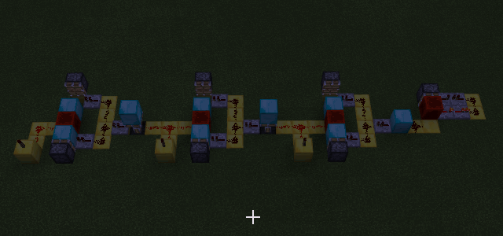
Computer Architecture
Inputs
Oscillator
Or
Clock
Counter
Or
Memory
Decoder
Outputs
Build-It-Yourself.com

Slide 15
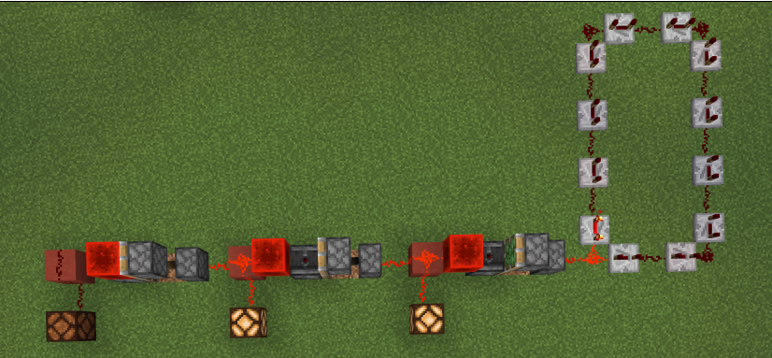
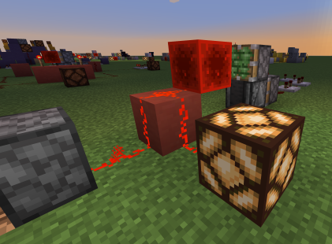
Computer Architecture
Inputs
Oscillator
Or
Clock
Counter
Or
Memory
Decoder
Outputs
3 stage T Flip Flop Counter
Build-It-Yourself.com

Slide 16
Computer Architecture
Inputs
Oscillator
Counter
Or
Memory
Decoder
Outputs
Show MC number 0,1,2,3, decoders
Build-It-Yourself.com

Slide 17
Computer Architecture
Inputs
Oscillator
Or
Clock
Counter
Or
Memory
Decoder
Outputs
Build-It-Yourself.com

Slide 18
Minecraft 103
Mission #1
Input
Oscillator
Output
Build-It-Yourself.com
Notes:
In Minecraft 103, we will explore how a computer works.

Slide 19
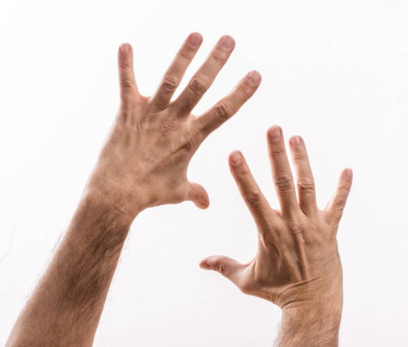
Decimal vs. Binary Number System
Why do humans think in terms of 10 digits? (0-9)
Why do computers know only 2 numbers? (0-1)
Computers are dumb but very, very fast.
A computer can calculate over 1 billion additions in a second.
Build-It-Yourself.com

Slide 20
Minecraft Redstone 102
What is Boolean Algebra?
Boolean Algebra is used to analyze and simplify the digital (logic) circuits. It uses only 0 and 1 (Binary number system)
The analog circuit needed to detect all these shades of gray is quite complex and very slow.

Slide 21
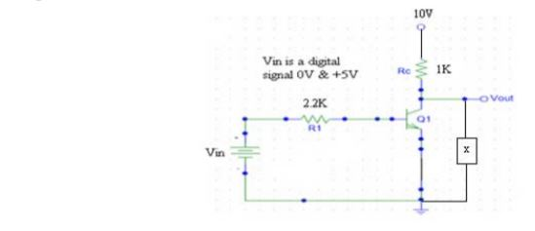
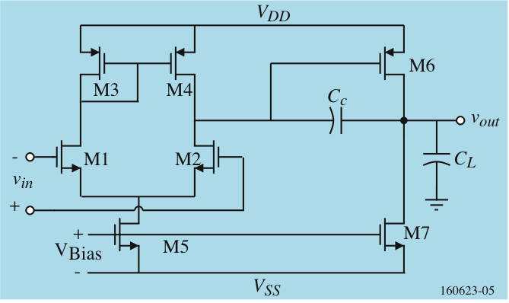
Computer Architecture
Input
Output
Analog circuit Digital circuit
Build-It-Yourself.com

Slide 22
Decimal vs. Binary Number System
Boolean Algebra is used to analyze and simplify digital (logic) circuits.
It uses only digits 0 and 1. (binary number system)
Decimal | 2 | 1
0 | 0 | 0
1 | 0 | 1
2 | 1 | 0
3 | 1 | 1
Decimal | 4 | 2 | 1
0 | 0 | 0 | 0
1 | 0 | 0 | 1
2 | 0 | 1 | 0
3 | 0 | 1 | 1
4 | 1 | 0 | 0
5 | 1 | 0 | 1
6 | 1 | 1 | 0
7 | 1 | 1 | 1

Slide 23
Minecraft Redstone 102
What is Boolean Algebra?
Boolean Algebra is used to analyze and simplify the digital (logic) circuits. It uses only 0 and 1 (Binary number system)
Challenge: Fill in the o’s and 1’s
Decimal | 2 | 1
0
1
2
3
Decimal | 4 | 2 | 1
0
1
2
3
4
5
6
7

Slide 24
Decimal vs. Binary Number System
Boolean Algebra is used to analyze and simplify digital (logic) circuits.
It uses only digits 0 and 1. (binary number system)
Decimal
Binary
10’s | Units | 8 | 4 | 2 | 1
0 | 0 | 0 | 0 | 0 | 0
0 | 1 | 0 | 0 | 0 | 1
0 | 2 | 0 | 0 | 1 | 0
0 | 3 | 0 | 0 | 1 | 1
0 | 8 | 1 | 0 | 0 | 0
1 | 2 | 1 | 1 | 0 | 0
1 | 5 | 1 | 1 | 1 | 1

Slide 25
Computer Counter + Decoder
State Table or Truth Table
Count
0 | 1 | 2 | 3
0 | 1 | 0 | 1
0 | 0 | 1 | 1
FF1
0 = False = Off
FF2
1 = True = On
Build-It-Yourself.com

Slide 26
Computer Counter + Decoder
What is an oscillator?
Clock
Or Oscillator
Tic
0
Toc
1
Tic
0
Toc
1
Tic
0
Toc
1
Build-It-Yourself.com

Slide 27
Computer Counter + Decoder
What is a Flip Flop?
When you trigger a Flip Flop it changes state
T-Flip Flop
Trigger
Input
Pulse or Oscillator
Output
0 or 1
Tic
0
Toc
1
Tic
0
Toc
1
Tic
0
Toc
1
Tic
0
Toc
1
Tic
0
Toc
1
Tic
0
Toc
1
Tic
0
Toc
1
T-Flip Flop
JK-Flip Flop
SR-Flip Flop
D-Flip Flop (protect against S=0 and R=0)
Build-It-Yourself.com

Slide 28
Computer Counter + Decoder
State Table or Truth Table
Count
0 | 1 | 2 | 3
0 | 1 | 0 | 1
0 | 0 | 1 | 1
FF1
0 = False = Off
FF2
1 = True = On
Timing Diagram
clock
FF1
0
1
0
1
FF2
0
0
1
1
Count
0
1
2
3
0
1
2
3
Build-It-Yourself.com

Slide 29
Computer Counter + Decoder
State Table or Truth Table
Count
0 | 1 | 2 | 3
0 | 1 | 0 | 1
0 | 0 | 1 | 1
FF1
0 = False = Off
FF2
1 = True = On
Timing Diagram
clock
FF1
0
1
0
1
FF2
0
0
1
1
Count
0
1
2
3
0
1
2
3
Trigger or T Flip Flop
FF1
c
FF2
Build-It-Yourself.com

Slide 30
Computer Counter + Decoder
State Table or Truth Table
Count
0 | 1 | 2 | 3
0 | 1 | 0 | 1
0 | 0 | 1 | 1
FF1
0 = False = Off
FF2
1 = True = On
Timing Diagram
clock
FF1
0
1
0
1
FF2
0
0
1
1
Count
0
1
2
3
0
1
2
3
Trigger or T Flip Flop
FF1
c
FF2
Build-It-Yourself.com

Slide 31
Computer Counter + Decoder
State Table or Truth Table
Count
0 | 1 | 2 | 3
0 | 1 | 0 | 1
0 | 0 | 1 | 1
FF1
0 = False = Off
FF2
1 = True = On
Timing Diagram
clock
FF1
0
1
0
1
FF2
0
0
1
1
Count
0
1
2
3
0
1
2
3
Trigger or T Flip Flop
FF1
c
FF2
Build-It-Yourself.com

Slide 32
Computer Counter + Decoder
State Table or Truth Table
Count
0 | 1 | 2 | 3
0 | 1 | 0 | 1
0 | 0 | 1 | 1
FF1
0 = False = Off
FF2
1 = True = On
Timing Diagram
clock
FF1
0
1
0
1
FF2
0
0
1
1
Count
0
1
2
3
0
1
2
3
Trigger or T Flip Flop
FF1
c
FF2
Build-It-Yourself.com

Slide 33
Minecraft 103
Mission #2
Build an 8 state counter
Build-It-Yourself.com
Notes:
In Minecraft 103, we will explore how a computer works.

Slide 34
Computer Counter + Decoder
clock
FF1
FF2
0
1
2
3
0
1
2
3
clock
Q1
Q2
T
T
FF1
FF2
FF2
0
Show MC
Oscillator,
flip flops
and decoder
FF2’
1
FF1
2
FF1’
C`
3
Build-It-Yourself.com

Slide 35
Computer Counter + Decoder
clock
FF1
FF2
0
1
2
3
0
1
2
3
Q1
Q2
T
T
FF1
FF2
FF2
0
Show MC
Oscillator,
flip flops
and decoder
FF2’
1
FF1
2
FF1’
C`
3
Build-It-Yourself.com

Slide 36
Computer Counter + Decoder
clock
FF1
FF2
0
1
2
3
0
1
2
3
clock
Q1
Q2
T
T
FF1
FF2
FF2
0
Show MC
Oscillator,
flip flops
and decoder
FF2’
1
FF1
2
FF1’
C`
3
Build-It-Yourself.com

Slide 37
Computer Counter + Decoder
clock
FF1
FF2
0
1
2
3
0
1
2
3
clock
Q1
Q2
T
T
FF1
FF2
FF2
0
Show MC
Oscillator,
flip flops
and decoder
FF2’
1
FF1
2
FF1’
C`
3
Build-It-Yourself.com

Slide 38
Computer Counter + Decoder
clock
FF1
FF2
0
1
2
3
0
1
2
3
clock
Q1
Q2
T
T
FF1
FF2
FF2
0
FF2’
1
FF1
2
FF1’
C`
3
Build-It-Yourself.com

Slide 39
Computer Counter + Decoder
clock
FF1
FF2
0
1
2
3
0
1
2
3
clock
Q1
Q2
T
T
FF1
FF2
FF2
0
FF2’
1
FF1
2
FF1’
C`
3
Build-It-Yourself.com

Slide 40
Computer Counter + Decoder
clock
FF1
FF2
0
1
2
3
0
1
2
3
clock
Q1
Q2
T
T
FF1
FF2
FF2
0
FF2’
1
FF1
2
FF1’
C`
3
Build-It-Yourself.com

Slide 41
Computer Counter + Decoder
clock
FF1
FF2
0
1
2
3
0
1
2
3
clock
Q1
Q2
T
T
FF1
FF2
FF2
0
FF2’
1
FF1
2
FF1’
C`
3
Build-It-Yourself.com

Slide 42
Minecraft 103
Mission #3
Build decoders that produce a pulse for states 2 and 5
Build-It-Yourself.com
Notes:
In Minecraft 103, we will explore how a computer works.

Slide 43
Latches, Registers, Memory
clock
FF1
FF2
0
1
2
3
0
1
2
3
Document 3 types of Flip Flops
T
Set / Reset
JK
Build-It-Yourself.com

Slide 44
Minecraft 103
Mission #4
Build latches or registers that turn on at state 2 and turn off at state 5
Build-It-Yourself.com
Notes:
In Minecraft 103, we will explore how a computer works.

Slide 45
Minecraft 103
Missions #5, #6, #7, #8
Build
Parkour game,
clock tower,
music machine or
fire works display
Build-It-Yourself.com
Notes:
In Minecraft 103, we will explore how a computer works.

Slide 46
Minecraft 103
Concepts you should be able to explain
5 components in computer architecture.
Oscillator
Input devices
Output devices
Counters, Memory and Registers
Decoders
Timing diagrams
Binary vs. Decimal number system
Boolean Algebra for AND, OR, and NOT
Build-It-Yourself.com
Notes:
In Minecraft 103, we will explore how a computer works.

