Slide 1
Minecraft 104 Server Installation Instructions

Slide 2
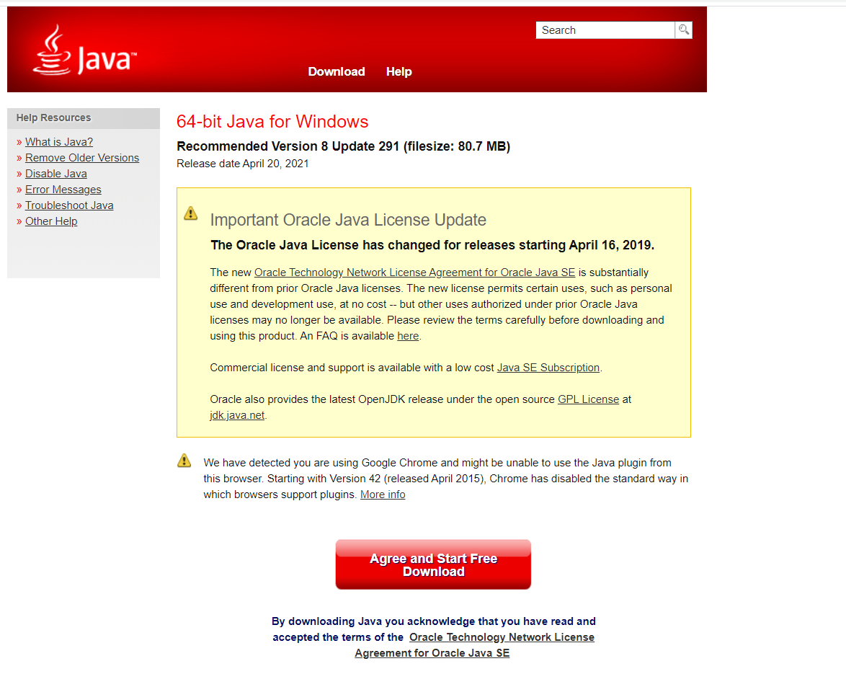
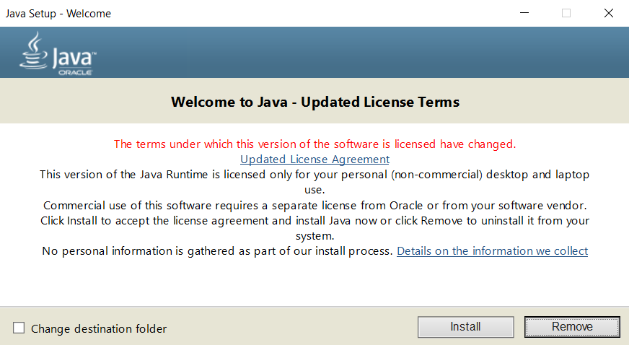
1.)Install Java
Use your preferred web browser to navigate to:
https://www.java.com/download
Click on the Red button that says “Agree and Start Free Download
Run the file that is downloaded. If your computer asks whether to allow this application to make changes make sure you select yes
Follow installation steps in pop up menu

Slide 3
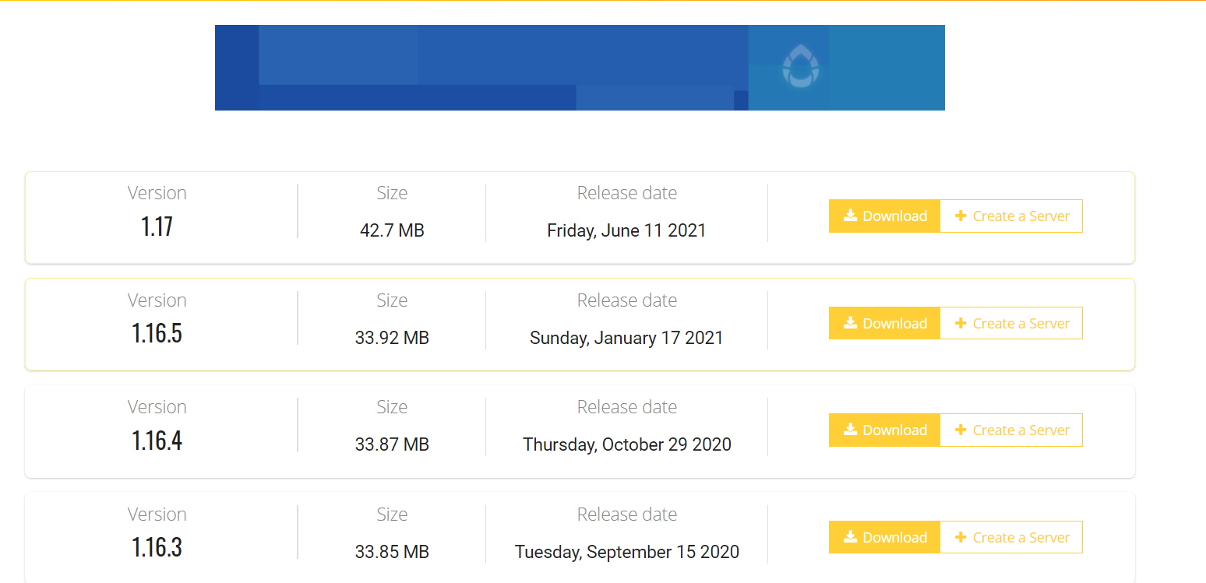
2.)Install the Minecraft Server
Use your preferred web browser to navigate to:
https://getbukkit.org/download/craftbukkit
Select the version of Minecraft your server will be running.(Your teacher will specify which version should be used)
Select Download
Click on the yellow link that says Craftbukkit-x.x.jar
You will get a warning once the download is complete stating this type of file could harm your computer. Select Keep when this warning shows up
Do not yet run this file

Slide 4
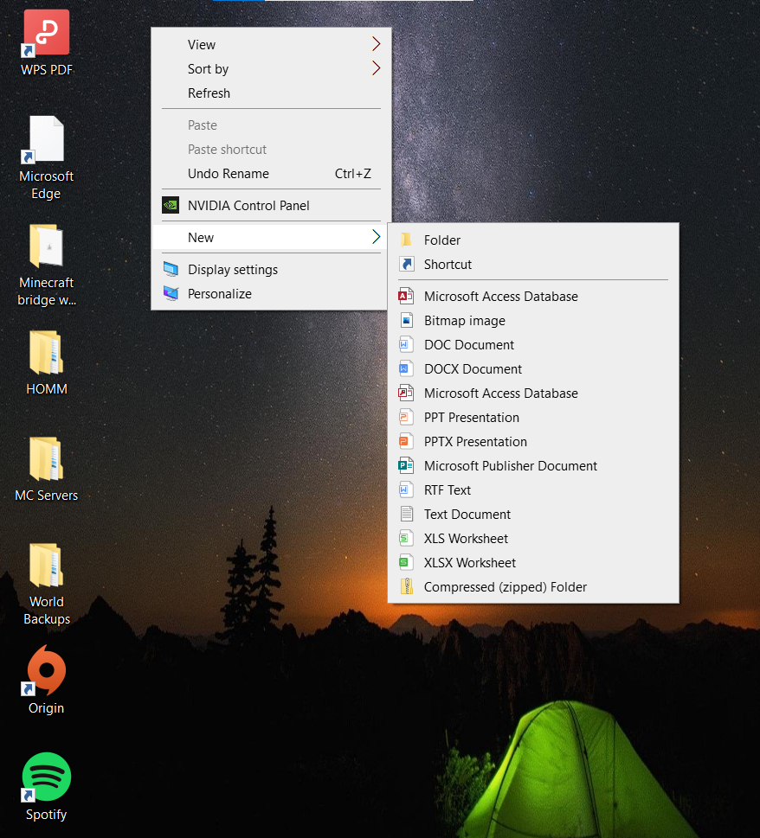
3.)Your Minecraft Server Folder
Right Click on your Desktop
In the dropdown menu that appears, select New→Folder
Rename the folder by to a name you will remember
Ex.
Minecraft Server
Tom’s Minecraft Server
Server files

Slide 5
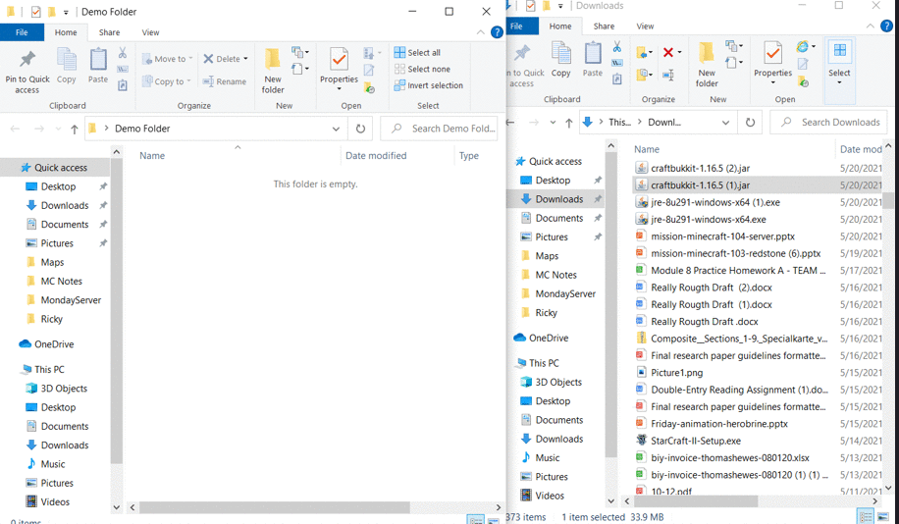
4.)1st steps
Drag the Craftbukkit file you downloaded in step 2 into your new Minecraft Server Folder
Once it is in your folder you can double click on it to run it.
Alternatively, you can right click on the file and select open.
After 20 seconds files should start appearing in your folder

Slide 6
5.)Next Steps
Open the file named eula.txt
Inside the file where it says false, delete and write in true(No Capital Letters no extra spaces)
Save the file and close
Run the Craftbukkit file again like you did in step 4
Wait Approximately 20 Seconds and files should start appearing in your folder

Slide 7
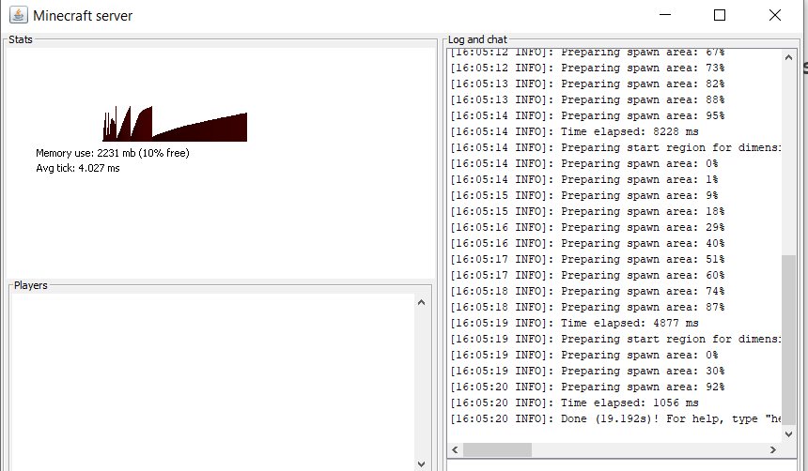
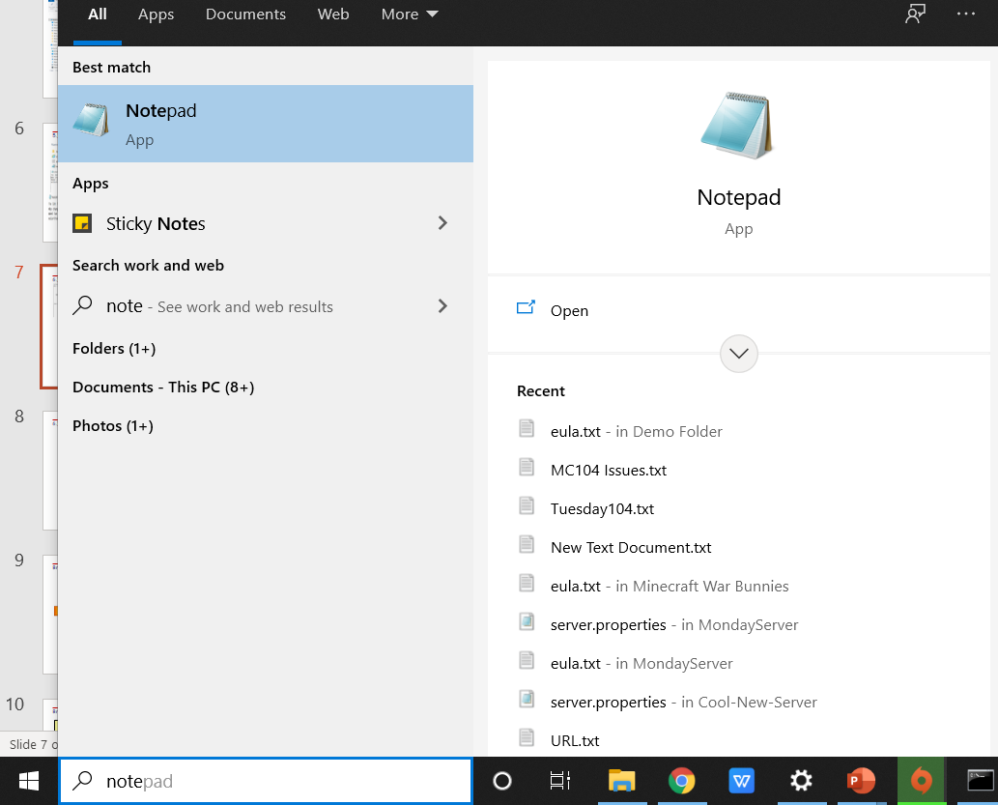
6.)Create the Batch File-Windows
A Java window should run at this point. You can simply close it as it is not yet needed
Go to the search bar in the bottom left of you screen and look for the application “Notepad
Open Notepad

Slide 8
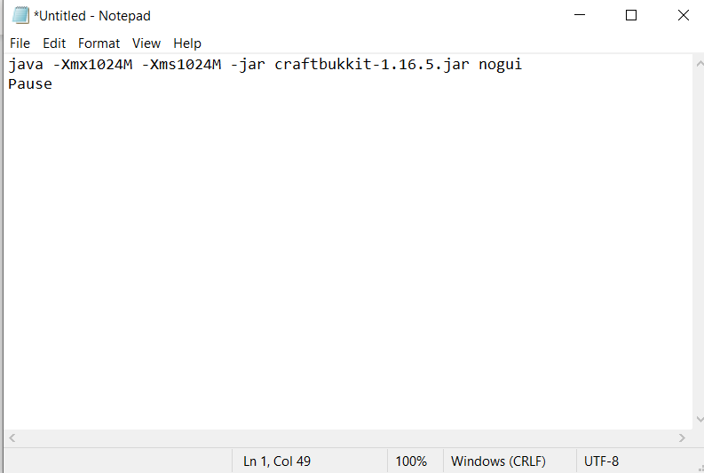
7.)Create the Batch File-Windows-Cont.
In the Notepad paste this following line exactly as it appears here
java -Xmx1024M -Xms1024M -jar craftbukkit-1.x.x.jar nogui
Pause
You will have to modify this line replacing the x’s with the current version of the Minecraft server, or the number that appears in the name of the craftbukkit file

Slide 9
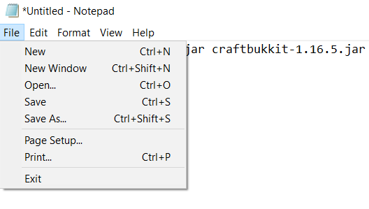
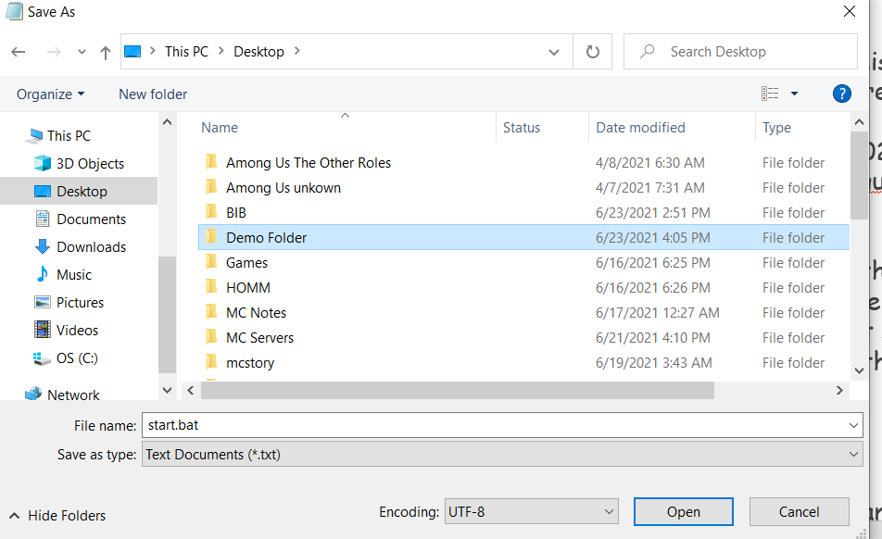
8.)Create the Batch File-Windows-Cont.
Go to file→Save as
Save the file with the name:
start.bat
In the dropdown box named “Save as type” select all files
Locate your Minecraft server folder and save the file inside that folder

Slide 10
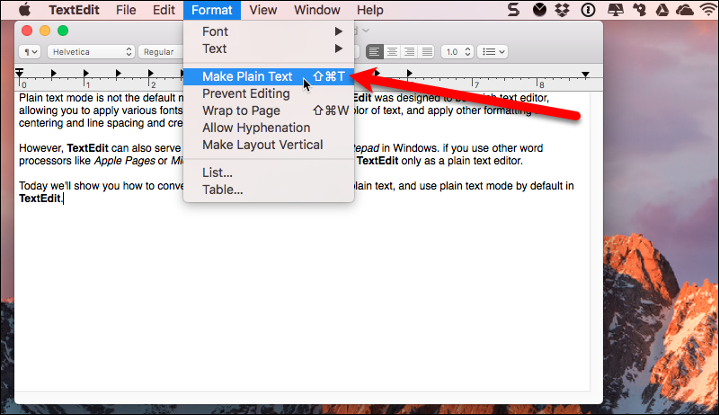
9.)Create the Batch File-Mac
Go to spotlight [The search bar in the top right corner of your screen] and look up TextEdit and open it
In TextEdit go to the tool bar and select Format, then click on Make Plain Text
In TextEdit go to the tool bar and click Format then click on Make Plain Text.
Paste in the following code exactly as it appears here
#!/bin/bash
cd "$( dirname "$0" )"
java -Xms1024M -Xmx1024M -jar craftbukkit.jar -o true

Slide 11
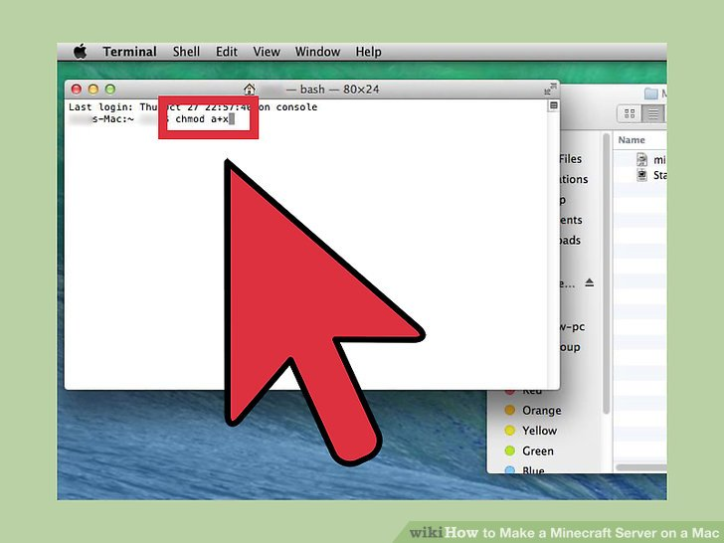
10.)Create the Batch File-Mac
Go to the tool bar again in TextEdit and go to File then click save. Save it as 'Start.command'. and save it into your folder on your desktop.
Go to spotlight again and search up Terminal [Already installed on Mac] open it and type this exactly: chmod a+x[space]
Don't actually type [space] do a space or else it wont work. DONT hit enter.
Then drag your Start.command folder into Terminal
You can now hit Enter

Slide 12
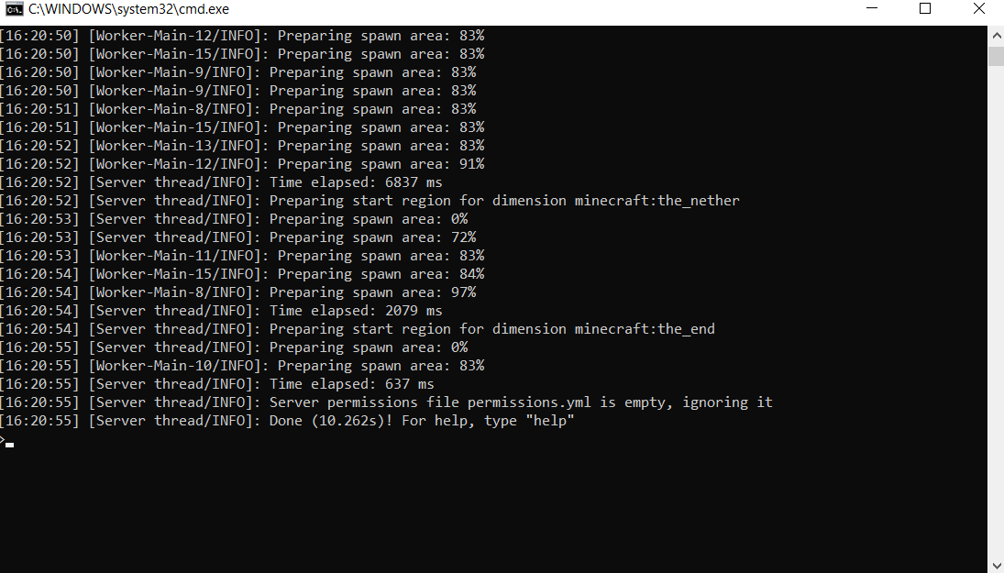
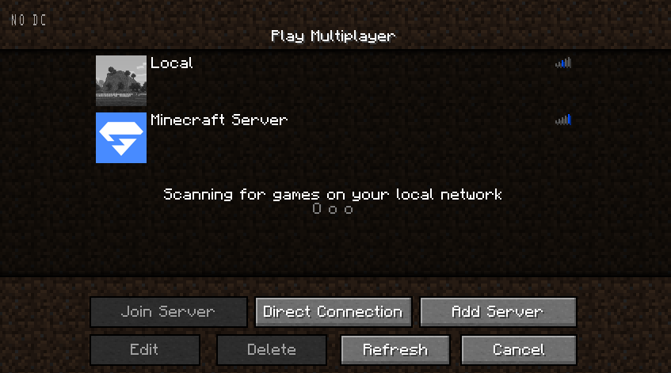
11.)Joining your MC server
In your Minecraft folder run the start.bat or start.command file by double clicking on the file. If your firewall asks whether to allow this file to run, select yes.
The app Command prompt(Windows) should then open. Wait until the command prompt says Done as seen the the left. While this runs you can launch Minecraft. Run the same version of Minecraft as your server is running
Navigate to multiplayer in Minecraft
Select add server

Slide 13
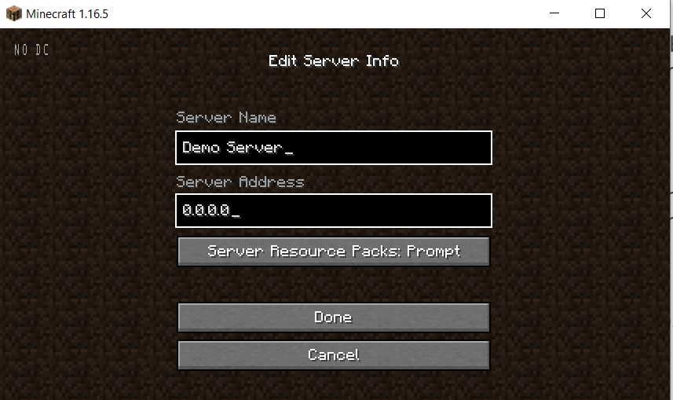
12.)Joining your MC server
Enter 1 of the 2 options below into the field called “Server Address” and select done.
0.0.0.0
localhost
In the field called server name you can select any name you will remember
Select Done and join the server
You are now all set to go!

Slide 14
The End
If You have any Question or issues, feel free to ask your teachers and they will be happy to help!
Notes:
By the end of the project you should know the following.
If you get ahead or have the time and interest here are some way cool ideas to expand your website!

