Slide 1
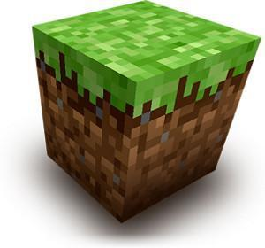
Hotshot 102
Build-It-Yourself.com

Slide 2
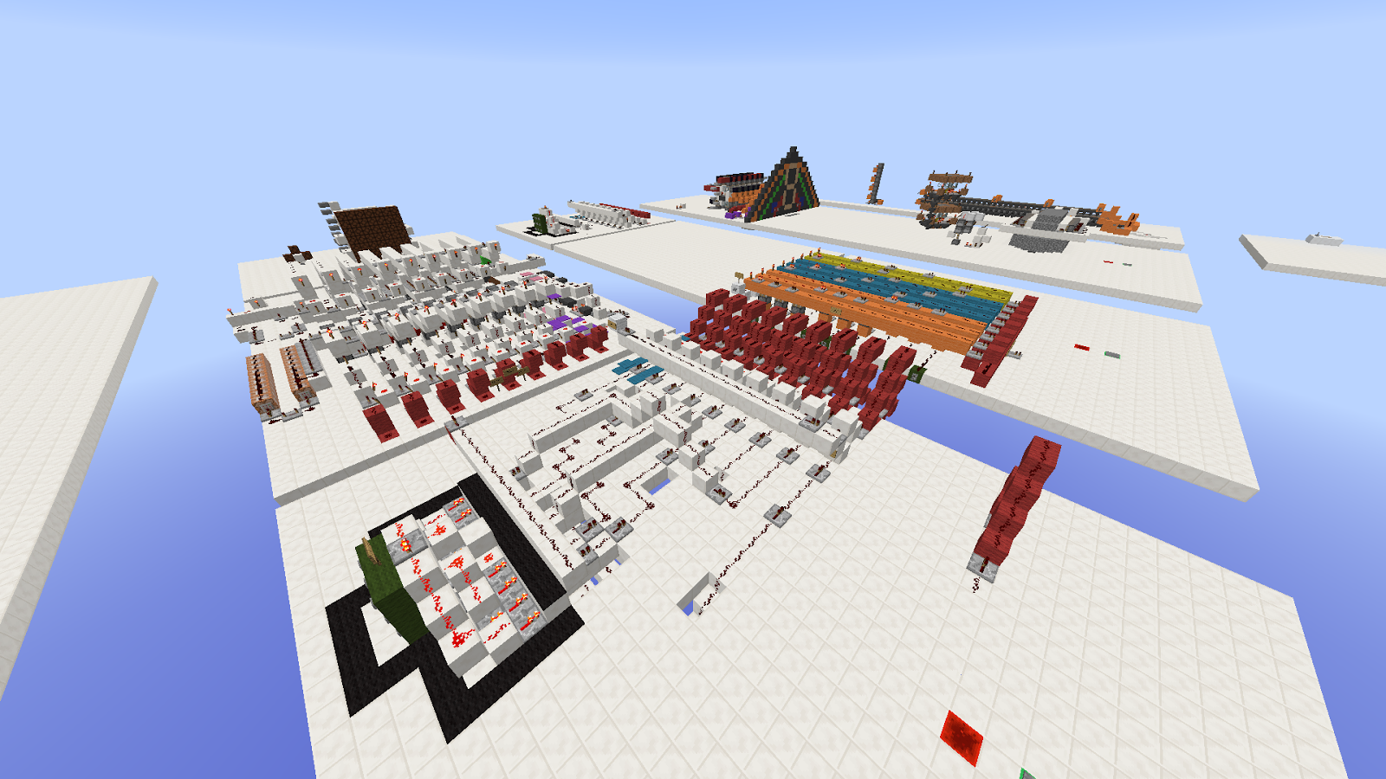
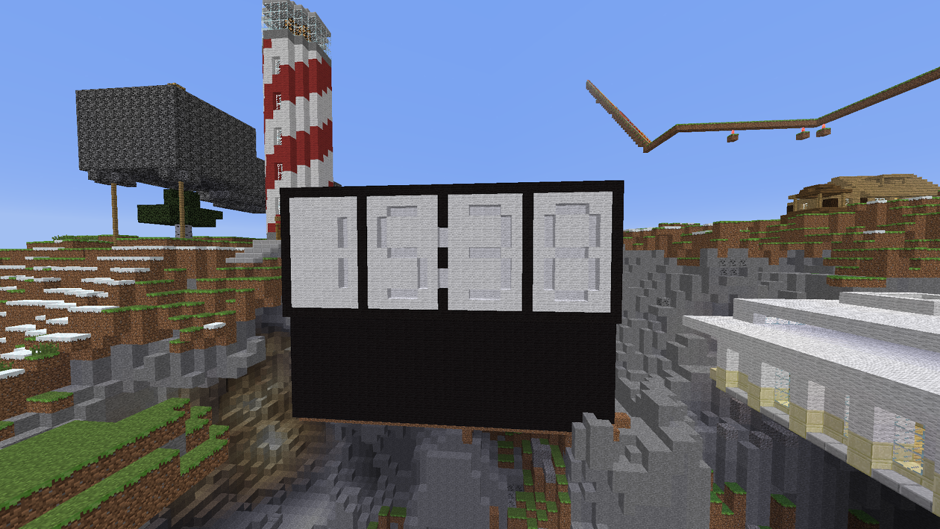
Minecraft
The Amaterasu
Build-It-Yourself.com
Notes:
-people that make
-incredible, awesome, mind-blowing inventions
-peaceful

Slide 3
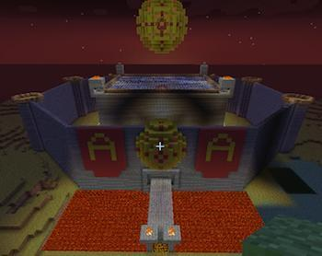
Minecraft
The Problem
The Amaterasu stronghold is under attack! Blackshadow is searching for the knowledge that the Amaterasu hold, and plan to use it for evil!
Build-It-Yourself.com

Slide 4
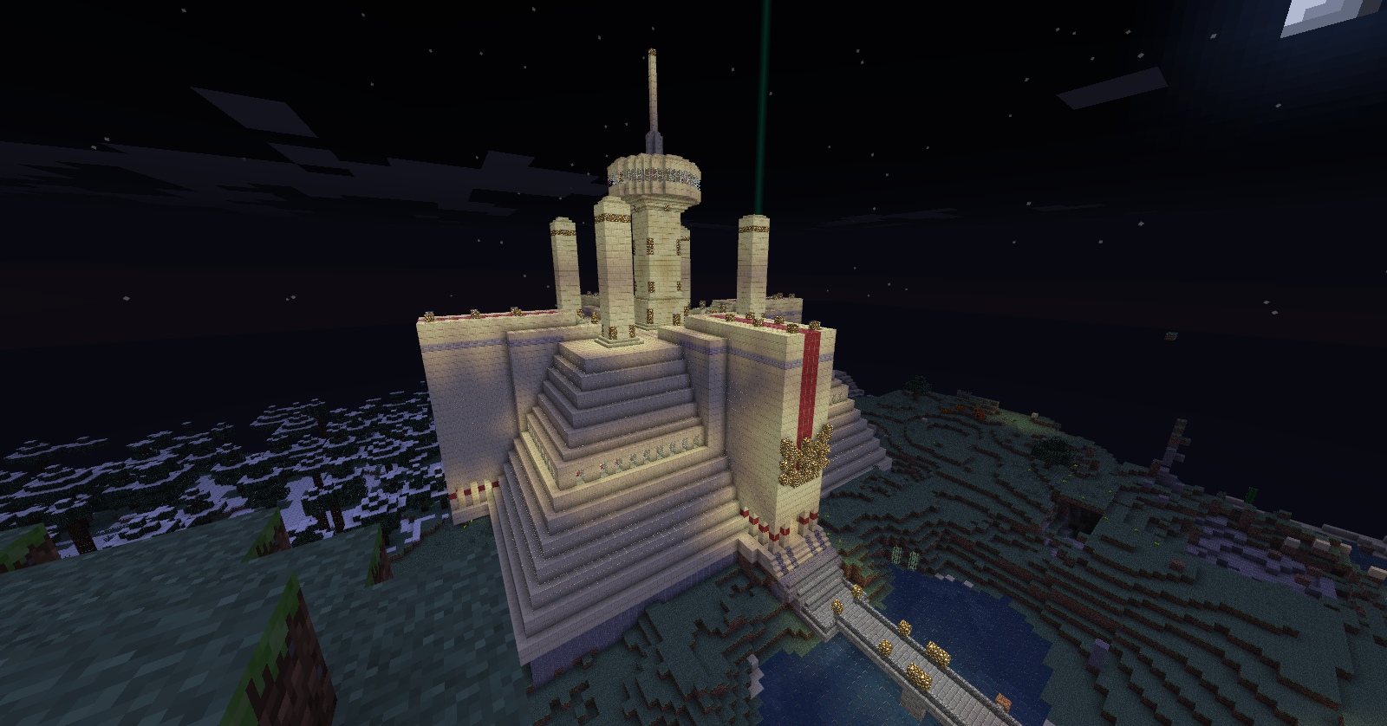
Minecraft
The Mission
We must construct a high-tech fortress using redstone technology that will protect Amaterasu's intelligence and ward off evil.
Build-It-Yourself.com

Slide 5
Minecraft
Teams
You will be split into teams of 2-3
Your team will be assigned a building site
Get to know your teams usernames
Communicate with your team
Build-It-Yourself.com

Slide 6
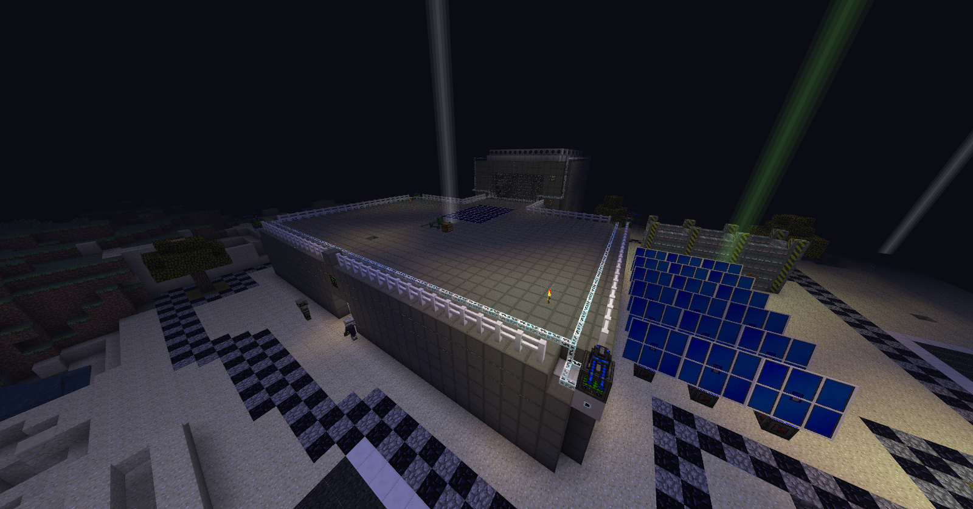
Minecraft
Structure
We need a stronghold! Can you build the best of the best?
Build-It-Yourself.com

Slide 7
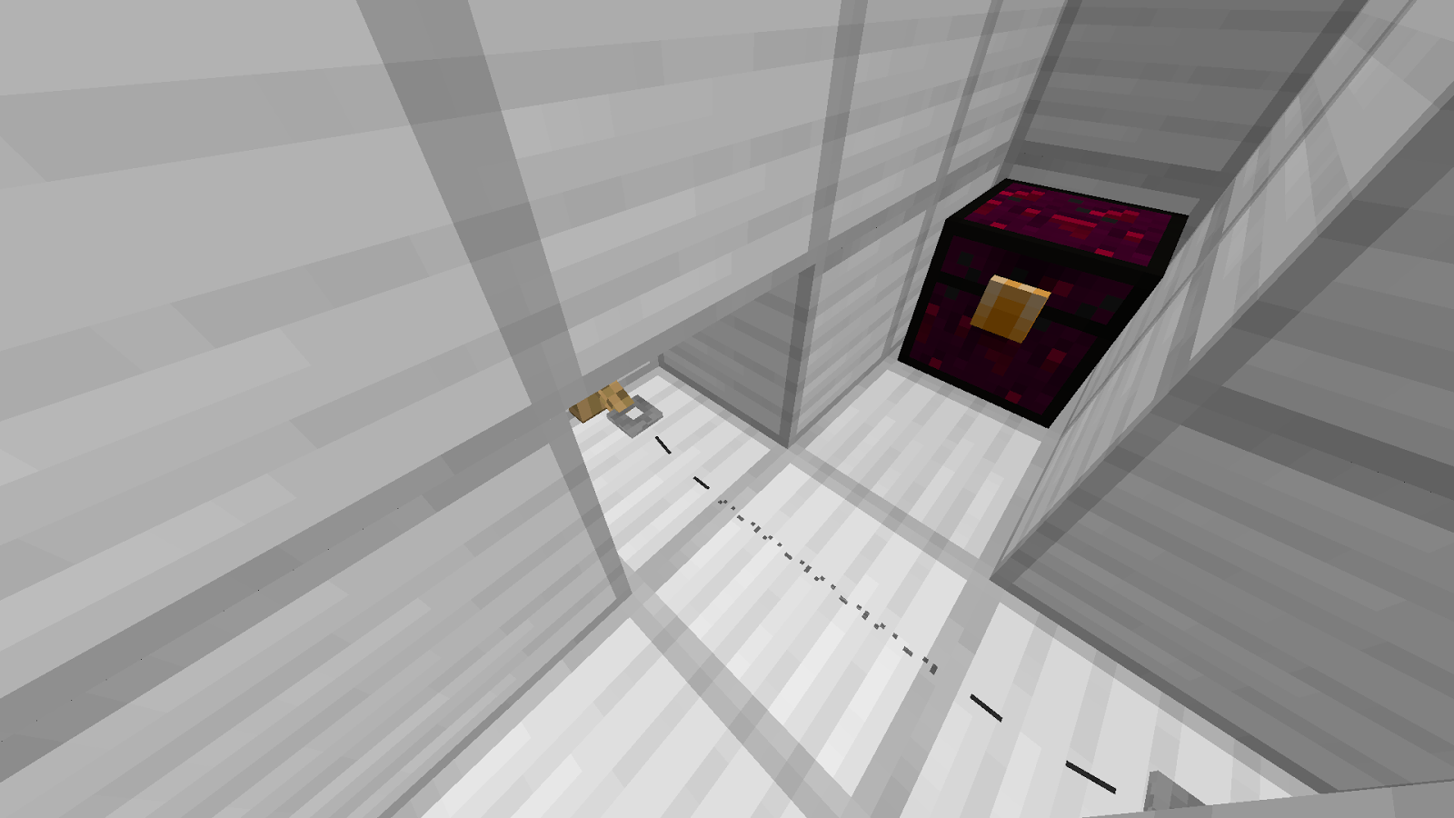
Minecraft
Warning System
We need a detection system to prevent spies.
Try tripwires, pressure plates, and redstone!
Build-It-Yourself.com

Slide 8
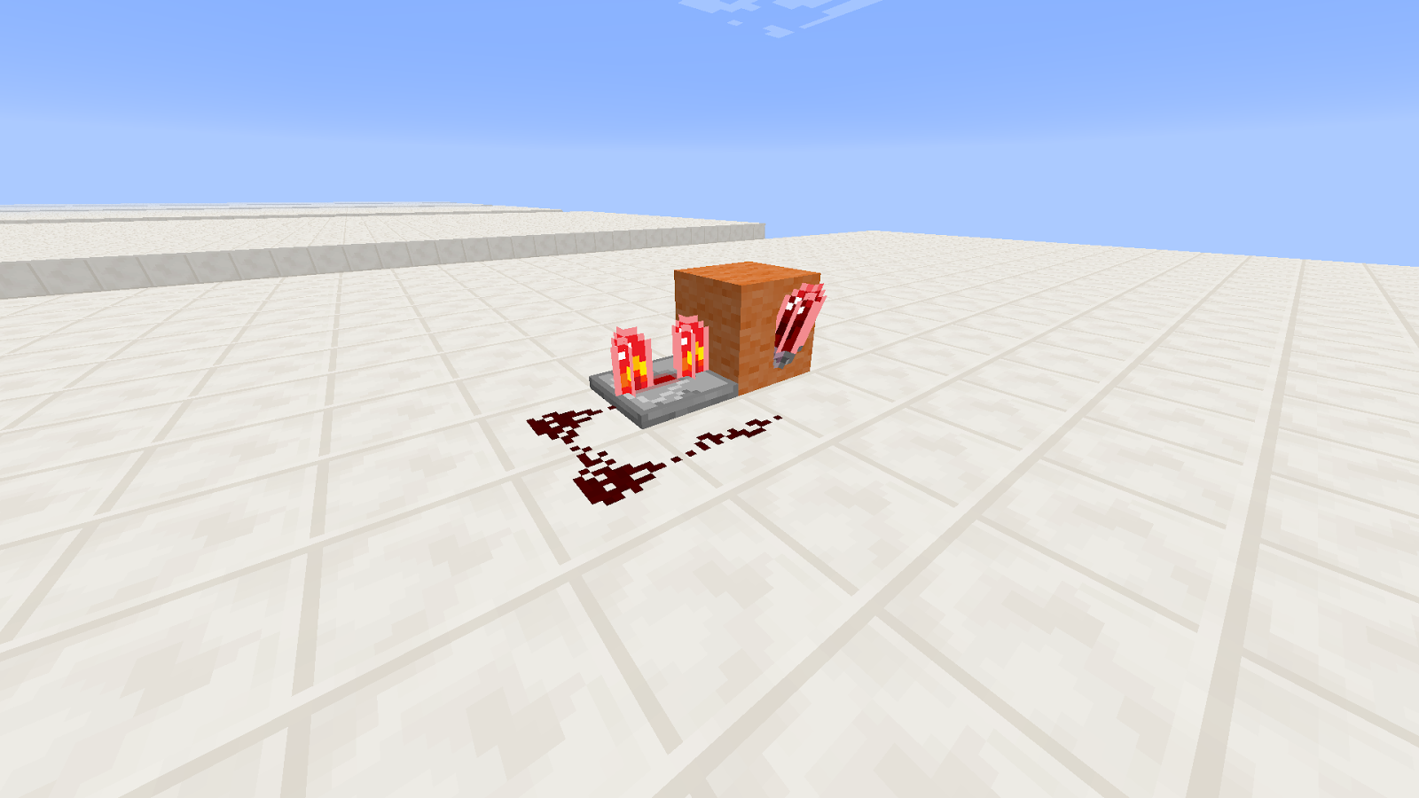
Minecraft
Redstone Pulser
We need a way to time our traps right…
A redstone pulser can work as a clock!
Build-It-Yourself.com

Slide 9
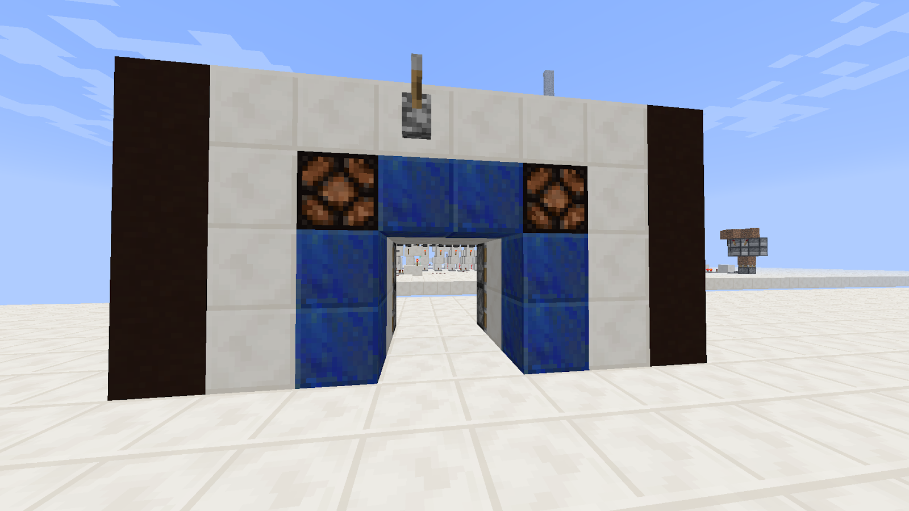
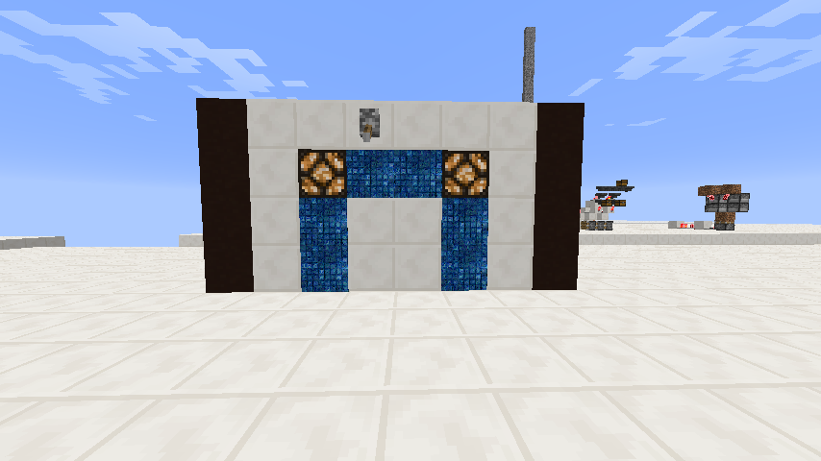
Minecraft
Double Piston Door
We need a hidden passageway.
Using this door, we can escape anytime!

Slide 10
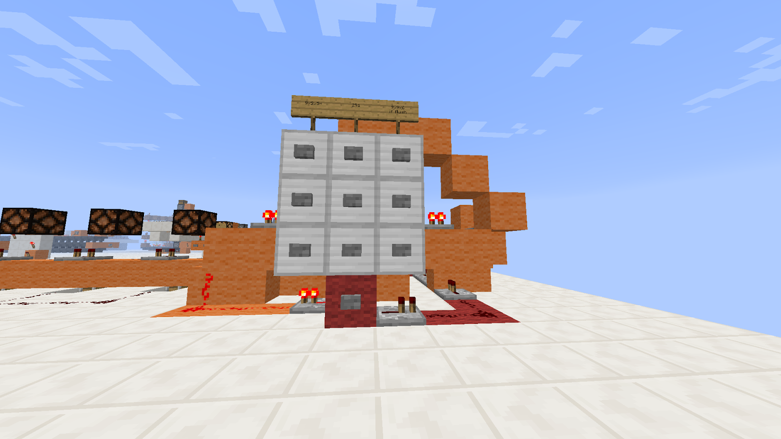
Minecraft
Combo Lock
If Blackshadow sees us enter a door, how do we stop them?
A combination lock, thats how!
Build-It-Yourself.com

