Slide 1
Nature, Art and Engineering
Creative Technology Laboratory

Slide 2
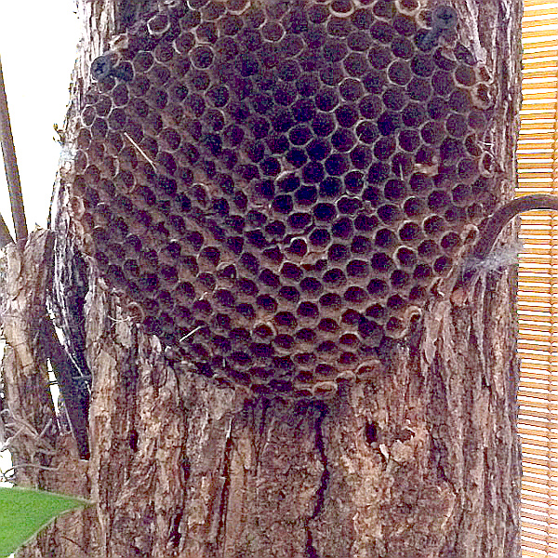
Nature Art and Engineering
Overview
Archimedes, DaVinci, Bell, Tesla, Edison, Ford, Eiffel, Wozniak, Gates - just a handful of the men whose names are regularly included on lists of the greatest engineers who ever lived.
But each of these men would readily agree that the greatest engineer of all time wasn't a man at all. The first, and greatest of all engineers, was a woman. We all know her as Mother Nature - "Mom" to her closest friends - and her list of engineering feats is impressive, to say the least.

Slide 3
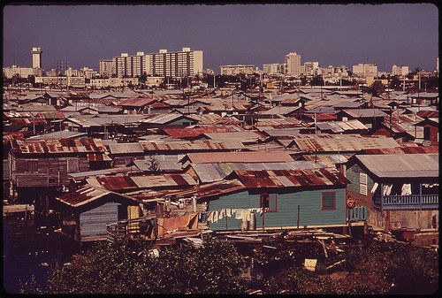
Nature Art and Engineering
The Problem
Are humans interfering with nature's plan? Maybe we can learn a lot from the way animals and plants operate.

Slide 4
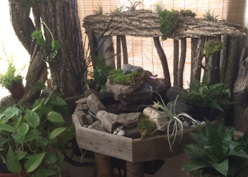
Nature Art and Engineering
The Mission
Build and environment where nature, art and technology can live in harmony.
In the Build-It-Yourself Jungle Garden we will pretend to be:
bees building a honey comb to store food
birds building a nest home
ants digging a tunnel
plants growing a structure that will not bend or break in the wind

Slide 5
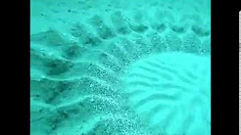
Nature Art and Engineering
Inspirations
Puffer Fish
https://www.youtube.com/watch?v=p1PID91sEW8
Weaver Birds and nests
Bees and hives
Venus Fly Trap
Tree Roots
Flowers

