Slide 1
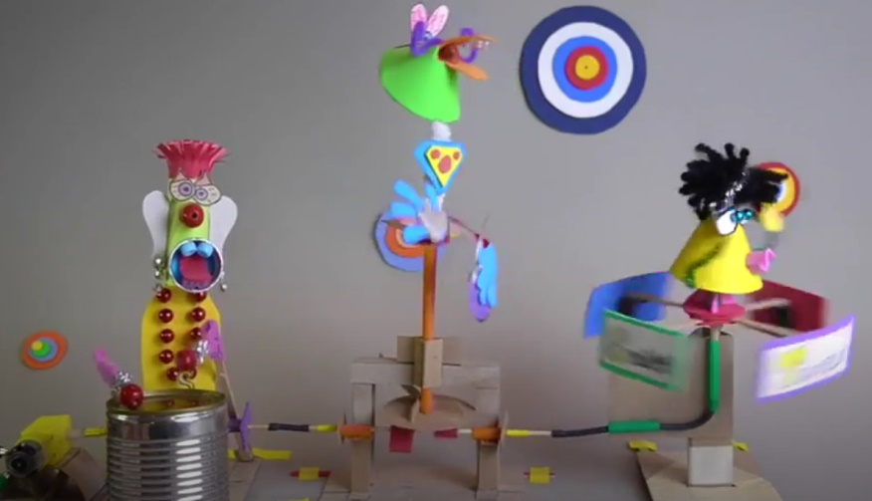
Rock n Robots
Music Studio
Watch the video
https://youtu.be/vZFDRMlyEw4
Notes:
Welcome to the Build-It-Yourself music studio where rock n robots rule!

Slide 2
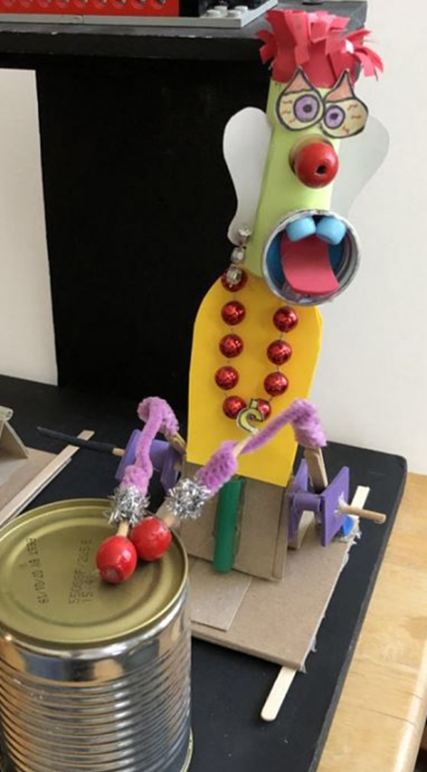
Define the problem and mission
The Problem
Many people are mad, unhappy and in a funk about life and the world around them.
Your Mission
Build a band of hip hop, rock n robot music makers who will turn a frown into a smile.
Notes:
Many people are mad, unhappy and in a funk about life and the world around them.
Build a band of hip hop, rock n robot music makers who will turn a frown into a smile.

Slide 3
Research
Battle of the Robot Bands
https://www.youtube.com/watch?v=h0DyYLLf3m8
Robots from Japan and Germany duke it out.
Robot musician puppets
https://youtu.be/CsqKLT4v4x0
Disney calls these robots ‘animatonics’
Notes:
Research is an important part of the engineering process.
We do not need to reinvent the wheel.
Let’s improve on the ideas of others.

Slide 4
Modular Construction
Quick to build
Easy to edit
Reliable
1
2
3
4
5
6
7
8

Slide 5
Build-It-Block Modules
Module Name | Link
Switch | https://build-it-yourself.com/members/biy-blocks/resources/bib-switch-push-button.ppt
Motor Mount | https://build-it-yourself.com/members/biy-blocks/resources/bib-motor-mount.ppt
Up Down Swing | https://build-it-yourself.com/members/biy-blocks/resources/bib-up-dwn-swing.ppt
Up Down Turn | https://build-it-yourself.com/members/biy-blocks/resources/bib-up-dwn-turn.ppt
Horizontal to Vertical Turn | https://build-it-yourself.com/members/biy-blocks/resources/bib-horiz-vert-spin.ppt
Graffiti Signs | https://build-it-yourself.com/s-lessons/lesson-graffiti.ppt
Characters | https://build-it-yourself.com/s-lessons/lesson-hard-heads.ppt
Scratch Music Program | https://scratch.mit.edu/projects/452362164/editor

Slide 6
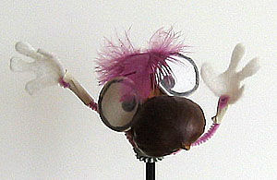
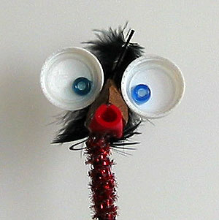
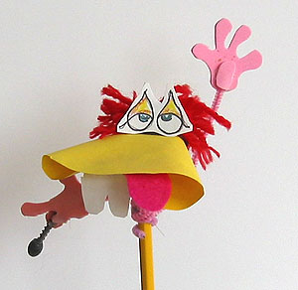
Break Mission Into Simple Parts
Module: Puppets
Measures of success:
Big soulful eyes
Clever use of materials
Colorful
Exaggerated, unusual shapes
Notes:
Module for candy to be delivered. What simple machine is this?

Slide 7
Break Mission Into Simple Parts
Module: Graffiti Signs
Measures of success:
Colorful
3 dimensional
Unusual shapes
Readable from a distance
eamwork
odular
uilding
Notes:
Module is a sign. This can be attached to the catapult, coin spillway, or another part of the chain reaction contraption. Emphasize art and it’s importance in drawing attention. Typically created in power point unless time is short.
Lesson: Graffiti is under lessons page on Build-It-Yourself.com
https://build-it-yourself.com/s-lessons/index-lessons.php
Look Good!
Decorate our modules!
-make cool characters
-draw signs the way cool way
-use many colors and shapes
-be neat and organized
A good idea that looks ugly …
may not get the attention it deserves!

Slide 8
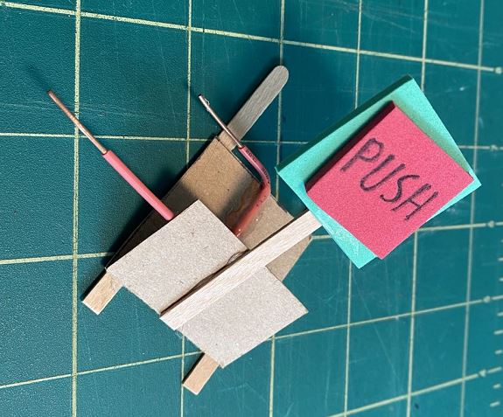
Break Mission Into Simple Parts
Module: Switch Push Button
Measures of success:
Strong: Can drop on the floor.
Reliable: Works 9 of 10 times.
Notes:
Module for candy to be delivered. What simple machine is this?

Slide 9
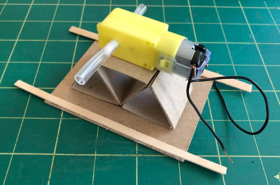
Break Mission Into Simple Parts
Module: Motor Mount
Measures of success:
Strong
Level
Notes:
Module for candy to be delivered. What simple machine is this?

Slide 10
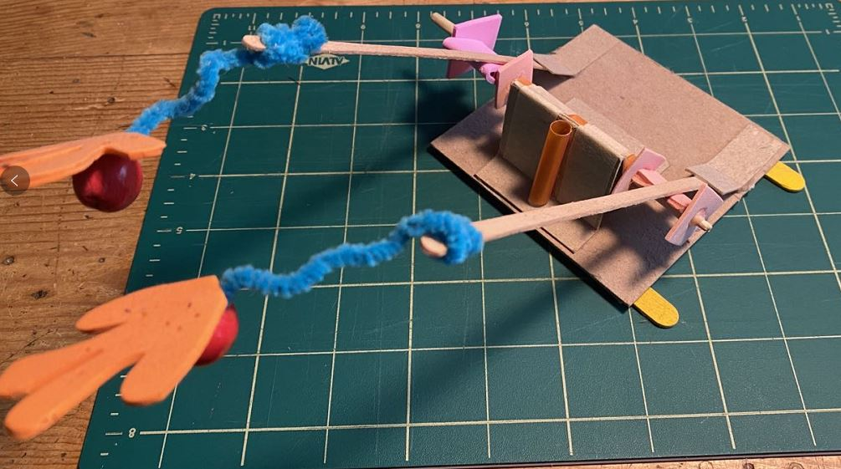
Break Mission Into Simple Parts
Module: Up Down Swing
Measures of success:
Strong: Can drop on the floor.
Reliable: Works 9 of 10 times.
Easy to modify.
Notes:
Module for candy to be delivered. What simple machine is this?

Slide 11
Presentation
Look Good
A good idea that looks ugly …
may not get the attention it deserves!
Be clear, concise and compelling.
way-cool
colors

Slide 12
You get points for …
Looking cool
Sounding smooth
Creativity
Reliability

Slide 13
Break your solution into simple parts
Start your lab book.
Document the problem and mission.
Research.
Build your musician characters.
Build the sensor, structural and motion modules.
Compose a song.
Write lyrics.
Incorporate your song and lyrics in a Scratch project.
Build a stage.
Design graffiti signs.
Integrate, test, and improve your solution.
Record a music video and present it to the world.

Slide 14
Skills you will exercise
Focus on the problem and the mission.
Plan.
Document.
Work together. Teamwork
Think creatively.
Build and test one module at a time.
Integrate, test and improve.
Present ideas in a way that attracts attention.
Notes:
Keep the problem and the mission in mind when building
Practice TEAMWORK. Help each other out.
Cut and fold the ‘way cool way.’ This will make your inventions stronger and more reliable. And cool looking inventions will attract more attention.
Build and test one section of your bumper machine before you work on the second and third sections. Practice modular construction.
Don’t give up. Remember Thomas Edison.

