Slide 1
Scratch Games 101
Lab Book
Turn an ugly school math test
into a fun computer game
Prototype
Notes:
Welcome to the Build-It-Yourself Laboratory

Slide 2
The Problem
What is the ugliest thing you have ever seen?
Is there anything uglier than a school math test?
Prototype
Prototype
Approved
JG
Date
Dec 2021
Project
Scratch Games 101 - 1/12
Notes:
Before building, a good engineer will define the problem and set goals.
This is an opportunity to talk about
being an entrepreneur
the pros and cons of capitalism and socialism.

Slide 3
The Mission
Make tests fun.
Turn them into computer games.
Prototype
Prototype
Prototype
Approved
JG
Date
Dec 2021
Project
Scratch Games 101 - 2/12
Notes:
Before building, a good engineer will define the problem and set goals.
This is an opportunity to talk about:
How technology has made life better
And
How technology has made life worse.

Slide 4
Assignments
Start a Leo DaVinci-Like Lab Book.
Document building tricks.
Write game storyline.
Draw game graphics.
Make game sound effects.
Program game.
Test and debug.
Present project.
Prototype
Prototype
Prototype
Approved
JG
Date
Dec 2021
Project
Scratch Games 101 - 3/12
Notes:
Before building, a good engineer will define the problem and set goals.
This is an opportunity to talk about:
How technology has made life better
And
How technology has made life worse.

Slide 5
Super Powers You Will Have
PowerPoint Guru
Problem Solver
Hot Shot Programmer
Cool Graphic Designer
Master of Presentations
Prototype
Prototype
Prototype
Approved
JG
Date
Dec 2021
Project
Scratch Games 101 - 4/12
Notes:
Before building, a good engineer will define the problem and set goals.
This is an opportunity to talk about:
How technology has made life better
And
How technology has made life worse.

Slide 6
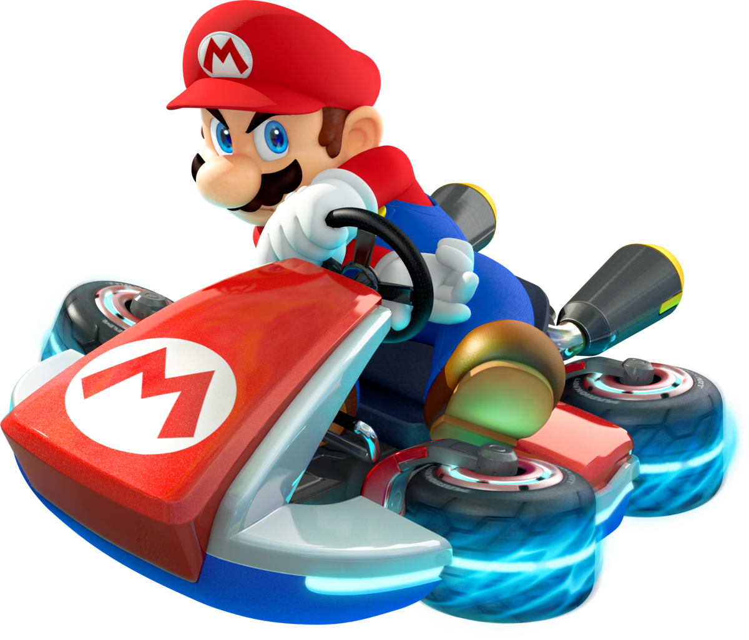
Research
Summarize the pros and cons of your favorite games.
Prototype
Prototype
Prototype
Approved
JG
Date
Dec 2021
Project
Scratch Games 101 - 5/12
Notes:
After a good engineer has defined the problem and the mission, the next step is to research how others have tried to solve the problem.
Don’t reinvent the wheel.
Build on top of the ideas of others.
Improve the ideas of others.
Inspire your own solutions.

Slide 7
Hall of Fame Solutions
What is 6x13?
https://scratch.mit.edu/projects/567723777
https://scratch.mit.edu/projects/425027602
Prototype
Approved
JG
Date
Dec 2021
Project
Scratch Games 101 - 6/12
Notes:
Inspire ideas and excitement

Slide 8
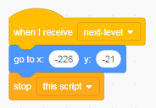
Components ofa Good Game
Are these components in your favorite games?
Game
Storylines
Graphics
Sound
Effects
Game
Logic
Prototype
Approved
JG
Date
Dec 2021
Project
Scratch Games 101 - 7/12

Slide 9
Write a Game Story
Tell a story that will make your buddies want to play your game.
Your story will guide you through the creation of your graphics.
Break your story into parts.
When?
Where?
Who
What?
There lived and alien
who loved math
and thought humans were dumb.
Prototype
Approved
JG
Date
Dec 2021
Project
Scratch Games 101 - 8/12

Slide 10
Draw Your Game Characters
Draw a professor cartoon.
Exaggerate.
Think 3D.
Use hot colors.
Make unusual shapes.
Animations:
Test your smarts
Correct answer
Wrong answer
Prototype
Approved
JG
Date
Dec 2021
Project
Scratch Games 101 - 9/12

Slide 11
Record Sound Effects
Make your game rock!
Prototype
Approved
JG
Date
Dec 2021
Project
Scratch Games 101 - 10/12

Slide 12
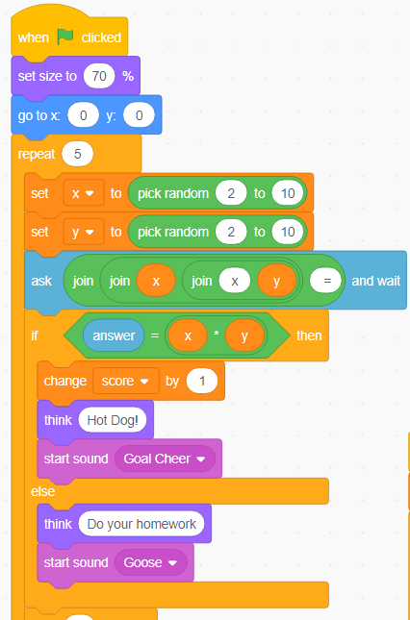
Code Your Game
Exercise 5 program primitives.
Serial vs. Parallel
Iteration
Conditional statements
Variables
Messaging
Prototype
Approved
JG
Date
Dec 2021
Project
Scratch Games 101 - 11/12

Slide 13
Present your project to the world.
Video record your project in action.
Post your project on Invention Universe.
Tell us why you should be in our
Hall of Fame and collect a prize.
Prototype
Approved
JG
Date
Dec 2021
Project
Scratch Games 101 - 12/12
Notes:
Inspire ideas and excitement

Slide 14
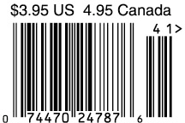
WANTED: FUNKY ARTISTS AND BUILDERS
Build online with art and engineering college students.
Grown ups need not apply.
build-it-yourself.com/apply
Published by ‘Distribution Partner’
Copyright 2022
Prototype
Prototype
Notes:
Welcome to the Build-It-Yourself Laboratory

Slide 15
Scratch Games 101
Curriculum Notes
Turn an ugly school math test
into a fun computer game.
Prototype
Notes:
For printed book cover on grey card stock

Slide 16
What We Will Learn
How to think creatively
How technology can make people happy
Benefits of modular construction
PowerPoint or Google Slides
Process for solving problems
How to present your work
Computer programming primitives
Project Plan Agenda
Session 1 Set up PowerPoint lab book.
Cover, problem and mission, research, plan
Session 2,3 Introduction to cartooning.
Draw professor character and animate.
Write storyline.
Session 4,5 Code multiple, random questions.
Session 6,7 Add scoring, timing, sound effects.
Session 8 Document and present project on Invention Universe.
Build-It-Yourself.com

Slide 17
Webcast Lesson Plan
For complete Lesson Plan,
Contact:
support@build-it-yourself.com
Build-It-Yourself.com

Slide 18
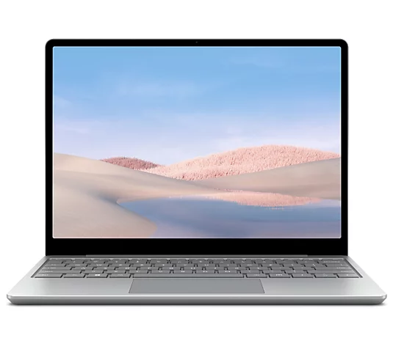
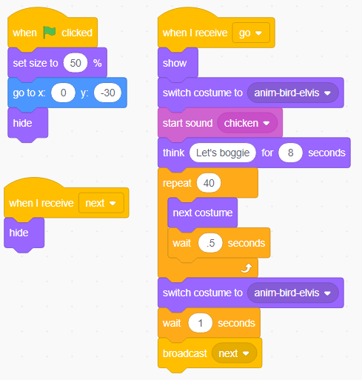
Parts, Tools, Supplies, Software
You'll need:
Power Point, Google Slides, or WPS
Access to Scratch (scratch.mit.edu)
Lesson modules
(from Build-It-Yourself)
Problem Solving Tricks
Presenting Ideas
Cartooning
Graffiti
5 Program Primitives
Build-It-Yourself.com

Slide 19
Workshop discussion questions
What are the pros and cons of computer games?
What are examples of how technology has improved life?
What are examples of how technology has made life worse?
What do you think are the most amazing computer applications?
Why is teamwork important?
What do you think are the biggest problems in the world and how could technology help solve these problems?
Advanced Projects
Incorporate more elaborate math equations. Level up.
Create a video
Post on Invention Universe.
Build-It-Yourself.com

Slide 20
Scratch Games 101
Lab Book
Turn an ugly school math test
into a fun computer game
Prototype
Notes:
For printed book cover on grey card stock

Slide 21
WANTED: FUNKY ARTISTS AND BUILDERS
Build online with art and engineering college students.
Grown ups need not apply.
build-it-yourself.com/apply
Published by ‘Distribution Partner’
Copyright 2022
Prototype
Prototype
Notes:
For printed book cover on grey card stock

