Slide 1
Scratch Games 102
Lab Book
Convince your parents that you will learn valuable skills building and playing computer games.
Prototype
Notes:
Welcome to the Build-It-Yourself Laboratory

Slide 2
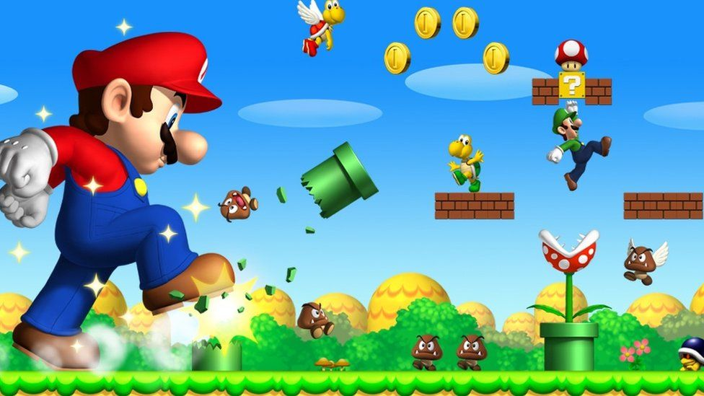
The Problem
Are your parents making your life miserable because they restrict the time you can play computer games?
Prototype
Prototype
Approved
JG
Date
Feb 2022
Project
Scratch Games 102 - 1/17
Notes:
Before building, a good engineer will define the problem and set goals.
This is an opportunity to talk about
being an entrepreneur
the pros and cons of capitalism and socialism.

Slide 3
The Mission
Convince your parents that you will learn valuable skills building and playing computer games. Skills you will need to be a player in tomorrow’s high tech world.
Maybe they will help you upgrade your computer power and give you more time to play games.
Prototype
Prototype
Prototype
Approved
JG
Date
Feb 2022
Project
Scratch Games 102 - 2/17
Notes:
Before building, a good engineer will define the problem and set goals.
This is an opportunity to talk about:
How technology has made life better
And
How technology has made life worse.

Slide 4
Assignments
Start a Leo DaVinci-Like Lab Book.
Document building tricks.
Write game storyline.
Draw game graphics.
Make game sound effects.
Program game.
Test and debug.
Present project.
Prototype
Prototype
Prototype
Approved
JG
Date
Feb 2022
Project
Scratch Games 102 - 3/17
Notes:
Before building, a good engineer will define the problem and set goals.
This is an opportunity to talk about:
How technology has made life better
And
How technology has made life worse.

Slide 5
Super Powers You Will Aquire
PowerPoint Guru
Problem Solver
Hot Shot Programmer
Cool Graphic Designer
Master of Presentations
Debating an important issue.
Prototype
Prototype
Prototype
Approved
JG
Date
Feb 2022
Project
Scratch Games 102 - 4/17
Notes:
Before building, a good engineer will define the problem and set goals.
This is an opportunity to talk about:
How technology has made life better
And
How technology has made life worse.

Slide 6
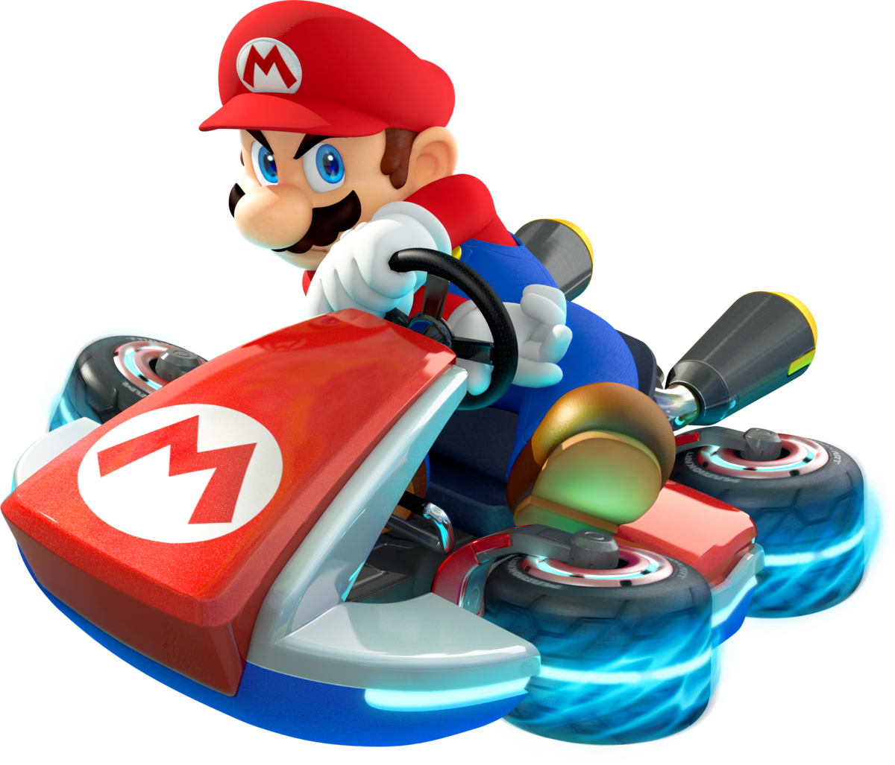
Research
Summarize the pros and cons of playing computer games.
Prototype
Prototype
Prototype
Approved
JG
Date
Feb 2022
Project
Scratch Games 102 - 5/17
Notes:
After a good engineer has defined the problem and the mission, the next step is to research how others have tried to solve the problem.
Don’t reinvent the wheel.
Build on top of the ideas of others.
Improve the ideas of others.
Inspire your own solutions.

Slide 7
Hall of Fame Solutions
What are the physics of jumping?
https://scratch.mit.edu/projects/271938344/editor/
https://scratch.mit.edu/projects/501255543/editor/
https://scratch.mit.edu/projects/579518036/editor/
https://scratch.mit.edu/projects/305161388/editor/
Prototype
Approved
JG
Date
Feb 2022
Project
Scratch Games 102 - 6/17
Notes:
Inspire ideas and excitement

Slide 8
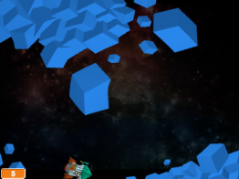
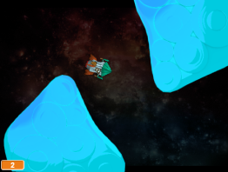
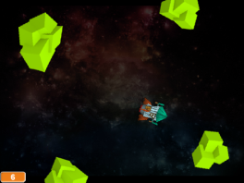
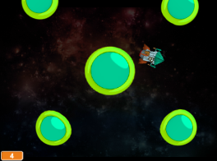
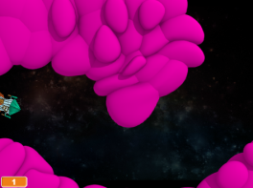
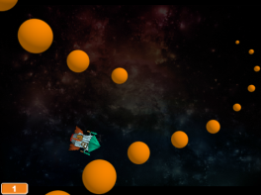
Hall of Fame Solutions
Prototype
Approved
JG
Date
Feb 2022
Project
Scratch Games 102 - 7/17
Notes:
Inspire ideas and excitement

Slide 9
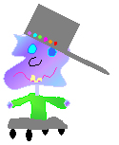
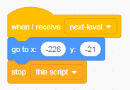
Components ofa Good Game
Are these components in your favorite games?
Game
Storylines
Graphics
Sound
Effects
Game
Logic
Prototype
Approved
JG
Date
Feb 2022
Project
Scratch Games 102 - 8/17

Slide 10
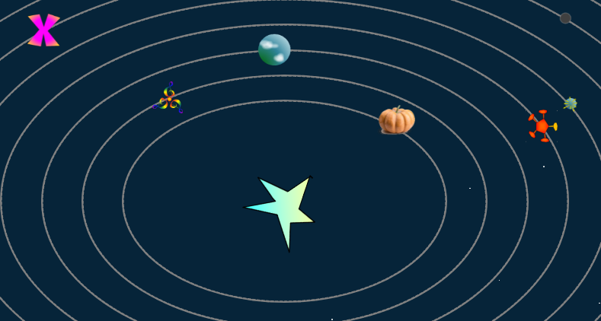
Write a Game Story
Tell a story that will make your buddies want to play your game.
Your story will guide you through the creation of your graphics.
Break your story into parts.
When?
Where?
Who
What?
Many moons into the future, there lived an alien who had to navigate a dangerous path through space to find a stash of high-quality candy.
Prototype
Approved
JG
Date
Feb 2022
Project
Scratch Games 102 - 9/17

Slide 11
Draw Your Game Characters
Draw a professor cartoon.
Exaggerate.
Think 3D.
Use hot colors.
Make unusual shapes.
Animations:
Test your smarts
Correct answer
Wrong answer
Prototype
Approved
JG
Date
Feb 2022
Project
Scratch Games 102 - 10/17

Slide 12
Record Sound Effects
Make your game rock!
Prototype
Approved
JG
Date
Feb 2022
Project
Scratch Games 102 - 11/17

Slide 13
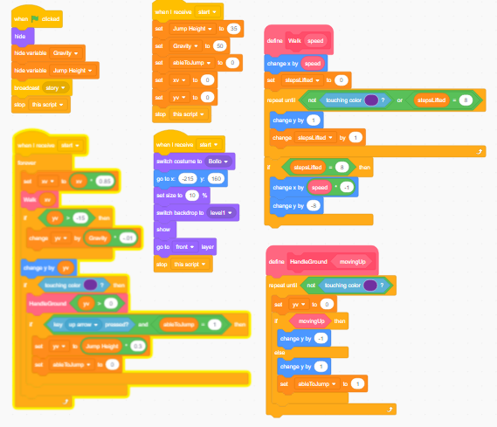
Code Your Game
How can you animate your characters?
Use conditional statements to make your animation smart.
How do you keep track of your position?
Prototype
Approved
JG
Date
Feb 2022
Project
Scratch Games 102 - 12/17

Slide 14
Present your project to the world.
Video record your project in action.
Post your project on Invention Universe.
Tell us why you should be in our
Hall of Fame and collect a prize.
Prototype
Approved
JG
Date
Feb 2022
Project
Scratch Games 102 - 13/17
Notes:
Inspire ideas and excitement

Slide 15
Why are computer games important?
Harvard Business School Press, ‘Got Game’
Gamers are better at handling risk and uncertainty, and believe taking measured risks is the best way to get ahead.
Gamers are more creative and have better problem solving habits.
Gamers are more sociable and have a greater need for human relationships.
Prototype
Approved
JG
Date
Feb 2022
Project
Scratch Games 102 - 14/17
Notes:
Inspire ideas and excitement

Slide 16
Why are computer games important?
Harvard Business School Press, ‘Got Game’
Gamers think of themselves as experts and want to tackle problems head-on.
Gamers aren’t discouraged by failure and believe each setback is just a chance to try again.
Gamers are more flexible about change.
Prototype
Approved
JG
Date
Feb 2022
Project
Scratch Games 102 - 15/17
Notes:
Inspire ideas and excitement

Slide 17
Why are computer games important?
Harvard Business School Press, ‘Got Game’
Gamers are better at seeing problems from a deeper perspective.
Gamers are great at learning in informal ways.
Gamers are more globally oriented and out-ward looking.
Gamers are more confident and have a more positive out look on life.
Prototype
Approved
JG
Date
Feb 2022
Project
Scratch Games 102 - 16/17
Notes:
Inspire ideas and excitement

Slide 18
Why can computer games be bad?
Harvard Business School Press, ‘Got Game’
You can be influenced by too much violence.
Single player games can be non-social.
Addiction to anything can be dangerous.
There can be online predators.
Prototype
Approved
JG
Date
Feb 2022
Project
Scratch Games 102 - 17/17
Notes:
Inspire ideas and excitement

Slide 19
WANTED: FUNKY ARTISTS AND BUILDERS
Build online with art and engineering college students.
Grown ups need not apply.
build-it-yourself.com/apply
Published by ‘Distribution Partner’
Copyright 2022
Prototype
Prototype
Notes:
Welcome to the Build-It-Yourself Laboratory

Slide 20
Scratch Games 102
Curriculum Notes
Convince your parents that you will learn valuable skills building and playing computer games.
Prototype
Notes:
For printed book cover on grey card stock

Slide 21
What We Will Learn
How to think creatively
How technology can make people happy
Benefits of modular construction
PowerPoint or Google Slides
Process for solving problems
How to present your work
Computer programming primitives
Project Plan Agenda
Session 1 Set up PowerPoint lab book.
Cover, problem and mission, research, plan
Session 2,3 Introduction to graphic design principles.
Draw main character and backgrounds.
Write storyline.
Session 4,5 Code physics of jumping
Control scrolling backgrounds.
Session 6,7 Add scoring, timing, sound effects.
Session 8 Document and present project on Invention Universe.
Build-It-Yourself.com

Slide 22
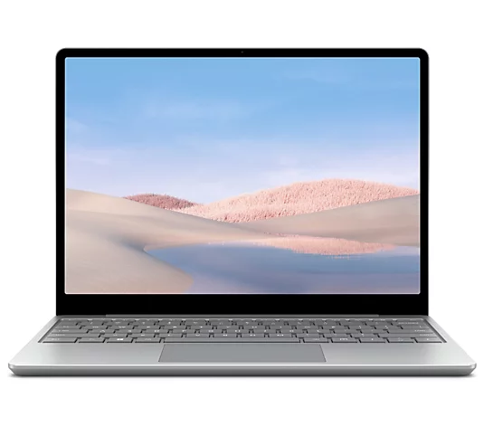
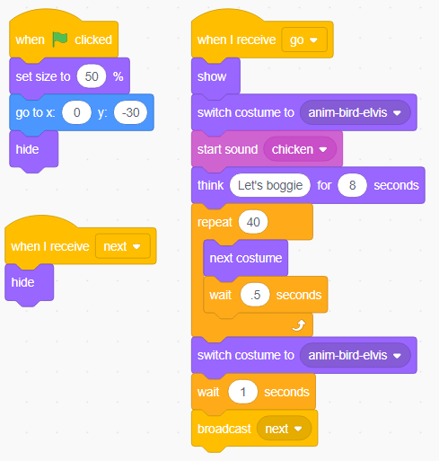
Parts, Tools, Supplies, Software
You'll need:
Power Point, Google Slides, or WPS
Access to Scratch (scratch.mit.edu)
Lesson modules
(from Build-It-Yourself)
Problem Solving Tricks
Presenting Ideas 102
Cartooning 102
Graffiti 102
Build-It-Yourself.com

Slide 23
Workshop discussion questions
What are the pros and cons of computer games?
What are examples of how technology has improved life?
What are examples of how technology has made life worse?
What do you think are the most amazing computer applications?
Why is teamwork important?
What do you think are the biggest problems in the world and how could technology help solve these problems?
Advanced Projects
Make a game trailer
Record your presentation
Add more boss levels/mini games
Level up.
Create a video
Post on Invention Universe.
Build-It-Yourself.com

Slide 24
Scratch Games 102
Lab Book
Convince your parents that you will learn valuable skills building and playing computer games.
Prototype
Notes:
For printed book cover on grey card stock

Slide 25
WANTED: FUNKY ARTISTS AND BUILDERS
Build online with art and engineering college students.
Grown ups need not apply.
build-it-yourself.com/apply
Published by ‘Distribution Partner’
Copyright 2022
Prototype
Prototype
Notes:
For printed book cover on grey card stock

