Slide 1
Voice Control Lab Book
What’s the best way to communicate with a machine?
Build-It-Yourself.com

Slide 2
The Problem
Do you need to control your computer?
Typing is waaaaay too slow!
Notes:
How hard is it to use a mouse to play a game? Is a keyboard or controller easier to use?

Slide 3
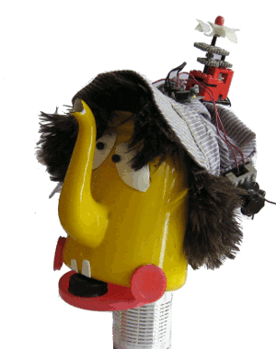
The Mission
Teach your computer to talk!
Notes:
Like we see in speech to text, ok google, siri and alexa, voice commands and handfree controls are now becoming popular. They are easier to use. Have you played any games/apps with voice control?
Game with voice control, screaming chickens

Slide 4
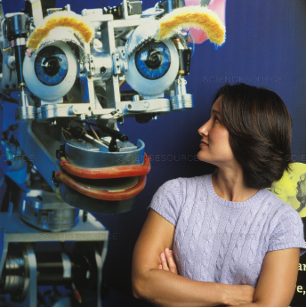
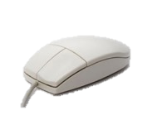
Research – History of Man-Machine Interfaces
Punch Cards
Touchscreen
The Future…
Abacus
1890
500 BC
1965
1868
1968
1952
Typewriter/Keyboard
Mouse
Voice recognition
Notes:
Examples of voice recognition. & touch screen were first created but not mature
Future – MIT researching and developing ways to read brain waves and use signal to control machines/ use as input device
Future – In addition, some engineers think that computers should not only sound like humans, they should even look like computers!
The goal is to make it as natural as possible to communicate between humans and computers.

Slide 5
Voice Recognition Variables
Detect a word by measuring:
Loudness (volume)
Number of syllables
Length of each syllable
Notes:
Advanced AI …
Try detecting sequences of words!
Scratch can detect how loud, time between sounds, and length of a sound!

Slide 6
Research
Research and document:
Voice controlled assistants
Ok Google
Alexa
Siri
…
Voice controlled games
Chicken Scream
…
Notes:
Show examples, have kids research more instances of voice control in present apps/games

Slide 7
Break Mission Into Simple Parts
Maybe
Bing
Vocabulary – make your own language!
Think of using volume and number of syllables to differentiate words.
No
Bing
Yes
Bing
Maybe
Bing
No
Bing
Bang
Yes
Bing
Bang
Bong
Notes:
Explain how kids can make their own language for controlling games. Simplest is to use number of syllables. It is how our demo code works.

Slide 8
Voice Recognition Variables
Detect a word by measuring:
Loudness (volume)
Number of syllables
Length of each syllable
Notes:
Advanced AI …
Try detecting sequences of words!
Scratch can detect how loud, time between sounds, and length of a sound!

Slide 9
Voice Recognition Variables
Loudness (volume)
Number of syllables
Length of each syllable
Notes:
Advanced AI …
Try detecting sequences of words!
Scratch can detect how loud, time between sounds, and length of a sound!

Slide 10
Measure of Success
Communicate at least 3 words
9 out of 10 code success rate
Understand a word within 2 seconds
Who can detect the most words with the highest success rate in the shortest time?
Notes:
Who can detect the most words with the highest success rate in the shortest time?

Slide 11
Code Flow Chart
Initialize code
Detect 1-3 words
1-3
Control Output Action
Notes:
How our code will work. Detects number of words. Based on number of words detected the program will execute a different script based on the number of words detected.

Slide 12
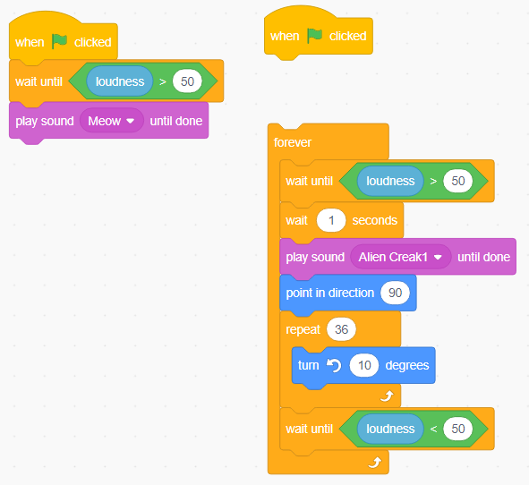
Code
Sample Scratch Code to detect a sound
https://scratch.mit.edu/projects/459228143/editor/

Slide 13
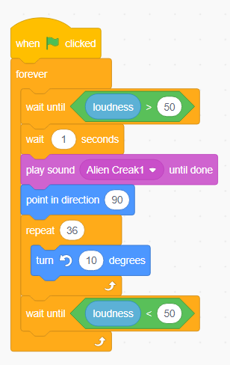
Code
Sample Scratch Code to detect a sound.
Does a flip when you talk.
Repeats forever.
https://scratch.mit.edu/projects/459228143/editor/
Notes:
Based on skill level of group you can start with template and modify or teach how to build the code.

Slide 14
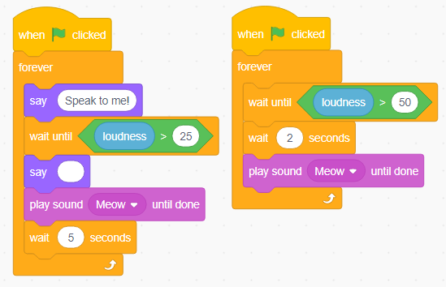
Code
Sample Scratch Code to detect
A soft sound or a loud sound
https://scratch.mit.edu/projects/459228143/editor/
Notes:
Based on skill level of group you can start with template and modify or teach how to build the code.

Slide 15
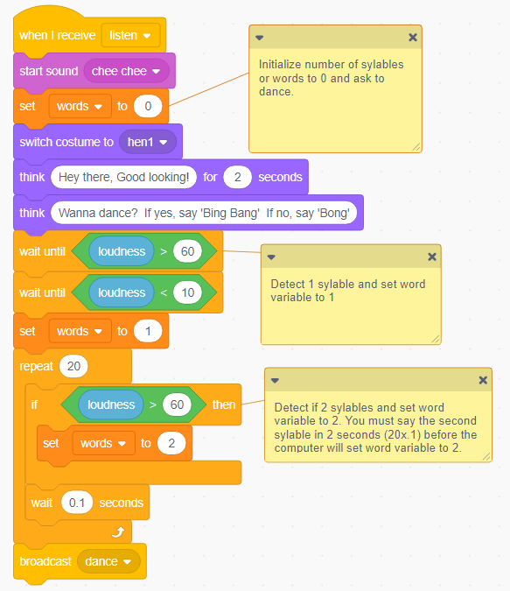
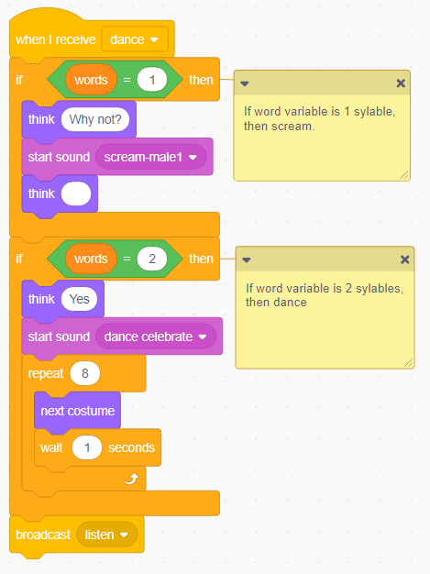
Code
Sample Scratch Code to detect two syllables.
https://scratch.mit.edu/projects/313136260/editor/
Notes:
https://scratch.mit.edu/projects/313136260/
Demo project has the code we need to create.
Based on skill level of group you can start with template and modify or teach how to build the code.

Slide 16
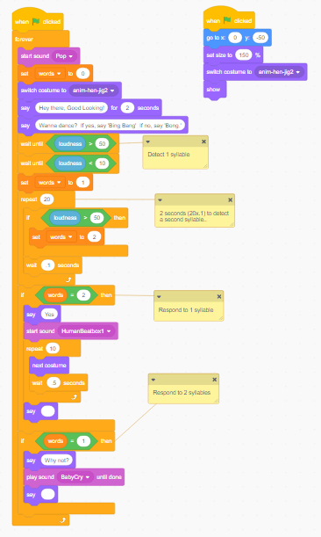
Code
Sample Scratch Code to detect multiple syllables.
https://scratch.mit.edu/projects/309302633/editor
Notes:
Based on skill level of group you can start with template and modify or teach how to build the code.

Slide 17
Advanced Projects
Show light:
Red when machine NOT listening
Green when machine IS listening
Show or play metronome to sync syllables
Start all words with common sound to reset
Train computer to understand your accent
Calibrate loudness threshold
Write a microphone audio calibrate routine.
Detect more than two words.
Improve speed of pattern recognition.
Improve reliability of pattern recognition.
Improve user interface and game play.
Record your own Beat Box riff.
Add a variety of dance moves.
Build a physical dancing robot.
Notes:
If kids are ahead challenge them to develop more advanced code. Alternatively have them help teach!

Slide 18
What we should know
Effective ways to use voice recognition in a game or application.
How to detect length, loudness and number of words in a program.
How to draw and animate way cool cartoons!
Notes:
If kids are ahead challenge them to develop more advanced code. Alternatively have them help teach!

