Slide 1
Web Design 101
Become a Coding Hotshot!
Notes:
Welcome to the Build-It-Yourself galactic laboratory!

Slide 2
The Problem
Aliens are scanning the universe for signs of intelligent life.
If they find a civilization of dummies they will blow it to smithereens.
If they find signs of intelligent life they may want to trade.
Notes:
Aliens are scanning the universe for signs of intelligent life. If they find a civilization of dummies they will blow it to smithereens. If they find signs of intelligent life they may want to trade ideas, music and computer games.
What do you think aliens would think of Earth and the people on it?
The good, the bad???

Slide 3
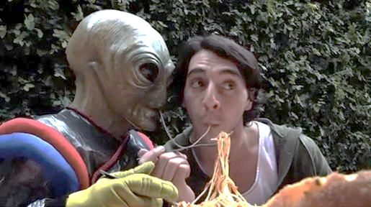
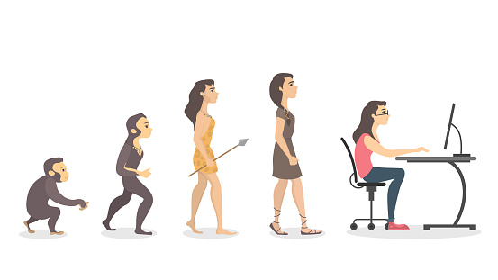
The Mission
Build a website that will make aliens want to make peace, not war. (And follow you on Instagram.)
Evolve from know-nothing, nat-brain rookies … …into Incredible Website Designers
Notes:
Build a website that will make aliens want to make peace, not war. (And follow you on Instagram.)
We need to make sure aliens see the good in our planet! We need to show our value.
In order to do so we need to become master web developers!

Slide 4
Research
Build Your Own Toys
http://www.build-it-yourself.com/
Mechanical Toys
http://www.cabaret.co.uk/
Mechanisms
http://www.flying-pig.co.uk/mechanisms/
Pixar
http://www.pixar.com/
Notes:
Before a builder builds it is important to research what others have done! Check out these cool web sites
What do you like? Dislike? What is different, what is similar?
Get kids engaged in discussion!

Slide 5
Research
Research the following:
Way cool websites
Ugly website
For each site list:
What you like about it
What you dislike about it
Notes:
Research your favorite and least favorite websites!
Document why you like and/or dislike each site. What is the site for, does the site help the owner reach their goals?

Slide 6
Project Plan
Project Plan:
How the Internet works
Web page vocabulary
Web page grammar
Programming tricks
Pictures, Audio, Video
Web site plan and navigation
Build-Your-Own-Site
Notes:
Set expectations for next 8 weeks and/or project

Slide 7
Skills Needed
Skills Needed:
PowerPoint Guru
Problem Solver
Master Designer
Modular Constructor
Hot Shot Programmer
Celebrity Presenter
Notes:
These are the skills you will acquire or further develop.

Slide 8
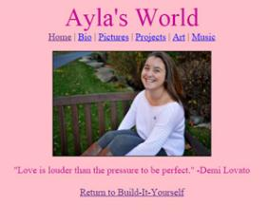
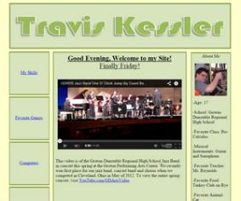
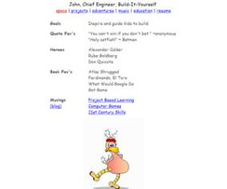
Hall of Fame
Hot Shot Web Designers!
Ayla, Travis, Val & John
Notes:
Here are some hot shot examples of what others have done in the past!

Slide 9
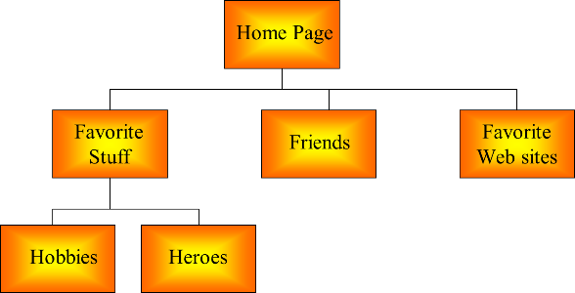
Break Mission Into Simple Parts
Site Map
Notes:
Create a site map! A site map is a map of all the pages of your website and how connect.
Drive the kids to create a site map. Have a kid share their screen and guide them to make a site map. Start with the home page and branch out.
Draw a box for each page that will appear in the navigation. Connect the home page to each other page.

Slide 10
Break Mission Into Simple Parts
Folder Structure/File Naming
documents
your name
images
Notes:
Folder structure is critical to success!
Create a folder with your name for your website in your documents folder. This is where your html files will be saved.
Create an images folder in root folder. This is where all of your images will be saved.
All files must use lower case letters, no spaces or underscores, and hyphens where needed.
All file names must be descriptive. Use common categories and zero in on unique

Slide 11
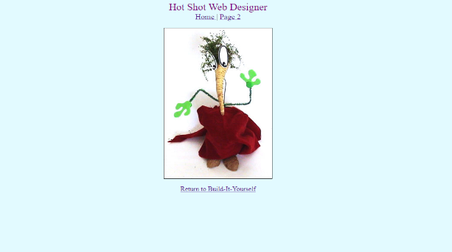
Break Mission Into Simple Parts
Title Page HTML Template
Notes:
We start with a simple template for your first page.

Slide 12
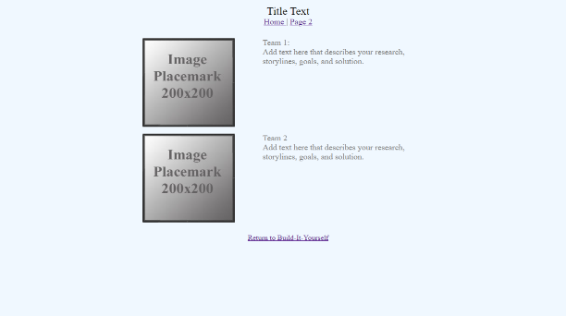
Break Mission Into Simple Parts
Table Page HTML Template
Notes:
Then we will build other pages using our table template.

Slide 13
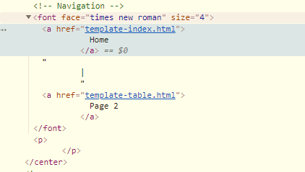
Break Mission Into Simple Parts
Website Navigation
Notes:
Once this is finished we will make the navigation and add it to all pages.

Slide 14
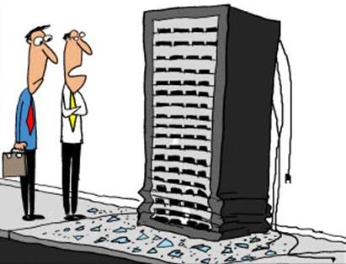
Break Mission Into Simple Parts
Upload to Web Server
Notes:
And finally upload it to our server! You can access this anywhere in the world!

Slide 15
What we should know
How to think outside the box
How to make people laugh
Benefits of modular construction
How to tell a compelling story
Advanced Projects:
Design more animated GIFs
Build more elaborate code modules
Reduce image file size by cropping, resizing and compression
Create a video
Notes:
By the end of the project you should know the following.
If you get ahead or have the time and interest here are some way cool ideas to expand your website!

