Slide 1
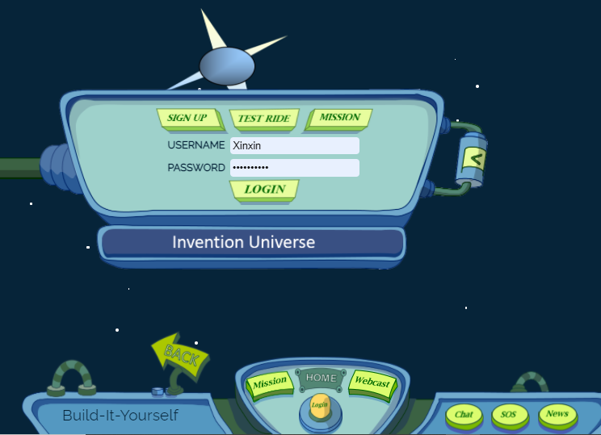
WEB DESIGN VIDEO LAB BOOK
Xinxin, Ryan, Jayden

Slide 2
PROBLEM
It is difficult to make get many kids to participate in the BIY
web design course
MISSION
Produce a video about the BIY web design course that gets 500 views on YouTube

Slide 3
Target Audience | Call to Action
Parents who invest in their children’s education | Enroll their kids
Kids who love to build, use technology, and/or draw | Tell parents why BIY is cool and useful
Notes:
Qualify/ describe

Slide 4
ATTRIBUTES OF A SUCCESSFUL 30 SECOND AD
Clear
Concise
Compelling
Music & sound effects
Relatable
Specific to target audience
Call to action
Attention-grabbing
Hyperbole
Dramatic story & images
Humor
Famous people
Notes:
So many advertisements – people only have time to look at a few
Relatable – you show you understand the problems the audience has

Slide 5
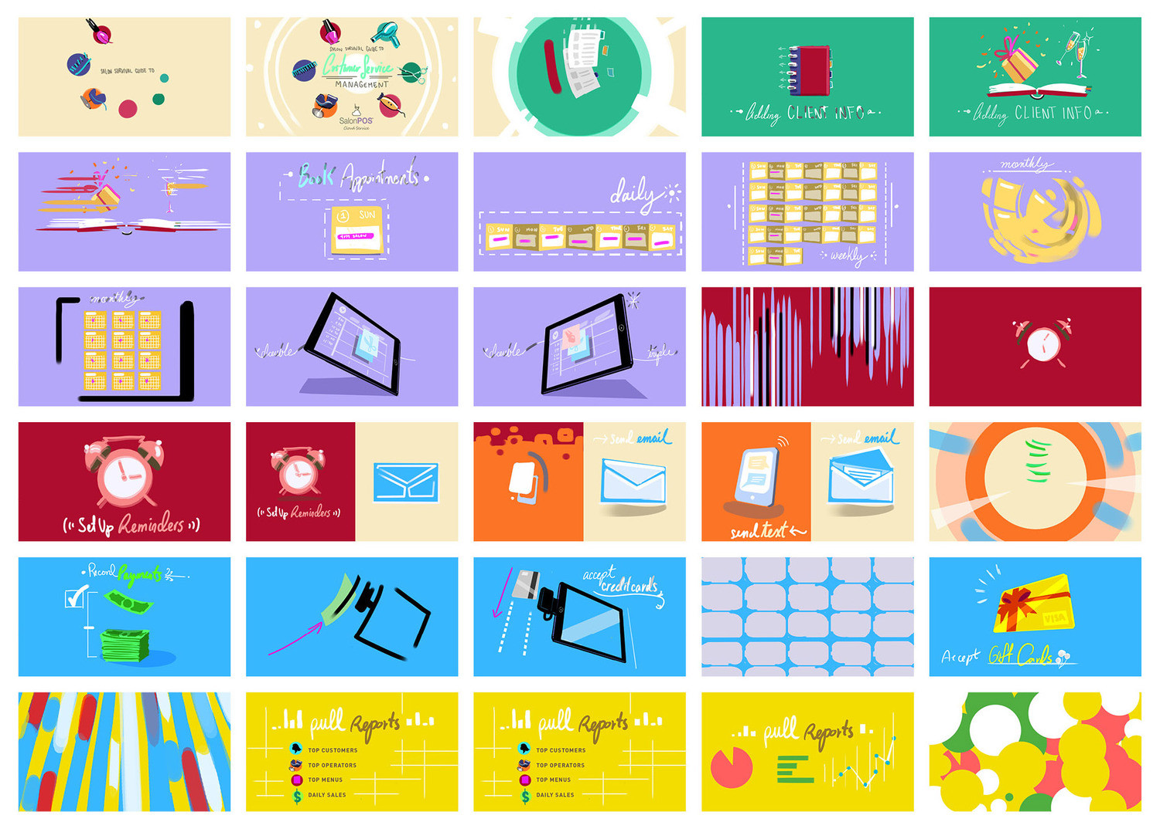
PRACTICE
STORYBOARDS

Slide 6
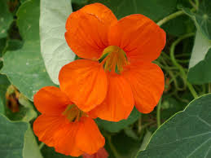
Brighten up your garden with nasturtium!

Slide 7
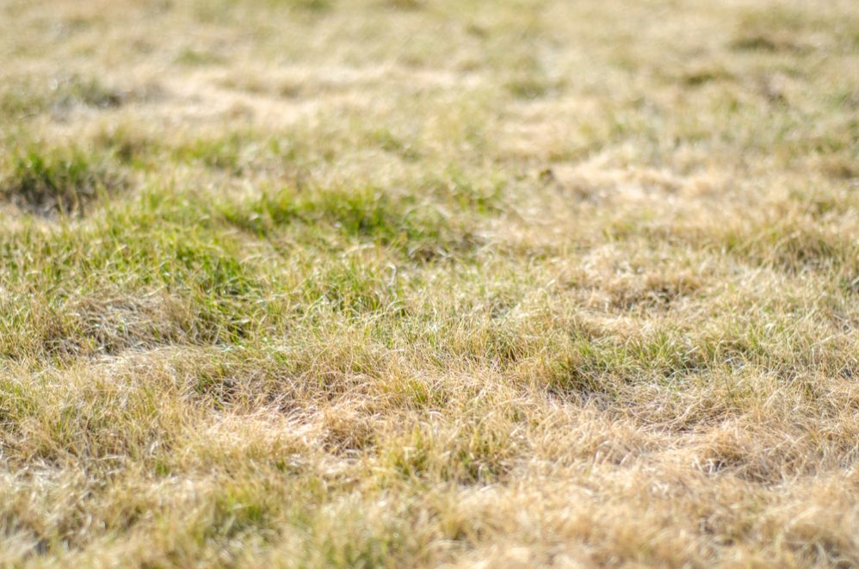
PROBLEM
Many people have drab yards and no time to make them beautiful

Slide 8
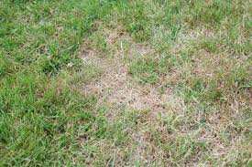
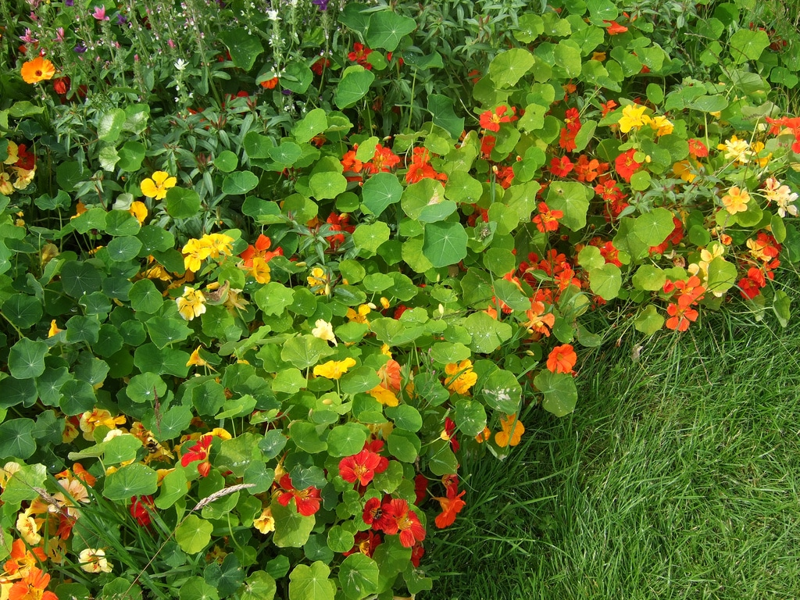
MISSION
Make people’s gardens
more lively by getting
500 people to plant
nasturtium

Slide 9
Vibrant red/orange/
yellow flowers

Slide 10
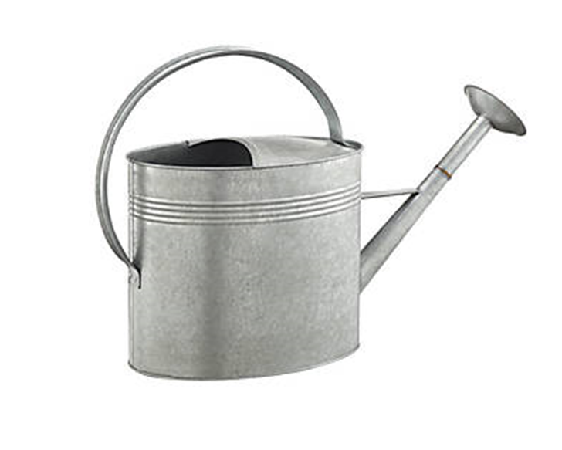
Very low
maintenance

Slide 11
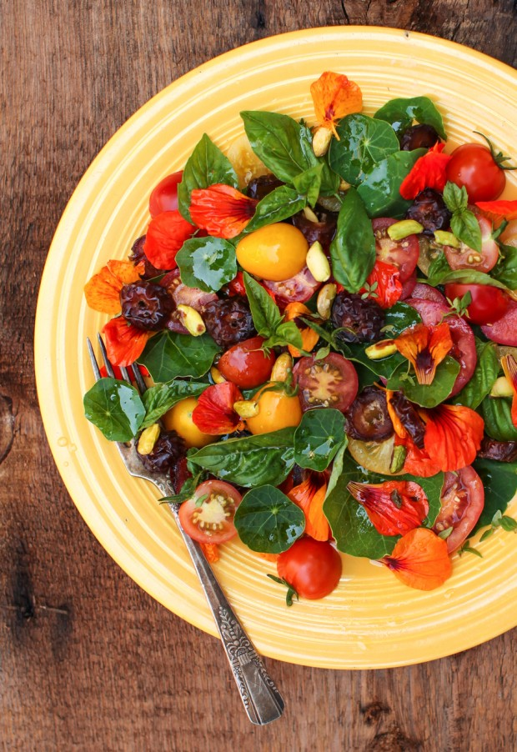
Edible

Slide 12
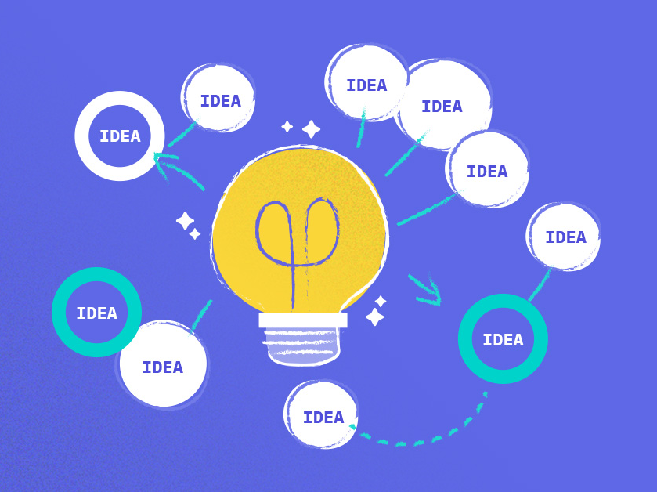
STORYBOARD DRAFTS & BRAINSTORMING

Slide 13
FUN BIY EXPERIENCES TO PROMOTE
Coding
Documenting/presenting ideas
Using tools like GIMP/Blender/PowerPoint
Building your own website
Organizing files
Invention Universe
Audience: families, investors, corporate partners

Slide 14
WHY WEB DESIGN COURSE IS COOL, FUN, & USEFUL
You will develop a skill that will make others think you’re super cool
The BIY web design course is fun because kids can share their ideas, stories, videos, etc. with friends around the world
It is useful to have a personal website as part of a college or job application
It’s satisfying to build a computer project
Target Audience | Call to Action
Parents who invest in their children’s education | Enroll their kids
Kids who love to build, use technology, and/or draw | Tell parents why BIY is cool and useful
Notes:
Cool – admirable

Slide 15
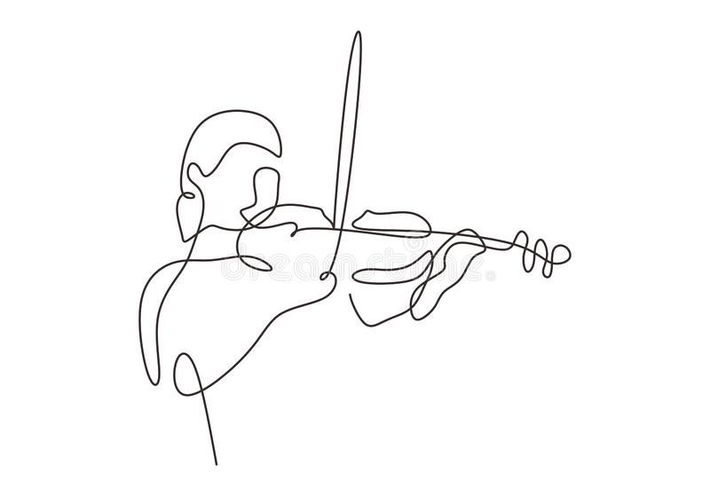
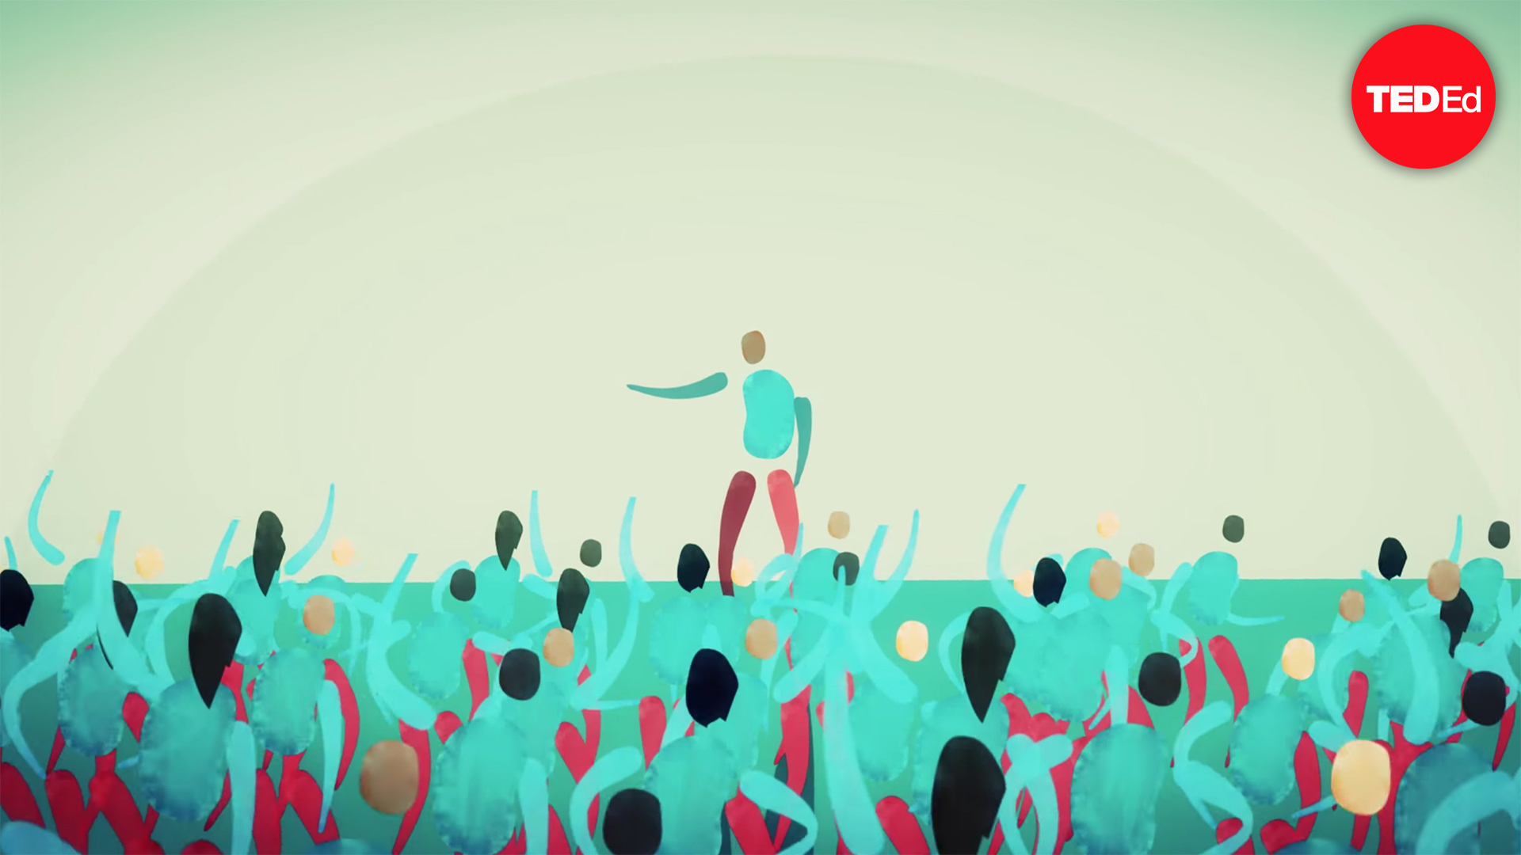
Simple & abstract graphics for inspiration:

Slide 16
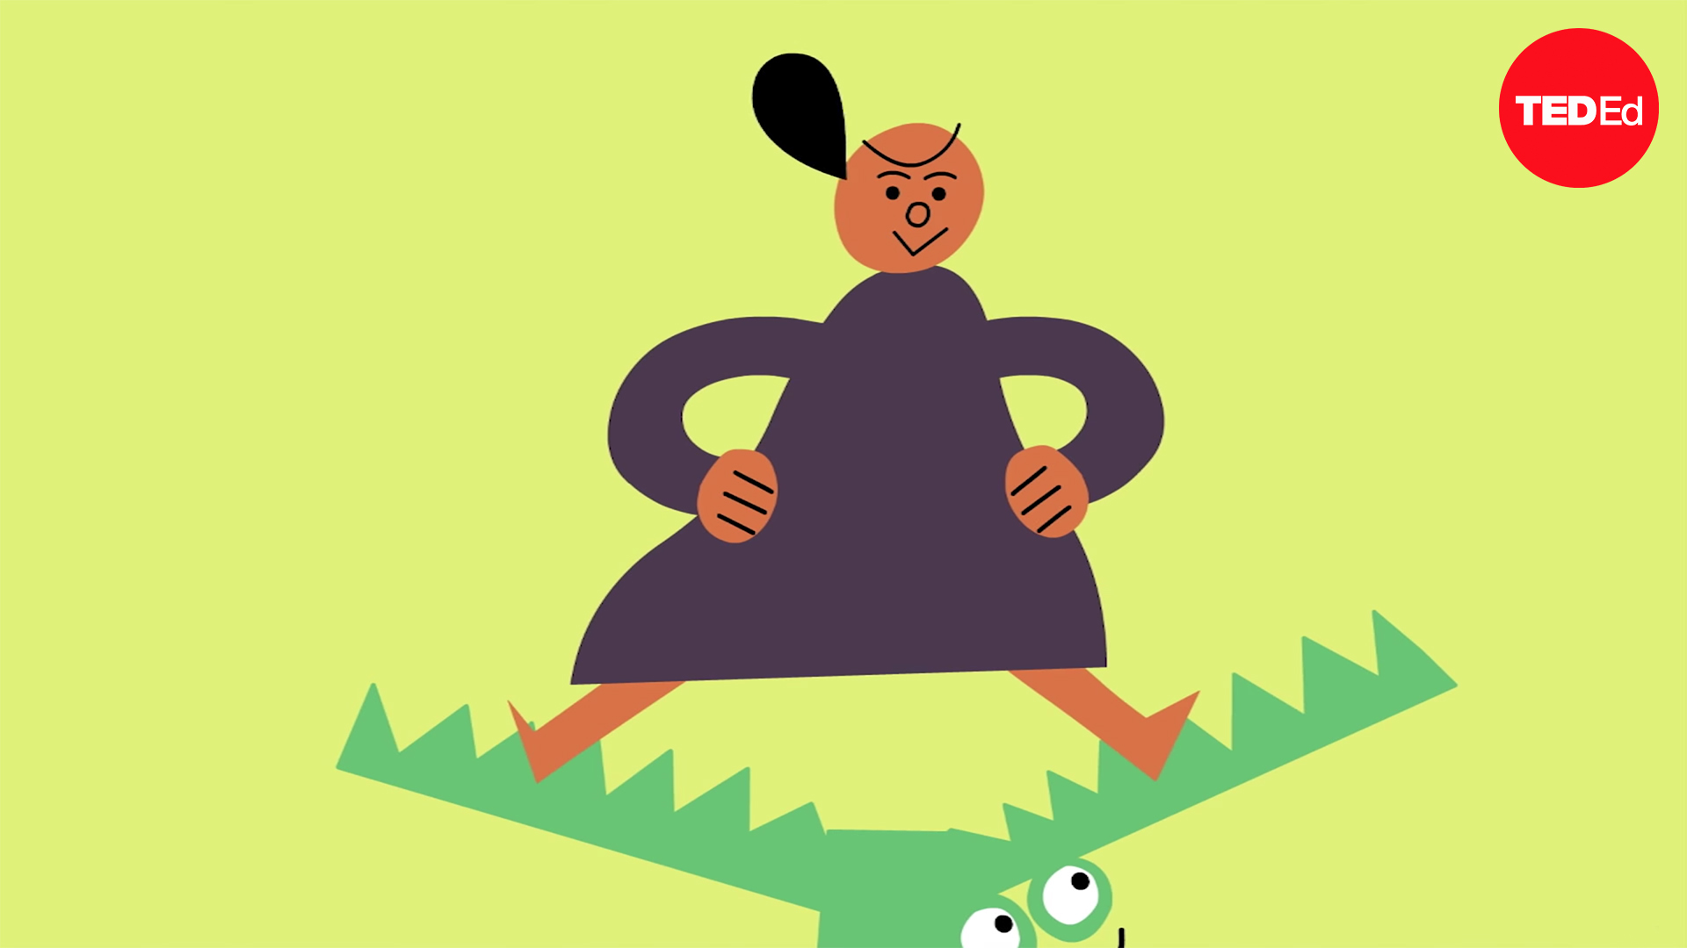
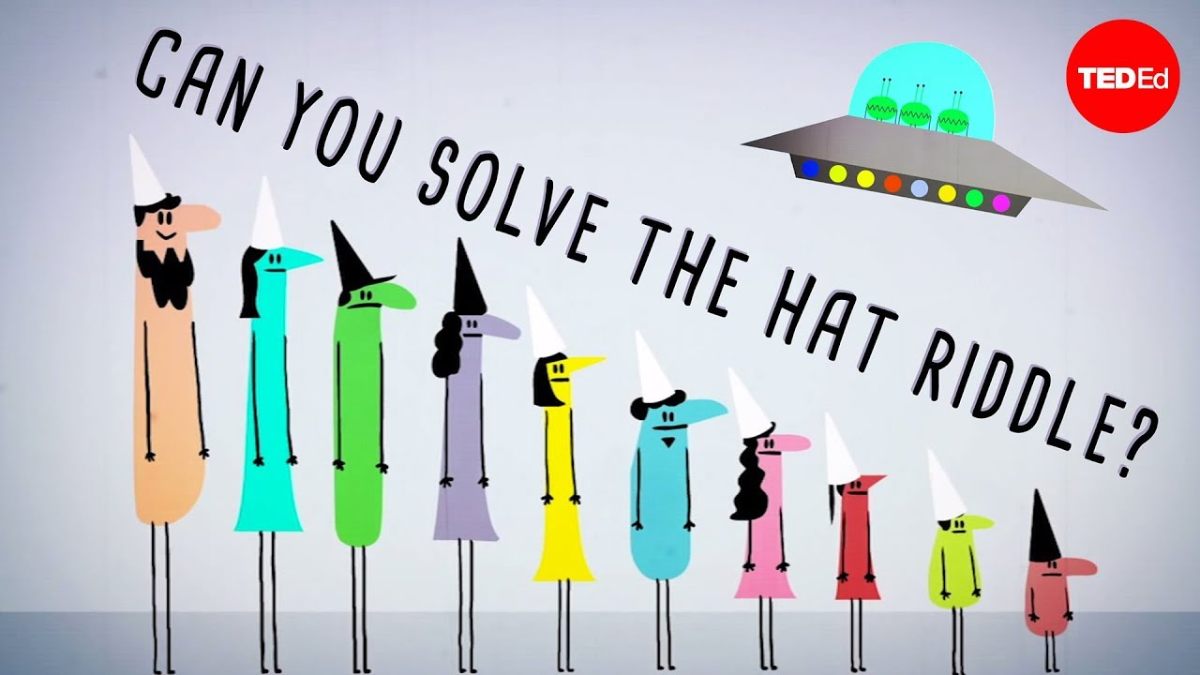
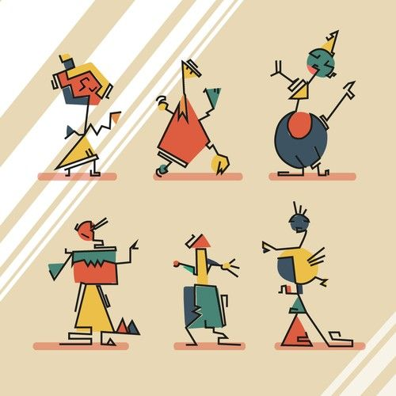
Simple & abstract graphics for inspiration:

Slide 17
NOTES
More dramatic – tell a story/use hyperbole to exaggerate the idea of being cool – add more 3D detail
Style:
Formal/ realistic/ photographic (detailed, photographic graphics)
Simple/ abstract (stick figures) – strange or unusual
Cartoons (with expressions)
Aggressive/ violent (attracts attention but not promoted by BIY)
Cute/ playful (like Pokemon)
Could depend on age, gender, etc.

Slide 18
FILTERS
Ideal age range: 10-18
Want to appeal to kids of all genders, races, religions, etc. – want to be as inclusive as possible
Kids who we think would be successful/ we want to recruit:
Who are on an ambitious college track
Curious & love learning
Innovative & creative
Who love computers & computer games

Slide 19
BRAINSTORMING
Title slide
Be Cool!
Equation: html=money
Computer screen w/ graffiti: cool, fun, useful, satisfying
Website of a famous person – text: wouldn’t you like to have a website like…

Slide 20
SCRATCH PROJECT
Scratch.mit.edu
biyaaaa
RobotSushi1
Example project:
https://scratch.mit.edu/projects/472422/editor/

Slide 21
BIY Web Design Course

Slide 25
WEB DESIGN AD
STORYBOARD

Slide 26
Notes:
Music

Slide 27
Notes:
Music

Slide 28
Notes:
Music

Slide 29
Notes:
Music

Slide 30
Notes:
Music

Slide 31
Notes:
Music

Slide 32
Notes:
Build it yourself web design workshop

Slide 33
Notes:
Develop a skill that will make others think you’re super cool!
Be cool!
Be way cool!

Slide 34
Notes:
Have fun sharing your ideas, stories, videos, art, and more with friends around the world!
Share your inventions with friends and aliens around the universe!

Slide 35
Notes:
Create an impressive personal website to strengthen your college or job application
Learn some knock-your-socks-off tricks to get your dream job!

Slide 36
$$$
$$$
$$$
Notes:
Make money
Use your new skills to make lots of money – not all kids want to buy toys?
Learn skills to make money to buy toys!
Buy toys with money made from your awesome skills
Learn skills, make money, buy toys – short, to the point, playful

Slide 37
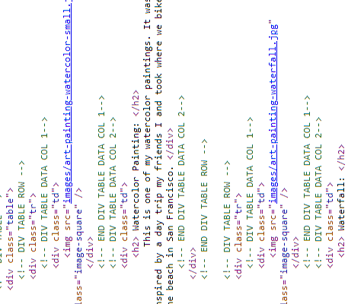
Notes:
Feel the personal satisfaction of building a computer project!
Be happy
Build to be happy
Be happy, build dreams

Slide 38
Notes:
Feel the personal satisfaction of building a computer project!
Be happy
Build to be happy
Be happy, build dreams

Slide 39
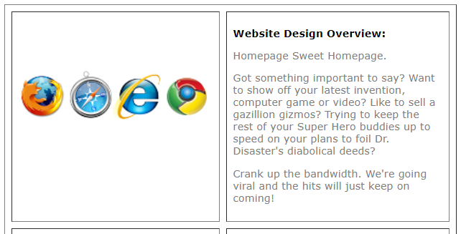
Notes:
Join the BIY web design course today!
Don’t wait! Join today!

Slide 40
HOMEWORK
Date: 4/12
Things to do:
Put storyboard into scratch
Look for background music (mp3 format)
Break down graphics
https://zoom.us/j/7030709799

