Slide 1
BIY Intern College Essay Journal
The Problem:
Applying to college can be stressful.
The Mission:
Let’s make it … and thought provoking.
Let’s tell a story about your dreams.
fun!
fun!
Build-It-Yourself

Slide 2
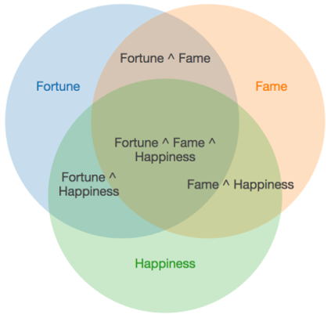
BIY Intern College Essay Journal
The Big Picture Problem:
It’s difficult to find a career that will make you happy.
If you want to be a doctor, lawyer, athlete, or artist, these days you may need to plan early.
The Mission:
Develop a plan to have a dream career.
Develop a plan to maximize your time doing the things that make you really happy.
The Immediate Mission:
If part of your plan is to develop the skills you will need in the college of your choice,
write a college application essay.
Note:
The suggestions in this outline are just one perspective.
In the end, follow your own logic, be yourself, and have fun.
Build-It-Yourself

Slide 3
BIY Intern College Essay Journal
The 4D Project Management Process:
This process can help organize your time if you are developing a rocket ship to Mars or if you are writing a college application essay.
Define
Define what makes you happy.
Profile your audience and set goals
Research
Schedule
Design
Outline
Storyboard
Develop
Write storyboard modules
Integrate
Test
Edit
Deliver
Submit
Follow-up
Build-It-Yourself

Slide 4
BIY Intern College Essay Journal
Define Design Develop Deliver
Profile your reader:
College Admission Officer who:
may have to read 1000 essays in two months.
is charged with filtering 1 out of 10 distinguished applicants.
is looking for …
Builders – Cornell Engineering
Artists – Brown/RISD
Entrepreneurs - MIT
Leaders - Harvard
STEM excellence – Cal Tech
Research common values that you and various schools share.
Who are well-known professors, alumni, and courses?
Goal / Call to action:
Convince admissions officer you will be a distinguished student and a prominent, loyal alumnus / alumna
Build-It-Yourself

Slide 5
BIY Intern College Essay Journal
Define Design Develop Deliver
Dream, imagine, fantasize about your future.
Life passions (Favorite things to do)
Dream job (What companies or products turn you on?)
Heroes (Who inspires you?)
Examples of favorite things to do:
I love to:
Build something that makes others say, ‘Wow!’
Be on a team that beats good soccer teams.
Examples of dream jobs:
Start a company that provides a valuable service. (Be specific)
Work with talented people from around the world to build an affordable, eco-friendly housing system.
The short story, ‘Walter Mitty’ may inspire you to dream big.
Build-It-Yourself

Slide 6
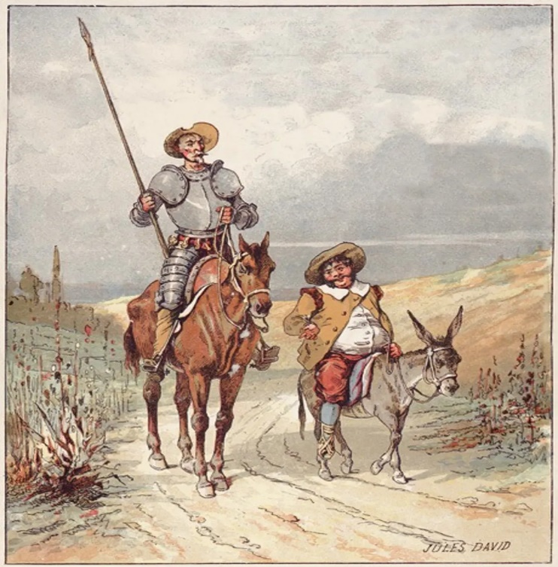
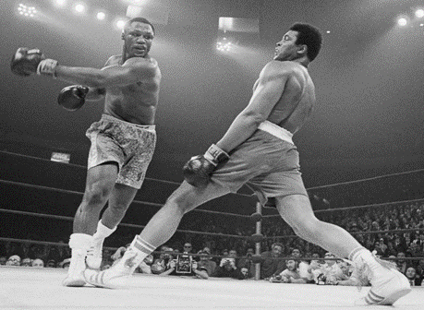
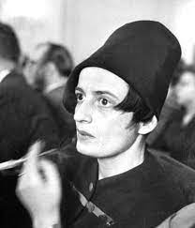
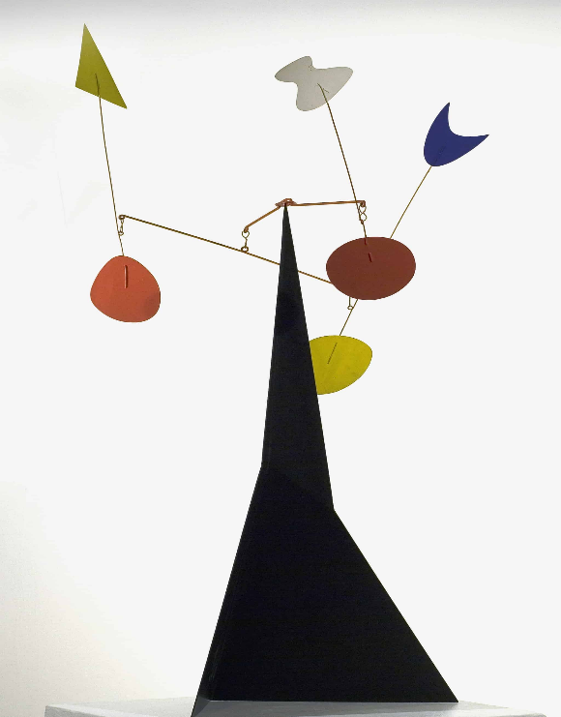
BIY Intern College Essay Journal
Define Design Develop Deliver
Examples of presenting heroes whose qualities you may want to develop.
Follows his principles.
Celebrates builders.
Playful and elegant.
Sees the future.
Focuses on the good.
Try to think of accomplishments that are unusual, thought provoking, and make the reader want to know more.
Build-It-Yourself

Slide 7
BIY Intern College Essay Journal
Define Design Develop Deliver
College Essay Service
https://www.collegeessayguy.com/personal-statement
Persuasive Writing Style
https://examples.yourdictionary.com/persuasive-writing-examples.html
Build-It-Yourself

Slide 8
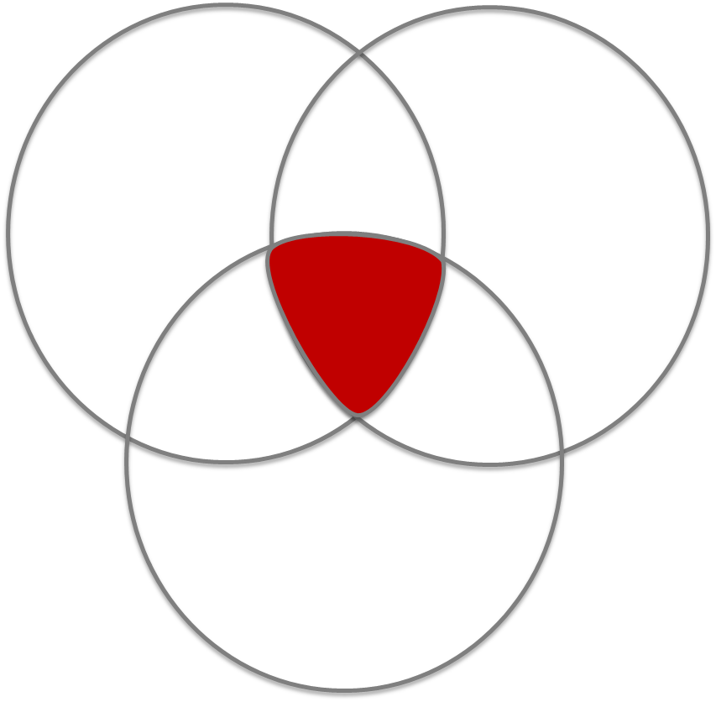
BIY Intern College Essay Journal
Define Design Develop Deliver
Outline / Storyboard
Break your essay into simple parts.
Introduction statement. (dramatic dream, vision, imagination)
Features and benefits. Accomplishments / supporting facts
Call to action.
Site map example
Home
Statement
Benefits
Art
Sports
Robots
Call to Action
Build-It-Yourself

Slide 9
BIY Intern College Essay Journal
Define Design Develop Deliver
Set a strategy:
What skill set do you need to demonstrate your commitment to reaching your goals?
How can you start developing your skill set at Build-It-Yourself?
Project management
Every project at BIY follows a 4D project management process.
Communication
BIY interns are invited to present projects at international education conferences and to partners.
Teamwork
BIY interns are invited to join development teams that use professional workflow tools like GitHub and MS Project
Mechanical engineering
BIY interns are invited to teach robotics projects.
Graphic and multimedia design
BIY interns are encouraged to learn GIMP, 3D Blender, Audacity and join content development teams.
Computer science
BIY interns may join the Invention Universe development team and become fluent in HTML, CSS, JavaScript, React, AWS
serverless database design
Consider how broad and how deep you want to develop your skill set.
“It takes 10,000 hours to get really good at something.”
Build-It-Yourself

Slide 10
BIY Intern College Essay Journal
Define Design Develop Deliver
Tell a good story:
You may like to present your goals and accomplishments
in the context of a story.
Attributes of a compelling story:
Unique, memorable, thought-provoking.
Humor, drama, irony.
Short and to the point.
Something big, especially that benefits others.
Relevant.
Full of passion.
Tricks writers use:
Start with a dramatic statement.
The power of three.
Ask for the reader to take an action.
Backup the qualities you are presenting with accomplishments and facts.
Tell the reader you know about their hot buttons.
Build-It-Yourself

Slide 11
BIY Intern College Essay Journal
Define Design Develop Deliver
Submit College Application Documents:
Follow application instructions. Not always as easy as it sounds!
You may like to format your college essay for your personal website or your Invention Universe planet. Some colleges, like Emmerson, invite you to submit a website, video, or multimedia piece. This can be much more fun than writing an essay.
Follow up. Your recommendations, interview and essay should be consistent. They should all reinforce 2-4 key points or reasons why you will be a distinguished alumnus / alumna
Build-It-Yourself

