Slide 1
Build-It-Blocks
The Problem
Building complex, satisfying solutions to BIY missions can take more than 8 hours, the time we have in a typical workshop series.
It is difficult for teachers to address individual student needs when the class size is 10 or more.
The Mission
Develop a library of functional modules that stimulate ideas for problem solving.
Enable kids to build complex solutions in less than 8 hours.
Reinforce the process and value of modular construction.
Give the teacher a resource that will free up time to work with individual kids
Build-It-Blocks modules have been developed for robotics, computer programming, Minecraft, art and music projects

Slide 2
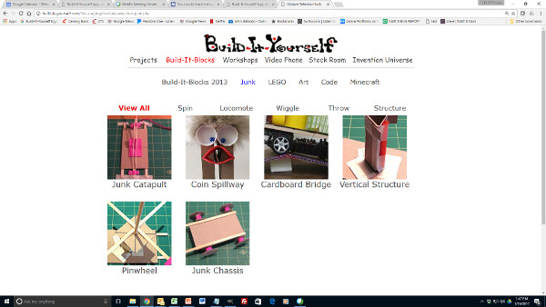
Build-It-Blocks
The Strategy
Find it – A database index should enable kids to scan icons/descriptions and quickly find functional modules that could be useful in a particular solution.

Slide 3
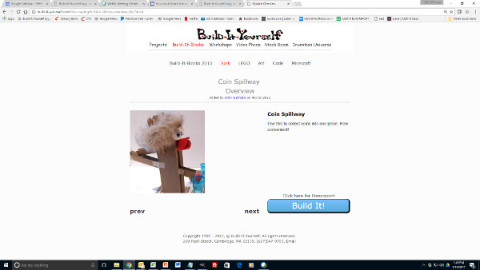
Build-It-Blocks
The Strategy
Find it – A database index should enable kids to scan icons/descriptions and quickly find functional modules that could be useful in a particular solution.
Love it – Applications of the module should inspire exciting ideas.

Slide 4
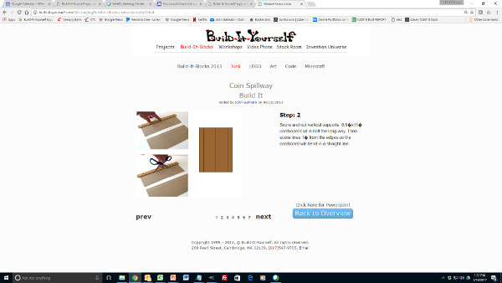
Build-It-Blocks
The Strategy
Find it – A database index should enable kids to scan icons/descriptions and quickly find functional modules that could be useful in a particular solution.
Love it – Applications of the module should inspire exciting ideas.
Build it – Step by step instruction should enable kids to build a module in 15 – 30 minutes.

Slide 5
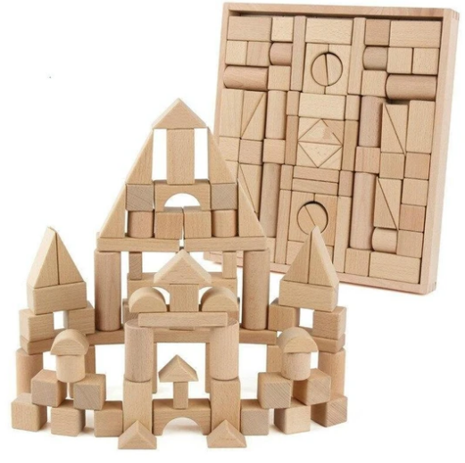
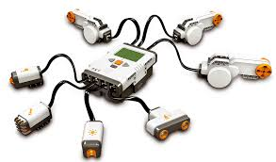
Build-It-Blocks
Attributes of a well-designed module:
Made from accessible materials
Uses materials in clever ways
Rugged (can be dropped from a table)
Integrates with other modules
Easy to edit
Has multiple uses in playful projects
B-I-B
Build-It-Yourself.com

Slide 6
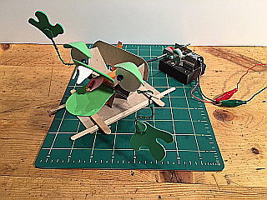
Build-It-Blocks
Puppet Mouth Open Close
Video Link
Build-It-Yourself.com

Slide 7
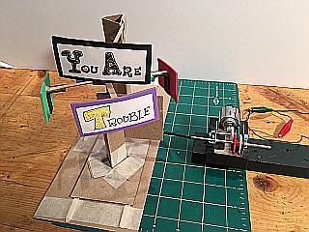
Build-It-Blocks
Horizontal to Vertical Rotation Translation
Video Link
Build-It-Yourself.com

Slide 8
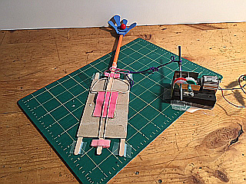
Build-It-Blocks
Catapult
Video Link
Build-It-Yourself.com

Slide 9
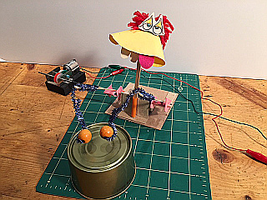
Build-It-Blocks
Drummer
Video Link
Build-It-Yourself.com

Slide 10
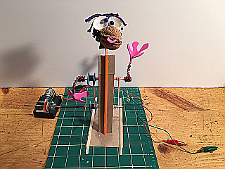
Build-It-Blocks
Vertical Rotation Translation
Video Link
Build-It-Yourself.com

Slide 11
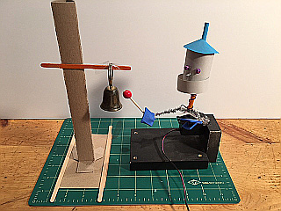
Build-It-Blocks
Bell Ringer
Build-It-Yourself.com

