Slide 1
Wanted: Funky Artists and Engineers
Programmers Evolve Invention Universe
Business Directors Lead rapid growth (full time ASAP)
Technical Directors Project manage our online app development (Part time => full time)
Product Managers Develop Aduino construction system developer (Part time => full time)
Content Developers Develop multimedia content (Part time => full time)
TAs Mentor online (Part time)

Slide 2
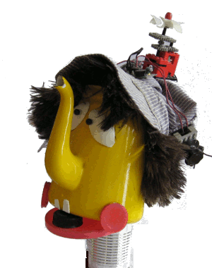
Team
Michael
CS MIT
Lucian
CS MIT
Ari
CS Toronto
Xinxin
CS Georgia Tech
Liu Huan
Jaime McKiernan
Steve Su Yao
Julian Hernandez
Michael Lu
Lucian Covarrubias
Will Chou
Yilin Lu
Mariana Barradas
Michael Choi
Ari Casas
Wisdom Chimezie
Xinxin Li
Notes:
Goal: Get to know the interests of our audience.
Tell the story of how we got to BIY.
Ask questions that speak to audience interests.
I’m John, Chief Builder and Build-It-Yourself. I’m an electrical engineer out of Cornell. BIY is a dream come true for me. I get to make money building toys with a way cool group of builders from all over the world.

Slide 3
Agenda
Intro to Build-It-Yourself
Intro to Invention Universe
Front End
Back End
Development Focus
Wish List

Slide 4
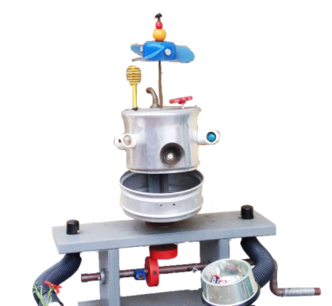
What does Build-It-Yourself do?
Inspire and guide kids to be creative builders.

Slide 5
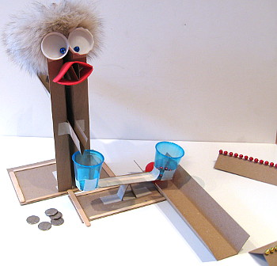
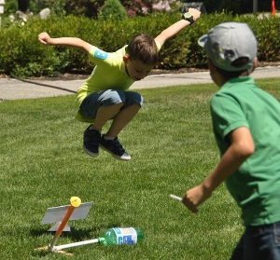
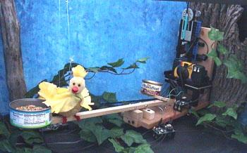
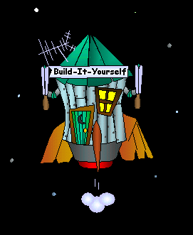
Content
Notes:
Our storylines lead to projects that build confidence, exercise practical skills, and drive creativity.

Slide 6
Online Platform
Content
Network of TAs
Build-It-Blocks
Invention Universe
Customer Engagement
Content
Network of TAs
Build-It-
Blocks
Invention Universe
Infrastructure
Notes:
Our unique global laboratory for young builders has 4 pillars.
These pillars are basic elements of Interactive TV of the future.

Slide 7
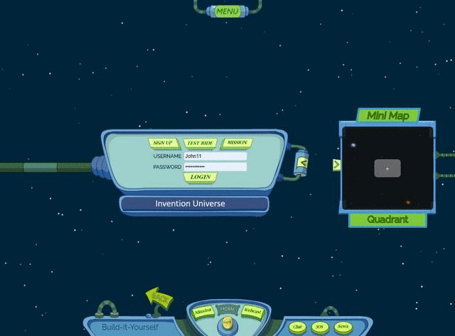
Invention Universe (LinkedIn for kids)
Kids 8 – 13
Computer Game (Spore)
Social Media (LinkedIn)
Content Channel (Pintrest)
Notes:
LinkedIn for Kids …
Invention Universe is a game-like social media site where kids have strong incentives to show off their portfolio of projects to the world.

Slide 8
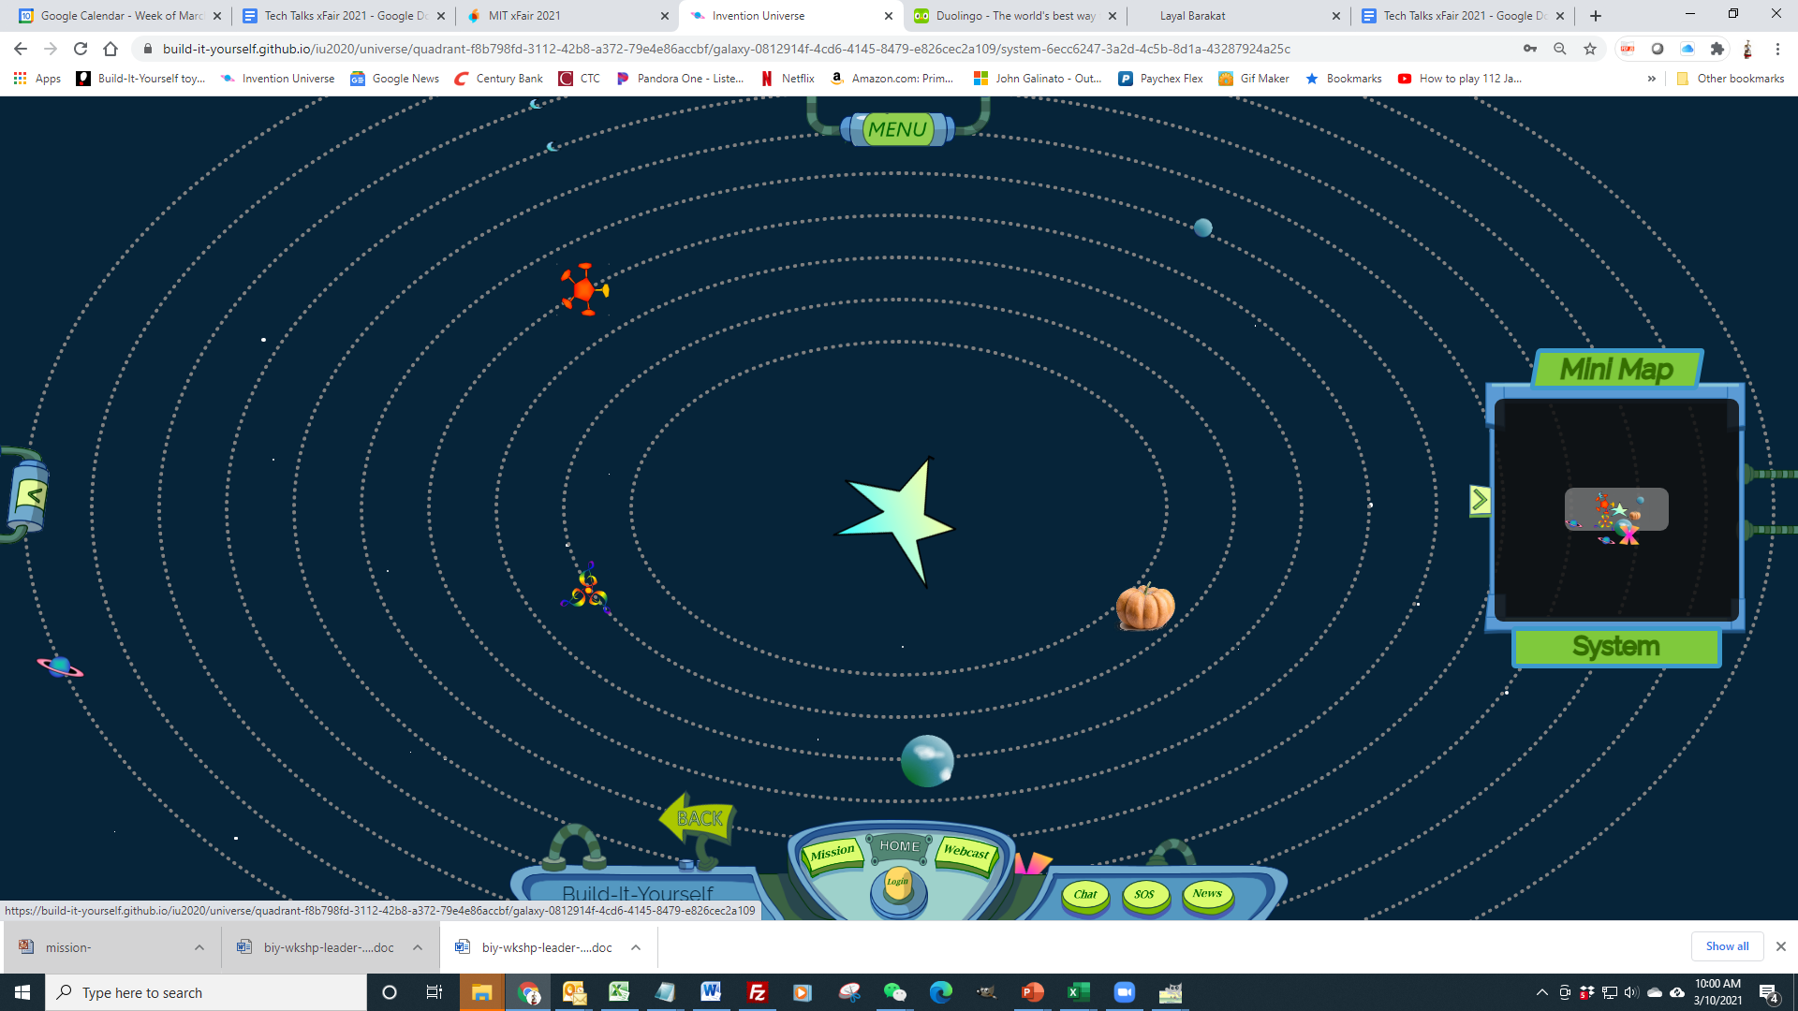
Invention Universe (LinkedIn for kids)
Notes:
Invention Universe is a game-like social media site where kids have strong incentives to show off their portfolio of projects to the world.

Slide 9
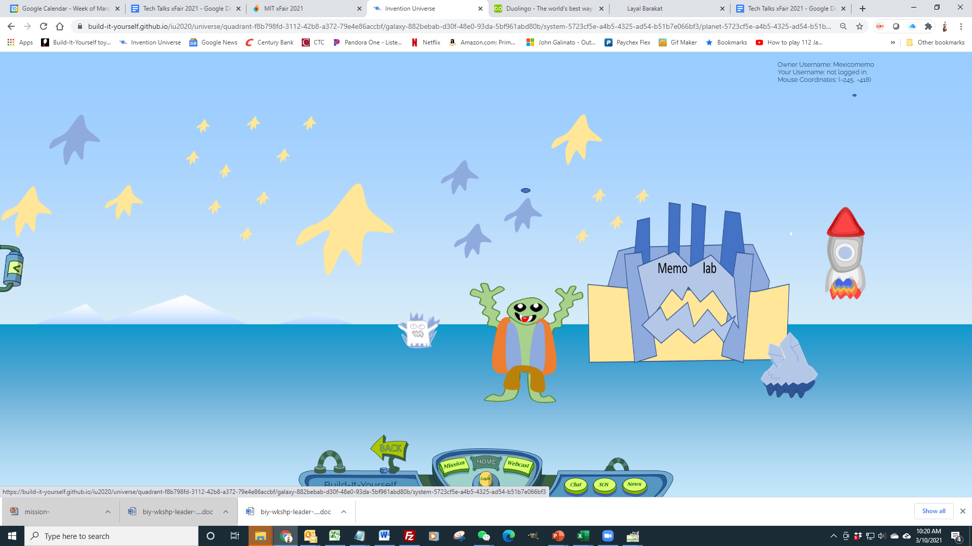
Invention Universe
Notes:
Invention Universe is a game-like social media site where kids have strong incentives to show off their portfolio of projects to the world.

Slide 10
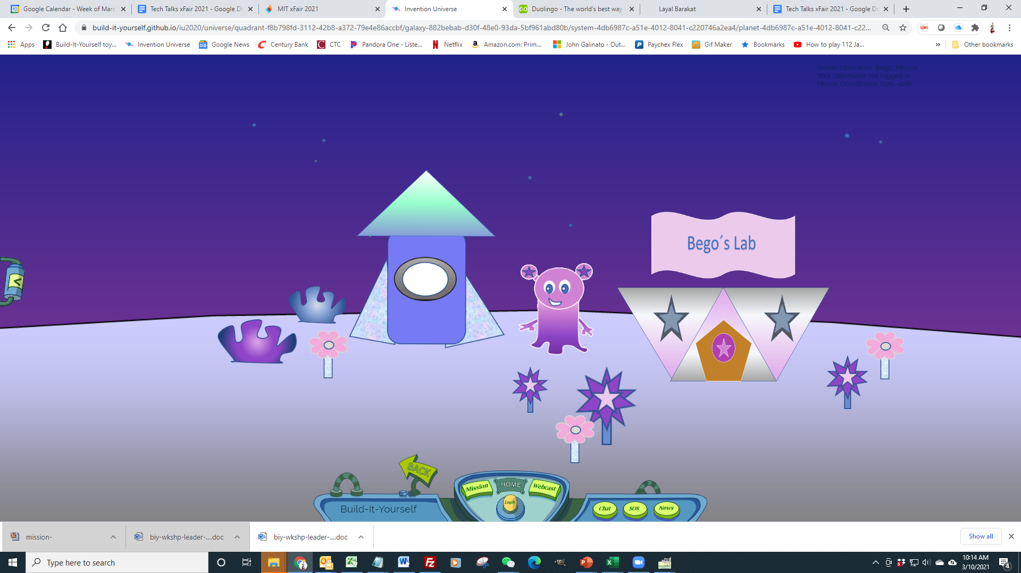
Invention Universe
Notes:
Invention Universe is a game-like social media site where kids have strong incentives to show off their portfolio of projects to the world.

Slide 11
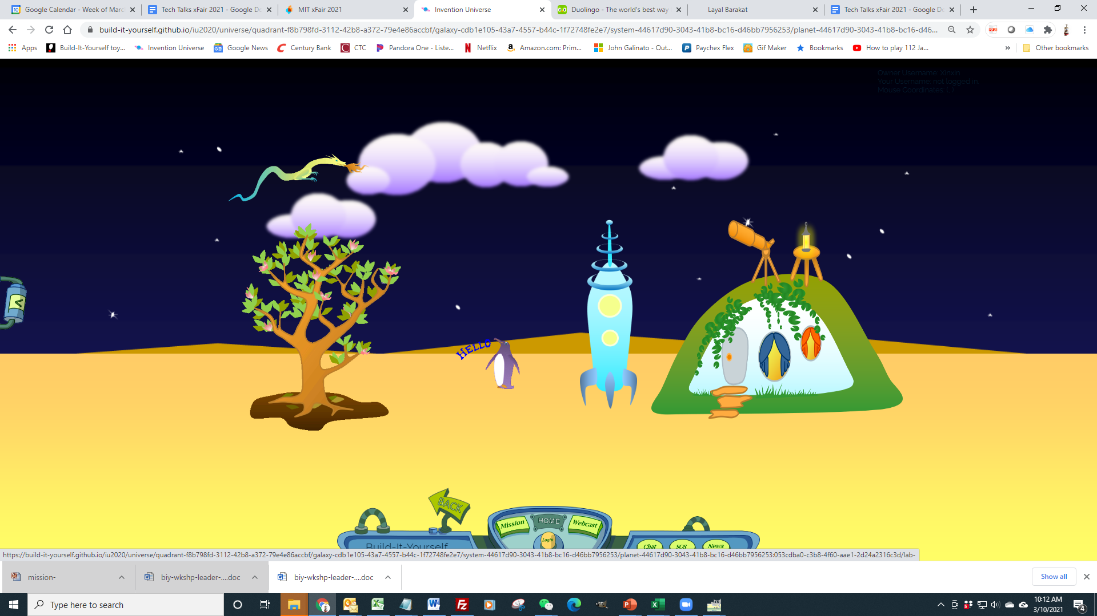
Invention Universe
Notes:
Invention Universe is a game-like social media site where kids have strong incentives to show off their portfolio of projects to the world.

Slide 12
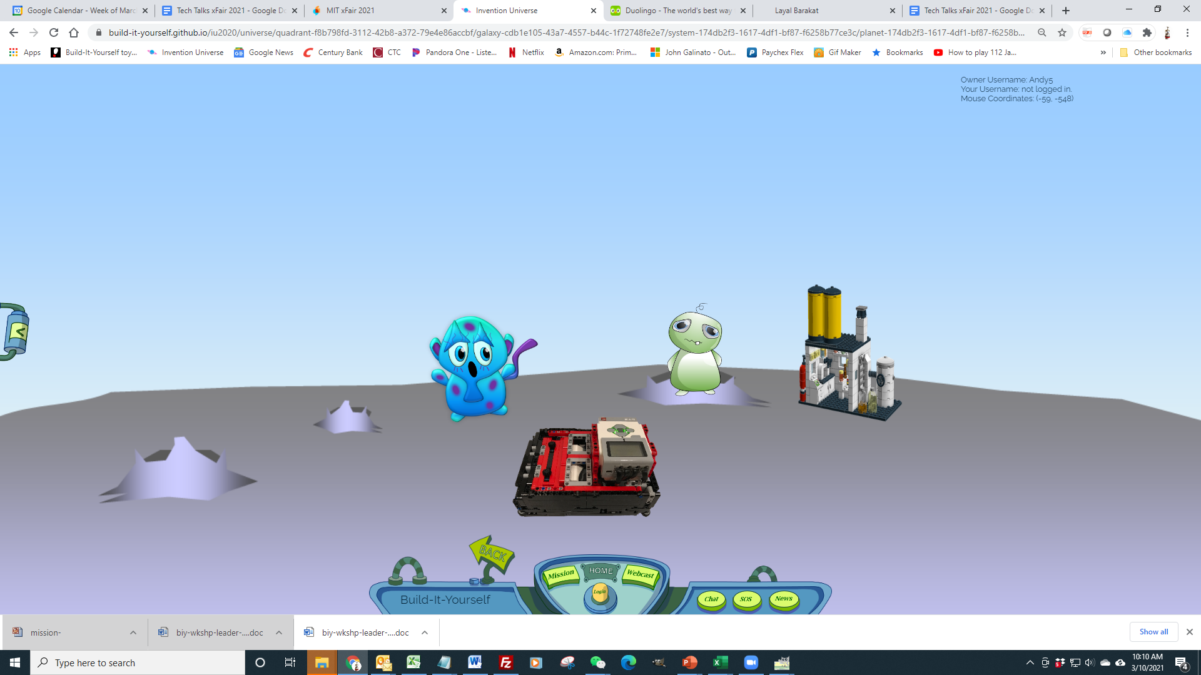
Invention Universe
john@build-it-yourself.com
Notes:
Invention Universe is a game-like social media site where kids have strong incentives to show off their portfolio of projects to the world.

Slide 13
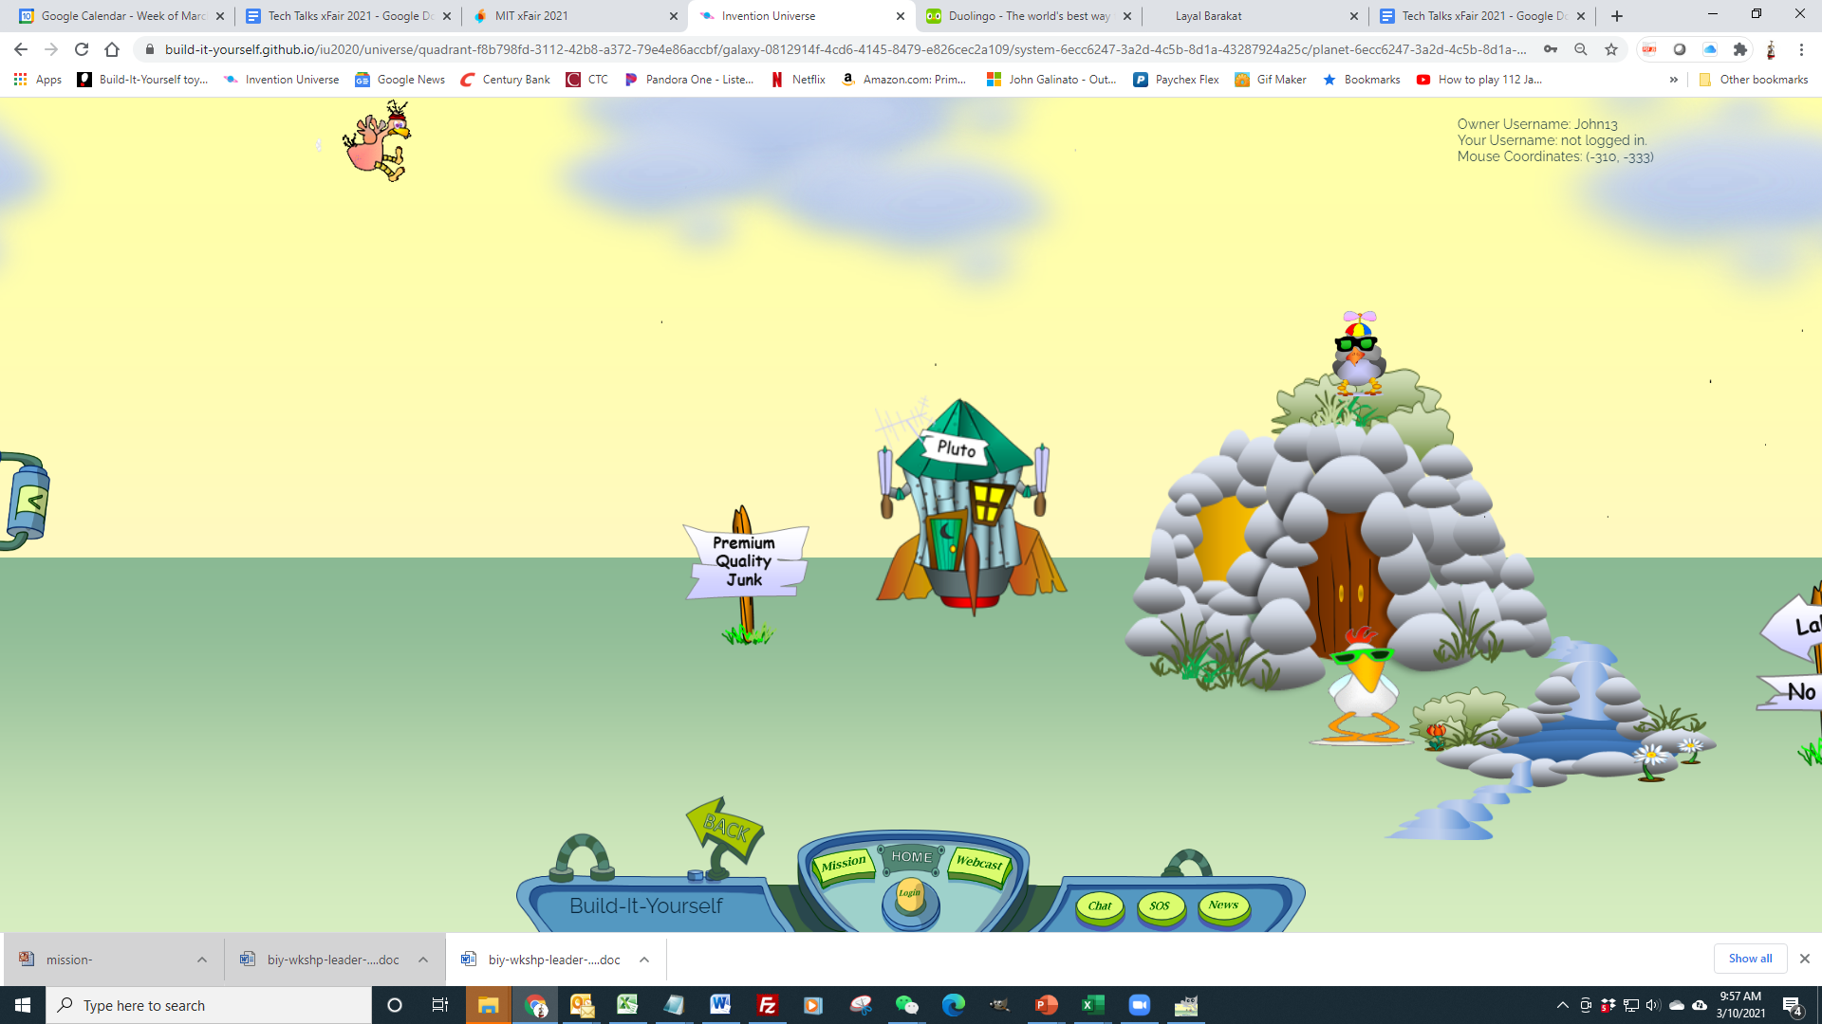
Invention Universe
Notes:
Invention Universe is a game-like social media site where kids have strong incentives to show off their portfolio of projects to the world.

Slide 14
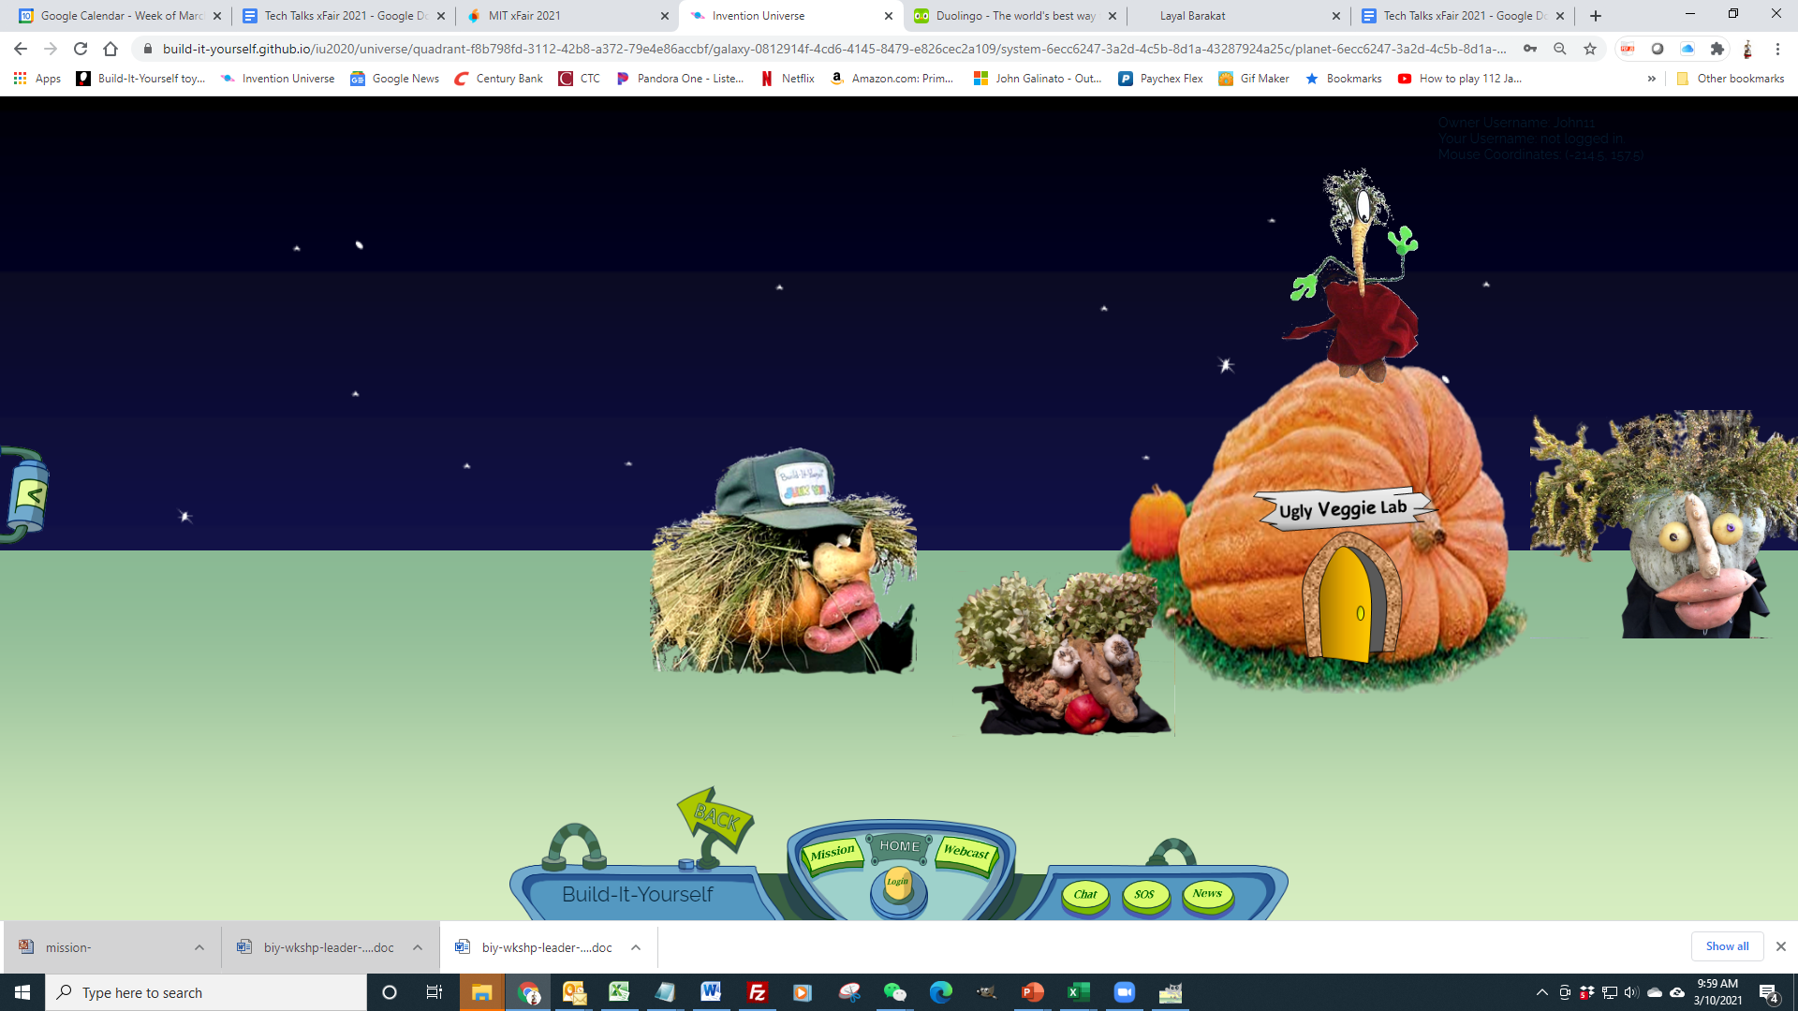
Invention Universe
Notes:
Invention Universe is a game-like social media site where kids have strong incentives to show off their portfolio of projects to the world.

Slide 15
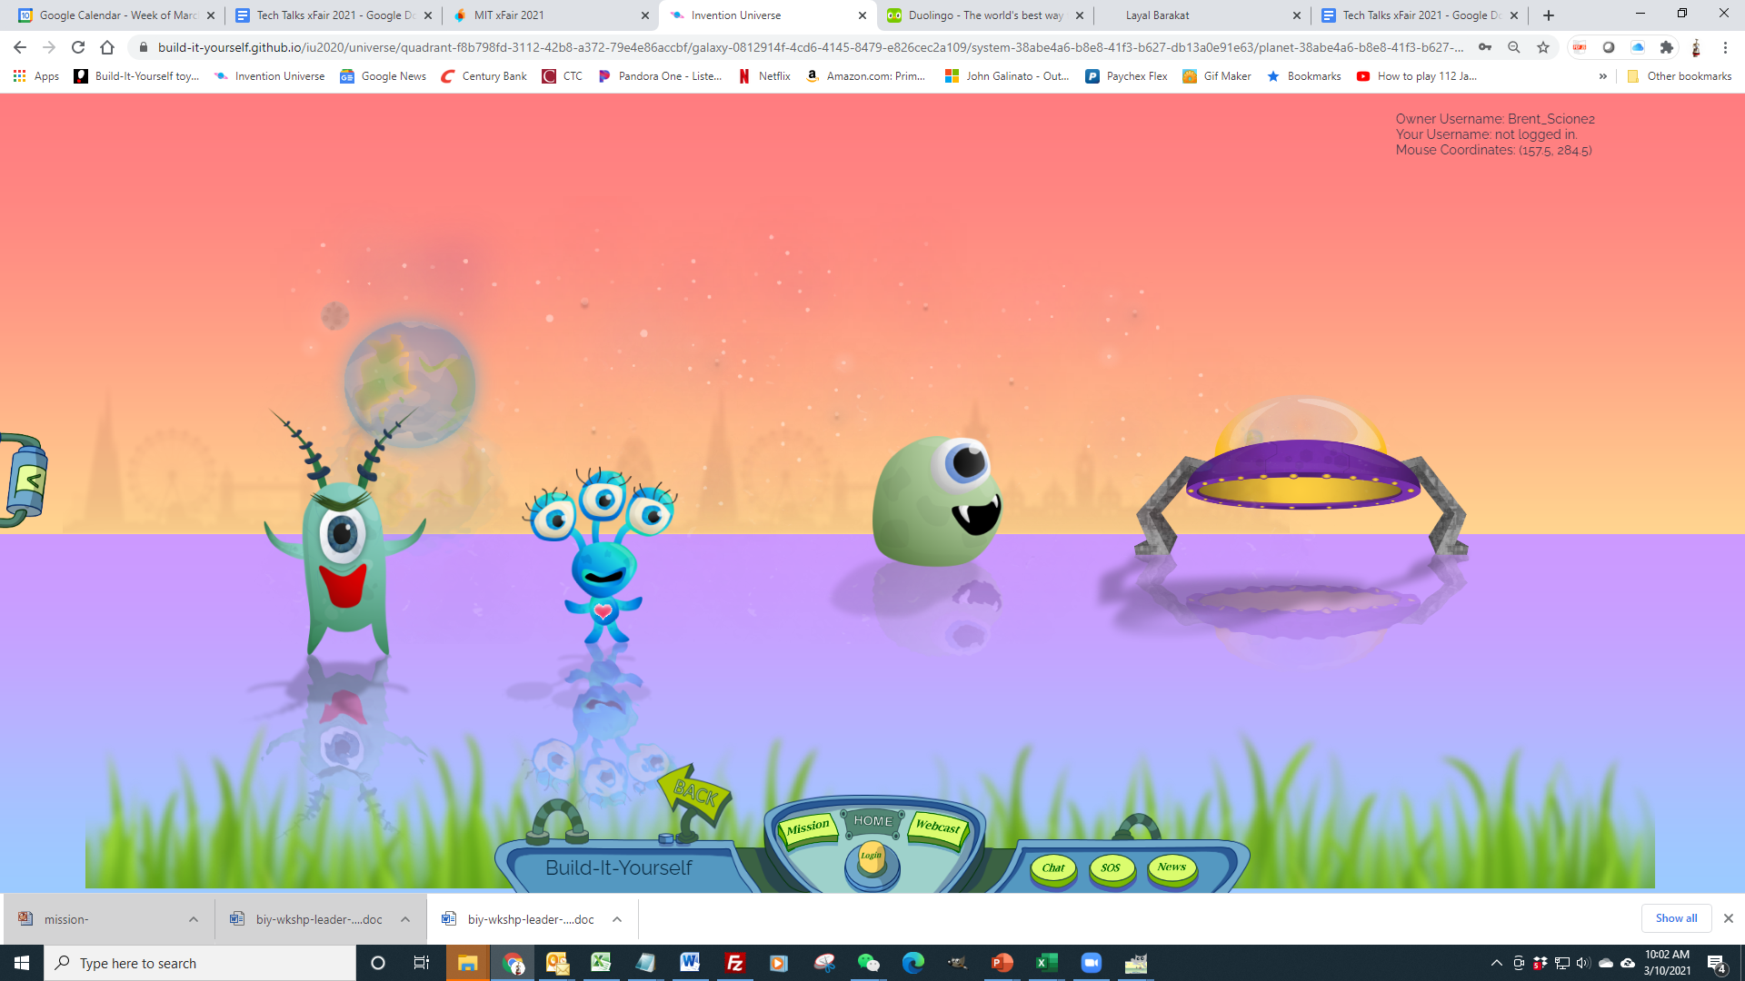
Invention Universe
Notes:
Invention Universe is a game-like social media site where kids have strong incentives to show off their portfolio of projects to the world.

Slide 16
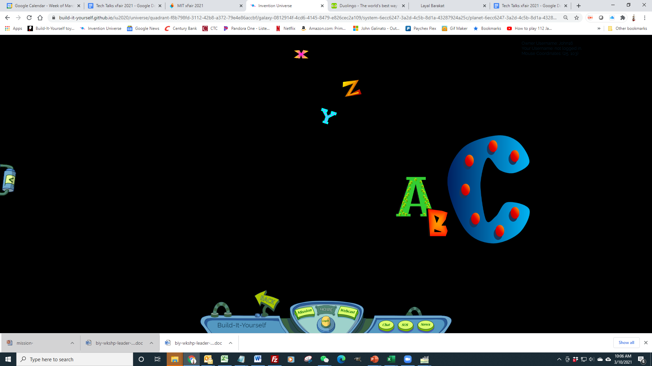
Invention Universe
Notes:
Invention Universe is a game-like social media site where kids have strong incentives to show off their portfolio of projects to the world.

Slide 17
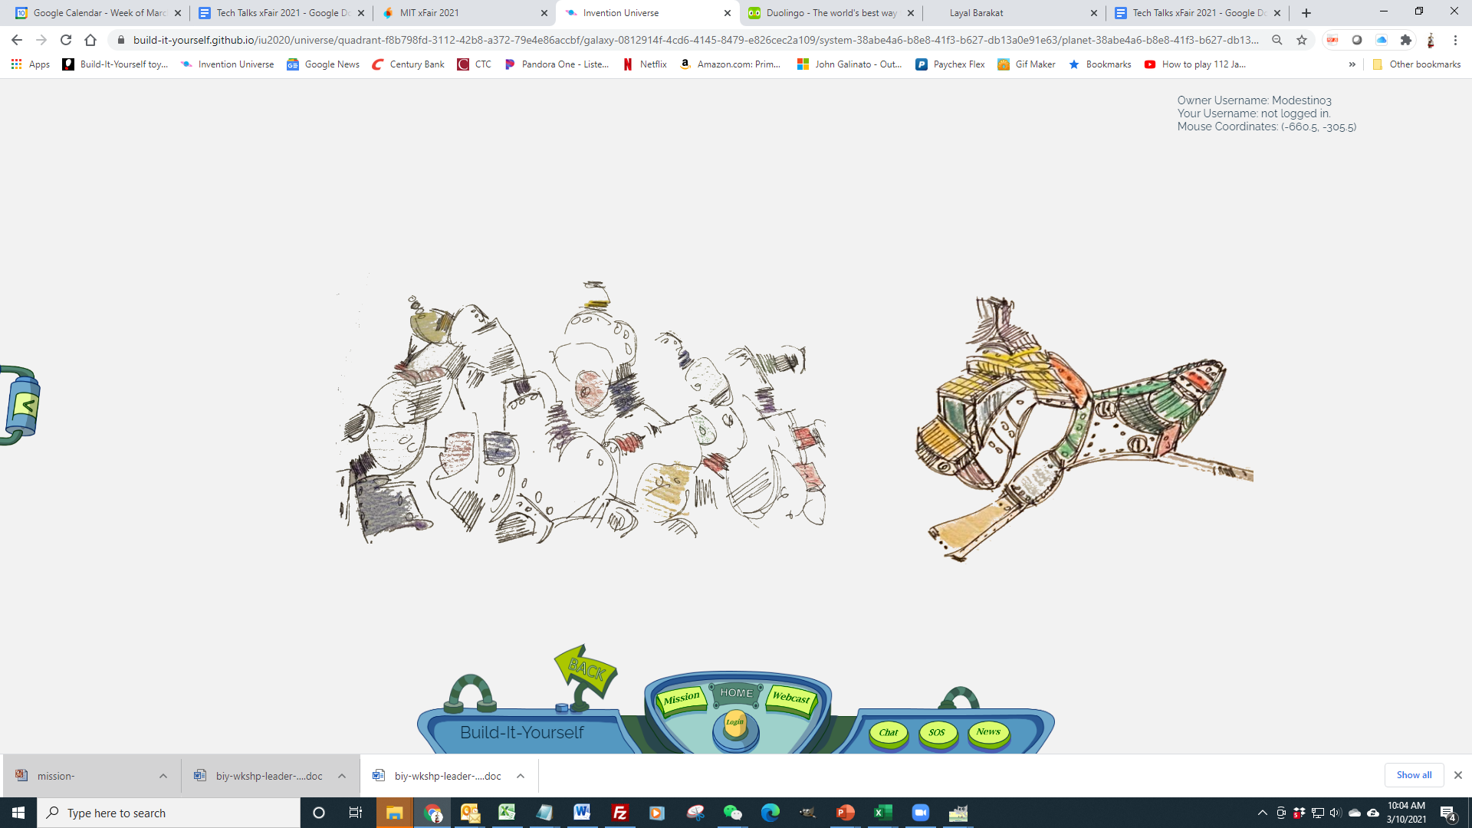
Invention Universe
Notes:
Invention Universe is a game-like social media site where kids have strong incentives to show off their portfolio of projects to the world.

Slide 18
Invention Universe
Notes:
Invention Universe is a game-like social media site where kids have strong incentives to show off their portfolio of projects to the world.

Slide 19
Invention Universe (LinkedIn for kids)
Development Focus:
Gamify Like Duolingo
Have Fun, Engage.
Learn valuable skills.
Sell in a hot $455B market.
Socialize Like Duolingo MAX
Have Fun, Engage.
Develop communication skills with humans.
Develop communication skills with AI.
AI
Teach kids to use AI wisely.
Enable custom learning. Khanmigo, Duolingo
Minimize COGS.
Get in the traffic.
Post Portfolio Pintrest
Admin Panel
Monitor usage Netflix
Manage db
Notes:
Can AI be used to make interesting game-like conversation?
Doulingo MAX
Carpet Salesman - negotiate rug cost.
Nvidia announced ACE
Notes:
Invention Universe is like LinkedIn for kids.
Invention Universe is a game-like social media site where kids have strong incentives to show off their portfolio of projects to the world.

Slide 20
IU Wish List Big Picture Jan 2022
Goals and admin panel should drive functionality
Add custom sound effects
Gamify - Add Scratch mini games and cartoons
Expand symbol library
Add points system
Integrate all kids web pages
Add formal PDF printout
Enable multiple rocket and lab view skins
Enable private server, branded IUs.
Meet privacy regs.
Add Hall of fame
Enable simple planet GPS coordinates
Add rocket view transition animation
Evolve Admin Panel to manage and monitor IU usage
Add AI Chat Avatars and Helpers.

