Slide 1
Cartoon Story Lab Book
By ÍIan

Slide 2
Problem
Drill Man Titan can’t find his allies because they were kidnapped by the Skibidi toilets out of the planet Earth and they were taken to planet X.
Mission
The Drill Man Titan has to travel across the Milky Way Galaxy in order to find them and defeat the skibidi toilets.

Slide 3
Story Parts
When?
Who?
WHERE?
What?

Slide 4
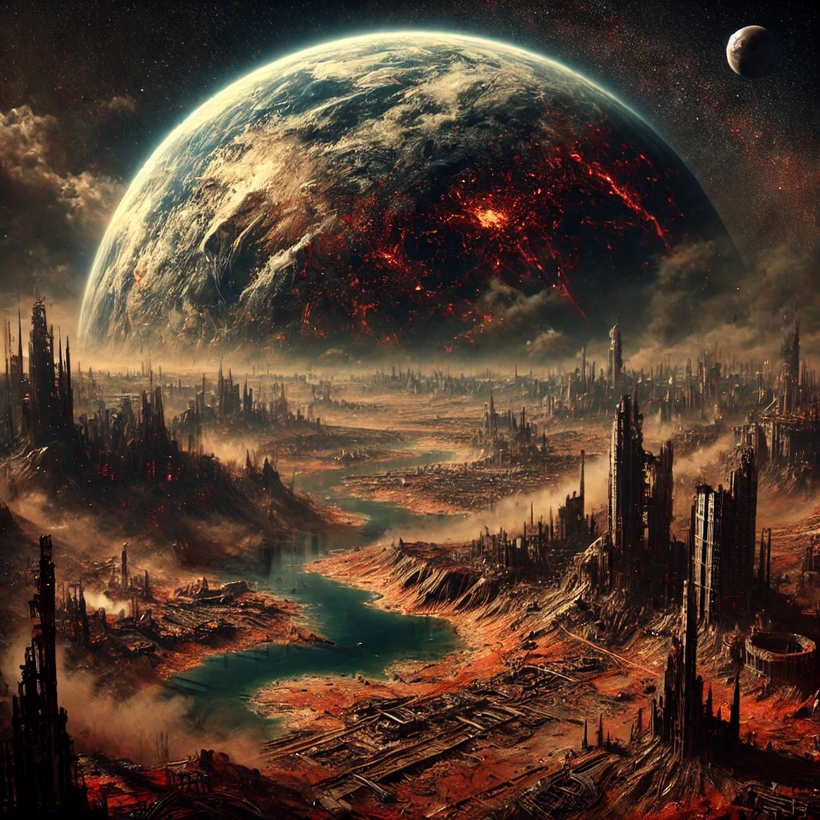
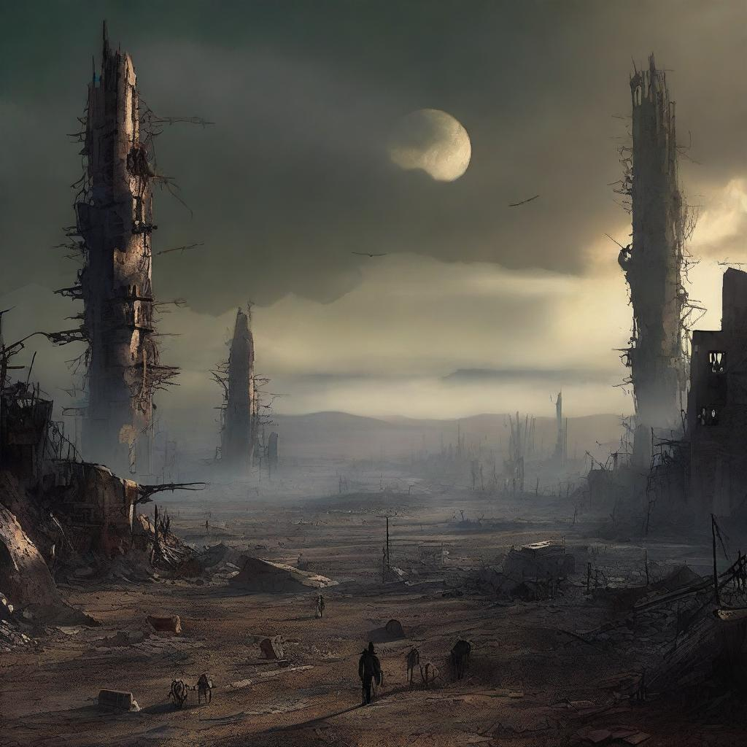
When?
3000 years in the future, after the first mankind extinction

Slide 5
Where?
On Planet Earth and Planet X.

Slide 6
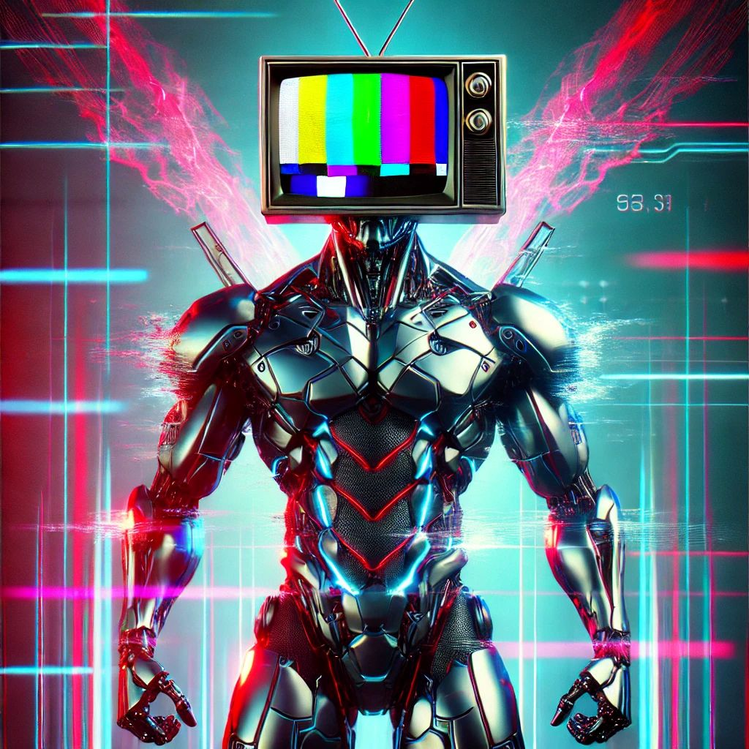
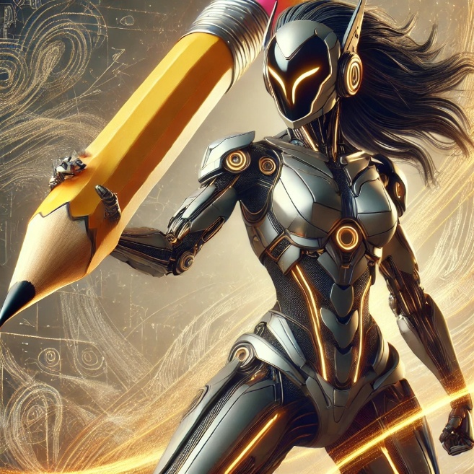
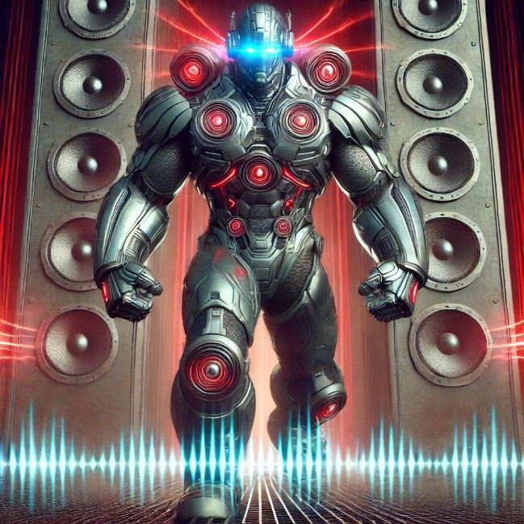
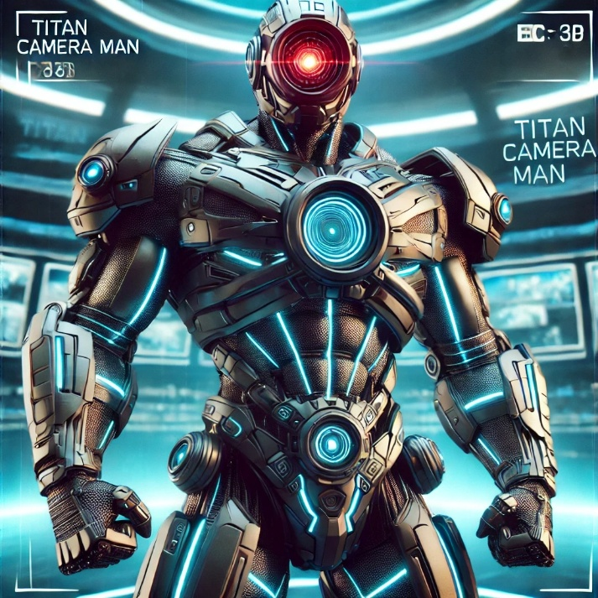
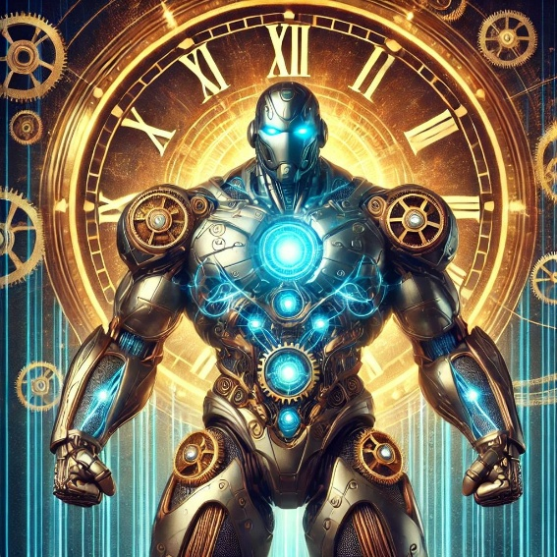
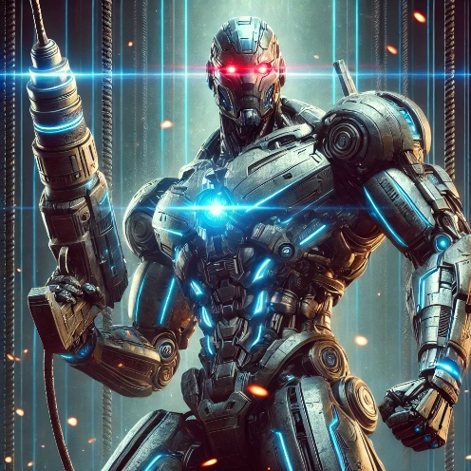
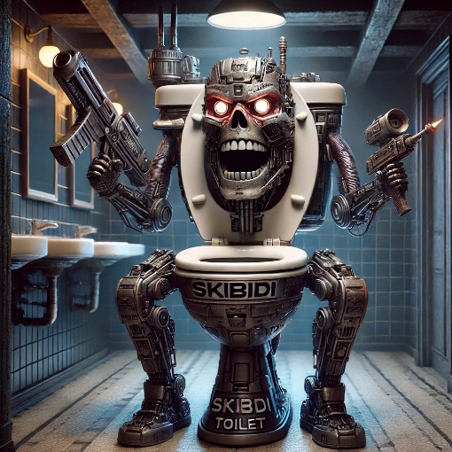
Who?
The Titan’s machines: Speaker man Titan, Camera man Titan, TV man Titan, Pencil woman Titan and Clock man Titan and a skibidi toilet.

Slide 7
What?
The Skibidi toilet kidnapped The Drill man Titan’s allies: The Speaker man Titan, The Camera man Titan, The TV man Titan, The Pencil woman Titan and The Clock man Titan; and took them to Planet X. So The Drill man has to travel across the Galaxy in order to find them and defeat the Skibidi toilet before he destroy the world.

Slide 8
CHARACTERS

Slide 9
Titan Clock Man – The Master of Time
Meet Titan Clock Man, the giant robot who controls time itself! 🕰🚀 With a massive clock on his chest and glowing gears all over his body, he can slow down, speed up, or even stop time in the middle of battle! 💥
His Time Punch is so fast that enemies don’t even see it coming! His Clock Shield can block any attack by rewinding damage! 🔄🛡 And when he uses his ULTIMATE ATTACK: THE TIME FREEZE, everything around him stops, and he takes down all his enemies in the blink of an eye! 😱⚡
Titan Clock Man is more than just a fighter—he’s the guardian of time! Whether he's helping his Titan friends or freezing Skibidi Toilets in their tracks, one thing is certain… time is on his side! 🔥🚀

Slide 10
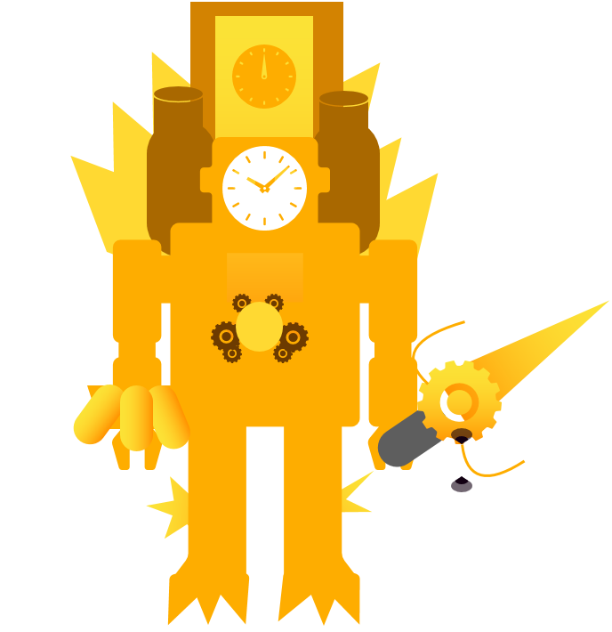
Made by Ían Pale
Made by AI

Slide 11
Titan Drill Man The – Ultimate Drilling Machine
In a top-secret robot lab (probably in an underground volcano), the greatest invention of all time was created—Titan Drill Man! Built from the toughest titanium and powered by glowing blue energy, this unstoppable hero has one job: to drill through anything that stands in his way!
With his mega drill arm spinning at super speed, he can smash through walls, break through enemy defenses, and even dig the ultimate secret base! His red glowing eyes scan for action, and his battle-worn armor proves he’s faced some of the toughest challenges in the world.
When Titan Drill Man stomps onto the scene, the ground shakes, sparks fly, and villains know they’re in BIG trouble. He’s fast, strong, and (probably) really good at making giant tunnels. If there’s an obstacle in his path, he’s not stopping—he’s drilling right through it!

Slide 12
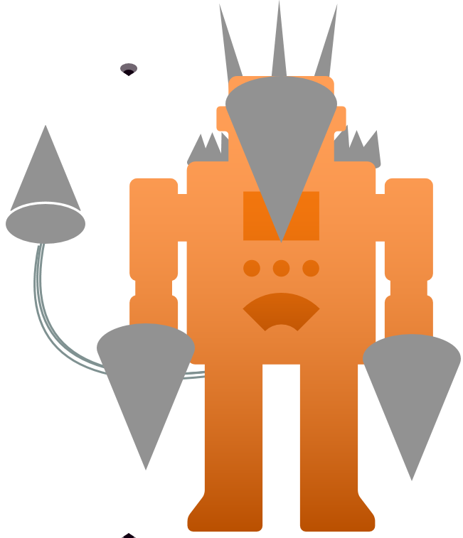
Made by Ían Pale
Made by AI

Slide 13
Titan TV Man – The Ultimate Broadcast Warrior! 📺⚡
Get ready for Titan TV Man, the gigantic robot hero who brings the action to the battlefield! 🚀💥 With a massive TV screen for a head, he can broadcast messages, control technology, and even hypnotize enemies! 📡😱
His Channel Blast sends out powerful energy waves that knock enemies off their feet! ⚡📺 His Static Shield surrounds him with electric TV signals that block attacks! 🛡️🔌 And when he uses his ULTIMATE ATTACK: THE SIGNAL STORM, he hacks every enemy, making them glitch and freeze in place! 🎮❄️
Titan TV Man is always in control of the action! Whether he’s leading the Titans, shutting down Skibidi Toilets, or showing the greatest battle highlights, one thing is certain… he’s always on air and ready to win! 📺🔥🚀

Slide 14
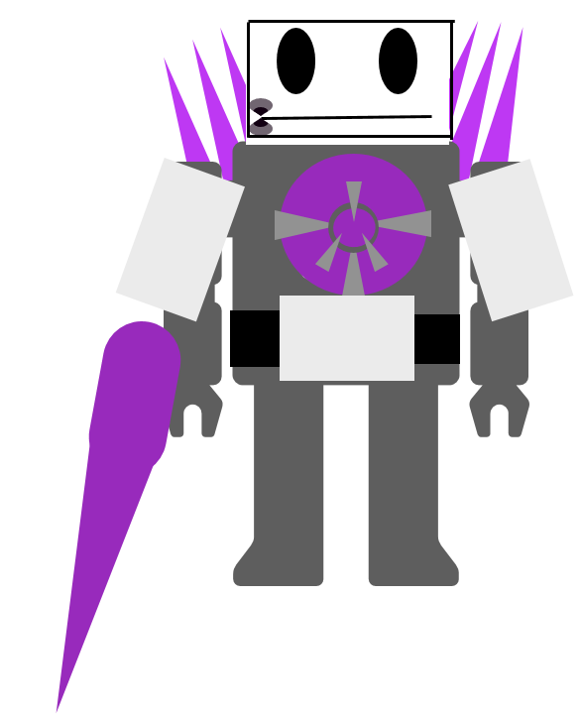
Made by Ían Pale
Made by AI

Slide 15
Titan Camera Man – The Ultimate Watcher! 📸⚡
Introducing Titan Camera Man, the super-sized robot hero with the most powerful camera in the universe! 🎥🚀 With a giant camera for a head and glowing lenses on his body, nothing escapes his sight! He sees EVERYTHING, even in total darkness! 👀🔦
His Flash Blast blinds enemies with a burst of super bright light! ⚡💥 His Zoom Strike lets him lock onto bad guys and blast them with pinpoint accuracy! 🎯 And when he activates his ULTIMATE ATTACK: THE SNAPSHOT FREEZE, he takes a photo so powerful that it freezes enemies in place! 📷❄️
Titan Camera Man is the protector of the battlefield, always watching, always ready! Whether he’s capturing victory or defeating Skibidi Toilets in high definition, one thing is for sure… he’s always in focus! 📸🔥🚀

Slide 16
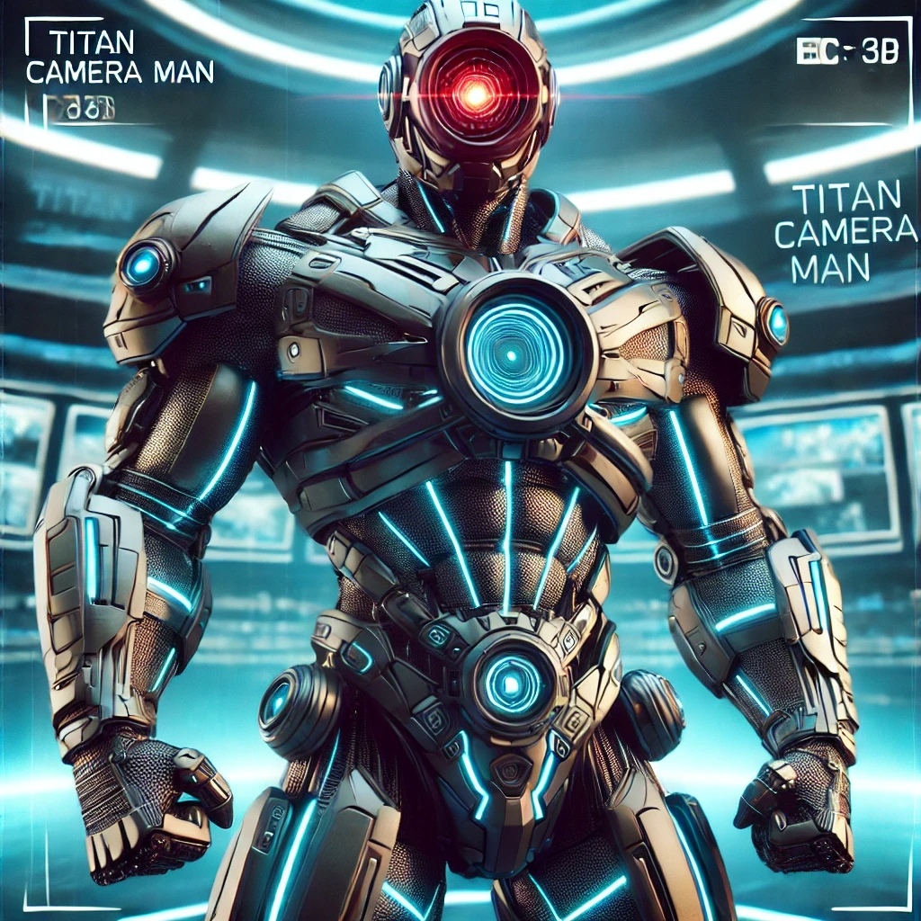
Made by Ían Pale
Made by AI

Slide 17
Titan Speaker Man – The Ultimate Sound Warrior! 🎵🔊
Get ready to meet Titan Speaker Man, the biggest, loudest, and coolest robot EVER! 🚀💥 This giant metal warrior has huge speakers all over his body, blasting sound so powerful it can knock enemies off their feet! 🎶⚡
With super bass cannons, he can shoot shockwaves that send bad guys flying! His mega stomp makes the ground shake like an earthquake! 🌍💥 And when he uses his ULTIMATE ATTACK: THE MEGA DROP, the whole battlefield explodes with sound! 🎧🔥
Titan Speaker Man isn’t just a fighter—he’s a walking concert of destruction! Whether he’s leading the Titans into battle or blasting beats that shake the sky, one thing is for sure… he’s here to turn up the volume and WIN!

Slide 18
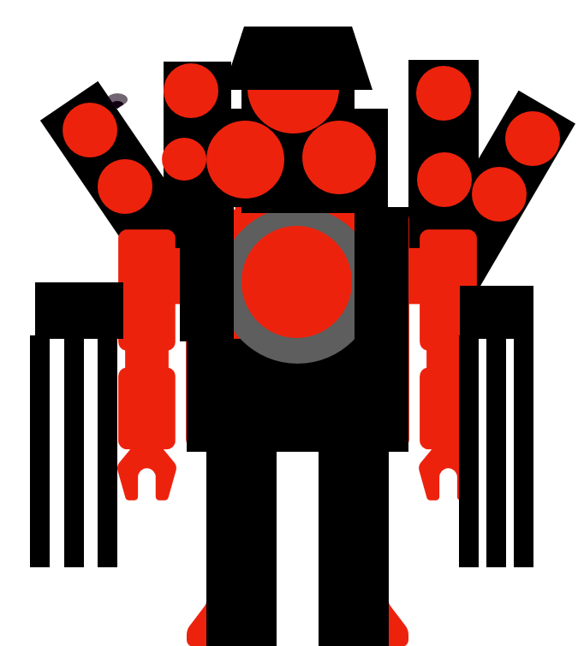
Made by Ían Pale
Made by AI

Slide 19
Titan Pencil Woman – The Ultimate Creator Warrior! ✏️⚡
Meet Titan Pencil Woman, the most creative and powerful Titan of them all! 🚀💥 With a gigantic pencil for an arm, she can draw anything into existence—weapons, shields, even new Titan allies! 🎨✨
Her Sketch Slash turns her pencil into a super-sharp sword that cuts through anything! ⚡✏️ Her Doodle Defense lets her draw shields in midair to block attacks! 🛡️ And when she uses her ULTIMATE ATTACK: THE INK STORM, she draws a giant tornado that sweeps up all her enemies! 🌪️🔥
Titan Pencil Woman is more than just a fighter—she’s an artist of battle! Whether she’s sketching victory or erasing Skibidi Toilets from the battlefield, one thing is for sure… her creativity knows no limits! 🎨🚀⚡

Slide 20
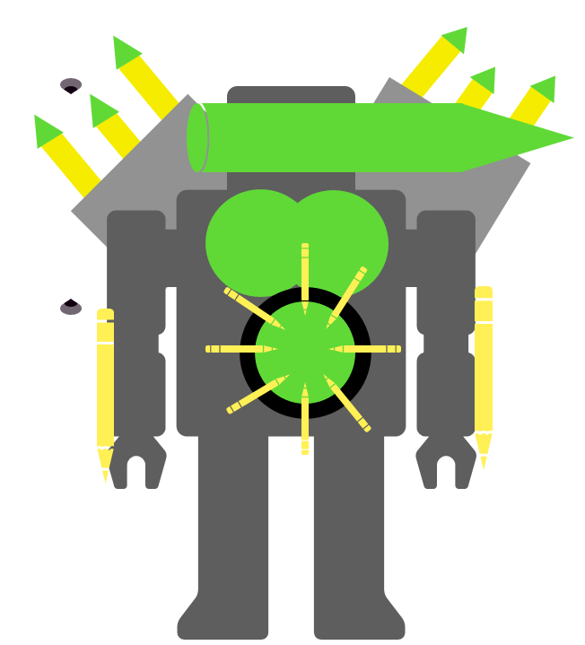
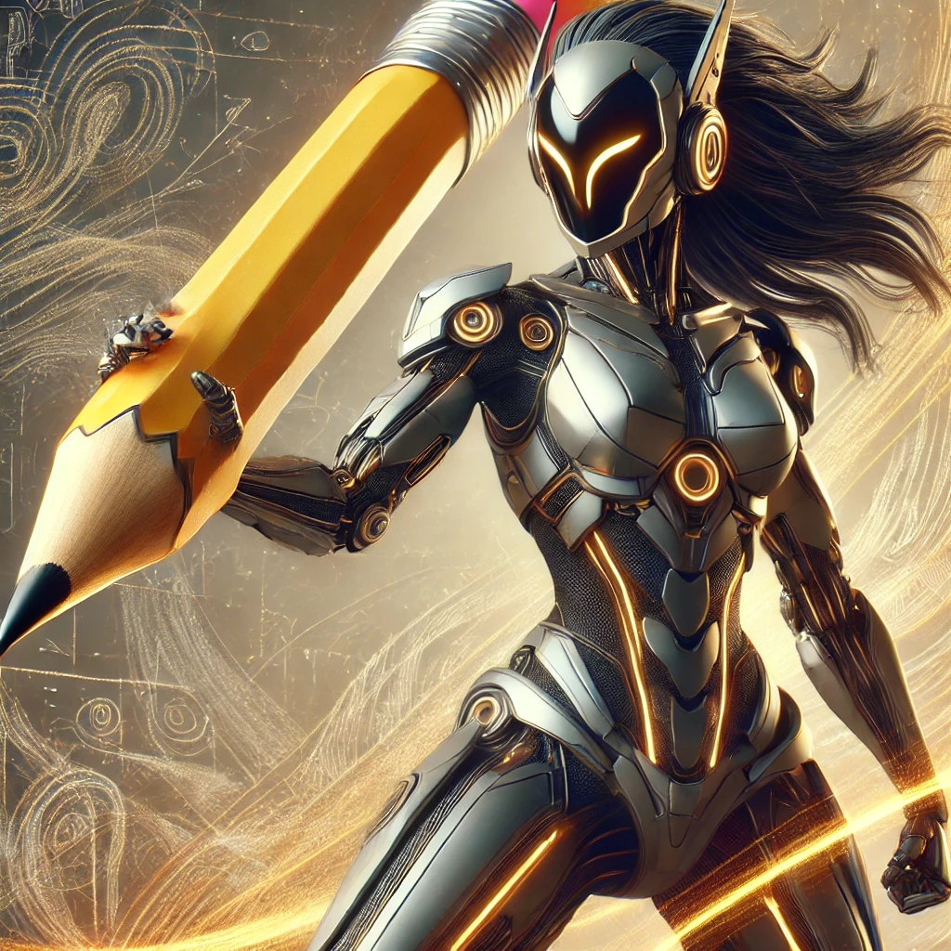
Made by Ían Pale
Made by AI

Slide 21
Skibidi Toilet – The Weirdest Enemy Ever! 🚽👀💥
Beware of the Skibidi Toilet, the craziest and strangest villain in the world! 😱🚽 With a floating human head inside a toilet, these creepy creatures are always up to no good! They laugh in a super creepy way and attack with their flushing powers! 💀💦
Their Toilet Tackle lets them slam into enemies at super speed! 🚀💢 Their Flush Wave sprays out a giant water blast to knock down Titans! 🌊😵 And when they use their ULTIMATE ATTACK: THE SUPER FLUSH, they create a whirlpool that sucks everything in! 🌀🚽💀
Skibidi Toilets may look funny, but they’re dangerous and everywhere! Whether they’re jumping out of nowhere or teaming up in giant armies, one thing is clear… you NEVER want to get caught by one! 😨🚽🔥

Slide 22
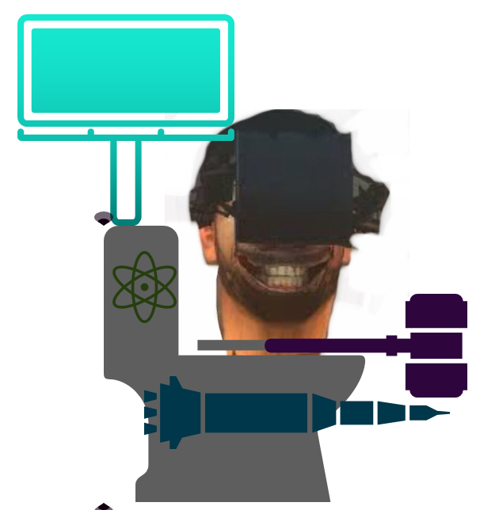
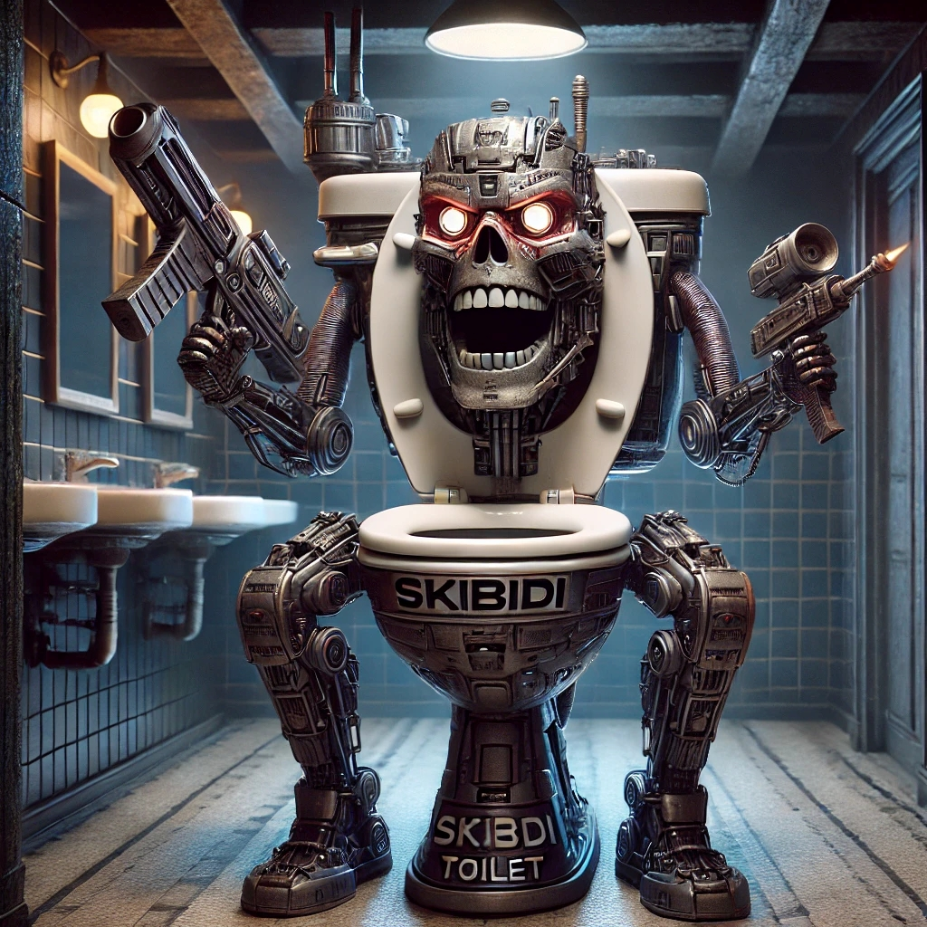
Made by Ían Pale
Made by AI

Slide 23
