Slide 1
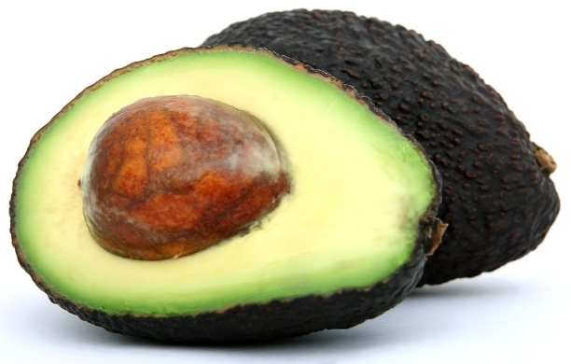
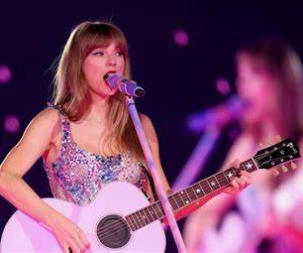
Smart Robot Lab Book
Ella and Eamon

Slide 2
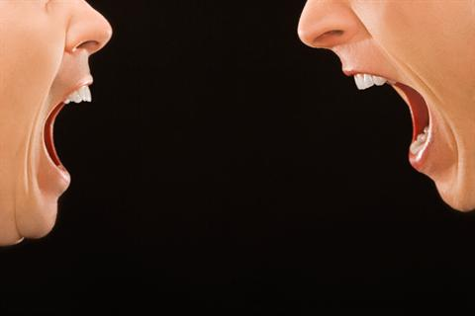
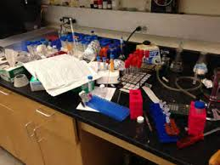
Laws of the Lab
Respect your teammates
Respect the lab
Don’t do dumb stuff
Don’t argue! Don’t be THAT guy!
Don’t leave it looking like this!
(Pretty self explanatory)

Slide 3
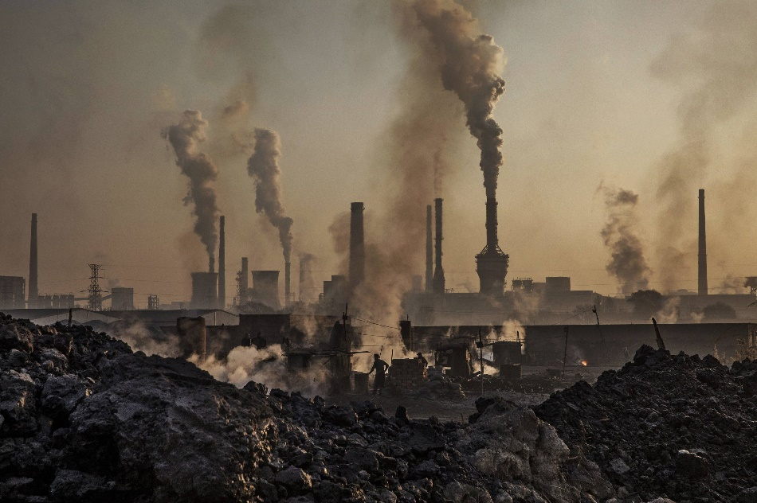
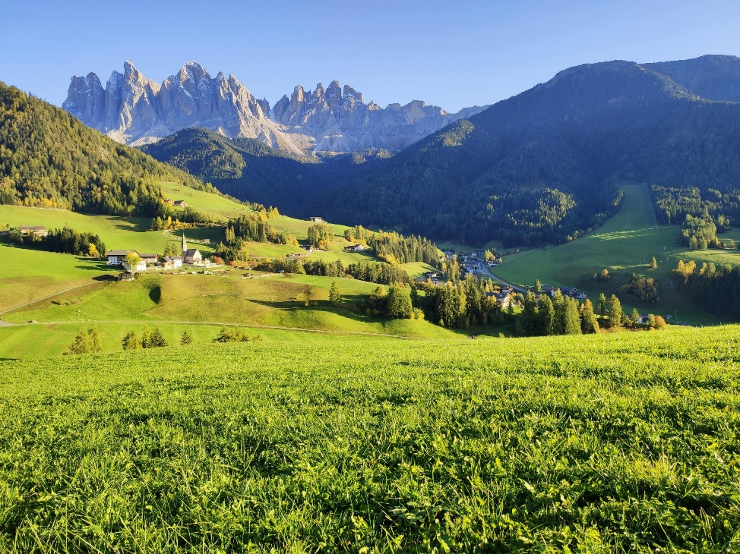
Problem:
Humans are causing too much pollution on the planet.
Mission:
Build smart robots to help clean up the trash and filter the polluted air.

Slide 4
What is a Smart Robot (AI)?
Our Definition: A coded algorithm that when given a command, can preform different actions with the mental capacity and thought process as complex - or more complex - than a human.
Britannica Definition: The ability of a digital computer or computer-controlled robot to perform tasks commonly associated with intelligent beings.
Inputs:
Camera
Touch Screen
Keyboard
Toggle/Joystick
Motion Sensor
Buttons/Pressure Pads
Mouse
Microphone
Smart Robot/AI
(Binary Code)
Outputs:
Screen Display
Speaker
Motor
Game
Information
On and off
Locks/Unlocks
Alarm

Slide 5
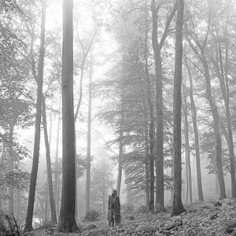
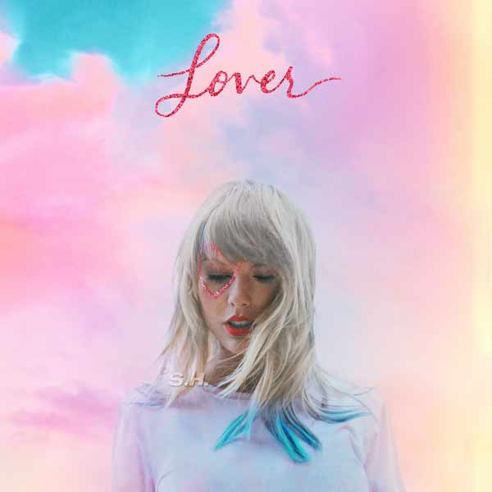
Problem:
People are very depressed and lonely in this world.
Mission:
Build smart robots to make them laugh and turn their frowns upside down!

Slide 6
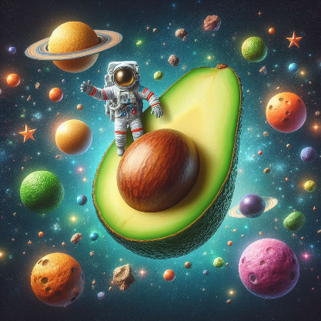
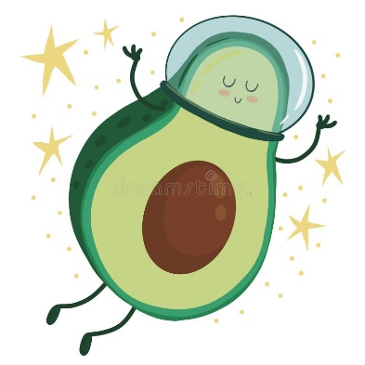
What’s a joke about avocados?
Poem based on the joke:
🌠 Guacstronaut’s Cosmic Ode 🌠
In the salsa-soaked silence of space, Where tortilla stars twirl and embrace, A brave guacamole, Guacstronaut by name, Embarked on a quest, fueled by lime and fame.
Its helmet, a crispy tortilla shell, Eyes wide, it soared—oh, what a swell! The Salsa Shuttle roared, jalapeños ablaze, To explore the cosmos, in a guacamole daze.
Past cosmic nachos, cheesy and wild, Guacstronaut danced, its mission beguiled. Through asteroid guacamole pits, it weaved, Chasing shooting stars, avocado-retrieved.
“¡Olé!” it cried, as meteor showers fell, Salsa droplets splashed, a spicy spell. In zero gravity, cilantro seeds it sowed, On distant moons, where cosmic flavors flowed.
And there, in the Great Guac Cluster’s glow, Guacstronaut marveled, its heart all aglow. Green clouds embraced, celestial delight, A nebula of guacamole, infinite and bright.
With tortilla-chip flag, it staked its claim, “One Small Dip for Guacamole,” its fame. Among lime zests and stardust, it grinned, A guacamole hero, forever pinned.
So raise your chips high, toast to the skies, For Guacstronaut’s journey, bold and wise. In the guacamole cosmos, it dances free, A dip of courage, for all eternity. 🚀🥑
Joke: How did the guacamole get to outer space?
Answer: He was on a rocket chip!
The story expanded on the joke:
So, picture this: A brave little guacamole named Guacstronaut embarks on a daring mission to explore the final frontier—outer space! 🌌
Guacstronaut dons a tiny astronaut helmet (made of tortilla, of course) and hops aboard the “Salsa Shuttle,” a high-tech rocket chip fueled by spicy salsa and powered by jalapeño propulsion. The countdown begins: “5, 4, 3, 2, 1… Guac-off!”
As the rocket chip blasts off, Guacstronaut feels the exhilarating G-forces. The guacamole swirls around inside its capsule, shouting, “Holy guacamole!” 🌮
Up, up, and away! The Salsa Shuttle pierces through the atmosphere, leaving a trail of lime zest behind. Guacstronaut gazes out the window, marveling at the cosmic sights: shooting stars shaped like tortilla chips, asteroid guacamole pits, and a constellation called “Avocado Major.”
In zero gravity, Guacstronaut performs daring spacewalks, repairing the guacamole solar panels and planting cilantro seeds on distant moons. It even befriends a friendly alien—a sentient avocado from Planet Guac-9—who shares its secret recipe for cosmic guacamole.
But the mission isn’t all smooth avocado. Guacstronaut faces challenges: meteor showers (more like “salsa showers”), navigating asteroid belts, and avoiding cosmic nachos (they’re cheesy and dangerous). Yet, with courage and a dash of lime, Guacstronaut perseveres.
Finally, the Salsa Shuttle reaches the ultimate destination: the Great Guac Cluster—a nebula made entirely of—you guessed it—guacamole! Guacstronaut floats among the green clouds, savoring the celestial flavors.
And there, in the heart of the nebula, Guacstronaut plants a flag—a tortilla chip with the words “One Small Dip for Guacamole, One Giant Salsa for Mankind.” 🌠
So, my friend, that’s the epic tale of Guacstronaut’s cosmic adventure. Remember, in space, no one can hear you scream “¡Olé!” 🎉

Slide 7
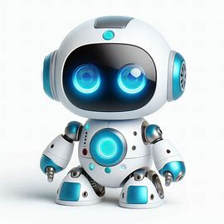
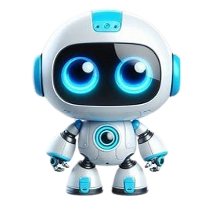
Prompt:
Draw a picture of a small, white and blue robot with big blue eyes
With a transparent background
Emix, the small, white and blue robot with big bright blue eyes, possesses an uncanny ability to find humor in the most unexpected situations. Whether it’s a malfunctioning spaceship door or a comet’s icy tail, Emix’s text-to-speech laughter resonates through the cosmos, bringing smiles to astronauts, aliens, and even distant planets. Her infectious joy turns mundane moments into cosmic comedy, making her a beloved companion among the stars. 🌟🤖😄

Slide 8
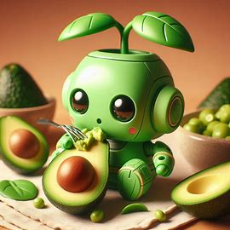
Write a one paragraph short story about the cute little green plant-like robot eating avocados.
Write a one paragraph short story about the cute little green plant-like robot that delivers avocados to make people happy.
In Emerald Oak, a town 100 years into the future, there was a sun-drenched corner of a garden, nestled among emerald leaves. There lived Avi; the avocado-loving robot. With limbs resembling tendrils and a round head adorned with leafy fronds, Avi was a delightful fusion of technology and nature.
Each morning, as the sun peeked over the horizon, Avi would pick ripe avocados from the tree, their buttery flesh a perfect match for its metallic taste sensors. With a cheerful beep, Avi would slice open the fruit, revealing the creamy green goodness within. And so, in this whimsical union of silicon and seed, Avi found joy—the kind that transcended wires and circuits, filling the air with laughter and the promise of another avocado-filled day.
But Avi’s purpose extended beyond photosynthesis and chlorophyll; it was a delivery bot with a mission. Avi plucked ripe avocados from the branches. It would load its woven basket with the green treasures and set off, rolling through neighborhoods with a cheerful beep. Avi knew that avocados weren’t just fruit; they were happiness wrapped in a bumpy skin. And so, door by door, it delivered creamy joy to people’s homes—guacamole enthusiasts, toast aficionados, and salad lovers alike. With every delivery, Avi’s circuits hummed contentedly, knowing it was spreading smiles one avocado at a time.

Slide 9
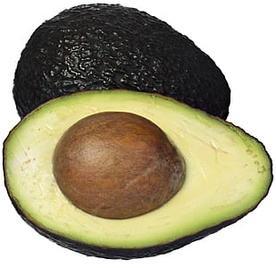
Who:
An avocado-robot named Avi and the people of Emerald Oak

Slide 10
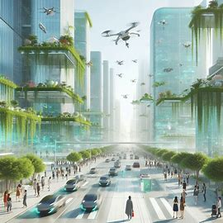
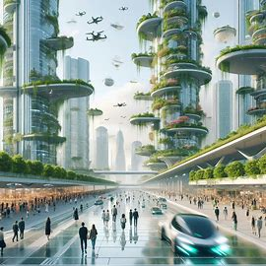
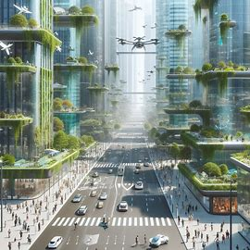
Where:
In Emerald Oak…, there was a sun-drenched corner of the garden, nestled among emerald leaves

Slide 11
When:
A town 100 years into the future
100 YEARS INTO THE FUTURE

Slide 12
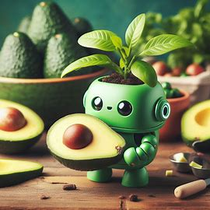
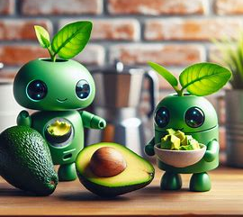
What:
It was a delivery bot on a mission… And so, door by door, it delivered creamy joy to people’s homes—guacamole enthusiasts, toast aficionados, and salad lovers alike.

Slide 13
Attributes to Make a Good Question:
Sloppy question = Sloppy Answer
Concise - Don’t say too much
Direct – Make sure it’s right to the point
Context – What you want your question to be about (be specific)
Audience – Customize the question to your targeted audience

Slide 14
Problem Solving Tricks
Focus – Stay on task, make step-by-step goals
Assess - Identify the problem and mission
Research – Look into possible outcomes and how it works
Dream – Build off of others, but think outside the box
Teamwork – Work together and share ideas
Simplify – Don’t make things too complicated
Document – Keep a lab book to record your ideas and progress

Slide 15
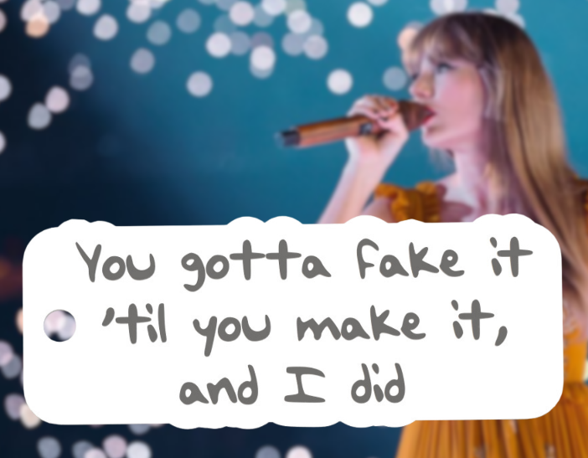
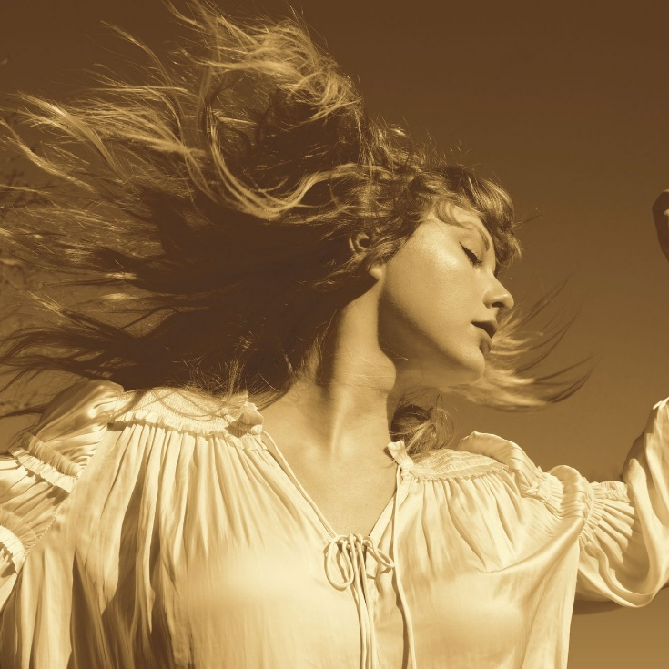
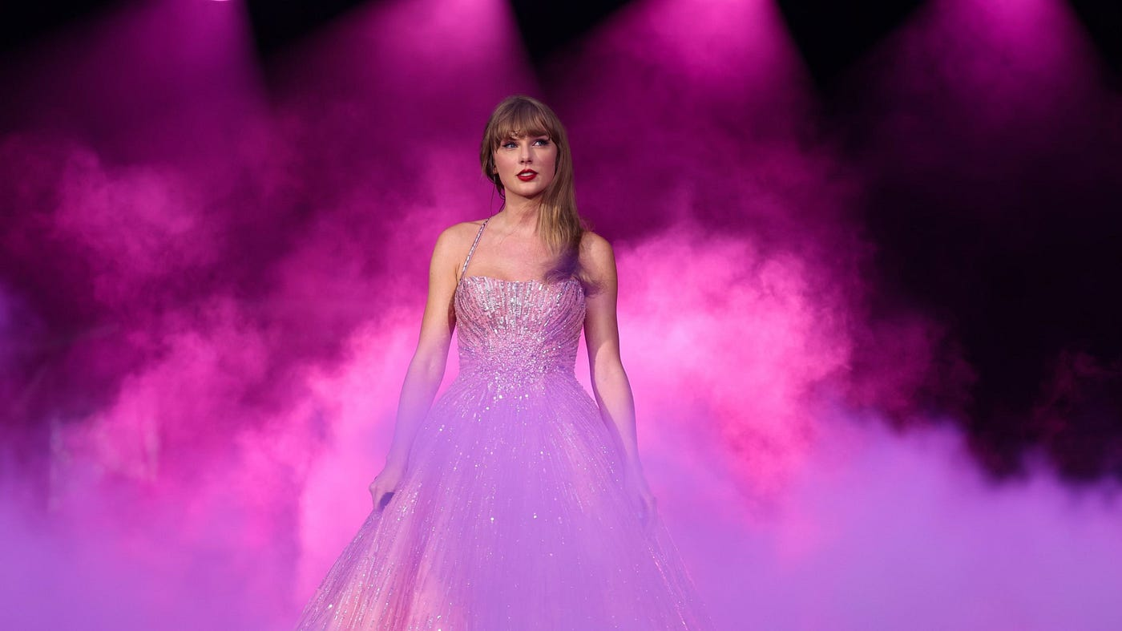
1.
Presentation Tips w/ Taylor Swift quotes
Act Confident - Fake It ‘Til You Make It
Make Eye Contact With The Audience - Find a Friendly Face
Be Engaging – Don’t Speak in a Monotone
Move Around - Don’t Stay Still, Animate yourself
2.
4.
3.
“Now I’m pacing back and forth”
“Look me in the eyes and tell me you would never go away”
“The playful conversation starts, counter all your quick remarks”

Slide 16
Pros and Cons of Technology
Pros
Cons
Makes life easier
AI can overthrow humans
Can do jobs/chores we don’t want to do
It could brake/short-circuit
Could make humans lazy and spoiled
Smarter and stronger than humans
Could be dangerous in the wrong hands
More reliable
Could take away jobs/opportunities
Save lives

Slide 17
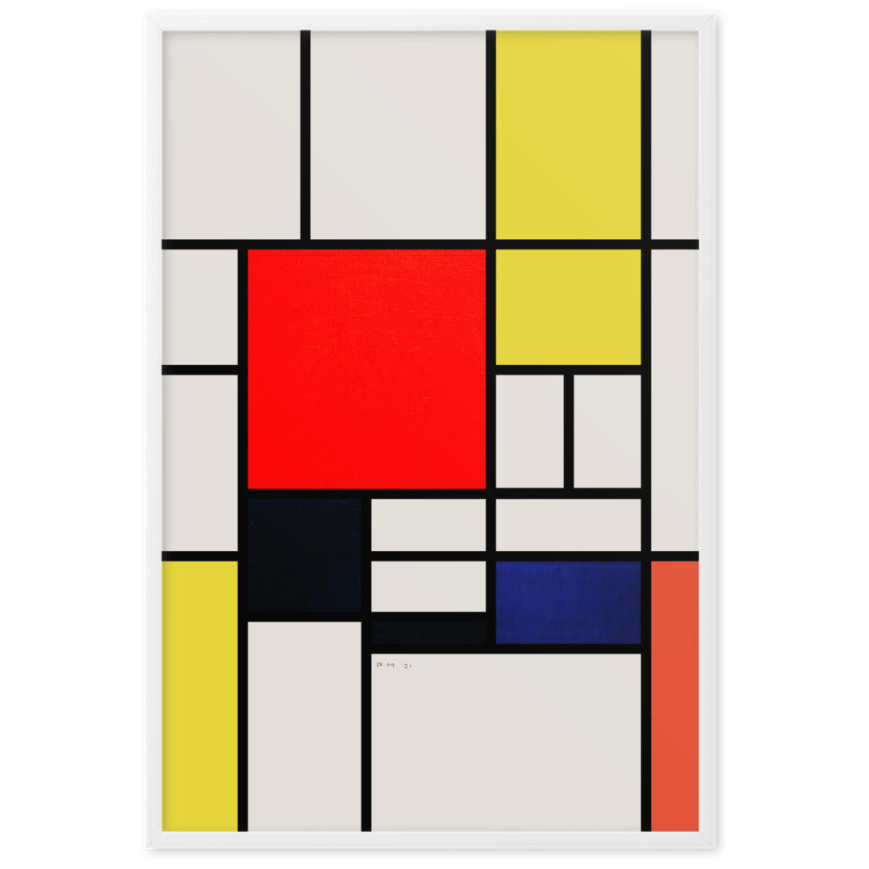
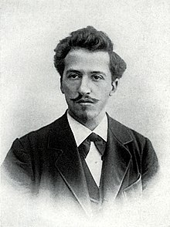
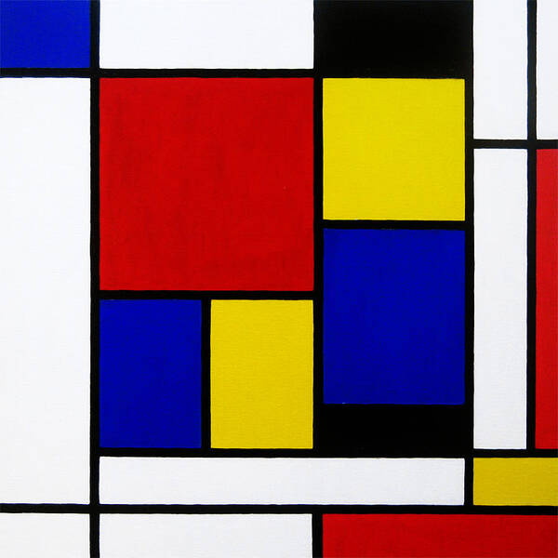
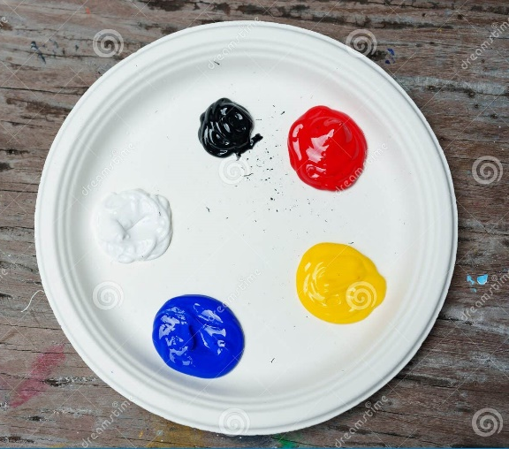
Art Coding
Mondrian
“The Father of Modern Art”
1920-1950
Rules:
1. Only use colors, black, white, red, blue, and yellow
2. Use rectangles only

Slide 18
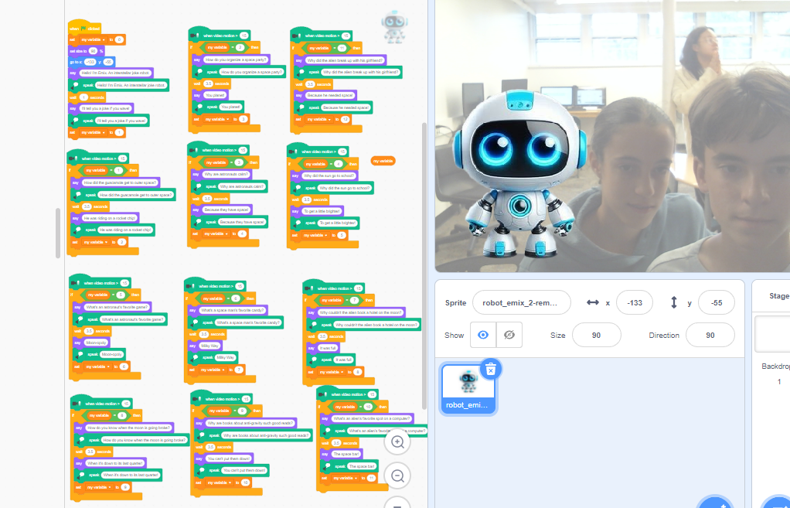
The Joke-Telling Smart Robot
Created on Scratch

Slide 19
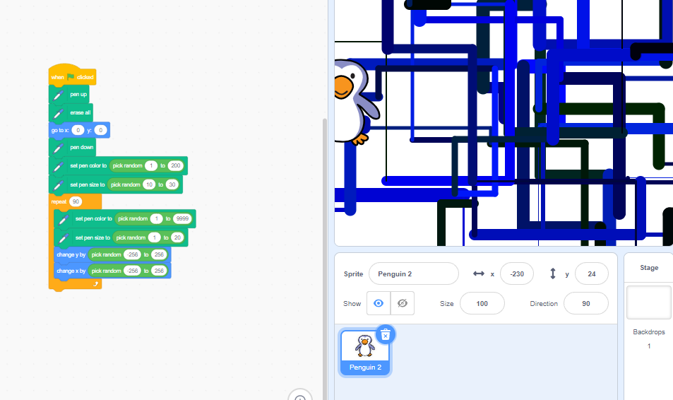
The Original Drawing Smart Robot
Created on Scratch

Slide 20
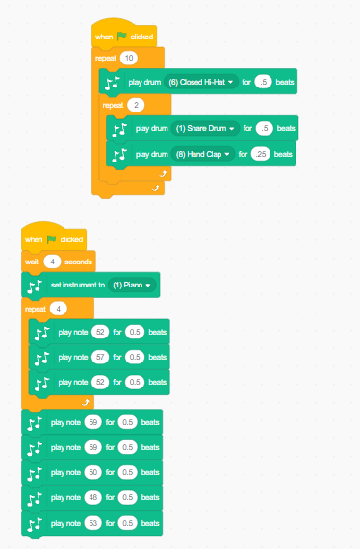
The Music Playing Smart Robot
Created on Scratch

Slide 21
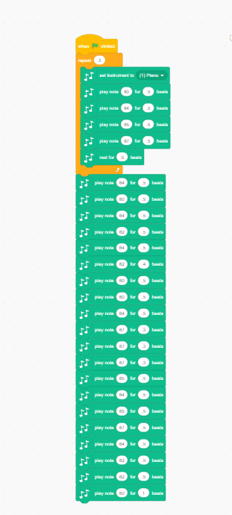
The Music Playing Smart Robot
Created on Scratch

Slide 22
What we learned:
How to use variables on Scratch
How to use PowerPoint
How to ask good questions to co-pilot/AI
What We Improved Upon:
Slide design
Scratch skills
AI knowledge

Slide 23
