Slide 1
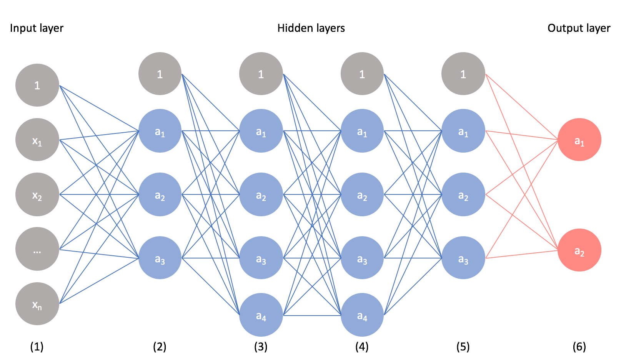
Neural Network Lab Book by Liam

Slide 2


Problem
Humans have caused many horrible, environmental harming, unabiding problems, like war, hacking, famine, and disease.
Mission
Learn how to teach computers to be smarter than humans, so they can help us solve hard problems beyond our reach.
Able to beat world champion of backgammon!

Slide 3
Research
What’s a LLM?
ChatGPT says:A Large Language Model (LLM) is an advanced type of AI trained on huge amounts of text. It learns to understand and generate human-like language. LLMs can do things like write stories, answer questions, translate languages, and even help with coding. They’re based on a special architecture called a Transformer, which helps them understand context better.

Slide 4
Research
(Continued)
What’s a neural network?
ChatGPT says:
A neural network is a type of AI that mimics how the human brain works. It’s made up of layers of connected "neurons" that process information. By adjusting the strength of these connections, it learns patterns from data. Neural networks are used in things like recognizing images, understanding speech, and powering chatbots.

Slide 5
Research
(Continued)
How many games did AlphaGo play to be smart enough to beat the worlds smartest go player?
ChatGPT says:
AlphaGo learned to beat the world’s best Go player by:
Studying about 160,000 human games (around 30 million moves) to understand how good players think.
Then playing over 1 million games against itself to get even better.
It used neural networks and reinforcement learning—meaning it kept adjusting and improving by learning from its own wins and losses.

Slide 6
Research
(Continued)
What’s a transformer?
ChatGPT says: A transformer is an AI model that reads and understands whole sentences at once, using a method called attention to figure out which words are most important. It’s powerful because it can learn from massive amounts of data without needing a lot of human help and can work very quickly. Transformers are the technology behind many modern AI tools like chatbots (such as ChatGPT), language translators, search engines, and systems that summarize text or recognize images and speech. They are considered one of the biggest breakthroughs in making AI smarter and more useful.

Slide 7

My Image Model
Link: https://teachablemachine.withgoogle.com/models/[...]
Instructions:
Add an image of sunglasses or glasses
See what the model says!
(side note: Please don’t put images that aren’t sunglasses or glasses, the model gets terribly confused.)
Image of Model

Slide 8
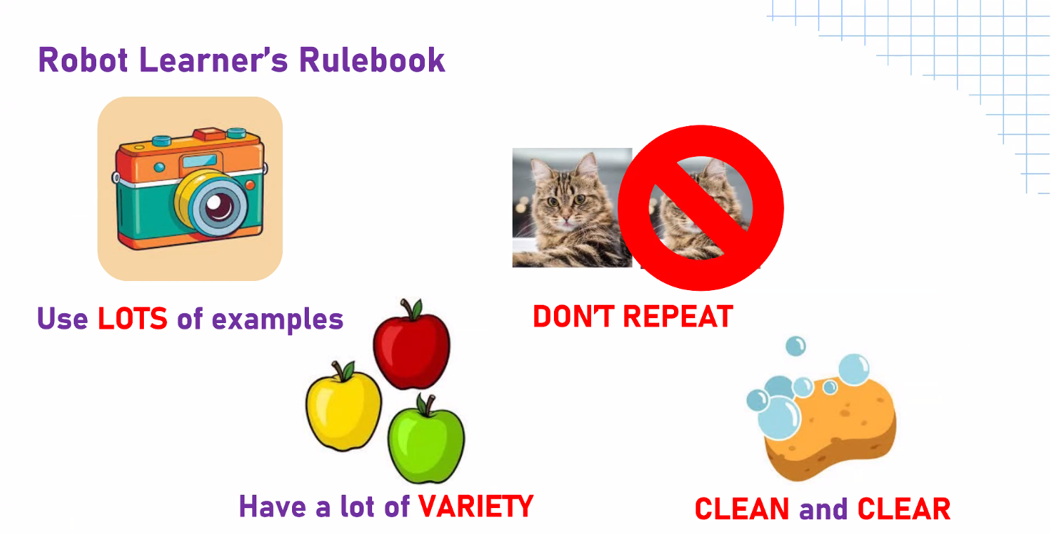
Good Vs. Bad Data
The four rules of AI Learning

Slide 9

Good Vs. Bad Data
Bad AI Model
AI has been trained to recognize too many images that are not related.

Slide 10
Good Vs. Bad Data
Good AI Model
AI model has been trained somewhat similar images.

Slide 11
Three Mystical Creatures
1. The Bogey Man
It is often described as a dark, formless creature with shapeshifting abilities. It has claws/talons and sharp teeth. It has a huge arm with spikes on each hair and a big stomach. And it also has a beak as large as an elephant's. It also has fur like a wooly mammoth and a tail that has a few wools on it. It can also bend gravity and wears a thick cloth that only reveals its body, and it looks like a human. Coat makes shapeshifting possible. It can also make a weapon come towards its hands at will, bringing rocks raining down from the underground. He has a white, fairly large blaster, about the size of a car for the regular one, a dragon skull. It can shoot out a laser around the size of its head, and the laser is very long. It can also summon bones out of the ground. It can move any object at will and toss it around. It can create platforms that track things down and attack at will.

Slide 12
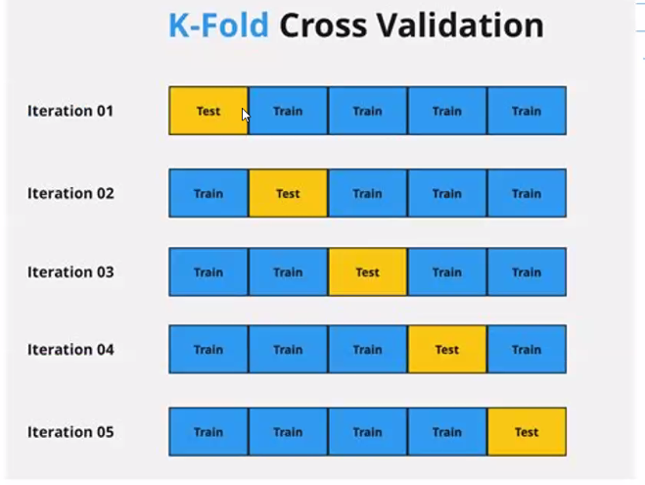
How to test the robot many times

Slide 13
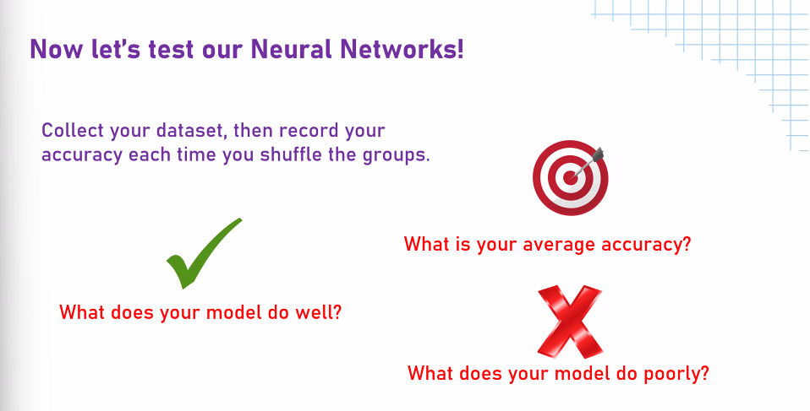

Slide 14

Test 1

Slide 15
Test 1
Results: Says it’s 99% internet explorer (Group 2), and 1% Google (Group 1).

Slide 16
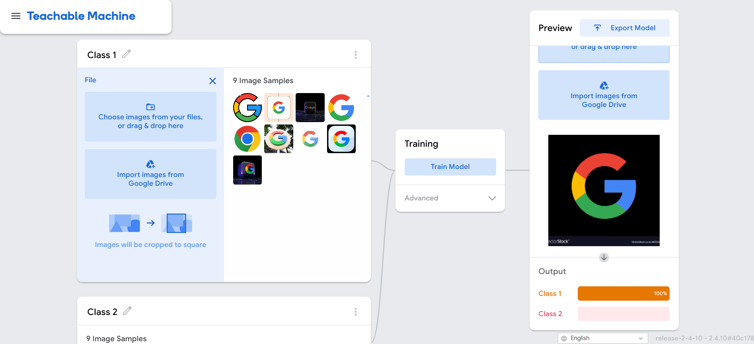
Test 2

Slide 17
Test 2
Results: Says it’s 100% google and 0% internet explorer.

Slide 18

Test 3

Slide 19
Test 3
Results: Says it’s 0% google and 100% internet explorer.

Slide 20
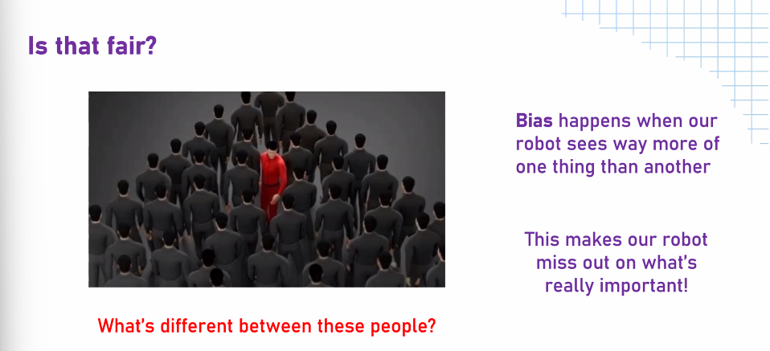

Slide 21
Reasearch
What’s a confusion matrix?
False Negative
False Positive

Slide 22
Reasearch
What’s a False Negative?

Slide 23
Reasearch
What’s a False Positive?
ChatGPT says: A false positive happens when a test or system mistakenly says something is true or present when it's actually not. Think of it as a false alarm.
For example:
A medical test says you have a condition, but you don't.
A security alarm goes off, but there's no intruder.
A spam filter puts a legitimate email in your junk folder.
These false alarms can cause unnecessary worry, waste resources, and reduce the effectiveness of the system over time.

Slide 24
Understanding
Too much of a good thing is bad!

