Slide 1
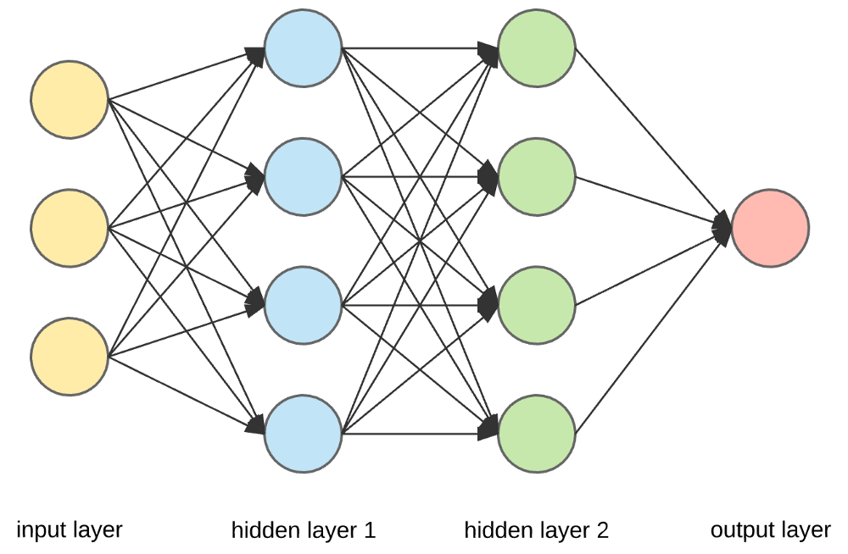
Ai Lab Book
- Isaiah

Slide 2


Problem:
There are many problems on this planet such as war, pollution, crime, hunger and much more. It is making an impact on earth and is not a good thing

Slide 3
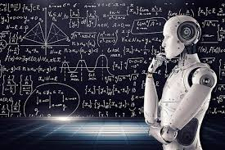

Mission:
We can design an Ai that can solve all these problems. It will be smarter than any human and can change the world and fix our problems.

Slide 4
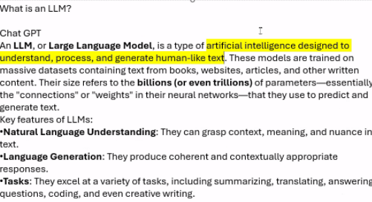

What is a LLM?(According to ChatGPT)

Slide 5
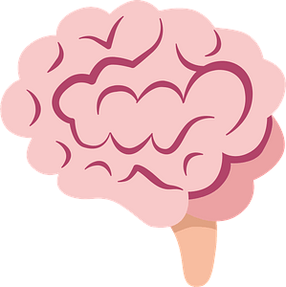
What is a LLM?(In my own words)
LLM stands for Large Language Model, it is a type of Ai that is made to understand things just like the human brain. They are trained to learn from the web(websites, articles, and other stuff on the internet). They can try things billions of times to get the most accurate information to generate texts

Slide 6
What neutral network?(According to ChatGPT
A neural network is a key concept in machine learning and artificial intelligence. It's a system that's inspired by how the human brain works—kind of like a digital brain that learns patterns from data.
A neural network is a set of algorithms modeled loosely after the human brain that is designed to recognize patterns. It interprets sensory data (like text, images, or audio) through a kind of machine perception.
🧱 How it works:
Neurons (Nodes): The basic units—like brain cells—that process input.
Layers:
  Input Layer: Takes in the raw data.
  Hidden Layers: Do the processing. There can be many of these.
  Output Layer: Gives the result.
Weights & Biases: Each connection has a weight (importance) and a bias (like a baseline adjustment).
Activation Function: Decides whether a neuron should "fire" or not, kind of like making a decision.
.

Slide 7

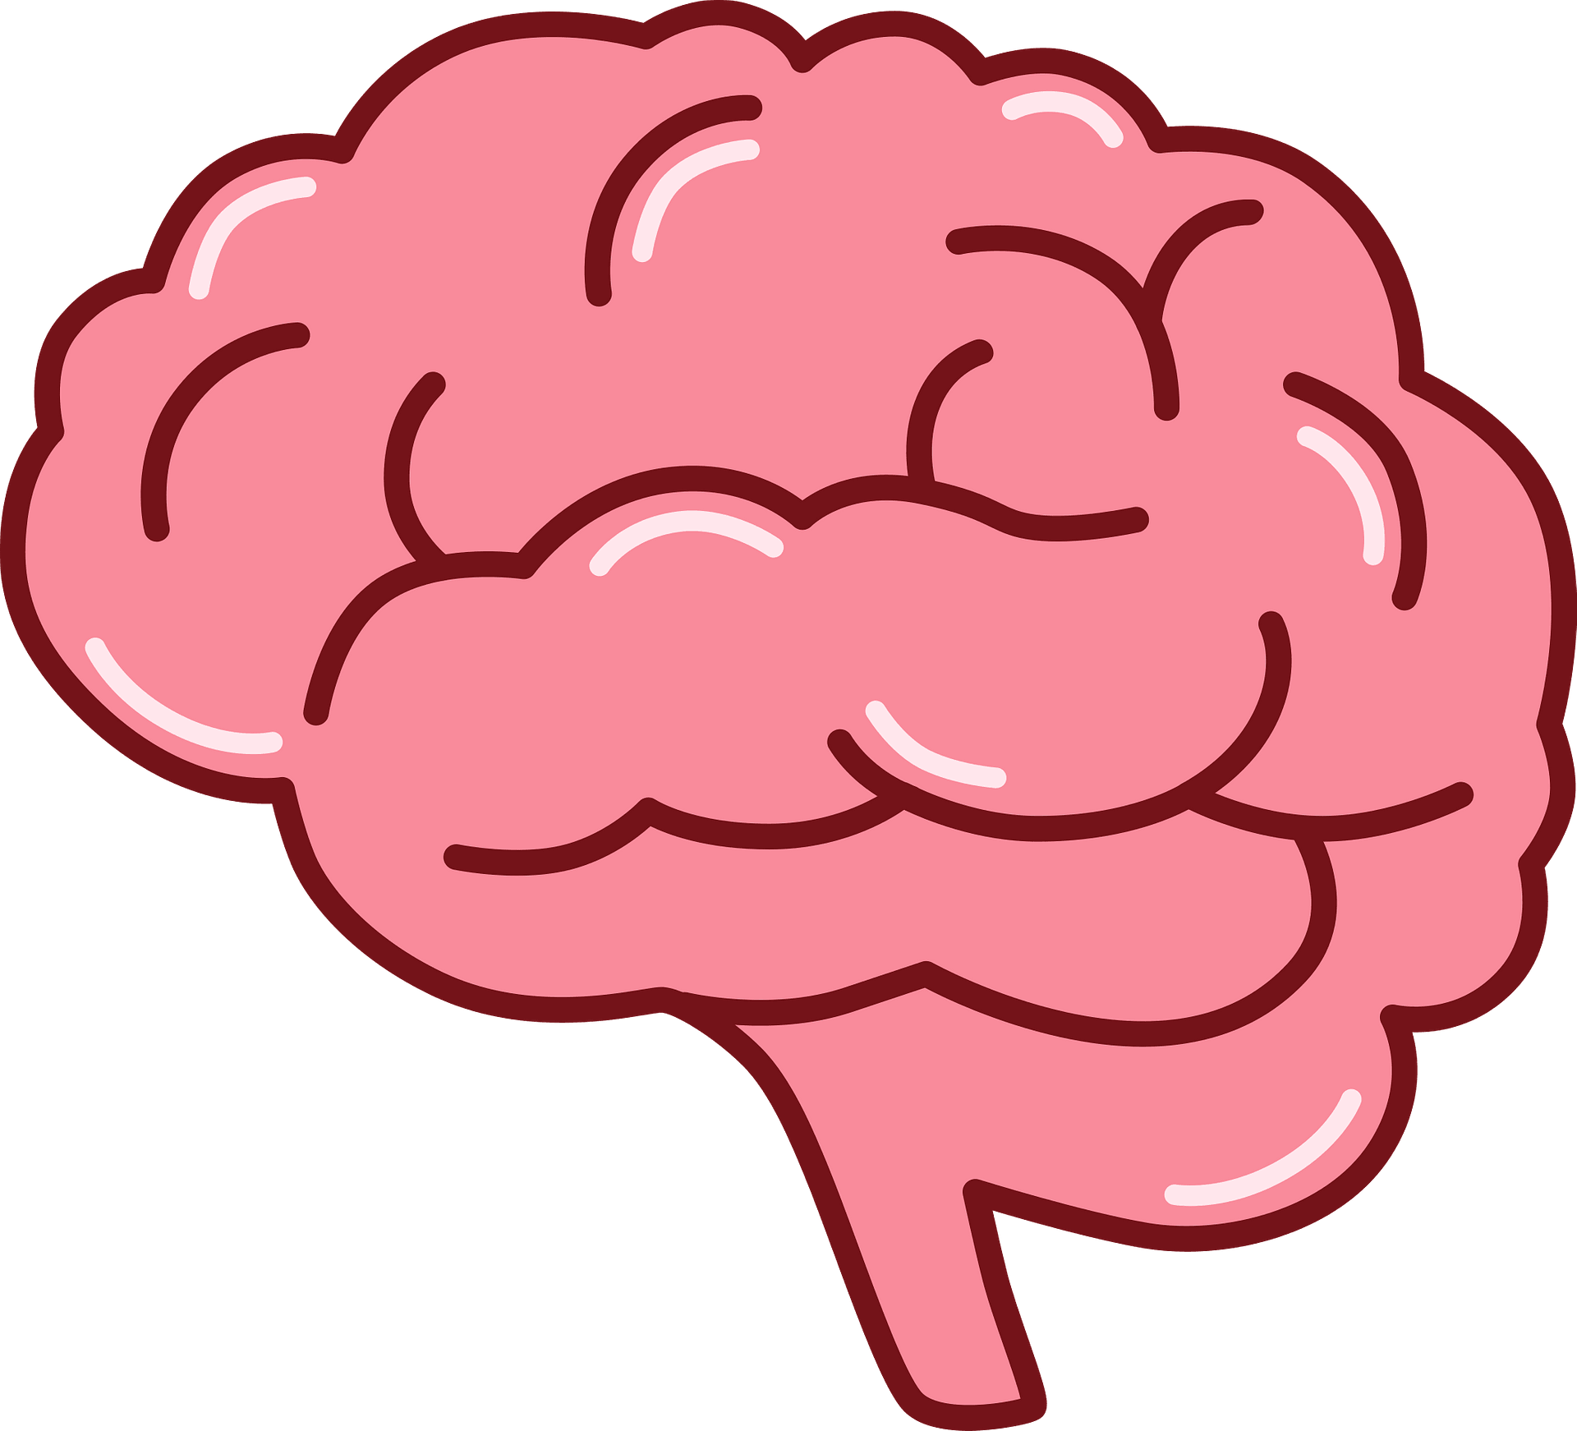
What Neural Network?(In my own words)
Neural Network is similar to a LLM. It is a system that is inspired by the human brain. It is basically a digital brain that is very smart. It is a network of different algorithms. It has different layers which is the Input, Hidden, and Output layer

