Slide 1
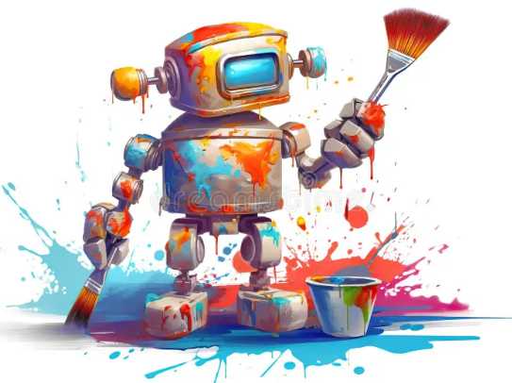
Smart Robot Artist
Lab Book
The Build-It-Yourself Team
Can a robot be creative?

Slide 2
The Problem:
It often takes creative thinking to
solve difficult problems.
Our Mission:
Teach a robot to draw creatively.
(unique, thought-provoking designs)

Slide 3
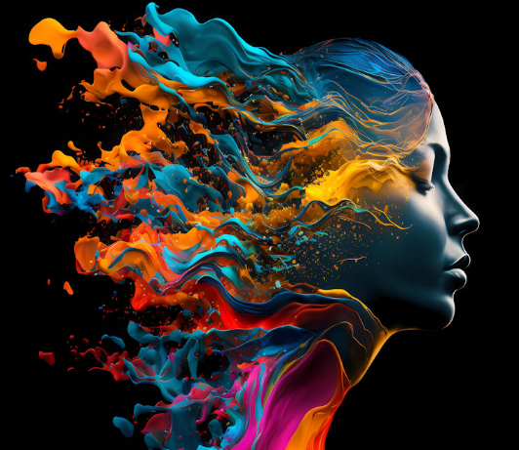
Can a robot be creative?
What does it mean to be creative?
Creativity is defined as the ability to create something new through the use of your imagination, mind, and experiences.
Why is it important to be creative?
To change, solve tough problems, and communicate, it is helpful to be creative.
Can a turtle or a robot be creative?
To survive, animals may do creative tasks.
By the above definition, robots can be creative at drawing images, composing music, writing stories, and programming.
It is an open question if robots will be able to add emotion and empathy to creative tasks. (Artificial General Intelligence???)

Slide 4
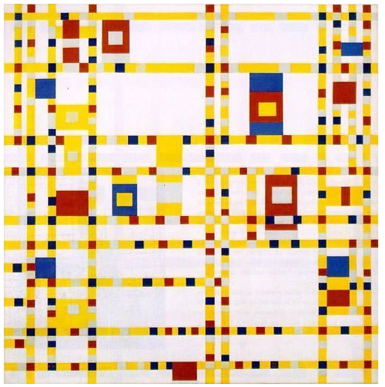
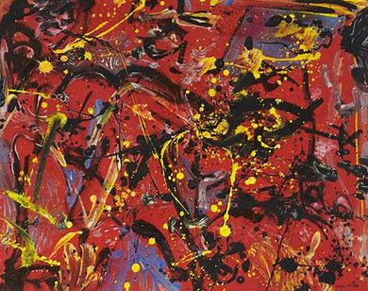
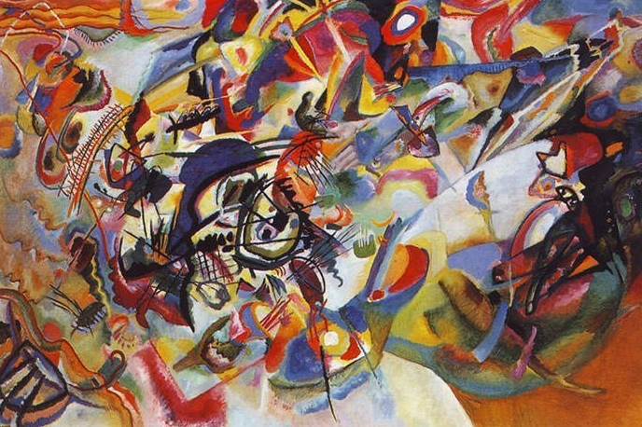
Research
Principles of famous art designs
Interesting colors
???
???
Mondrian
Pollock
Kandinski
Top 3 of the 10 most famous modern artists

Slide 5
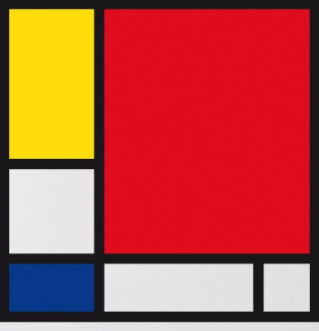
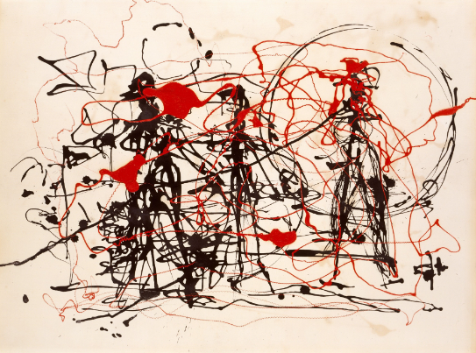
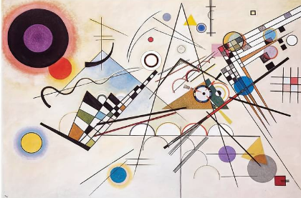
Research
Principles of famous art designs
Pleasing use of colors
Different or original
Makes you think or be emotional
Mondrian
Pollock
Kandinski

Slide 6
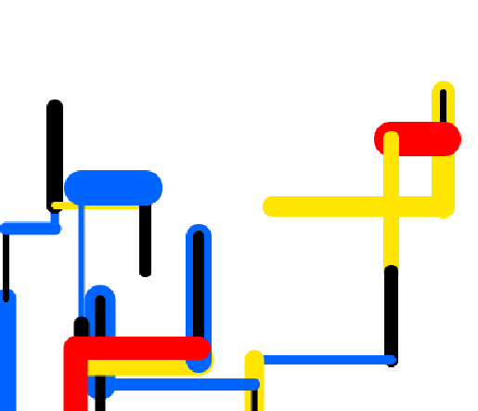
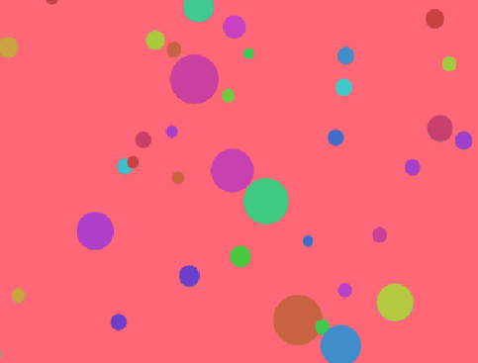
Research
Art created by Build-It-Yourself members
Pleasing use of colors
Different or original
Makes you think or be emotional
Balance
Focus
Rhythm
Repetition
Mondrian-inspired
Pollock-inspired
Kandinski-inspired ???
https://turbofuture.com/misc/Everything-You-Wanted-To-Know-About-Dall-E-2-The-Amazing-AI-Artist

Slide 7
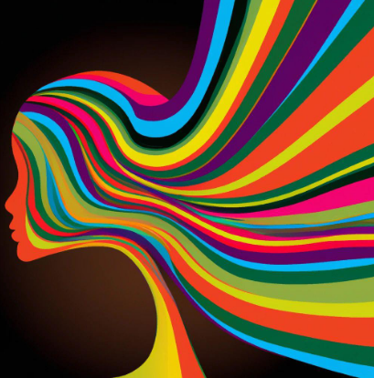
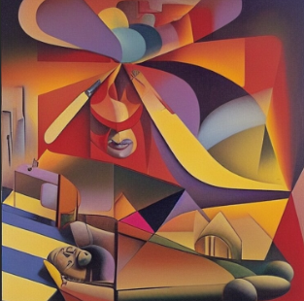
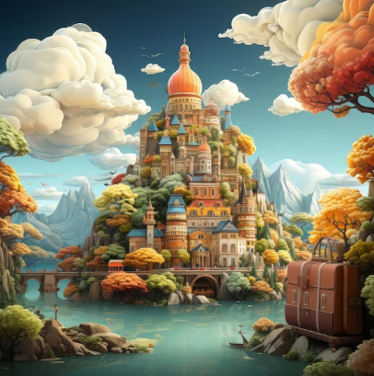
Research
Art created by DALL-E
Pleasing use of colors
Different or original
Makes you think or be emotional
Balance
Focus
Rhythm
Repetition
https://turbofuture.com/misc/Everything-You-Wanted-To-Know-About-Dall-E-2-The-Amazing-AI-Artist

Slide 8
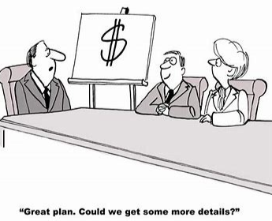
The BIY Project Management Process:
Discover
Document the problem and mission.
Profile the target audience.
Research.
Design
Storyboard a viral video.
Prompt Chat GPT to make suggestions.
Analyze the Chat GPT feedback. (What can we learn from Chat GPT?)
Develop
Find/create graphics that dramatize the storyboard.
Execute the video in Scratch.
Deploy
Share with the world.
Adjust to feedback.

Slide 9
Design
Art created by BIY AI Engineers
Expand on Mondrian’s style.
Paint horizontal and vertical lines of random lengths and widths.
Use primary colors
Expand on Pollock’s style.
Paint dots of different sizes.
Expand on Kandinsky’s style.
???
https://turbofuture.com/misc/Everything-You-Wanted-To-Know-About-Dall-E-2-The-Amazing-AI-Artist

Slide 10
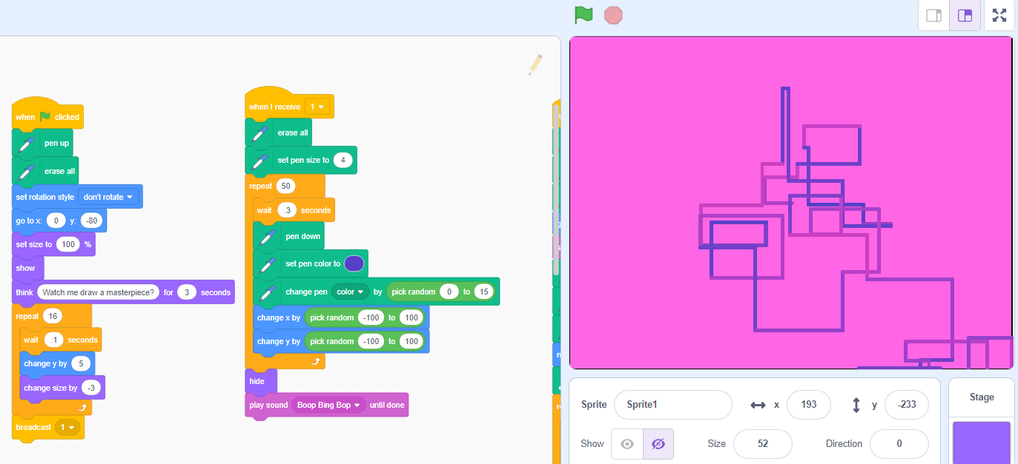
Development: Art created by BIY AI Engineers
https://scratch.mit.edu/projects/695118092/editor

Slide 11
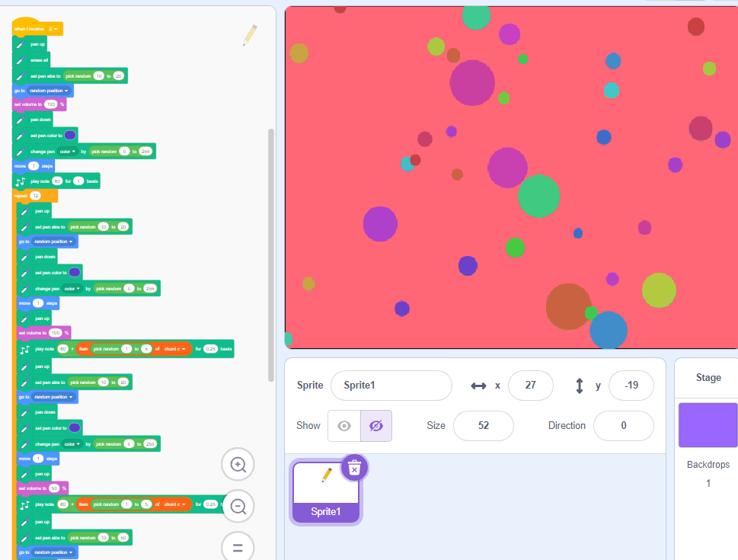
Development: Art created by BIY AI Engineers
https://scratch.mit.edu/projects/695118092/editor

Slide 12
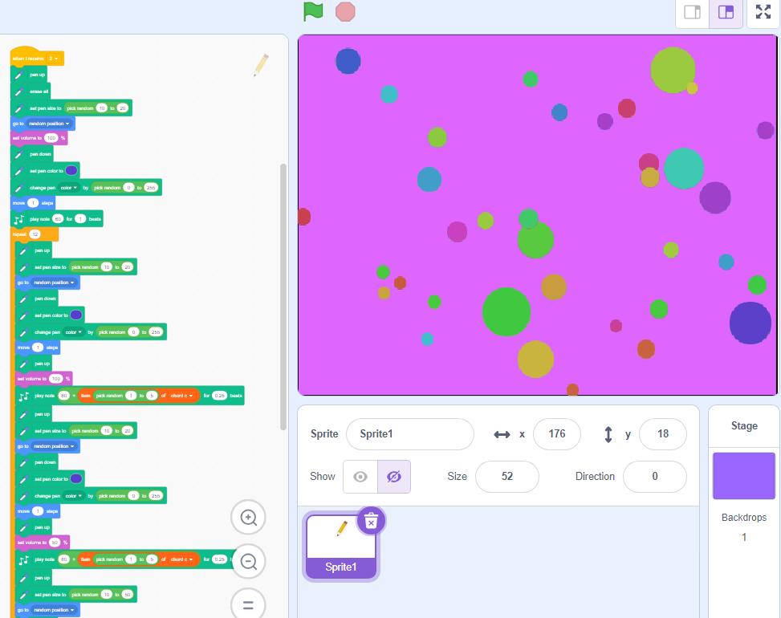
Development: Art created by BIY AI Engineers
https://scratch.mit.edu/projects/695118092/editor

Slide 13
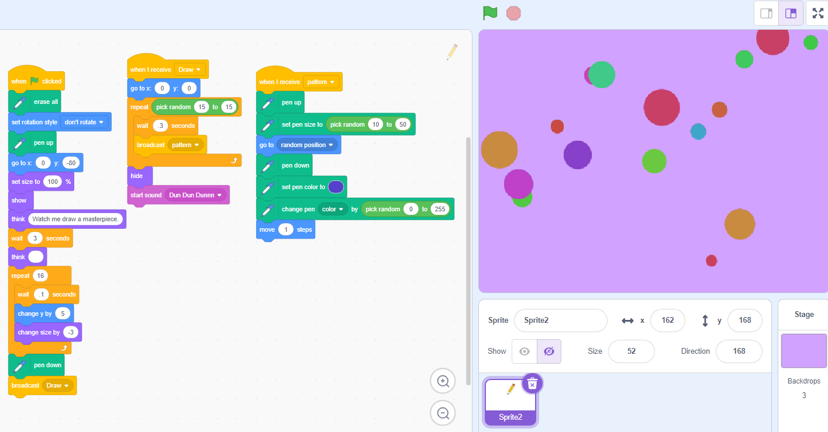
Development: Art created by BIY AI Engineers
https://scratch.mit.edu/projects/948529313/editor/

Slide 14
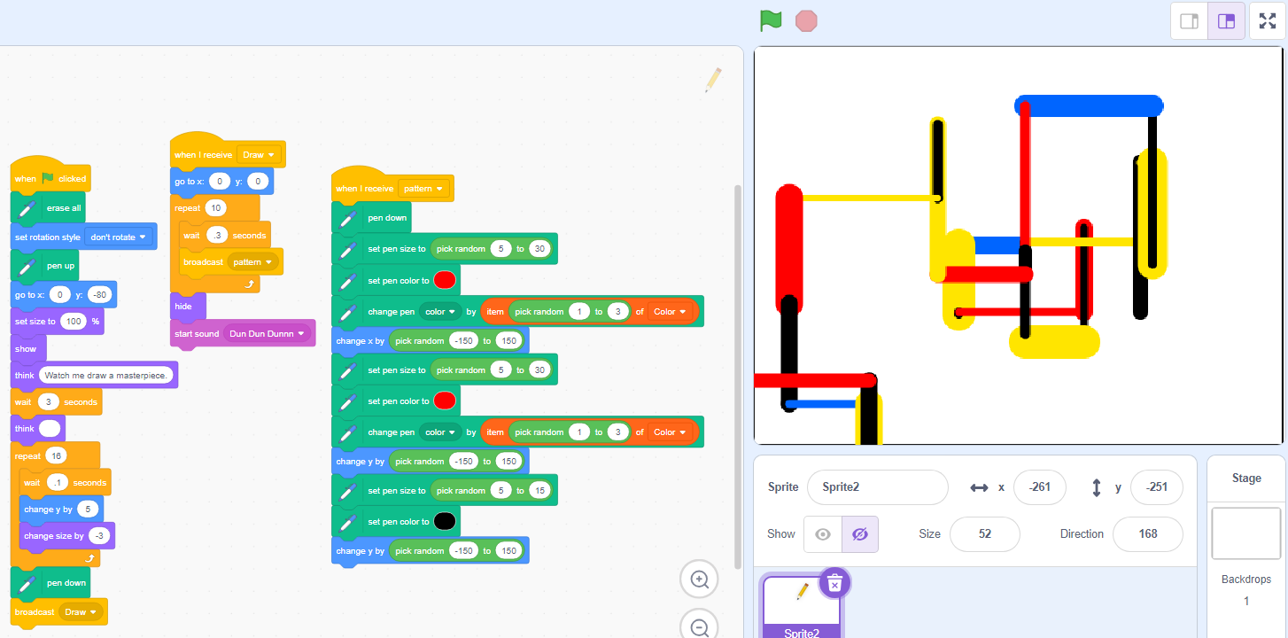
Development: Art created by BIY AI Engineers
https://scratch.mit.edu/projects/948529313/editor/

Slide 15
Skills we will exercise:
Planning projects
Appreciating principles of graphic design
Balancing rules with creativity
Coding with variables

