Slide 1
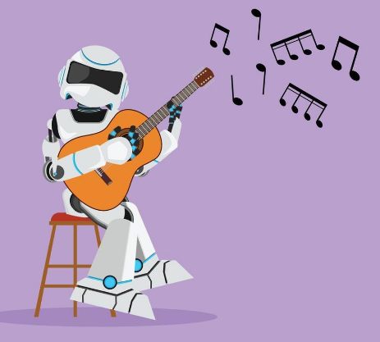
Smart Robot Musician
Lab Book
The Build-It-Yourself Team
Can a robot be creative?

Slide 2
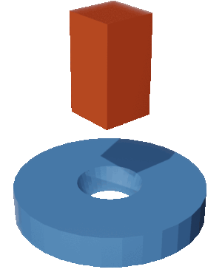
The Problem:
It often takes creative thinking to
solve difficult problems.
Our Mission:
Teach a robot to compose creative music.
(unique, thought-provoking rifs)

Slide 3
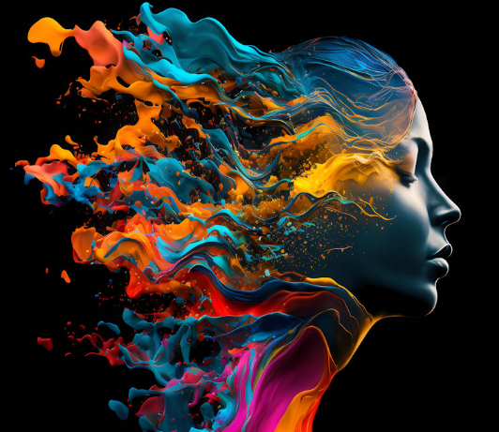
Can a robot be creative?
What does it mean to be creative?
Creativity is defined as the ability to create something new through the use of your imagination, mind, and experiences.
Why is it important to be creative?
To change, solve tough problems, and communicate, it is helpful to be creative.
Can a turtle or a robot be creative?
To survive, animals may do creative tasks.
By the above definition, robots can be creative at drawing images, composing music, writing stories, and programming.
It is an open question if robots will be able to add emotion and empathy to creative tasks. (Artificial General Intelligence???)

Slide 4
Research
Principles of basic music
Beats per measure 4/4 time
Music dynamics 1st note in a measure is usually louder than than the other notes
Notes in a chord C, F, G
Tempo Beats per minute

Slide 5
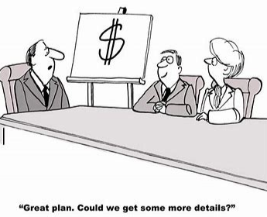
The BIY Project Management Process:
Discover
Document the problem and mission.
Profile the target audience.
Research.
Design
Storyboard a viral video.
Prompt Chat GPT to make suggestions.
Analyze the Chat GPT feedback. (What can we learn from Chat GPT?)
Develop
Find/create graphics that dramatize the storyboard.
Execute the video in Scratch.
Deploy
Share with the world.
Adjust to feedback.

Slide 6
Design
Music created by BIY AI Engineers
Music rules:
Our music will have 4 beats per measure
The first beat would be louder than the others
Each measure will play random notes in a chord (C,F,G)
Conclusions:
Music with no rules tense not to sound good as music that follows the rules.
When the computer plays random notes within the rules it usually sounds creative and makes you wanna dance.

Slide 7
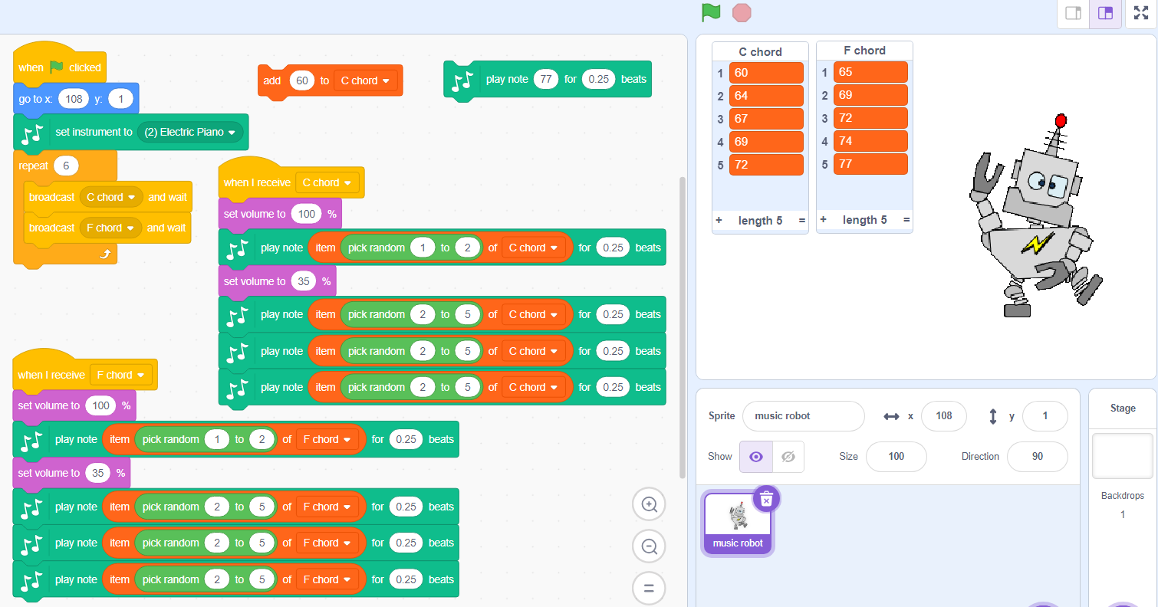
Development: Music created by BIY AI Engineers
https://scratch.mit.edu/projects/706757699/editor/

Slide 8
Design and Develop new music
Research the rules of your favorite music genre.
Program the computer to play a drum or bass track and a melody track that plays randomly within your genre rules.
Define and program Mozart’s style.
Define and program Hip Hop style.
https://turbofuture.com/misc/Everything-You-Wanted-To-Know-About-Dall-E-2-The-Amazing-AI-Artist

Slide 9
Skills we will exercise:
Planning projects
Appreciating principles of graphic design
Balancing rules with creativity
Coding with variables

