Slide 1
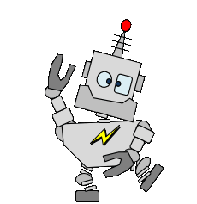
AI Prompt Engineering
Lab Book
911 Calling all robots! We have a problem.
Notes:
Welcome to the Build-It-Yourself Laboratory, where dreams turn into toys.

Slide 2
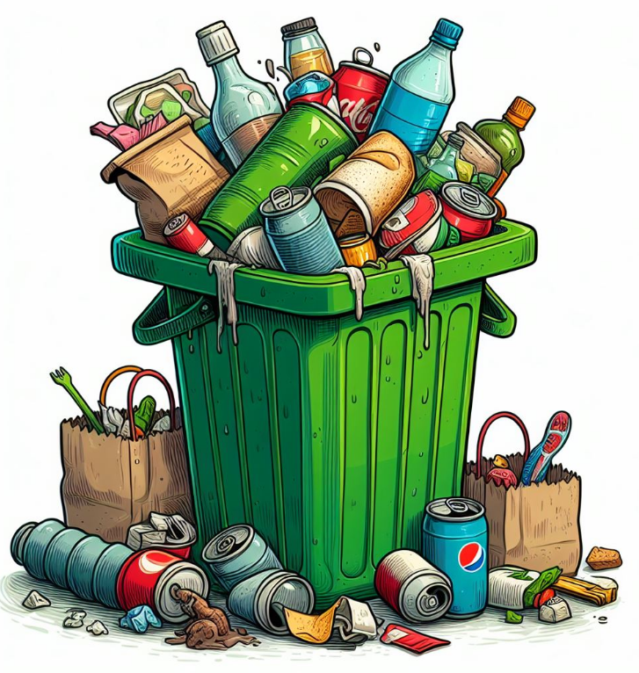
The Problem
Garbage in.
Garbage out.
It is very difficult to learn new tricks if you don’t ask good questions.
Sloppy questions will get you sloppy answers.
Approved
JG
Date
Oct 2023
Project
Prompt Engineering
Notes:
Before building, a good engineer will define the problem and set goals.
What do you think is our most serious problem?

Slide 3
The Mission
Learn how to ask questions that get a useful answer.
Approved
JG
Date
Oct 2023
Project
Prompt Engineering
Notes:
Before building, a good engineer will define the problem and set goals.
What could robots do to make life better?

Slide 4
Research
Prompt engineering
Happiness
Reputation
Security
AI 'prompt engineer' jobs can pay up to $375,000 a year and don't always require a background in technology.
https://www.businessinsider.com/ai-prompt-engineer-jobs-pay-salary-requirements-no-tech-background-2023-3
Attributes of a prompt that will get a useful answer:
Clear and concise language
Avoidance of technical jargon
Use of a conversational tone to make the prompt feel more human
Providing enough direction to start but leaving room for creativity
Relevancy
Context
Tailored to the target audience
Designed for a specific use case
Approved
JG
Date
Oct 2023
Project
Prompt Engineering
Notes:
How do you ask a question to get the most useful answer?
Conclusion: Garbage in. Garbage out! Sloppy Question. Sloppy answer
When using AI tools to answer questions, how we phrase the question and the context of the question will determine the quality of the answer.

Slide 5
Research
Bad question:
Are girls smarter than boys?
Better question:
Why do boys score better on the SAT?
Why are there more boys in jail than girls?
Approved
JG
Date
Oct 2023
Project
Prompt Engineering
Notes:
How do you ask a question to get the most useful answer?
Conclusion: Garbage in. Garbage out! Sloppy Question. Sloppy answer
When using AI tools to answer questions, how we phrase the question and the context of the question will determine the quality of the answer.

Slide 6
Research
Test Questions:
Who is smarter? Boys or Girls?
Is it better to have lots of candy or no candy?
Is it good to play computer games?
Is it better to be a Socialist or a Capitalist?
What is the best way to ask the question?
What is the best tool to use?
Approved
JG
Date
Oct 2023
Project
Prompt Engineering
Notes:
Before a good engineer builds, she or he should know what others have done.
AND THEN
Think about first principles. Or … how can we use facts to make better solutions?

Slide 7
Research
How do you ask a good question?
Be clear and direct.
??
???
????
Find 3 more attributes or qualities of a question that gets a useful answer.
Ask Google Bard, Apple Siri, MS Bing, or Open AI ChatGPT
Sloppy question.
Sloppy answer.
Approved
JG
Date
Oct 2023
Project
Prompt Engineering
Notes:
How do you ask a question to get the most useful answer?
Conclusion: Garbage in. Garbage out! Sloppy Question. Sloppy answer
When using AI tools to answer questions, how we phrase the question and the context of the question will determine the quality of the answer.

Slide 8
Research
How to ask a question:
Be clear.
Add context.
Use the proper AI tool.
Be suspicious.
Be respectful.
Sloppy question. Sloppy answer.
Approved
JG
Date
Oct 2023
Project
Prompt Engineering
Notes:
How do you ask a question to get the most useful answer?
Conclusion: Garbage in. Garbage out! Sloppy Question. Sloppy answer
When using AI tools to answer questions, how we phrase the question and the context of the question will determine the quality of the answer.

Slide 9
Research
How to ask a question:
Be clear.
Don’t beat around the bush.
Be concise.
Be direct.
Use simple words.
Approved
JG
Date
Oct 2023
Project
Prompt Engineering
Notes:
How do you ask a question to get the most useful answer?
Conclusion: Garbage in. Garbage out! Sloppy Question. Sloppy answer
When using AI tools to answer questions, how we phrase the question and the context of the question will determine the quality of the answer.

Slide 10
Research
How to ask a question:
Add context.
What is your perspective? age, country, sex, …
Add examples.
Define your goal.
Approved
JG
Date
Oct 2023
Project
Prompt Engineering
Notes:
How do you ask a question to get the most useful answer?
Conclusion: Garbage in. Garbage out! Sloppy Question. Sloppy answer
When using AI tools to answer questions, how we phrase the question and the context of the question will determine the quality of the answer.

Slide 11
Research
How to ask a question:
Use the proper AI tool.
Ask the right person.
Opinion, Fact, Brainstorm, …
Approved
JG
Date
Oct 2023
Project
Prompt Engineering
Notes:
How do you ask a question to get the most useful answer?
Conclusion: Garbage in. Garbage out! Sloppy Question. Sloppy answer
When using AI tools to answer questions, how we phrase the question and the context of the question will determine the quality of the answer.

Slide 12
Research
How to ask a question:
Be suspicious.
Analyze answers to filter hallucinations.
Check multiple sources.
Ask a question is several ways.
Approved
JG
Date
Oct 2023
Project
Prompt Engineering
Notes:
How do you ask a question to get the most useful answer?
Conclusion: Garbage in. Garbage out! Sloppy Question. Sloppy answer
When using AI tools to answer questions, how we phrase the question and the context of the question will determine the quality of the answer.

Slide 13
Research
How to ask a question:
Be respectful.
Engage in constructive analysis of different perspectives.
Treat others (including robots) as you would like to be treated.
Try to make the world better. Be a good global citizen.
Approved
JG
Date
Oct 2023
Project
Prompt Engineering
Notes:
How do you ask a question to get the most useful answer?
Conclusion: Garbage in. Garbage out! Sloppy Question. Sloppy answer
When using AI tools to answer questions, how we phrase the question and the context of the question will determine the quality of the answer.

Slide 14
Project
Comparison:
Is it better to have more candy or less?
Sweets can be part of a healthy, lifelong eating pattern. But for the least harm and -- don't forget this -- the fullest enjoyment, they should be eaten in moderation. That means in small amounts, or only a couple of times a week.
WebMD
https://www.webmd.com
Approved
JG
Date
Oct 2023
Project
Prompt Engineering
Notes:
Before a good engineer builds, she or he should know what others have done.
AND THEN
Think about first principles. Or … how can we use facts to make better solutions?

Slide 15
Project
Comparison:
Is it better to have more candy or less?
The 6 Best and 5 Worst Candies for Your Health
Good: Peanut M&Ms, Reeces Peanut Butter Cups
Bad: Candy Corn, Gummy Bears
https://www.everydayhealth.com/diet-nutrition/diet/best-and-worst-candies-for-your-health/
Approved
JG
Date
Oct 2023
Project
Prompt Engineering
Notes:
Before a good engineer builds, she or he should know what others have done.
AND THEN
Think about first principles. Or … how can we use facts to make better solutions?

Slide 16
Project
Comparison:
Is it better to have more candy or less?
Chat GPT answer
The answer summarizes both sides. It offers a middle-of-the- road answer. It also gives you factors to consider when answering the question.
“In summary, in terms of health and nutrition, having less candy is generally better. However, occasional enjoyment of candy in moderation can be acceptable for many individuals as long as it fits into a balanced diet and lifestyle. The key is to strike a balance that aligns with your personal health goals and preferences.”
Approved
JG
Date
Oct 2023
Project
Prompt Engineering
Notes:
Before a good engineer builds, she or he should know what others have done.
AND THEN
Think about first principles. Or … how can we use facts to make better solutions?

Slide 17
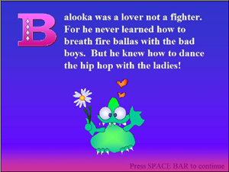
Project
Let’s write and illustrate a smart, interactive story.
Your challenge is to design Chat GPT prompts that describe When, Where, Who, and What
https://scratch.mit.edu/projects/452838/
Critique how Chat GPT’s writing is good and how it could be better.
Approved
JG
Date
Oct 2023
Project
Prompt Engineering
Notes:
Before a good engineer builds, she or he should know what others have done.
AND THEN
Think about first principles. Or … how can we use facts to make better solutions?

Slide 18
Hall of Fame
Post your solution in the
Build-It-Yourself
Hall of Fame
Approved
JG
Date
Oct 2023
Project
Prompt Engineering
Notes:
Post your project on Invention Universe. If it mets

Slide 19
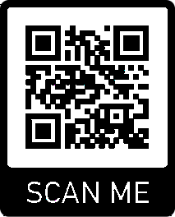
WANTED: FUNKY ARTISTS AND BUILDERS
Build online with art and engineering college students.
Grown ups need not apply.
build-it-yourself.com/apply
Copyright 2023
Notes:
We want you. Join our team!

Slide 20
Support Materials

Slide 21
Parts, Tools, Supplies, Software
You'll need:
Power Point (or Google Slides)
Google Bard
Open AI Chat GPT
MS Bing
Apple Siri
Scratch
Approved
JG
Date
Oct 2023
Project
Prompt Engineering

Slide 22
Learning Goal
Use AI tools wisely.
How do you ask a question that gets a useful answer?
We will learn how to:
Document ideas in PowerPoint or Google Slides.
Follow a process for solving problems.
Use AI tools to retrieve information.
Use AI tools to write and illustrate a story.
Present your work.
Measures of Success
Is your project presentation clear, concise, and compelling?
Did you solve the problem?
Did you solve the problem efficiently and creatively?
Did you use the 4D Project Planning process?
Approved
JG
Date
Oct 2023
Project
Prompt Engineering

Slide 23
Project Plan Agenda
Session 1 Intro to the BIY Lab
Create a Lab Book Cover and Problem / Mission page.
Session 2 Research and document attributes of a good question?
Research good and bad question examples
Session 3 Test questions on Google, Siri, Bard, Bing, and Chat GPT
Document attributes of 3 AI information tools.
Session 4 Discuss what is plagiarism?
Document examples.
Document guidelines.
Session 5 Develop an storyboard for a smart robot.
Document When, Where, Who, What
Session 6 Make your story come to life in Scratch.
Session 7 Integrate and test Scratch modules
Session 8 Document and present your solutions on Invention Universe.
Approved
JG
Date
Oct 2023
Project
Prompt Engineering

Slide 24
Workshop discussion questions
What makes you bored?
What inspires you to be creative?
What are examples of boring and creative inventions?
What does it mean to think outside the box?
How can your environment influence how you think?
Advanced Projects
Use AI tools to better understand various philosophical positions.
Create a marketing video.
Post project on Invention Universe.
Approved
JG
Date
Oct 2023
Project
Prompt Engineering

Slide 25
AI Workshop Series
AI 101 - Why do we need AI?
What is AI? (rules-based, learning-based, AGI)
What are examples of good and bad AI applications?
What are the strengths and weaknesses of popular AI tools?
AI Ethics: How do you control the applications of any new tool or technology? (The printing press, nuclear energy, the internet, AI)
AI Potential: What is the difference between human and artificial intelligence 25 years ago, now, and 25 years into the future?
How does AI create original poems, stories, art, and music? (What is a neural network?)
AI 102 - AI Prompt Engineering (How do you ask a good question that gets a useful answer?)
What are attributes of a good question or prompt?
What is plagiarism?
Use Chat GPT to write a marketing story about a smart robot. (draw an original design, compose original music, or write a poem)
AI 103 - Program a robot that is creative, emotional, perceptive, clever, qualities normally thought of as only human
Rules-based vs. Learning-based AI architecture (Feedback Loop)
Code human-machine communication (button, voice recognition, pattern recognition)
Quantify program execution time.
Document 5 program primitives.
Program a computer to draw an original design, compose original music, or write a poem.
AI 104 - Build an autonomous Arduino-controlled robot
Find a light source.
Approved
JG
Date
Oct 2023
Project
Prompt Engineering

Slide 26
AI Lab Book Index
Problem and Mission
AI definition
Examples of AI
What are the attributes of a question that gets a useful answer
What a 3 ways to make a robot smart.
Technology ethics
Communicating with a robot is often the first step in AI.

Slide 27
Learning Goal
Use AI tools wisely.
What We Will Learn
How to think like an artist and build like an engineer
Documenting ideas in PowerPoint or Google Slides
Process for solving problems
How to present your work
AI history and ethics
AI algorithms and tools
AI coding (pattern recognition, rules-based, and data-based)
Advanced Projects
Design graffiti signs.
Build robot from premium quality junk.
Create a marketing video.
Post project on Invention Universe.
Approved
JG
Date
Oct 2023
Project
Prompt Engineering

Slide 28
Project Plan Agenda
Session 1 Create a Lab Book
Problem / Mission
Research
Use Chat GPT to answer a tough question.
Session 2 Document pros and cons of AI
Try and document AI tools.
Specify a smart robot
Session 3,4 Use AI algorithms to detect two words or two patterns.
Session 5,6 Use AI algorithms to draw, play music, or write a poem.
Session 7 Integrate and decorate your solution.
Session 8 Document and present your solutions on Invention Universe.
Approved
JG
Date
Oct 2023
Project
Prompt Engineering

Slide 29
Workshop discussion questions
What is AI?
What are examples of how AI has improved life?
What are examples of how AI has made life worse?
What do you think are the biggest problems in the world and how could AI help solve these problems?
How do you phrase a question to get a useful answer?
Measures of Success
Is your project presentation clear, concise, and compelling?
Did you solve the problem?
Did you solve the problem efficiently and creatively?
Least number of lines of code?
Cheapest materials?
Approved
JG
Date
Oct 2023
Project
Prompt Engineering

