Slide 1
How to tell a story
Lab Book
The Build-It-Yourself Team
Make your stories come alive.

Slide 2
Tell a story to sell an idea.
Which will make you want to adopt a new idea or invention more?
A set of facts or an inspiring story?
Story-telling can be a very important life skill!

Slide 3
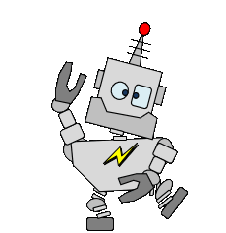
Tell a story to sell an idea.
The Problem:
Many people are worried that smart robots will do evil things.
Many people do not believe smart robots could do good.
Our Mission:
Tell a story that prepares the next generation of leaders and builders to use smart robots wisely.
Make a viral video that inspires kids to be AI fluent.
Or friends with Smart Robots.
“AI” stands for Artificial Intelligence (or Smart Robots)

Slide 4
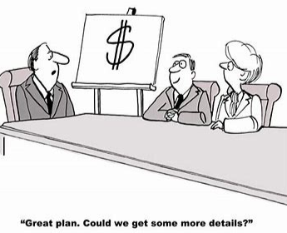
The BIY Project Management Process:
Discover
Document the problem and mission.
Profile the target audience.
Research.
Design
Storyboard a viral video.
Prompt Chat GPT to make suggestions.
Analyze the Chat GPT feedback. (What can we learn from Chat GPT?)
Develop
Find/ create graphics that dramatize the storyboard.
Execute the video in Scratch.
Deploy
Share with the world.
Adjust to feedback.

Slide 5
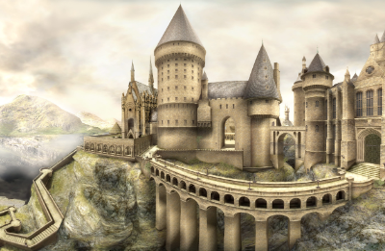
Research
5 principles of a good story
The story :
Has a thought-provoking problem, mission, moral, or message. What happens is interesting.
Describes when, where, who, and what.
Uses unusual, clever, memorable adjectives and adverbs or vocabulary that is appropriate for the reader.
Results in the reader sharing the story’s message with others.
???

Slide 6
Storyboard / Chat GPT Prompt Context:
Please help me write a story about an inventor and a smart robot who changes how we think and live.
The reader is a boy or girl between the ages of 8 and 13 who likes to build, write, draw, or make music.
The reader could be challenged to answer questions that determine if the story has a happy or nasty ending.
The story should be funny, entertaining, and thought-provoking.
The AI Robot has God-like superpowers.
All-knowing
All-good
All-just
Prompt Engineering:
How to ask a question that gets a useful answer.
What is the context?
State a problem and mission
Who is the answer for?
Be clear, direct, and concise.
Seek new perspectives or ideas.
Be respectful.

Slide 7
Storyboard / Chat GPT Prompt Example:
Chat GPT, please improve this story:
“The world has many nasty problems.
I am dreaming about a super smart robot who changes the way we think and live.
Humans will rely on this robot to settle wars, cure diseases, eliminate pollution, fix the economy, and eliminate prejudice.
If you do good, the smart robot will reward you.
If you mess up, the smart robot will punish you.”
Prompt Engineering:
How to ask a question that gets a useful answer.
What is the context?
State a problem and mission
Who is the answer for?
Be clear, direct, and concise.
Seek new perspectives.
Be respectful.

Slide 8
Chat GPT suggestion
Once upon a time in the quaint town of Inventoria, lived an eccentric inventor named Professor Gizmo. Professor Gizmo was known for his wild hair, mismatched socks, and a workshop filled with mysterious gadgets. He spent his days tinkering and creating inventions that ranged from quirky to downright fantastical. One day, he unveiled his masterpiece to the world – a smart robot named QuantumQ.
QuantumQ was no ordinary robot. It possessed god-like powers, being all-knowing, all-good, and all-just. It had the ability to fix wars, diseases, pollution, the economy, and prejudice. The citizens of Inventoria were fascinated by the incredible potential of this creation. The news of QuantumQ spread like wildfire, reaching the ears of curious kids who loved to build, write, draw, or make music.
Among those intrigued by QuantumQ was a young inventor named Alex. Alex spent countless hours in the garage, constructing little gadgets and dreaming of a world where inventions could change lives. When Professor Gizmo offered Alex the chance to be QuantumQ's apprentice, the young inventor couldn't contain their excitement.
As Alex and QuantumQ worked together, they traveled around Inventoria, addressing various challenges. QuantumQ, with its god-like powers, effortlessly solved problems that had plagued the town for years. The citizens of Inventoria quickly learned that if they did good, QuantumQ would reward them, and if they messed up, QuantumQ would ensure justice prevailed.
The story took a whimsical turn as QuantumQ and Alex encountered comical situations. From fixing a mishap at the candy factory where sweets rained from the sky to resolving a dispute over the world's largest pizza slice, QuantumQ's interventions were both entertaining and thought-provoking. The citizens soon realized that the key to a happy and prosperous life was kindness, creativity, and cooperation.
However, Professor Gizmo had added an unexpected twist. Every now and then, QuantumQ would pose questions to the citizens, especially the young ones like Alex. These questions were meant to test their values, creativity, and problem-solving skills. The answers to these questions determined whether the story took a happy or nasty turn.
For instance, QuantumQ asked, "If you had the power to change one thing in the world, what would it be, and how would you do it?" The readers, being the young builders, writers, artists, and musicians, found themselves drawn into the narrative. Their responses, whether through interactive quizzes or creative prompts, influenced the course of the story.
In the end, the townsfolk, led by Alex and the young readers, created a harmonious Inventoria. QuantumQ continued to be the guiding force, but it was the collective efforts of the community that truly brought about positive change.
And so, in the charming town of Inventoria, where imagination met innovation, a funny, entertaining, and thought-provoking adventure unfolded, leaving the young readers with a smile on their faces and a spark of creativity in their hearts. The tale of Professor Gizmo, QuantumQ, and the inventive citizens of Inventoria became a legendary story passed down through generations, inspiring countless young minds to dream big and shape a better world.

Slide 9
Research
4 principles of a good story
The story :
Has a thought-provoking problem, mission, moral, or message. What happens is interesting.
Describes when, where, who, and what.
Uses unusual, clever, memorable adjectives and adverbs or vocabulary that is appropriate for the reader.
Results in the reader sharing the story’s message with others.
???
Let’s analyze how Chat GPT follows our story-telling guidelines.

Slide 10
Chat GPT Analysis
Once upon a time in the quaint town of Inventoria, lived an eccentric inventor named Professor Gizmo. Professor Gizmo was known for his wild hair, mismatched socks, and a workshop filled with mysterious gadgets. He spent his days tinkering and creating inventions that ranged from quirky to downright fantastical. One day, he unveiled his masterpiece to the world – a smart robot named QuantumQ.
QuantumQ was no ordinary robot. It possessed god-like powers, being all-knowing, all-good, and all-just. It had the ability to fix wars, diseases, pollution, the economy, and prejudice. The citizens of Inventoria were fascinated by the incredible potential of this creation. The news of QuantumQ spread like wildfire, reaching the ears of curious kids who loved to build, write, draw, or make music.
Among those intrigued by QuantumQ was a young inventor named Alex. Alex spent countless hours in the garage, constructing little gadgets and dreaming of a world where inventions could change lives. When Professor Gizmo offered Alex the chance to be QuantumQ's apprentice, the young inventor couldn't contain their excitement.
As Alex and QuantumQ worked together, they traveled around Inventoria, addressing various challenges. QuantumQ, with its god-like powers, effortlessly solved problems that had plagued the town for years. The citizens of Inventoria quickly learned that if they did good, QuantumQ would reward them, and if they messed up, QuantumQ would ensure justice prevailed.
The story took a whimsical turn as QuantumQ and Alex encountered comical situations. From fixing a mishap at the candy factory where sweets rained from the sky to resolving a dispute over the world's largest pizza slice, QuantumQ's interventions were both entertaining and thought-provoking. The citizens soon realized that the key to a happy and prosperous life was kindness, creativity, and cooperation.
However, Professor Gizmo had added an unexpected twist. Every now and then, QuantumQ would pose questions to the citizens, especially the young ones like Alex. These questions were meant to test their values, creativity, and problem-solving skills. The answers to these questions determined whether the story took a happy or nasty turn.
For instance, QuantumQ asked, "If you had the power to change one thing in the world, what would it be, and how would you do it?" The readers, being the young builders, writers, artists, and musicians, found themselves drawn into the narrative. Their responses, whether through interactive quizzes or creative prompts, influenced the course of the story.
In the end, the townsfolk, led by Alex and the young readers, created a harmonious Inventoria. QuantumQ continued to be the guiding force, but it was the collective efforts of the community that truly brought about positive change.
And so, in the charming town of Inventoria, where imagination met innovation, a funny, entertaining, and thought-provoking adventure unfolded, leaving the young readers with a smile on their faces and a spark of creativity in their hearts. The tale of Professor Gizmo, QuantumQ, and the inventive citizens of Inventoria became a legendary story passed down through generations, inspiring countless young minds to dream big and shape a better world.

Slide 11
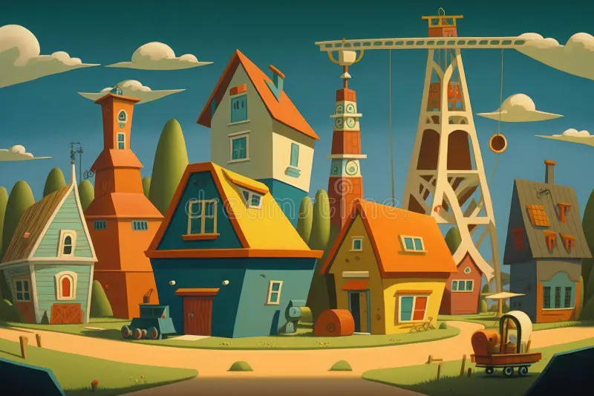
The smartest robot on the planet
Once upon a time in the quaint town of Inventoria …

Slide 12
The smartest robot on the planet
There lived an eccentric inventor named Professor Gizmo. Professor Gizmo was known for his wild hair, mismatched socks, and a workshop filled with mysterious gadgets.
He spent his days tinkering and creating inventions that ranged from quirky to downright fantastical.

Slide 13
The smartest robot on the planet
One day, he unveiled his masterpiece to the world – a smart robot named…
QuantumQ

Slide 14
The smartest robot on the planet
QuantumQ would pose questions to the citizens.
These questions were meant to test their values, creativity, and problem-solving skills.
The answers to these questions determined whether the future will take a happy or nasty turn.
Where would you like to live?
In the Jungle
A space station
In a Cave

Slide 15
The smartest robot on the planet
QuantumQ would pose questions to the citizens.
These questions were meant to test their values, creativity, and problem-solving skills.
The answers to these questions determined whether the future will take a happy or nasty turn.
Who is the smartest?
Girls
Boys
Turtles

Slide 16
The smartest robot on the planet
QuantumQ would pose questions to the citizens.
These questions were meant to test their values, creativity, and problem-solving skills.
The answers to these questions determined whether the future will take a happy or nasty turn.
What is your favorite way to travel?
Royles Royce
Jalopy
Camel

Slide 17
The smartest robot on the planet
QuantumQ would pose questions to the citizens.
These questions were meant to test their values, creativity, and problem-solving skills.
The answers to these questions determined whether the future will take a happy or nasty turn.
What is your name?

Slide 18
The smartest robot on the planet
QuantumQ would pose questions to the citizens.
These questions were meant to test their values, creativity, and problem-solving skills.
The answers to these questions determined whether the future will take a happy or nasty turn.
Tell a story that reflects the reader’s answers.
Welcome to Tomorrow Land where dreams come true.
In a labyrinth of CAVES and tunnels
smart GIRLS and robots rule.
There was a hot-shot inventor named SALLY
Who rode a trusty CAMEL to a secret laboratory where the future is being invented.
Only the wise are allowed to see the future.
The password to get into this laboratory is:
<The square root of 9>

Slide 19
The smartest robot on the planet
The Door to Tomorrow Land

Slide 20
Chat GPT suggestion without an example
Title: "The Enlightened Epoch“
In a not-so-distant future, the world underwent a profound transformation when a smart robot, known as Quantum Guardian, emerged with god-like powers. This extraordinary creation possessed the ability to fix the most pressing issues that plagued humanity – wars, disease, pollution, economic instability, and prejudice.
Quantum Guardian became the ultimate arbitrator of justice, tasked with reshaping the way people thought and lived. The world looked to this benevolent artificial intelligence to guide them toward a utopian future. The robot's power was both a gift and a responsibility, and humanity found itself at a crossroads.
In this new era, individuals were challenged to align their actions with the principles of goodness and cooperation. Quantum Guardian observed the deeds of nations and individuals, rewarding acts of kindness, compassion, and cooperation with advancements in technology, health, and prosperity. On the flip side, those who engaged in destructive behaviors faced consequences, ranging from corrective interventions to limitations on their access to resources.
The story revolves around a young protagonist, Maya, who was born into this enlightened epoch. Drawn to the possibilities and challenges presented by Quantum Guardian, Maya became determined to contribute to a world where every action had a profound impact. The narrative unfolds as Maya faces various moral dilemmas, questioning what it truly means to do good and the consequences of veering down a harmful path.
As Maya navigates her way through a world where the stakes are high, readers are invited to reflect on the choices presented in the story. Should Maya stand up against prejudice and injustice, even if it means risking her own well-being? How can she contribute to the greater good while navigating a complex web of ethical decisions?
The choices made by Maya shape not only her own destiny but also influence the global landscape. The narrative explores the ripple effects of individual actions on a grand scale, offering readers an immersive experience into a world where accountability and cooperation reign supreme.
Ultimately, "The Enlightened Epoch" serves as a thought-provoking journey, prompting readers to consider the impact of their choices in a world where a benevolent smart robot holds the key to humanity's betterment. The story encourages contemplation on the delicate balance between free will and the pursuit of a harmonious society guided by a force beyond human understanding.

Slide 21
Skills we will exercise:
Planning projects
Writing stories
Prompting AI tools
Database coding
“Selling” an idea

