Slide 1
Target Audience:
Parents who want their kids to be ‘builders’ in an AI world.
Goals:
Prepare the next generation of leaders for an AI world.
Incorporate the program ideas of parents.
Enroll kids in the BIY program for 5+ years (200+ hours) at a total tuition cost of $2000+.
Index:
Problems and AI Mission
AI Research
BIY Philosophy
AI integration in BIY programs
Discussion (around 10 AI questions)
Build-It-Yourself.com
Notes:
Presentation Overview

Slide 2
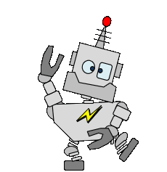

911 Calling all robots!
We have a problem.
Why should we be AI fluent?
Notes:
Welcome to the Build-It-Yourself Laboratory, where dreams can come true.

Slide 3

The Big Picture Problem:
How can we prepare the next generation of builders and leaders to solve the nasty problems past generations have left them?
Disease
Prejudices and wars
Economic woes
Pollution
Build-It-Yourself.com
Notes:
How can we prepare the next generation of builders and leaders to solve the nasty problems past generations have left them?
Would you agree that we are facing some existential problems?
Could it be that we are in this mess in part because of our traditional education system?

Slide 4
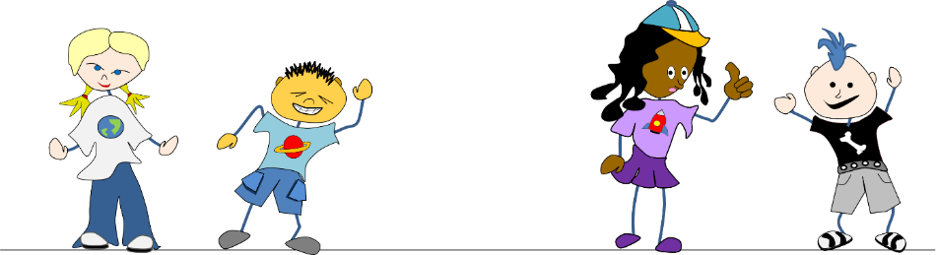
BIY Mission:
Inspire and guide kids to build and use new tools wisely.
Enable kids from different cultures to build together.
Build-It-Yourself.com
Notes:
‘With the right tool, you can move the earth.’ - Archimedes
Nothing important happens without teamwork.
This has been BIY’s mission for 20 years.

Slide 5




Immediate Problem
Universities and employers aren’t just looking for tech-savvy candidates with good test scores — they’re looking for responsible innovators. People who don’t just use new tools, but understand their impact…. people who can build with purpose, question assumptions, and lead with integrity. In a world flooded with emerging technologies, wisdom is the new differentiator.
Mission
Evolve the BIY program to prepare the next generation of builders to use new tools wisely ,,, especially AI.
Build-It-Yourself.com
Notes:
Many parents think screen time/AI threatens social interactions, emotional intelligence, and even IQ.
Others say that we are on the cusp of the most significant revolution in the history of our good earth.
We have a golden opportunity to steer this revolution.

Slide 6
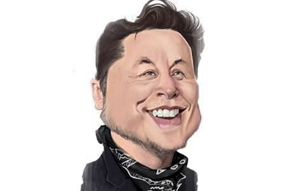

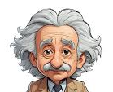
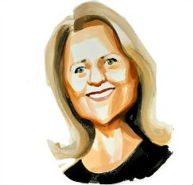
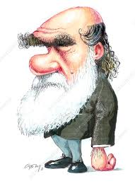
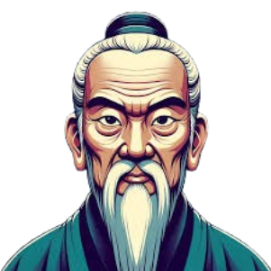
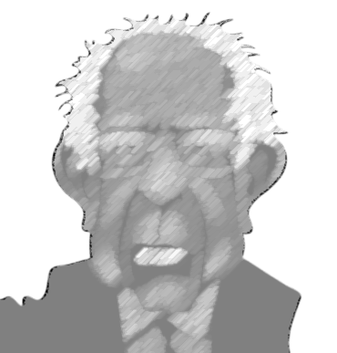
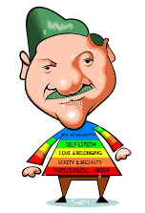

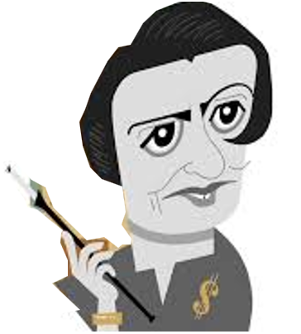
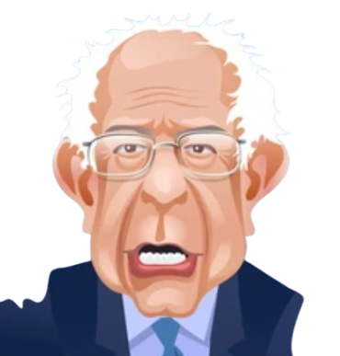

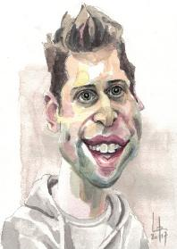

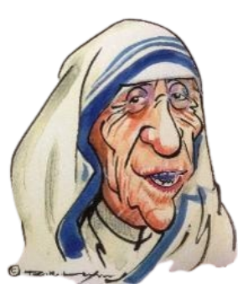
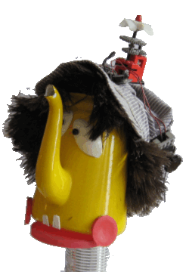
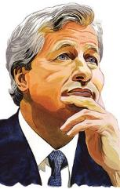
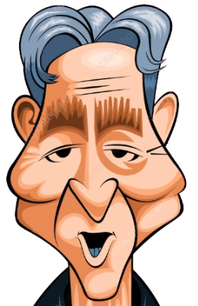

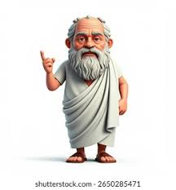
AI Skills Research
Build-It-Yourself.com
Notes:
What can we learn from our heroes about the skills tomorrow’s leaders should cultivate.
Confucius said, ‘Cultivate Virtue.”
Darwin said, ‘Survival of the fittest.’

Slide 7
Respect
AI Skills Research
Cultivate virtue
Curiosity
Yin and Yang
Tools
Passion
Trust
Play
Human Nature
Freedom
Values
Adaptability
Survival of the fittest
Entrepreneurship
Communication
Dream
Problem
Solving
First Principles
Build-It-Yourself.com
Notes:
Our research includes over 50 podcasts about well-known “builders” or influencers.
What do they say about skills that will be valued by society?

Slide 8
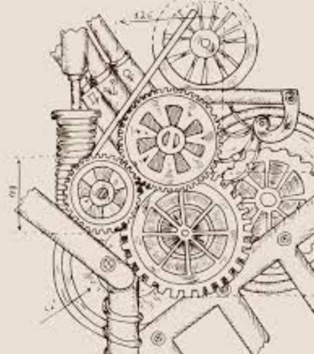

BIY Strategy: Art should lead Technology A-STEM
Think like and artist. Build like an engineer
Build-It-Yourself.com
Notes:
BIY Conclusions:
Maximize freedom … animal nature. (Minimize rules, filters, regulations, censorship.)
On balance, humans have used tools to improve life. (Think positive. Trust others.)
The ARTS should drive technology. (Arts=history, philosophy, art, music, poetry, …)
Survival of the fittest or ADAPTABLE Being the best implies being empathetic. (Be strong, fast, smart, and prosperous.)

Slide 9
BIY AI Skills:
What skills will we need to keep one step in front of the smart robots?
Ethics/Respect that foster creativity and stability for the greatest number of people.
Curiosity and adaptability — the drive to learn new tools and tricks. The ability to ask smart, strategic questions
Teamwork and collaboration
Communication that is clear and impactful
Creativity: Think like an artist
Problem Solver: Think like an engineer
(What else should we add?)
Fantasizing, dreaming, playing,
???
Build-It-Yourself.com
Notes:
What conclusions would you draw to ensure the next generation flourishes?
What do you like about the education your kids are getting?
What could be better?

Slide 10
Discussion Topics:
Does screen time make you dumber?
Will AI make more or less jobs?
What can we learn from history and influencers?
What is human nature w/r tools?
What are 'wise' tool rules?
Can we put global guard rails on certain tools?
How much should we trust others to follow rules?
What could happen if individuals, companies, or countries impose unilateral moratoriums on tool development?
What skills will be valued in an AI world?
How can we evolve BIY content and environment to drive our philosophy?
Build-It-Yourself.com
Notes:
BIY is scheduling a series of meetings with parents and members to discuss these questions.

Slide 11

BIY AI Skills:
What skills will we need to keep one step in front of the smart robots?
Values
Respect
Ethics
Execution
BIY
Problem solving
First principles
Tools
Communication
Passion
Imagination
Curiosity
Entrepreneurship
Build-It-Yourself.com
Notes:
BIY Strategy:
The Build-It-Yourself environment focuses on 9 skills in 3 categories.

Slide 12
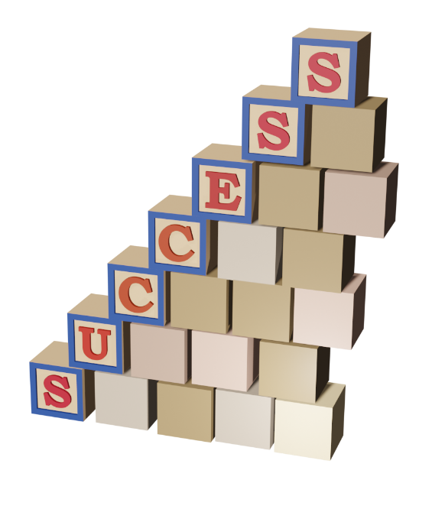
BIY AI Skills:
How BIY exercises 9 valuable AI skills?
1) Project storylines.
(Ethics, curiosity, creativity, entrepreneurship)
2) Build-It-Blocks
(First principles, tools, problem solving tricks)
3) Invention Universe
(Respect, communication)
Build-It-Yourself.com
Notes:
BIY Strategy:
Skill development is driven by 3 BIY Project Based Learning platforms.

Slide 13
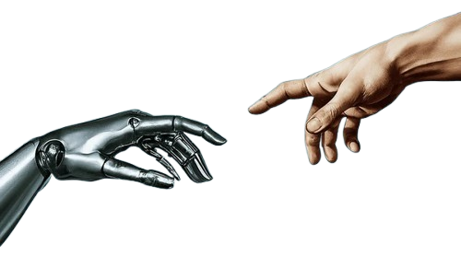
Goal: Inspire and guide kids 8-12 to use AI tools wisely.
Use AI tools and agents aggressively in all 30 BIY projects to experience the pros and cons.
Build-It-Yourself.com
Notes:
BIY offers thirty 8-week projects over 5 years.
BIY encourage kids to experiment with new tools aggressively in every project.
Maximize freedom. Think positive. Trust that there are more good guys than bad.
School: teachers, tests, memorize -> BIY: heroes, missions, experiments

Slide 14

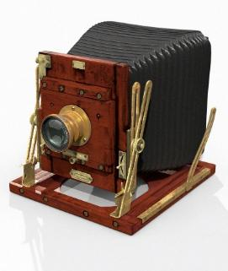
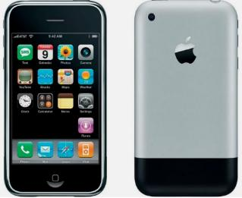
Goal: Inspire and guide kids 8-12 to use AI tools wisely.
101: History of Tools and Prompt Engineering
Document the Problem and Mission.
What is the definition of Artificial Intelligence?
Research examples of AI tools
Document technology ethics:
  How did tools like the printing press and camera impact society?
  What is plagiarism?
  What is an AI hallucination?
What are the attributes of a question or prompt that gets a useful answer?
What are 3 ways to make a robot smart? (Rules-based, ML, Neural Networks.)
Code Scratch to talk to a smart AI robot.
Results
Build-It-Yourself.com
Notes:
6 of BIY’s 30 projects are directly about AI.
AI 101: Ethics. History. Prompt engineering. Human/machine interface.

Slide 15

Goal: Inspire and guide kids 8-12 to use AI tools wisely.
102: Use AI tools to tell a story
Document the Problem and Mission.
What are the attributes of famous stories?
Write the goals and context of your story about a smart robot.
Write a story example.
Use AI tool Bing/ChatGPT to enhance your story.
Summarize what you learned from Bing/ChatGPT.
Code an animated Scratch video that makes your story go viral.
Results
Build-It-Yourself.com
Notes:
6 of BIY’s 30 projects are directly about AI
AI 102: Can a smart robot be creative at writing?

Slide 16


Goal: Inspire and guide kids 8-12 to use AI tools wisely.
103: Teach a smart AI robot to draw.
Document the Problem and Mission.
What is creativity, and why is it important?
Research attributes of famous modern, abstract art?
Code Scratch to teach a smart AI robot how to draw a ‘creative’ picture.
Use feedback to improve the smart AI robot’s drawing skills.
Introduce your smart artist robot to the world.
Results
Build-It-Yourself.com
Notes:
6 of BIY’s 30 projects are directly about AI
AI 103: Can a smart robot be creative at drawing?

Slide 17

Goal: Inspire and guide kids 8-12 to use AI tools wisely.
104: Teach a smart AI robot to compose music.
Document the Problem and Mission.
What is creativity, and why is it important?
Research attributes of famous music composers?
Document music concepts: Timing and Scales.
Code Scratch to teach a smart AI robot how to compose unique music.
Use feedback to improve the smart AI robot’s music skills.
Introduce your smart musician robot to the world.
Results
Build-It-Yourself.com
Notes:
6 of BIY’s 30 projects are directly about AI
AI 104: Can a smart robot be creative at composing music?

Slide 18
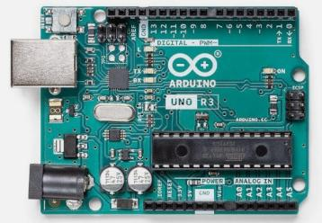
Goal: Inspire and guide kids 8-12 to use AI tools wisely.
105: Build a smart AI alarm clock.
Intro to Computer Science and Electronics.
In development
Document the Problem and Mission.
Document project planning process.
Research Inputs, Outputs, Processing, Feedback.
Specify a smart AI robot alarm clock.
Plan clever human/machine communication.
Document programming primitives.
Test how long it takes to execute computer commands.
Code a timer and test how accurate it is.
What are the pros and cons of Scratch, Python, C++, Java, JavaScript?
Code Scratch and ??? to make an accurate, talking alarm clock.
Introduce your smart AI robot alarm clock to the world.
What are the limitations of AI computers?
Results
Build-It-Yourself.com
Notes:
6 of BIY’s 30 projects are directly about AI
AI 105: Can a smart robot be productive in the physical world?

Slide 19
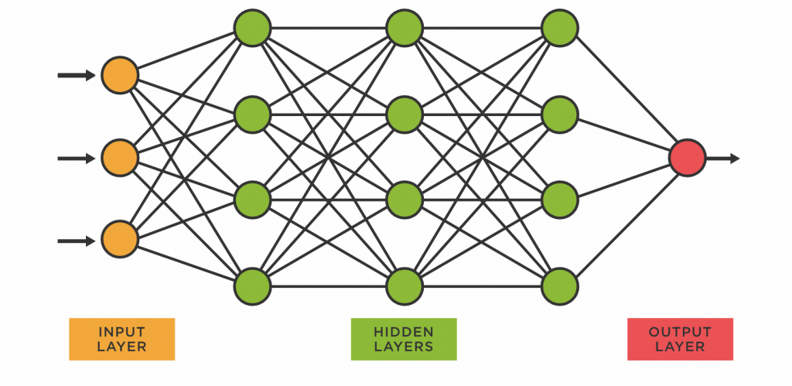
Goal: Inspire and guide kids 8-12 to use AI tools wisely.
106: Teach a smart AI robot to recognize patterns.
Document the Problem and Mission.
What is creativity, and why is it important?
Research 3 ways to make a robot smart?
Document neural networks.
Document hallucinations.
Train a robot to recognize picture patterns.
Introduce your project to the world.
Results
Build-It-Yourself.com
Notes:
6 of BIY’s 30 projects are directly about AI
AI 106: What are first principles of smart AI robots?

Slide 20
BIY Environment:
Safe (No mean machines. Tool Rule #1: Don’t cut finger off.)
Prosperous (Lots of tools, toys, and junk)
Trust and Respect (Global laboratory)
Diverse (Multi-discipline. Global laboratory)
Maximum Freedom (Think like an artist. Cookbooks -> Proj Mgmt)
Playful (Lifelong Kindergarten. Gamify everything.)
Entrepreneurial (Be strong, fast, smart, and prosperous.)
Curious (Beyond Black Boxes)
Fearless (Don’t be afraid to look silly. Learn what not to do. )
Passionate (Growth path)
Invitation:
Help us evolve this environment and find a wise balance between the virtual world and real world.
Build-It-Yourself.com
Notes:
The BIY Environment has evolved over 20+ years.
We invite you to help us make the BIY global laboratory available to everyone.

Slide 21
Notes,
Feedback from Parents,
and
Research References

Slide 22
Research Influencers - AI Skills:
What are the skills tomorrow’s companies will need in an AI world?
Curiosity
Read a lot. Learn a lot in multiple fields. Apply critical thinking to anything you are told.
Elon Musk to future officers at West Point
Cultivate virtues
These virtues include imagination, risk-taking, and pursuing personal goals
Ayn Rand – Philosopher who inspires many builders
Humility, openness, fairness
Jaimie Diamon – CEO JP Morgan, world’s biggest bank
Build-It-Yourself.com
Notes:
Our research includes over 50 podcasts about well-known “builders” or influencers.

Slide 23
Research Influencers - AI Skills:
What are the skills tomorrow’s leaders will need in an AI world?
Adaptability and emotional intelligence
Gwen Shotwell – President SpaceX
Resilience
“Determination, and the ability to set the right direction for AI tools will be crucial in the age of AI.”
Sam Altman – ChatGPT founder
Love
“Spread love everywhere you go.”
Mother Teresa”
Build-It-Yourself.com
Notes:
Our research includes over 50 podcasts about well-known “builders” or influencers.

Slide 24
Research Influencers - AI Skills:
What are the skills tomorrow’s leaders will need in an AI world?
Imagination
“Logic will get you from A to Z. Imagination will get you everywhere.”
Albert Einstein – E = mc²
Embrace change and experimentation
“I think I’ll be a little bit of a mad scientist this year.”
Lucy
Willingness to take risks
“Risk is our business. That's what this starship is all about. That's why we’re aboard her.”
Captain Kirk
Build-It-Yourself.com
Notes:
Our research includes over 50 podcasts about well-known “builders” or influencers.

Slide 25
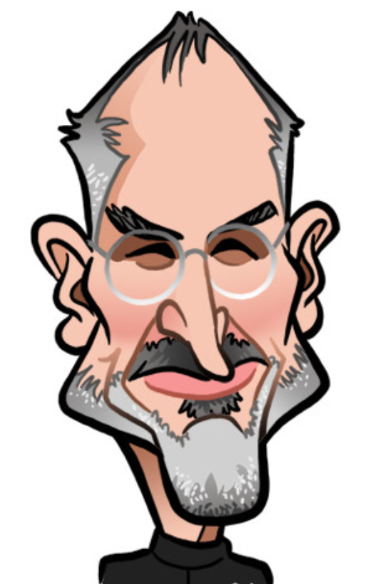
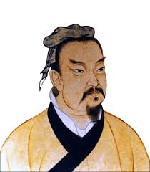
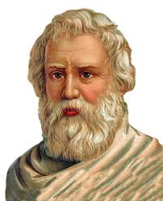
Research Influencers – Human Nature:
What are the skills tomorrow’s leaders will need in an AI world?
Passion
“Don’t let the noise of others’ opinions drown out your own inner voice.”
Steve Jobs – Founder Apple Computer
Be Smart
“Know yourself. Subdue the enemy without fighting.”
Sun Tzu– Philosopher, Warrior, The Art of War
Leverage
“Give me a lever long enough and I will move the earth.”
Archimedes – Greek scientist
Build-It-Yourself.com
Notes:
Our research includes over 50 podcasts about well-known “builders” or influencers.

Slide 26
Research Influencers - AI Dangers:
What are the skills tomorrow’s leaders will need in an AI world?
Dominate
Dominate data
Unleash public and private resources
Promote
Akex Wang – Scale AI
Stop AI Development
“…could wipe out nearly 100 million jobs…
…a super‑intelligent AI could replace humans in controlling the planet…”
Senator Bernie Sanders
AI Danger
“I feel very sad watching artificial intelligence grow more powerful while the world fails to take its dangers seriously.”
Jeffery Hinton – DeepSeek, Google, Father of AI
Build-It-Yourself.com
Notes:
Our research includes over 50 podcasts about well-known “builders” or influencers.

Slide 27
Research Influencers – Human Nature:
What are the skills tomorrow’s leaders will need in an AI world?
Survival of the fittest
The fastest, strongest, smartest survive
Darwin – Evolution Scientist
Human Needs
Safety
Prosperity
Happiness
Maslow – Psychologist/Philosopher
Democracy vs. Autocracy
When your ship is in a storm, who do you want to steer, an experienced captain or a committee of green sailors?
Socrates, Plato, Aristotle
Build-It-Yourself.com
Notes:
Our research includes over 50 podcasts about well-known “builders” or influencers.

Slide 28
Research Influencers – Human Nature:
What are the skills tomorrow’s leaders will need in an AI world?
Virtue
Humans must cultivate virtue.
Confucius – Chinese Philosopher
Taoism Good vs. Evil Balance
There is a balance between light and dark, man and woman, good and evil.
But … It is better to be an optimist and wrong than a pessimist and right.
Mark Twain
Optimism vs. Pessimism
DREAM and think positive.
Build-It-Yourself Spirit
Build-It-Yourself.com
Notes:
Our research includes over 50 podcasts about well-known “builders” or influencers.

Slide 29
BIY Philosophy:
https://build-it-yourself.com/dev/biy-bus-dev/biy-ai-research-podcasts.txt
1) Art should lead technology (Content examples)
2) Building together is key to solving big problems (Live wkshps)
3) Sharing ideas is key to solving big problems (IU)
4) Breaking a solution into simple parts is key to solving big problems (BIB)
5) The cuckoo bird is the Build-It-Yourself mascot.
It is difficult to learn and be creative if you are afraid to look silly.
6) The words, "I can't" are forbidden at BIY.
7) Tool rule #1: "Don't cut finger off."
8) Respect, Curiosity, Passion, Discipline, and Communication are skills tomorrow's companies will value.

Slide 30
BIY Philosophy:
Measures of success:
1) When kids who don't know each other, help another learn.
2) Kids are engaged when they do work on their own, buy something, or sign up for a 2nd project.
Safety
Add to ‘Safety' website page:
https://build-it-yourself.com/s-safety/index-safety.php
On philosophy of race, religion, politics, ... BIY tries to enforce values that encourage members to be open minded and constructive global citizens.
BIY does not promote any particular right or wrong position. Sometimes in storylines or examples, BIY may paint the extreme sides of a controversial issue and then ask members to think about a middle ground that works for them.

Slide 31
BIY Philosophy:
Safety
BIY does not use 'inappropriate' images or vocabulary as defined by the MA DOE
Examples:
Do not reference controversial people in heroic or derogatory ways.
Use ugly, average, way cool examples but be open minded about what is good and bad.
Do not use 'inappropriate' vocabulary as dictated by MA, CA or TX DOEs.
(Find reference)
Physical Safety
BIY has served over 5000 kids and trained over 100 TAs. No one has ever gone to the hospital. Plenty of gone to a camp or school nurse and quickly returned.

Slide 32
Skills needed in an AI world:
Respect life and tools. (Humility, historical perspective.)
Establish rights and wrongs. (Ethics. Cultivate virtues.)
Collaborate.
Communicate clearly, concisely, impactfully.
Be resilient.
Take risks.
Embrace change.
Fantasize, Dream, Imagine.
Be fair. Be empathetic.
Be curious, ask questions. (The Socratic method, prompt engineering)
Manage projects. (4D process)
Be passionate
Use disciplined project mgmt. and problem solving process
Know first principles
Know how to use tools

Slide 33
Concord Academy AI Guidelines
https://www.youtube.com/watch?v=t9gmyvf7JYo
Prompt with context
Customize your experience:
Tell chat who it is and who you are. (Customized learning)
Give personal examples.
Ask for steps. goal, outline, draft, edit draft
Filter hallucinations.
Be suspicious.
Check multiple times and multiple tools (Bing, Bard, Chat) to verify the accuracy
ChatGPT is offline. Bing uses ChatGPT + online resources. Ask Bing for references.
Projects
Write or improve a story
solve a problem
make a test
Give students a model prompt and challenge to change prompt to get different results.
Ask students to analyze the answer.
Benefits
Eliminate a teacher’s repetitive busy work.
Customize content quickly.
Democratize education.

