Slide 1
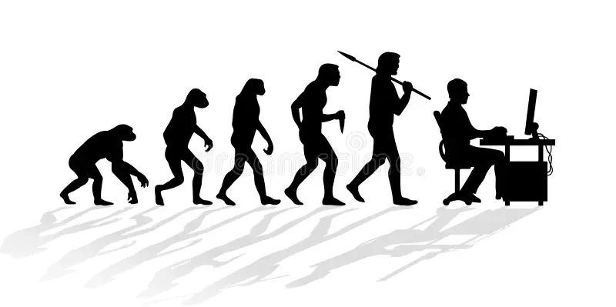
Philosophy of Tools
Lab Book
Ryan, Lena, Rodrigo, Sofia, Adi, Cindy, Claire, John
Build-It-Yourself

Slide 2
Strategy
The 4D Process
Discover:
Define the problem and mission
Research the history of tech and society.
Research qualities of a compelling presentation.
Design:
Storyboard our conclusions.
Draft and design text and layout. UX
Develop
Code
Deploy
Present and iterate
Build-It-Yourself

Slide 3
Problem 1
Universities and employers aren’t just looking for tech-savvy candidates—they’re looking for responsible innovators. People who don’t just use new tools, but understand their impact. People who can build with purpose, question assumptions, and lead with integrity.
In a world flooded with emerging technologies, wisdom is the new differentiator
.
Mission
Create a web page that could show off your technology philosophy plus your writing, graphic design, and coding skills. (A compelling web page that describes how you will use technology wisely.)
Build-It-Yourself

Slide 4
Problem 2
Many BIY parents are afraid that too much screen time (game, social media, and AI apps) are hurting their kids.
Mission
Create a web page that convinces BIY customers / parents that we are preparing their kids to use technology wisely. And that new tools are likely to do far more good than bad if we prepare the next generation of builders properly.
Build-It-Yourself

Slide 5
Research
Pros and Cons
Of screen time

Slide 6
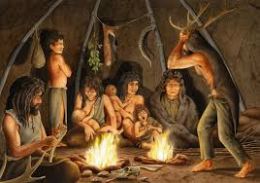
One of the first technologies
"fire was not just a tool...
it was a transformative force in human development, one that allowed us to shape the world around us and enabled the technological leap from basic survival to civilization-building."
- ChatGPT​
Enhanced social connection, diet, overall productivity. Unlocked new survival adaptations, increased brain growth, improved human intelligence.
With all its benefits, fire is notably dangerous. From its discovery, required careful management to prevent widespread destruction
Build-It-Yourself

Slide 7

Screen time is "digital fire"
Screen time, a "digital fire", fundamentally changes the way humans create and connect.
Our species will experience long-term evolutional adaptions based on how we engage with this technology.
+++ Pros +++
Connections across boarders
Unlimited information access, endless learning potential
Transformative productivity presents an opportunity to distribute its benefits to a global population quicker than we have ever seen
--- Cons ---
Effect on cognitive development, compared to fire, may not be positive for individual intelligence.
Can lead to over-isolation, social anxiety, and a loss of face-face community values.
Digital addiction can spread like wildfire
Build-It-Yourself

Slide 8
Don't forget – we build for humans!
Our generations wield the torch! How will we guide usage on this technology to ensure a long-term benefit to society?
What do you see as the right balance of usage, and how will you achieve this in your day-day life in and outside of work?
Creation and content are becoming a commodity... how will you bring value at a higher level?
The best companies will be more interested than ever in your HUMAN qualities.
Emotional intelligence demonstrated throughout your technological engagements
A demonstrated commitment to avoiding the pitfalls of mis-use
Use the ability to globally connect to lift up the community around you – do NOT seek an isolated path to the top that steps on the shoulders of others!
Build-It-Yourself

Slide 9
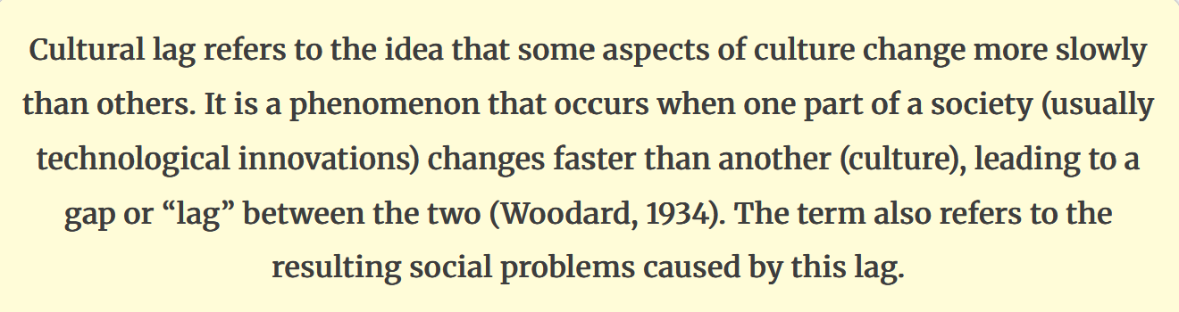
What is "cultural lag"?
Source and extra details
Build-It-Yourself

Slide 10

Case study: Industrial Revolution
Stage 1: Technological Acceleration (c. 1750–1820)
Rapid innovation: steam power, mechanized textile
Work moves from home workshops → factories.
Lag: Society unprepared for factory conditions, wage labor, and urban life.
No labor laws, poor working conditions.
Stage 2: Social Dislocation & Resistance (c. 1820–1850)
Urban crowding, disease, child labor, and class tension.
Lag: Industrial systems advanced faster than moral norms or urban infrastructure.
Breakdown of traditional family/work patterns.
Stage 3: Institutional Adaptation (c. 1850–1890)
Gradual social & legal reform: Factory Acts, labor unions, public health.
Growth of education and welfare movements.
Lag narrowing: Society begins adjusting values & institutions to industrial reality.
Build-It-Yourself

Slide 11
Digital Revolution is not so different!
Stage 1: Technological Acceleration (1970–2000)
Rise of PCs, Internet, and early mobile tech
Information becomes instant and global
Lag: Society still organized around analog habits and laws
Stage 2: Social Dislocation & Tension (Now)
Smartphones, social media, and AI reshape daily life
Anxiety, distraction, and “screen time” concerns grow
Lag: Data privacy, digital labor, mental health implications
Stage 3: Adaptation (hypothetical)
Regulation of data, AI, and screen use develops
Digital literacy and wellbeing become civic priorities
Cultural “guardrails” form to balance connection and health
⟶ What do you think this looks like?
Build-It-Yourself

Slide 12
Research Pros and Cons of Screen Time
Questions:
Can internet tools make us more or less creative, connected, and fulfilled?
What skills will tomorrow’s companies—and communities—really value?
What makes you feel proud, curious, and alive?
How can BIY help you grow those skills and share them with others?
Build-It-Yourself

Slide 13
Research Pros and Cons of Screen Time
Questions:
What was life like before paper and paint were invented?
Is AI making us dumber or more creative?
Lazier or more able to pursue our passions?
More isolated or connected to many cultures?
Build-It-Yourself

Slide 14
Research Pros and Cons of Screen Time
Will AI be the devil?
Emphasizing evil helps focus to solve a problem
Bernie Sanders – Senator
https://www.youtube.com/shorts/zKMtIY_2gZE
Jeff Hinton – Deep Mind, God-father or AI
https://www.youtube.com/shorts/Wd8RzZ3xn7w
Yuval Horari - Isreali Philosoper
https://www.youtube.com/watch?v=8GaW36EfidI
Build-It-Yourself

Slide 15
Research Pros and Cons of Screen Time
Will AI be omnificent?
One component of creativity is ‘positivity.’ (B. Fredrickson)
Jamie Diamon – JPMorgan CEO
https://www.youtube.com/shorts/y62hsE22DSY
Mustafa Sulyman CEO MS AI
https://www.youtube.com/watch?v=SP76PvgMzVU
Elon Musk – Space X CEO
https://w.yEOoutube.com/shorts/B3hx9DMG3Bw
Jensen Huang – Nvidia CEO
https://www.youtube.com/watch?v=jpZ0dPsnIWw
Build-It-Yourself

Slide 16
Research Pros and Cons of Screen Time
Technology Ethics:
What are good and bad applications of inventions that changed the world?
Cavemen invented how to make fire.
Fire can keep you warm, cook your food, and light your cave at night.
Fire can also be used to burn an enemy.
Chat GPT
Fire was a game-changer for early humans—especially for warmth, cooking, and light. The ability to make and control fire is one of the most important technological leaps in human history.
🔥 Who "invented" fire-making? While cavemen didn’t invent fire itself (it existed naturally), they did learn how to create and control it. This likely began with Homo erectus around 1.5 million years ago, who may have used friction or striking stones to spark flames. Over time, fire-making became a skill passed down through generations.
Notes:
Before a good engineer builds, she or he should know what others have done.
AND THEN
Think about first principles. Or … how can we use facts to make better solutions?

Slide 17
Research Pros and Cons of Screen Time
Technology Ethics:
What are good and bad applications of inventions that changed the world?
Cavemen invented how to make fire.
Fire can keep you warm, cook your food, and light your cave at night.
Fire can also be used to burn an enemy.
Chat GPT
🍲 Why fire mattered:
Warmth: Essential for surviving cold climates.
Cooking: Made food safer and easier to digest.
Light: Extended activity into nighttime.
Protection: Kept predators at bay.
⚔️ Fire as a weapon? Yes, fire has also been used in conflict—though that came much later. Ancient armies used flaming arrows, burning oil, and even fire traps. But for early humans, fire was more about survival than aggression.
Research life span and quality of life before and after humans learned to control fire.
Notes:
Before a good engineer builds, she or he should know what others have done.
AND THEN
Think about first principles. Or … how can we use facts to make better solutions?

Slide 18
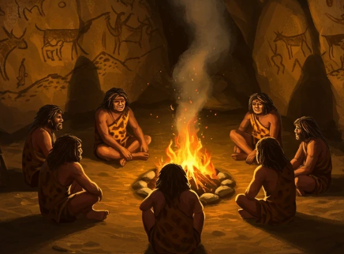
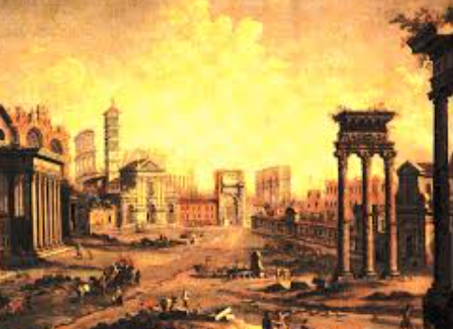
Research Pros and Cons of Screen Time
Invention of Fire:
Humans learned how to make fire and control it 1.5 million years ago.
Fire can keep you warm, cook your food, and light your cave at night, protect you from animals.
Fire can also be used as a weapon to kill.
What can we learn from this ‘game changer?’
It took many many years before humans switched this invention from a survival tool to a tool that could harm others.
Overall, was fire good or bad for the human race?
If fire was bad for humans, on balance, would humans continue to use it?
Notes:
Before a good engineer builds, she or he should know what others have done.
AND THEN
Think about first principles. Or … how can we use facts to make better solutions?

Slide 19
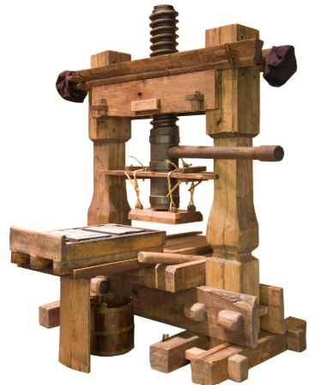
Research Pros and Cons of Screen Time
Invention of Printing Press:
How did the printing press and internet change society?
Many say that the industrial revolution, which improved the lives of many people, started when the printing press was invented. The printing press enabled people to share more ideas.
However, the printing press was sometimes used to spread lies that could hurt people.
Notes:
Before a good engineer builds, she or he should know what others have done.
AND THEN
Think about first principles. Or … how can we use facts to make better solutions?

Slide 20

Research Pros and Cons of Screen Time
Technology Ethics:
What are good and bad applications of inventions that changed the world?
Should right and wrong be set by
instinct or by
emotions or by
facts and logic?
Animals live mostly by instinct and evolution, not logic.
But animals can learn.
Notes:
Before a good engineer builds, she or he should know what others have done.
AND THEN
Think about first principles. Or … how can we use facts to make better solutions?

Slide 21
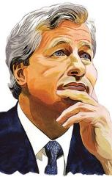
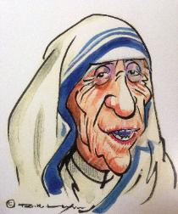

Research Pros and Cons of Screen Time
Technology Ethics:
What do opinion leaders say?
Jaime Diamon – CEO, JP Morgan Bank
Humility
Openness
Fairness
Authenticity
Mother Teresa
“Spread love everywhere you go.”
Akex Wang – CEO, Scale AI
Dominate data
Unleash public and private resources
Set safe guidelines
Promote
Notes:
Before a good engineer builds, she or he should know what others have done.
AND THEN
Think about first principles. Or … how can we use facts to make better solutions?

Slide 22
Research Pros and Cons of Screen Time
What skills will tomorrow’s companies—and communities—really value?
What skills have businesses valued most historically?
What new skills are important after the internet?
?????????
Build-It-Yourself

Slide 23
Research Pros and Cons of Screen Time
What makes you feel proud, curious, and alive? Who had the most fulfilling lives?
Cave men?
Middle ages?
Today?
Whose employees are happier?
General Motors vs. Tesla?
Build-It-Yourself

Slide 24
Research Pros and Cons of Screen Time
Is there a difference between past tools and AI technology (Agentive AI)?
Humans control tools.
AGI can create and act on ideas it generates.
Yuval Harari – Isreali Philosopher / Historian says AI companies need urgent regulation and ethics oversight. (Globally possible?)
https://www.youtube.com/watch?v=8GaW36EfidI
Build-It-Yourself

Slide 25
Research Pros and Cons of Screen Time
How will AI impact the work force?
Bernie Sanders says AI will destroy the middle class
https://www.youtube.com/watch?v=K3qS345gAWI
MIT Economics prof David Autor says AI will enable everyone to be more highly valued.
https://www.youtube.com/watch?v=1Epl0bI_jW4
MS AI CEO Mustafa Sulyman says AI will empower and democratize everyone to build ideas.
https://www.youtube.com/watch?v=SP76PvgMzVU
Build-It-Yourself

Slide 26
Research Pros and Cons of Screen Time
Will AI make us dumber or more creative?
Creativity = Imagination + Knowledge + Courage
Creativity = Positivity + Knowledge + Imagination + Evaluation
Barbara Fredrickson
There is evidence that AI is making us dumber at math, spelling, grammar, writing, memorizing facts.
Analysis of MIT 2025 study.
https://www.youtube.com/watch?v=gV9qUGOYk1Q
https://www.youtube.com/watch?v=faWcUoshAHA
Does AI enable more brain cells to engage in creative thinking?
Build-It-Yourself
Notes:
In an AI world, EQ, AQ, and SQ will prevent robots from making you redundant.
9 skills will be highly valued. BIY aims to exercise these skills in a series of 8-week projects. Skill 9 is what most parents value highly. Skills 1-3 will be what future companies will need to harmonize with AI. Skills 4-8 will be needed to get useful things done.

Slide 27
Research
Conclusions

Slide 28

To build a better future we must learn to use the tools of the future.
Build-It-Yourself
Notes:
How does BIY guide kids to build and be skeptical in a way that benefits the most people?

Slide 29
What is the wise balance between embracing and resisting new tools?
Build-It-Yourself
Notes:
How does BIY guide kids to build and be skeptical in a way that benefits the most people?

Slide 30
Fork in the Road?
Impose a global order to control technology
Let the strongest society dictate
???
Build-It-Yourself
Notes:
How does a community preserve its culture?
What is the environment that promotes the most freedom?

Slide 31
Analysis
Inputs
Research:
Problem
Utopia
Human Nature
History
Influencers
Outputs
Specify:
Goals
Tool Guidelines
BIY Content
BIY Environment
Build-It-Yourself
Notes:
Project Plan

Slide 32
History
Major Inventions
Fire 400K yrs
Wheel 5K yrs
Printing press 1K yrs
Steam engine 800 yrs
Nuclear energy 80 yrs
Computers 80 yrs
AI 50 yrs
Build-It-Yourself
Notes:
How did societies react to these inventions?
How quickly will powerful new tools evolve?

Slide 33
History
Dark Ages
Lords and Surfs.
Religious regulators discouraged new ideas.
0 -1500
Build-It-Yourself
Notes:
Major invention: Gun powder

Slide 34
History
Renaissance
Builders Medici, Leonardo, Michelangelo led the way to the industrial revolution.
1500-1800
Build-It-Yourself
Notes:
Major inventions: Music, art, architecture, …

Slide 35
History
Industrial Revolution
The steam engine reduced hard labor.
1800-1950
Build-It-Yourself
Notes:
Printing press, steam engine, transportation made the masses more mobile and informed. Less slavery?

Slide 36
History
Computer Revolution
Computers reduced repetitive labor.
1950 - ?
Build-It-Yourself
Notes:
Computers and the internet made the masses more productive and globally connected.

Slide 37
History
AI Revolution
AI may enable all humans to make passions and dreams come true.
1975 - ?
Build-It-Yourself
Notes:
How will AI be used for good and for evil?

Slide 38

Conclusions
Human Nature ?
Good vs. Evil
Build-It-Yourself
Notes:
Ancient Chinese philosophers saw balance between good and evil, optimism and pessimism, light and dark, man and woman.

Slide 39
Conclusions
Build-It-Yourself
Build-It-Yourself
Notes:
At BIY, we want our builders to believe more people are good than evil. Therefore, we should trust fellow humans and minimize rules.

Slide 40
Conclusions
Build-It-Yourself
BIY believes that large majority of people want to build machines that:
Enable more freedom.
Benefit the most people.
Build-It-Yourself
Notes:
Trust that good trumps evil and therefore minimize rules.

Slide 41
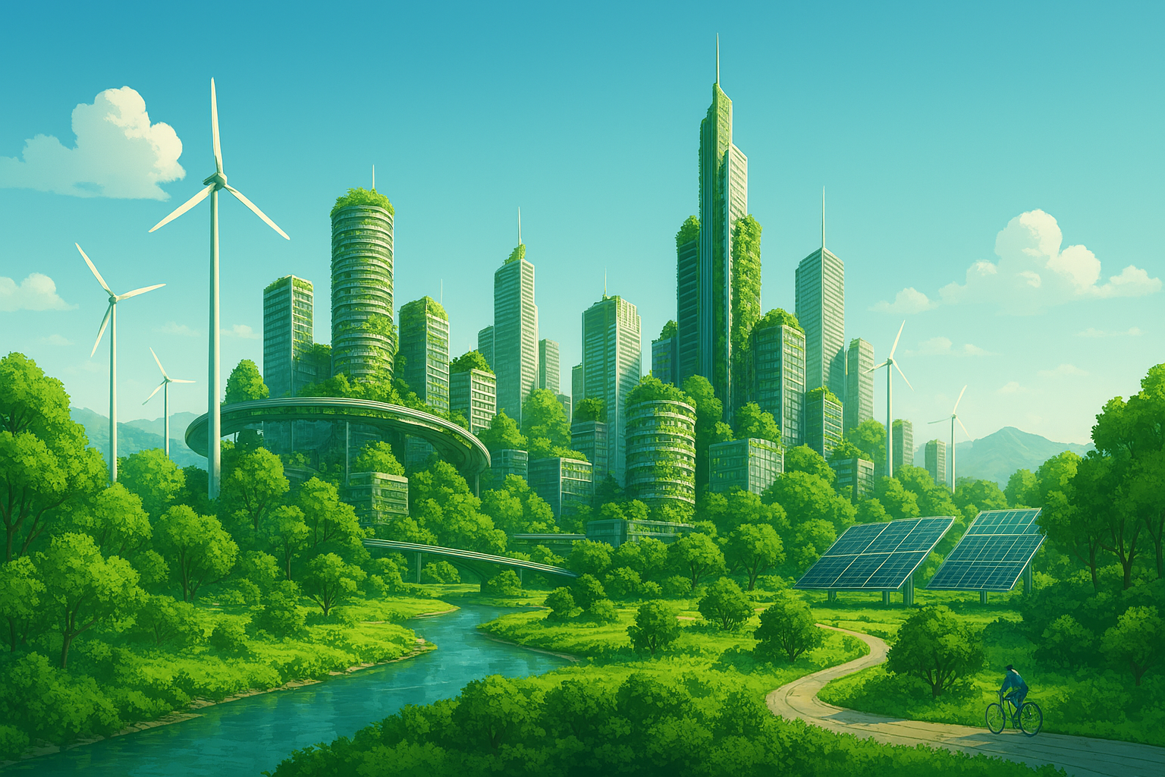
Conclusions
Build-It-Yourself
Thoughtful integration of art, nature, and technology.
Build-It-Yourself
Notes:
On balance, the world gets better.

Slide 42
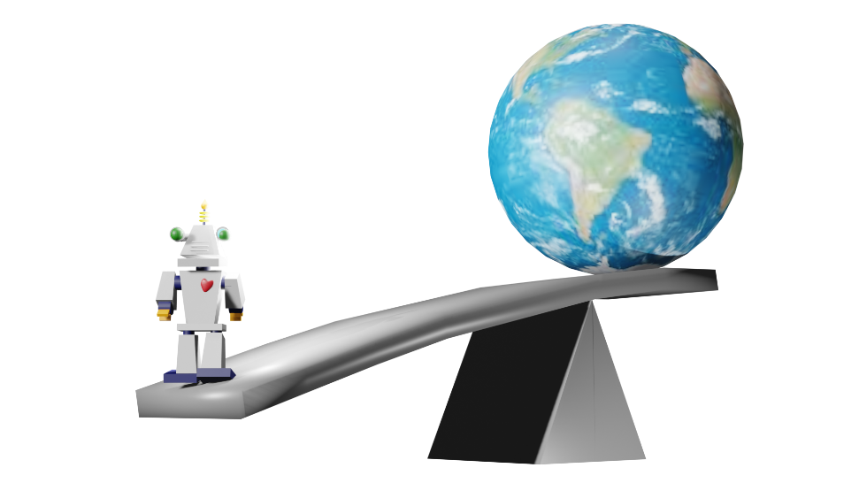
Execution
Build-It-Yourself
Embrace technology to make the world even better.
Build-It-Yourself
Notes:
At BIY, Freedom is the goal.
But Peace (safety) and Prosperity (money) must come first.
Maslow said basic human needs are:
Physiological Needs – Food, water, shelter, clothing, sleep. Safety Needs – Security, stability, protection, health, employment.
Love & Belonging Needs – Relationships, friendships, intimacy, community.
Esteem Needs – Respect, recognition, achievement, confidence.
Self-Actualization – Realizing one’s full potential, creativity, personal growth.

Slide 43
Execution
Stability
Freedom
Prosperity
Peace
Build-It-Yourself
Notes:
At BIY, Freedom is the goal.
But Peace (safety) and Prosperity (money) must come first.
Maslow said basic human needs are:
Physiological Needs – Food, water, shelter, clothing, sleep. Safety Needs – Security, stability, protection, health, employment.
Love & Belonging Needs – Relationships, friendships, intimacy, community.
Esteem Needs – Respect, recognition, achievement, confidence.
Self-Actualization – Realizing one’s full potential, creativity, personal growth.

Slide 44
Conclusions
Fork in the Road?
90% control
10% freedom
???
10% control
90% freedom
Build-It-Yourself
Notes:
BIY’s challenge is to build a culture and environment where there are minimum rules and maximum freedom.

Slide 45
Execution
Conclusions (IQ, EQ, AQ, SQ)
What do you value in a community?
Peace and safety
Strong economy, abundance
Freedom
If you are clever, work hard, and help others, you should be rewarded.
The best chance to reach this state:
Democracy
80% Capitalism + 20% Socialism balance
Rule of law ???
Build-It-Yourself
Notes:
First, we must set our values.
Then, we must be strong, smart, and open mined.

Slide 46
Execution
Conclusions (IQ, EQ, AQ, SQ)
What country do you want to live in?
France, Sweden, Cuba, Russia, China, USA
Every society will try to be strong to protect its values.
If the USA, Google, and BIY slow down technology development, will other countries, companies, or individuals also slow down?
Can everyone win?
BUILDERS RULE!
Build-It-Yourself
Notes:
First, we must set our values.
Then, we must be strong, smart, and open mined.

Slide 47
Execution
Conclusions (IQ, EQ, AQ, SQ)
How can BIY help you grow tomorrow’s skills
Ethics - Art must lead technology.
Respect - Create a global community.
Use technology aggressively to be more creative and productive.
Creativity:
f(positivity, knowledge, imagination, courage)
Build-It-Yourself
Notes:
First, we must set our values.
Then, we must be strong, smart, and open mined.

Slide 48
Execution
Conclusions (IQ, EQ, AQ, SQ)
How can BIY help you grow tomorrow’s skills
IQ Ask interesting questions.
Inspire to be curious by expanding existing storylines.
Promote the Socratic Method.
EQ Interact with a global community.
Build confidence and passion by gamifying everything.
Allocate significant time for presenting projects.
AQ Tie rewards to results.
Promote Build-It-Blocks.
SQ Create opportunities to socialize in Zoom,
Invention Universe, and Meetups.
Build-It-Yourself
Notes:
In an AI world, EQ, AQ, and SQ will prevent robots from making you redundant.

Slide 49
Execution
Conclusions (IQ, EQ, AQ, SQ)
How can BIY help you grow tomorrow’s skills
Trust, Respect,
Be curious, Prompt Engineering, Socratic Method
Establish ethics
Dream, Fantasize, Imagine
Be entrepreneurial - Be positive
Solve problems
Present ideas, Communicate,
Collaborate, Teamwork
Use Tools, Knowledge, First Principles
Build-It-Yourself
Notes:
9 skills will be highly valued. BIY aims to exercise these skills in a series of 8-week projects. Skill 9 is what most parents value highly. Skills 1-3 will be what future companies will need to harmonize with AI. Skills 4-8 will be needed to get useful things done.

Slide 50
Execution
What is the balance between building and regulagtion that benefits the most people?
Create global community mindset.
Maximize incentives to build.
Minimize regulations.
Build-It-Yourself
Notes:
In an AI world, EQ, AQ, and SQ will prevent robots from making you redundant.
9 skills will be highly valued. BIY aims to exercise these skills in a series of 8-week projects. Skill 9 is what most parents value highly. Skills 1-3 will be what future companies will need to harmonize with AI. Skills 4-8 will be needed to get useful things done.

Slide 51
Webpage Design

Slide 52
Compelling Webpage Design
What are attributes of a webpage that make you think?
CoPilot:
Content, especially stories
Contrasts
Minimalism and visuals
Interactivity – THE SOCRATIC METHOD
Drama
Emotional
Call to action
Build-It-Yourself

Slide 53
Compelling Webpage Design
CoPilot:
🧠 Cognitive & Emotional Triggers
Thought-provoking content: Pages that pose questions, present dilemmas, or explore complex topics (e.g., philosophy, ethics, innovation) invite deeper thinking.
Narrative storytelling: A well-crafted story—whether personal, historical, or fictional—can evoke empathy and reflection.
Unexpected juxtapositions: Contrasting ideas, visuals, or themes (e.g., beauty vs. decay, tradition vs. technology) challenge assumptions and spark curiosity.
🎨 Design That Enhances Reflection
Minimalist layout with intentional whitespace: Clean design gives users mental space to process ideas.
Evocative imagery and symbolism: Visuals that carry metaphorical or emotional weight can prompt introspection.
Interactive elements: Quizzes, sliders, or simulations that let users explore scenarios or test beliefs deepen engagement.
🧭 User Experience & Flow
Intuitive navigation: A seamless experience keeps users focused on content rather than mechanics.
Slow reveals or progressive disclosure: Gradually unfolding information builds suspense and encourages exploration.
Calls to action that challenge norms: Instead of “Buy Now,” phrases like “What would you do?” or “Imagine this…” invite reflection.
🔍 Content Depth & Authenticity
Well-researched insights: Pages that cite sources, offer multiple perspectives, or include expert commentary build trust and stimulate analysis.
Personal voice or vulnerability: Authentic writing—especially when sharing struggles or questions—can resonate deeply.
Philosophical or ethical framing: Framing content around “why” rather than just “how” encourages deeper inquiry.
Build-It-Yourself

Slide 54
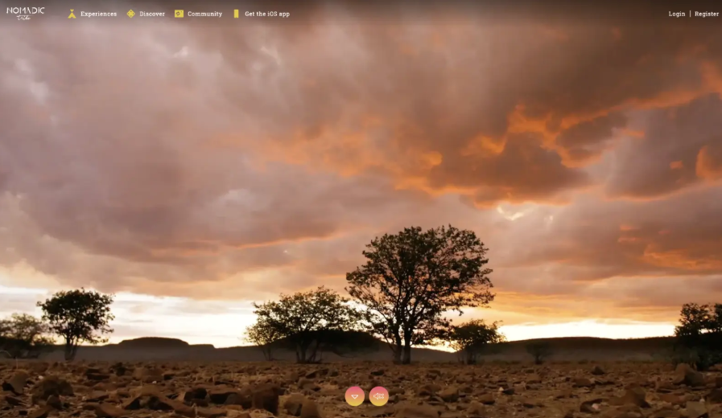
Award Winning Websites

Slide 55
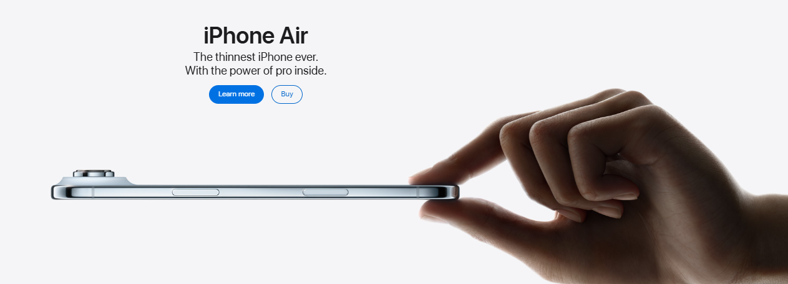
Award Winning Websites

Slide 56
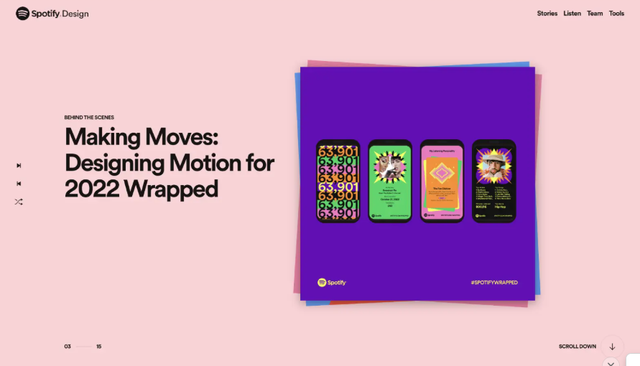
Award Winning Websites

Slide 57
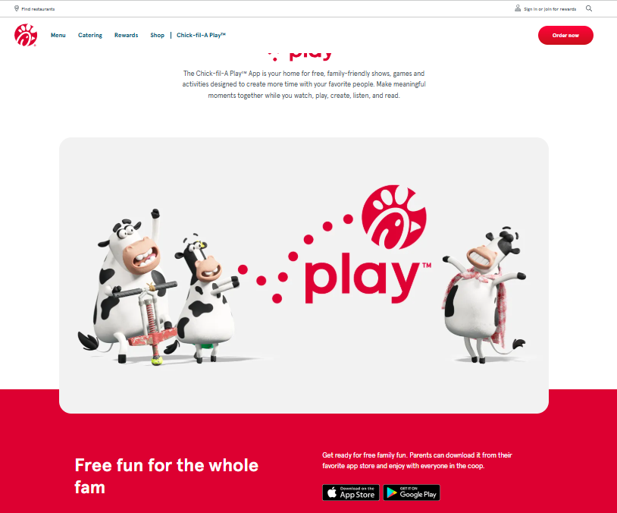
Award Winning Websites

Slide 58
Average
Way Cool
Think Different!

Slide 59
Webpage
Storyboard

Slide 60
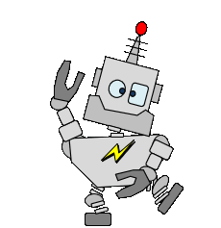
Can’t we just all get along?
Notes:
Would you agree we have a potential dooms day problem? Who gets to rule?

Slide 61

What make humans different?
Notes:
What do you think is the main reason humans have risen to the top of the animal kingdom?

Slide 62
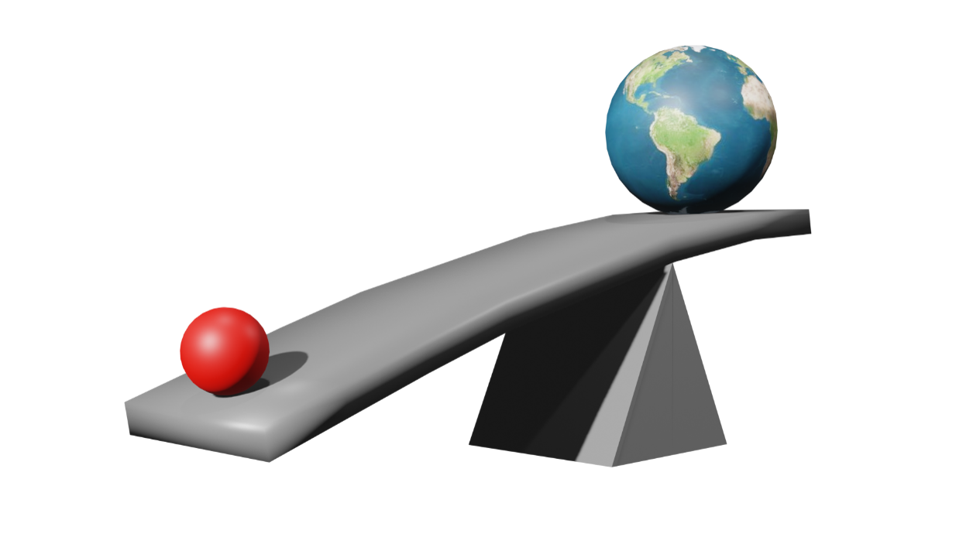

How can we make the world EVEN BETTER?
Notes:
Has life improved because humans have a long history of using tools wisely?

Slide 63
What skills will we need tomorrow?
Notes:
Do you believe there is a natural balance between right and wrong?

Slide 64
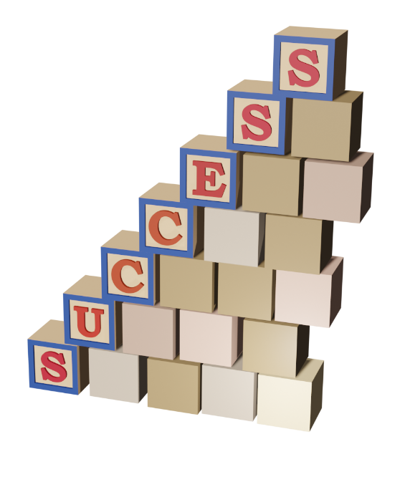
BIY Skills Exercised:
Ethics / Respect
Curiosity
Communication
Creative thinking
Problem solving
Tools
www.build-it-yourself.com
Notes:
Our mission is to inspire and guide the next generation of builders and leaders to use tools wisely.

Slide 65
Please write a playful but thoughtful rap tune that expresses these thoughts:
Can't we just all get along?
What make humans so powerful?
How do we use tools wisely?
CoPilot:
(Verse 1)
Yo, I’m lookin’ at the world like, “What’s goin’ on?”
Feelin’ like Rodney, sayin’ “Can’t we all get along?”
We got brains, we got hearts, we got rhythm and soul,
But we still throw shade when we could be whole.
Why we beefin’ when we breathin’ the same air?
Why we fightin’ when we could be showin’ care?
Unity’s the key, not division and pride,
Let’s build bridges, not walls, let love be our guide.
(Hook)
We got power, yeah, it’s true —
In the things we think and the things we do.
But tools ain’t wise if the heart ain’t right,
So let’s shine smart in the darkest night.

Slide 66
Please write a playful but thoughtful rap tune that expresses these thoughts:
Can't we just all get along?
What make humans so powerful?
How do we use tools wisely?
CoPilot:
(Verse 2)
What makes us mighty? It ain’t just the tech,
It’s the mind, the spirit, the self-respect.
We craft, we code, we paint, we write,
We dream in color, we invent the light.
But power ain’t just in the muscle or gear,
It’s in empathy, courage, and conquering fear.
We build rockets, but can we build peace?
We got tools — now let wisdom increase.
(Hook)
We got power, yeah, it’s true —
In the things we think and the things we do.
But tools ain’t wise if the heart ain’t right,
So let’s shine smart in the darkest night.

Slide 67
Please write a playful but thoughtful rap tune that expresses these thoughts:
Can't we just all get along?
What make humans so powerful?
How do we use tools wisely?
CoPilot:
(Bridge)
Hammer in hand — will you build or destroy?
Code in your brain — will you heal or annoy?
Every tool’s a mirror, reflecting our soul,
So use it with purpose, make kindness the goal.
(Outro)
So next time you scroll, or you speak, or you act,
Ask: “Am I lifting up or holding back?”
We’re powerful beings, with love as our fuel,
So let’s not just be smart — let’s be wise with our tools.
Peace. ✌️

Slide 68
Reference
BIY Intro to team, partners, & investors

Slide 69
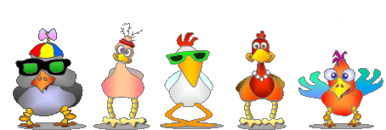
BIY Team Goals
Great Product
Inspiring teammates
Big rewards
www.build-it-yourself.com
Notes:
Lab Book Goal: Focus the BIY Biz Dev Team
How do we turn product into profit?
Doug Hannah – BU Business School Professor, Dartmouth BA, Stanford PhD Management Science and Engineering
Cindy Li – BIY high school intern
Rodrigo Kai – BIY high school intern
Sofia Arana – BIY high school intern
Claire Wang – BIY high school intern
John Galinato – Cornell BEE, MEE

Slide 70
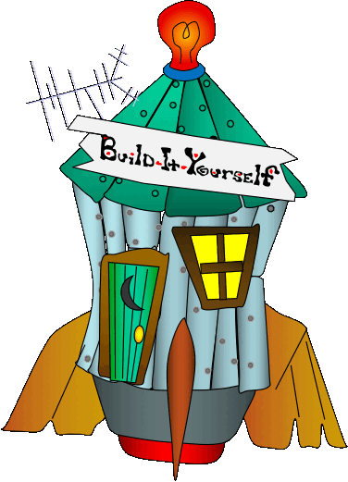
BIY Core Values:
Playful
Creative vs. scientific
Quality
Respect
Entrepreneurial
www.build-it-yourself.com
Notes:
Lab Book Goal: Focus the BIY Biz Dev Team
How do we turn product into profit?
Doug Hannah – BU Business School Professor, Dartmouth BA, Stanford PhD Management Science and Engineering
Cindy Li – BIY high school intern
Rodrigo Kai – BIY high school intern
Sofia Arana – BIY high school intern
Claire Wang – BIY high school intern
John Galinato – Cornell BEE, MEE

Slide 71
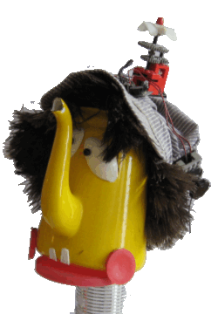
BIY Product Mission
Use technology wisely.
Think like an artist. Build like an engineer
Global laboratory.
Reduce cost AND
increase the value.
www.build-it-yourself.com
Notes:
Lab Book Goal: Focus the BIY Biz Dev Team
How do we turn product into profit?
Doug Hannah – BU Business School Professor, Dartmouth BA, Stanford PhD Management Science and Engineering
Cindy Li – BIY high school intern
Rodrigo Kai – BIY high school intern
Sofia Arana – BIY high school intern
Claire Wang – BIY high school intern
John Galinato – Cornell BEE, MEE

Slide 72

BIY Product Strategy:
Target audience: kids ages 8-18
$400/yr membership
$2500/yr internship
Gamify everything!
A-sTEm
www.build-it-yourself.com
Notes:
Lab Book Goal: Focus the BIY Biz Dev Team
How do we turn product into profit?
Doug Hannah – BU Business School Professor, Dartmouth BA, Stanford PhD Management Science and Engineering
Cindy Li – BIY high school intern
Rodrigo Kai – BIY high school intern
Sofia Arana – BIY high school intern
Claire Wang – BIY high school intern
John Galinato – Cornell BEE, MEE

Slide 73
BIY Product Strategy:
Thirty 8-week projects
Build-It-Blocks
Invention Universe
www.build-it-yourself.com
Notes:
Lab Book Goal: Focus the BIY Biz Dev Team
How do we turn product into profit?
Doug Hannah – BU Business School Professor, Dartmouth BA, Stanford PhD Management Science and Engineering
Cindy Li – BIY high school intern
Rodrigo Kai – BIY high school intern
Sofia Arana – BIY high school intern
Claire Wang – BIY high school intern
John Galinato – Cornell BEE, MEE

Slide 74
BIY Skills Exercised:
Ethics
Curiosity
Respect
Communication
www.build-it-yourself.com
Notes:
Lab Book Goal: Focus the BIY Biz Dev Team
How do we turn product into profit?
Doug Hannah – BU Business School Professor, Dartmouth BA, Stanford PhD Management Science and Engineering
Cindy Li – BIY high school intern
Rodrigo Kai – BIY high school intern
Sofia Arana – BIY high school intern
Claire Wang – BIY high school intern
John Galinato – Cornell BEE, MEE

Slide 75
BIY Skills Exercised:
Creative thinking
Problem solving
Tools
www.build-it-yourself.com
Notes:
Lab Book Goal: Focus the BIY Biz Dev Team
How do we turn product into profit?
Doug Hannah – BU Business School Professor, Dartmouth BA, Stanford PhD Management Science and Engineering
Cindy Li – BIY high school intern
Rodrigo Kai – BIY high school intern
Sofia Arana – BIY high school intern
Claire Wang – BIY high school intern
John Galinato – Cornell BEE, MEE

Slide 76
BIY Differentiators / Assets
Build-It-Blocks
Invention Universe
Development team
Growth path.
www.build-it-yourself.com
Notes:
Lab Book Goal: Focus the BIY Biz Dev Team
How do we turn product into profit?
Doug Hannah – BU Business School Professor, Dartmouth BA, Stanford PhD Management Science and Engineering
Cindy Li – BIY high school intern
Rodrigo Kai – BIY high school intern
Sofia Arana – BIY high school intern
Claire Wang – BIY high school intern
John Galinato – Cornell BEE, MEE

Slide 77
BIY Differentiators / Assets
It should take a large corporate partner >12 months to re-build BIY assets.
Make vs. Partner Decision
+ Cost of 3 people years
+ Time to market
+ Uncertainty
www.build-it-yourself.com
Notes:
Lab Book Goal: Focus the BIY Biz Dev Team
How do we turn product into profit?
Doug Hannah – BU Business School Professor, Dartmouth BA, Stanford PhD Management Science and Engineering
Cindy Li – BIY high school intern
Rodrigo Kai – BIY high school intern
Sofia Arana – BIY high school intern
Claire Wang – BIY high school intern
John Galinato – Cornell BEE, MEE

