Slide 1

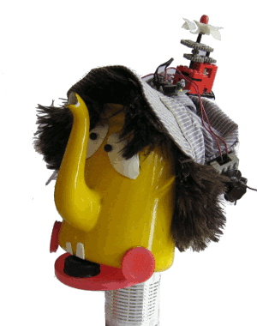
Creative Art and Engineering
Train your Robot
Build-It-Yourself.com
Notes:
BIB Module Title Page

Slide 2

Train Your Robot
Lab Book
Matt and John

Slide 3


Train Your Robot
Problem:
Many parents object to screen time, computer games, and AI.
Mission:
Build Smart AI robots that parents and kids love.
Mad parent
Happy parents

Slide 4
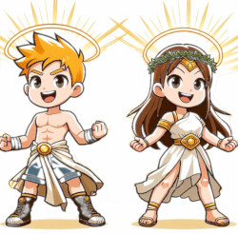


Train Your Robot
Learn cool AI skills:
Evolve from guinea pigs to superstars.
Build, train, test, and present a smart AI robot.

Slide 5
Train Your Robot
Research:
AlphaGo, AlphaStar, AlphaFold
https://www.youtube.com/watch?v=OYIGwLx_GSk
Smart robots started 70 years ago by beating the world champion chess player, then StarCraft and Go world champs.
Really smart robots can do really practical things like interpret maps and make cancer drugs.
Smart robots can do complicated stuff in seconds that would take humans many years to do.

Slide 6
Train Your Robot
Research:
Boston Dynamics Dancing Robots
https://www.youtube.com/watch?v=fn3KWM1kuAw
Can you imagine a future where really dangerous things like mining coal or cataract surgery are done more safely by humanoid robots?
Can you imagine a future where repetitive, boring tasks like washing dishes, taking out the trash are done by smart robots?

Slide 7

Train Your Robot
What are some of the most amazing things Humans have built?
8 man-made wonders of the world?
Build-It-Yourself.com
Notes:
BIB Module Regular Pages

Slide 8
Train Your Robot
What are some of the most amazing things Humans have done?
8 man-made wonders of the world?
The Great Wall of China
Beautiful Taj Mahal in India
Rice paddies on steep Philippine mountains
The majestic Chichen Itza pyramids of Mexico
The Apple Computer???
Build-It-Yourself.com
Notes:
BIB Module Regular Pages

Slide 9

Train Your Robot
Would you agree? …
Past generations have made a big mess!
What are some of the biggest messes?
Build-It-Yourself.com
Notes:
BIB Module Regular Pages

Slide 10

Train Your Robot
Would you agree? …
Past generations have made a big mess!
What are some of the biggest messes?
Nasty prejudices and wars
Dirty pollution
Deadly diseases
Economic meltdowns
???
Build-It-Yourself.com
Notes:
BIB Module Regular Pages

Slide 11

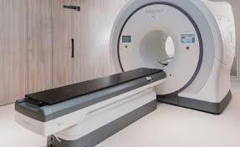
Train Your Robot
Are humans smart enough to solve the problems that could threaten our planet?
Build-It-Yourself.com
Notes:
BIB Module Regular Pages

Slide 12
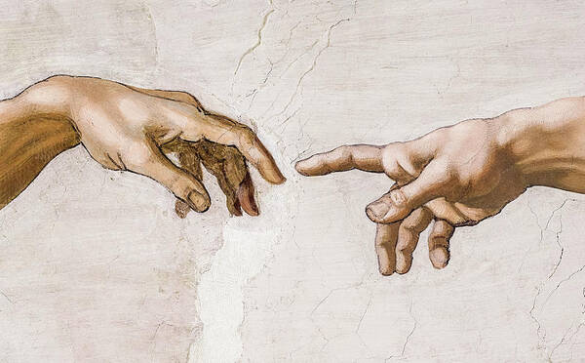
Train Your Robot
Just as Michelangelo painted the spark passing from God to Adam,
Build-It-Yourself.com
Notes:
BIB Module Regular Pages

Slide 13
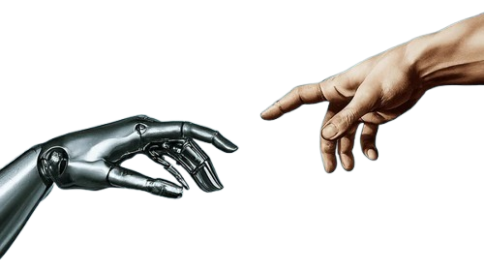
Train Your Robot
… should we pass our spark to robots — not to replace us, but to extend our creativity into new hands?
Build-It-Yourself.com
Notes:
BIB Module Regular Pages

Slide 14
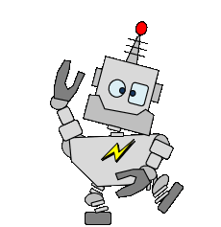
Train Your Robot
Mirror Mirror on the wall,
who trains their robot to stand tall?
which robot builds the best of all?
which bot will answer every call?
Build-It-Yourself.com
Notes:
BIB Module Regular Pages

Slide 15

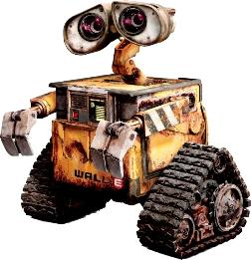
Train Your Robot
What is the plot of ‘Train your Dragon?’
What is the plot of ‘Wall-E?’
Build-It-Yourself.com
Notes:
BIB Module Regular Pages

Slide 16


Train Your Robot
Let’s make sure our robot cannot be used to make any more messes.
What are the values we want our robot to have?
What values do your heroes have?
Build-It-Yourself.com
Notes:
BIB Module Regular Pages

Slide 17

Train Your Robot
What are some super-powers we would like our Smart AI Robot to have?
What should we name our robot?
Build-It-Yourself.com
Notes:
BIB Module Regular Pages

Slide 18

Bumble-Bot Graffiti
Unusual letter shapes
Colorful
3 Dimensional

Slide 19
Graffiti
Unusual letter shapes
Colorful
3 Dimensional

Slide 20
Train Your Robot
Our smart robot needs a name and an introduction.
Let’s ask an AI Chatbot for help.
First let’s learn some prompt engineering.
How do you ask a question that gets a useful answer?
“The Socratic Way”
Build-It-Yourself.com
Notes:
BIB Module Regular Pages

Slide 21
Train Your Robot
Let’s ask our smart robot companion to help us write a story about good vs. evil.
Plato’s Cave Allegory
https://www.youtube.com/watch?v=1RWOpQXTltA
Build-It-Yourself.com
Notes:
BIB Module Regular Pages

Slide 22
Train Your Robot
Let’s build it.
Structure
Head
Locomotion
Control
Outfit
Build-It-Yourself.com
Notes:
BIB Module Regular Pages

Slide 23
Notes to
project developers

Slide 24
Problems:
Many parents object to screen time.
AI may negate the value of BIY software.
Missions:
Develop AI projects that parents and kids love.
Develop ‘hardware’ motes, barriers to entry, and value propositions.

Slide 25
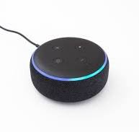
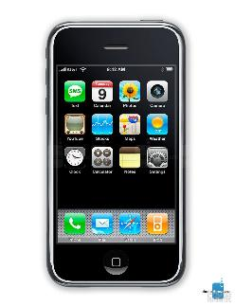
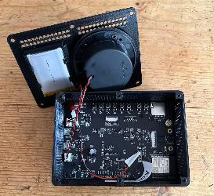
Research:
Talking Toy Labs https://www.talkingtoylabs.com/
Amazon Echo
Apple Siri

Slide 26
Project Guidelines / Specs
It must be a ton of FUN!
Accessible (<$100 from reliable distributor)
Introduces ‘Ethics’ and ‘Respect’
Helps kids understand AI Agents (Prompt Engineering)
Can sense inputs (audio, motion)
Can drive output devices
Hybrid RC + AI control
Trainable
Gangs with BIB Modular Construction System

Slide 27
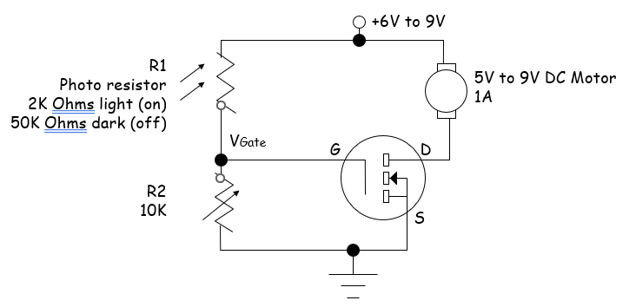
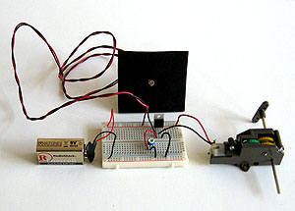
Project Guidelines / Specs - Hardware
Octostudio to take advantage of mobile device sensors.
FET Motor Controller kit to make BIY OS independent.

Slide 28
Project Guidelines / Specs - Software
Pishi.ai Scratch (Most Features, Works Offline)
Pishi.ai provides built‑in AI extensions that runs in your browser or combine with Google Teachable Machines
Go to Pishi.ai → Scratch.
Click Extensions.
Add any AI extension:
  FaceMesh (468 face landmarks)
  HandPose (21 hand keypoints)
  PoseNet (full‑body tracking)
  ImageTrainer (offline image classifier)
  SpeechRecognition
  Text‑to‑Speech
  Teachable Machine importer
What you get
  Real‑time face tracking
  Gesture control
  Body‑movement games
  Offline AI models
Who makes Pishi.ai?
How stable is Scratch and Pishi?
What is the future of Google Teachable Machines?

