Slide 1
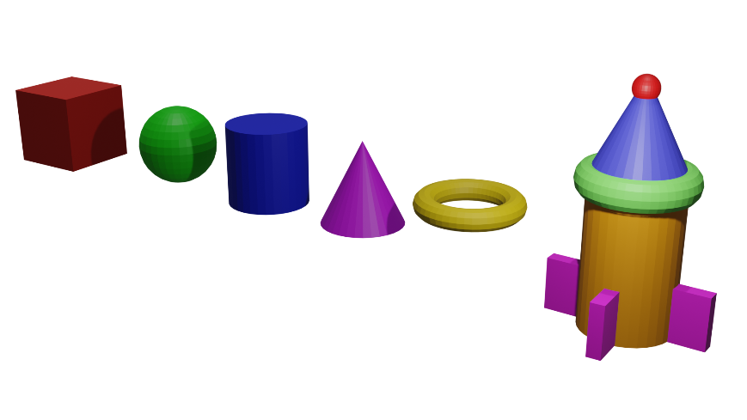
3D Blender Projects
At Build-It-Yourself
Learning Objectives
Think in 3 dimensions.
Manipulate solid geometric shapes, vertices, lines, and surfaces
Control lighting.
Animate objects.
Simulate the physics of moving objects.
Convert to common multimedia file types.
Optimize graphic file size and display time.
www.Build-It-Yourself.com

Slide 2
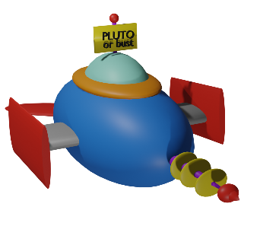
3D Blender Examples – Spaceships
www.Build-It-Yourself.com

Slide 3
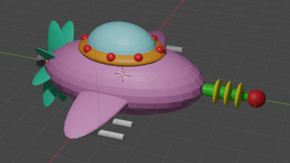
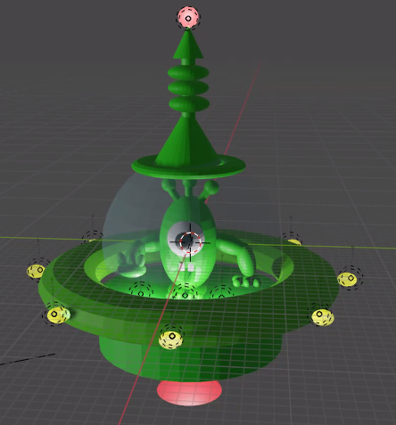
Member Results
Benjamin
Chuck
Xinxin
www.Build-It-Yourself.com

Slide 4
3D Blender Examples – Space Planets
www.Build-It-Yourself.com

Slide 5
3D Blender Examples – Space Planets
www.Build-It-Yourself.com

Slide 6
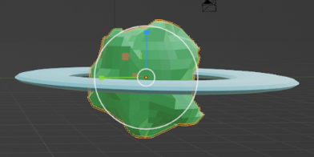
Member Results
Bego
Chuck
Xinxin
www.Build-It-Yourself.com

Slide 7
3D Blender Examples - Robots
www.Build-It-Yourself.com

Slide 8
3D Blender Examples - Robots
www.Build-It-Yourself.com

Slide 9
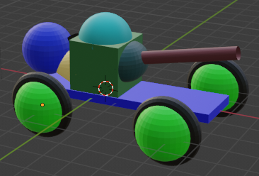
Member Results
Ian
Chuck
Jimmy
www.Build-It-Yourself.com

Slide 10
3D Blender Examples - Aliens
www.Build-It-Yourself.com

Slide 11
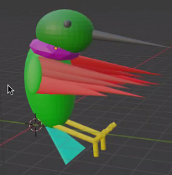
Member Results
Chuck
Chuck
Benjamin
Bego
Ella
Fernando
www.Build-It-Yourself.com

Slide 12
3D Blender Examples - Architecture
www.Build-It-Yourself.com

Slide 13
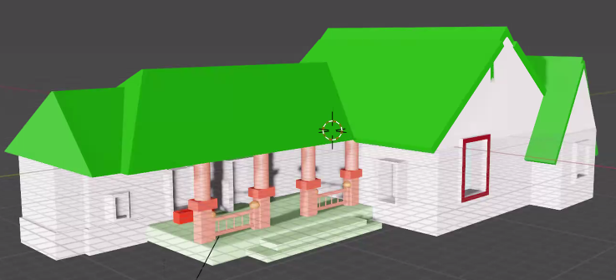
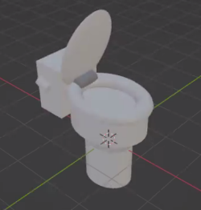
Member Results
Benjamin
Bego
Jimmy
Chuck

Slide 14
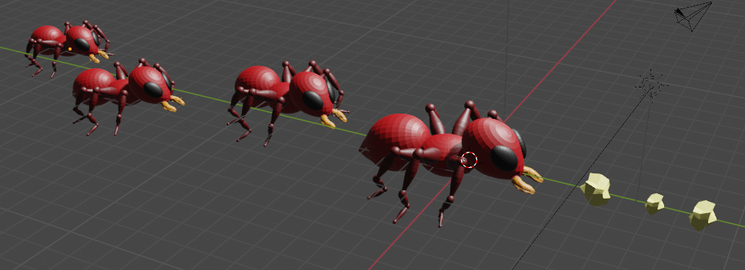
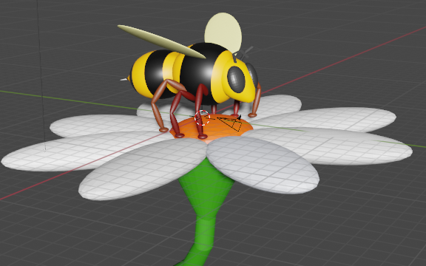
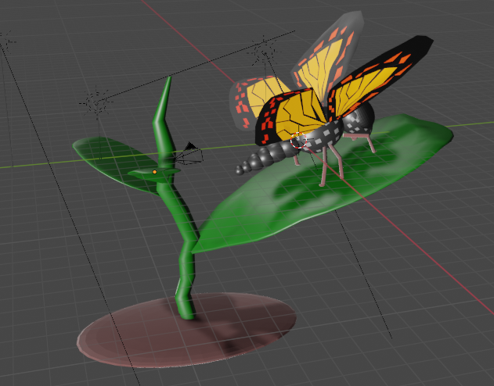

Slide 16
3D Blender Examples – Holiday Greetings
www.Build-It-Yourself.com

Slide 17
3D Blender Examples – Holiday Greetings
www.Build-It-Yourself.com

Slide 18
3D Blender Examples
www.Build-It-Yourself.com

Slide 19
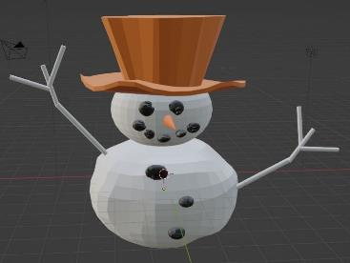
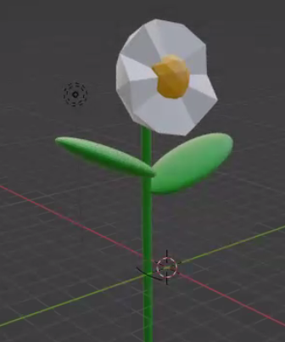
Member Results
Sophia
Chuck
www.Build-It-Yourself.com

Slide 20
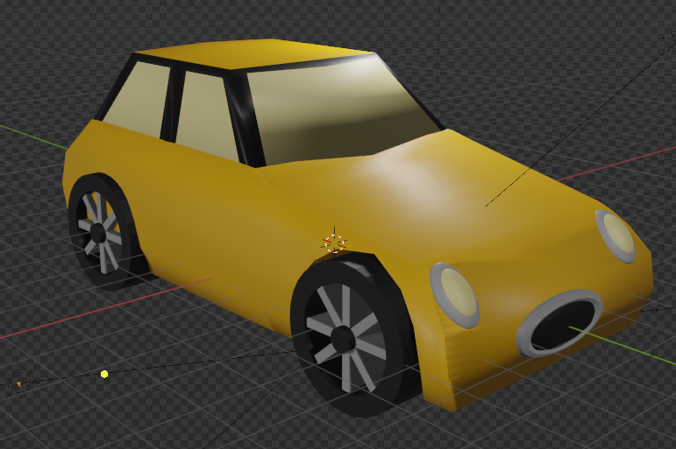
3D Blender Examples
www.Build-It-Yourself.com

Slide 21
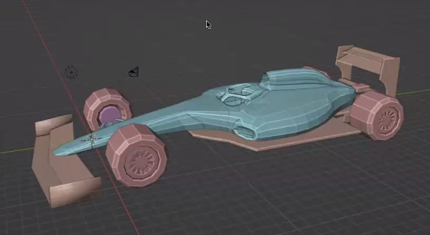
Member Results
Sam
Tom
www.Build-It-Yourself.com

Slide 22
3D Blender Examples – Mean Machines
www.Build-It-Yourself.com

Slide 23
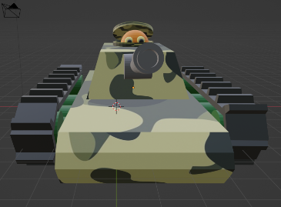
Member Results
Ryan
www.Build-It-Yourself.com

Slide 24
3D Blender Examples – Story Telling
www.Build-It-Yourself.com

Slide 25
3D Blender Examples – Story Telling
www.Build-It-Yourself.com

Slide 26
3D Blender Examples
3D Blender Examples – Story Telling
www.Build-It-Yourself.com

Slide 27
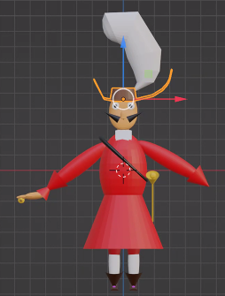
Member Results
Benjamin

Slide 28
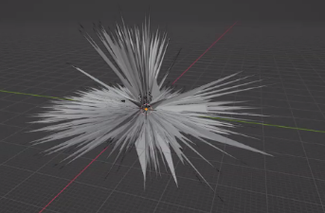
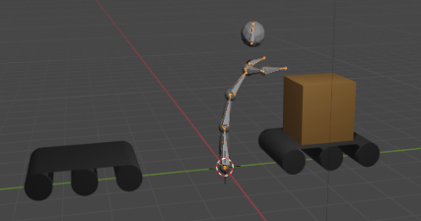
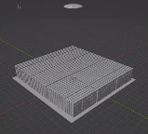
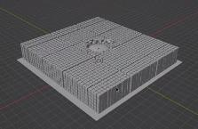
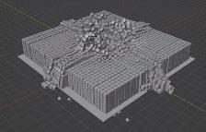
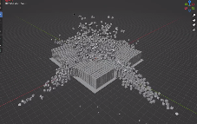
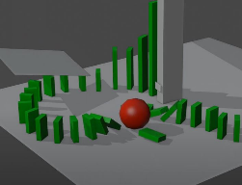
Member Results – Advanced Projects
Jack
Jimmy
Jack
Rodrigo
www.Build-It-Yourself.com

