Slide 1

3D Graphics Lab book
By: Angela

Slide 2

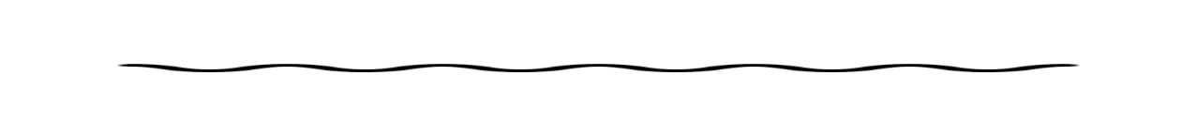
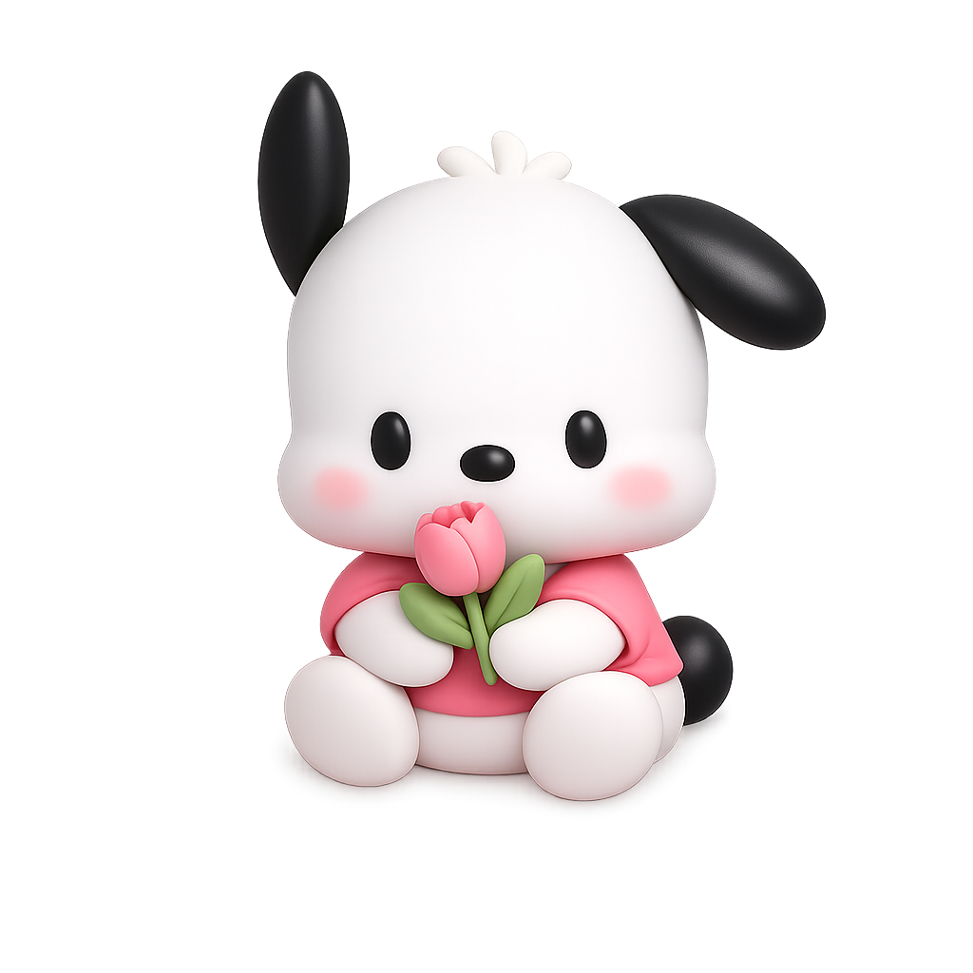
Problem
2D is used everywhere but it's not cool.
Mission
Make 3d models. Encourage people to use it(it's so much better).

Slide 3
Research
People use 3D models when real life is too tiny, too huge, too risky, or just too complicated to handle directly. A model lets them rotate, zoom, and explore something from every angle. 🔬
They can test ideas, run experiments, and see what might happen without damaging the real object. Doctors can plan surgeries, engineers can test buildings, and astronomers can study planets.
It also makes tricky ideas easier to understand and explain, because seeing something in 3D helps our brains picture how the parts fit together. 🌍✨-Chat G.P.T.

Slide 4

Blender airplane/Rocket

Slide 5

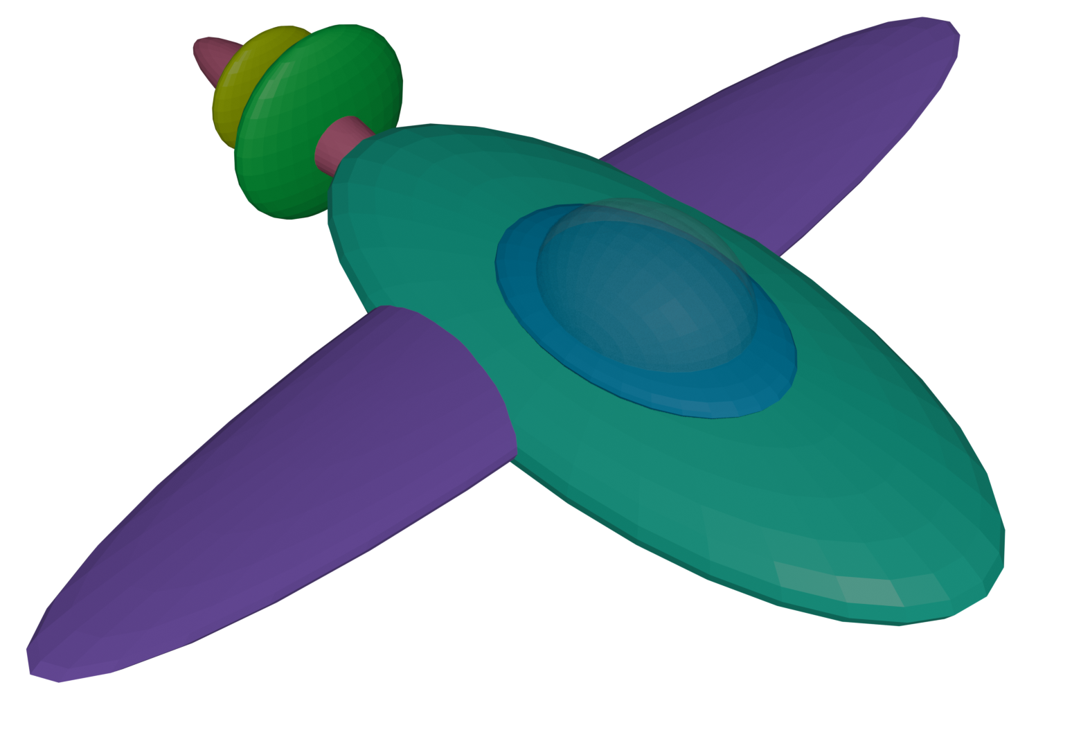

Slide 6
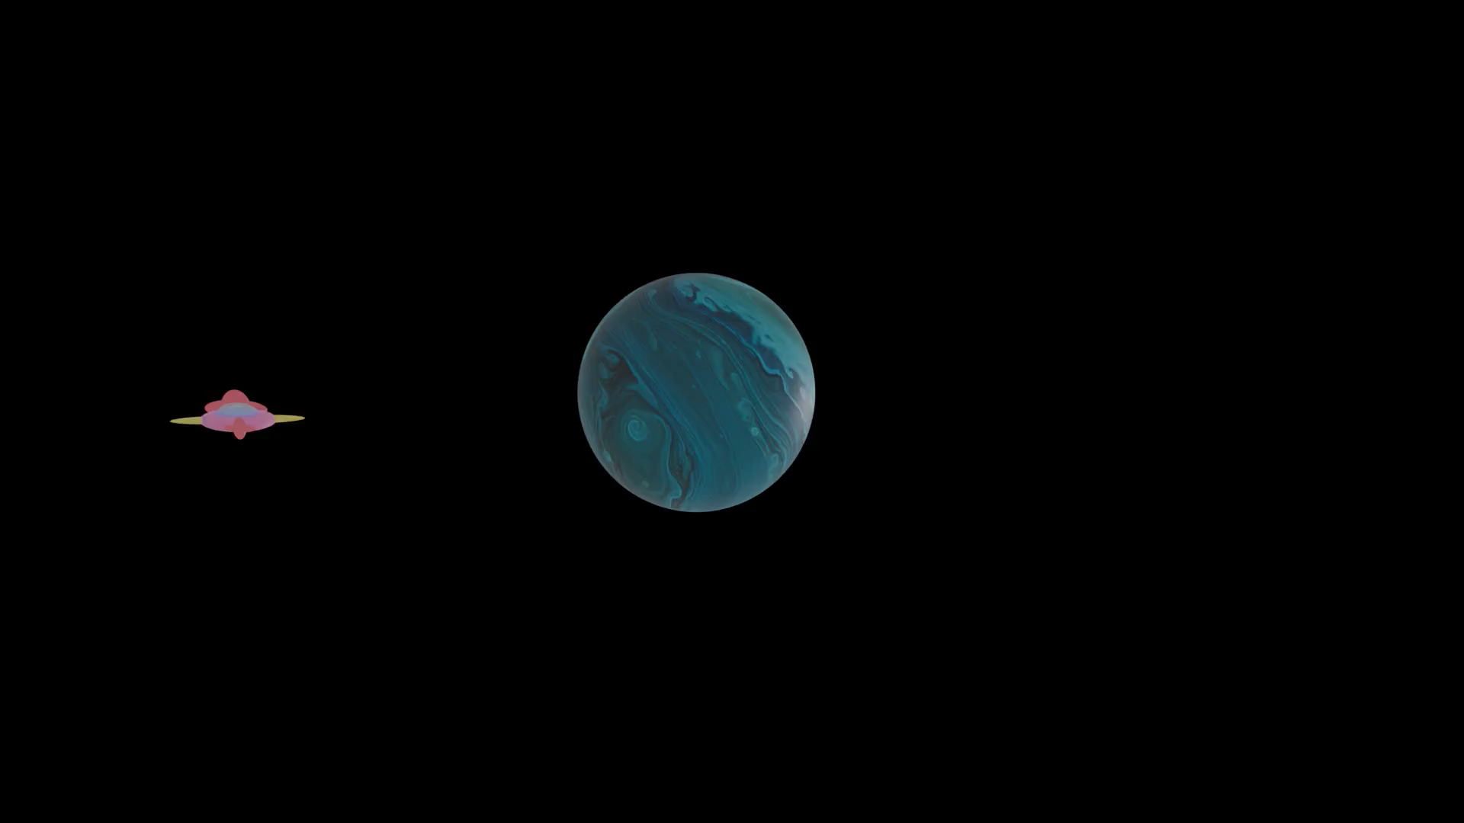

Slide 7

Blender Robot

Slide 8

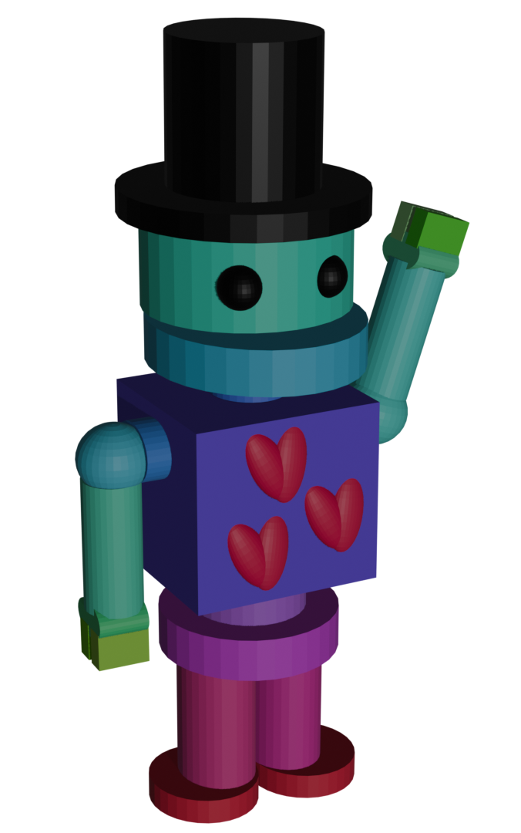

Slide 9
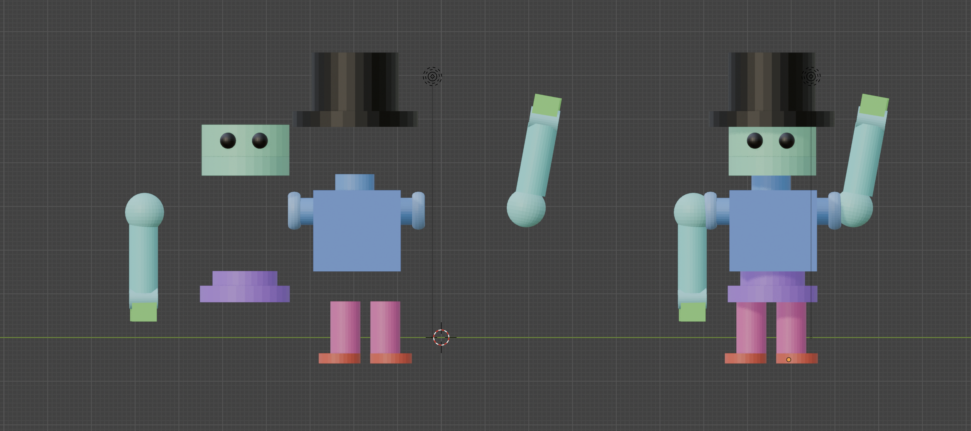
This is Melo’s body parts taken apart and together in blender
See Melo’s introduction on next slide

Slide 10
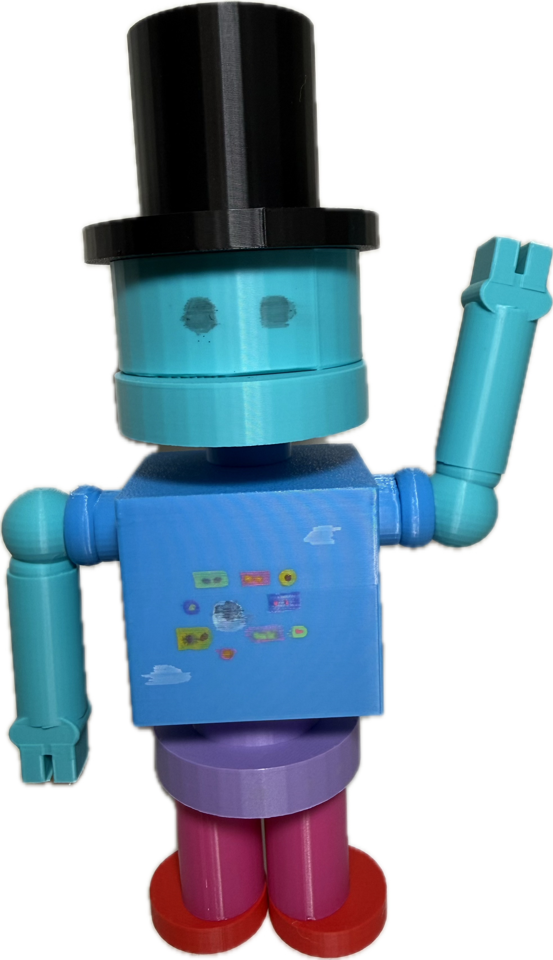
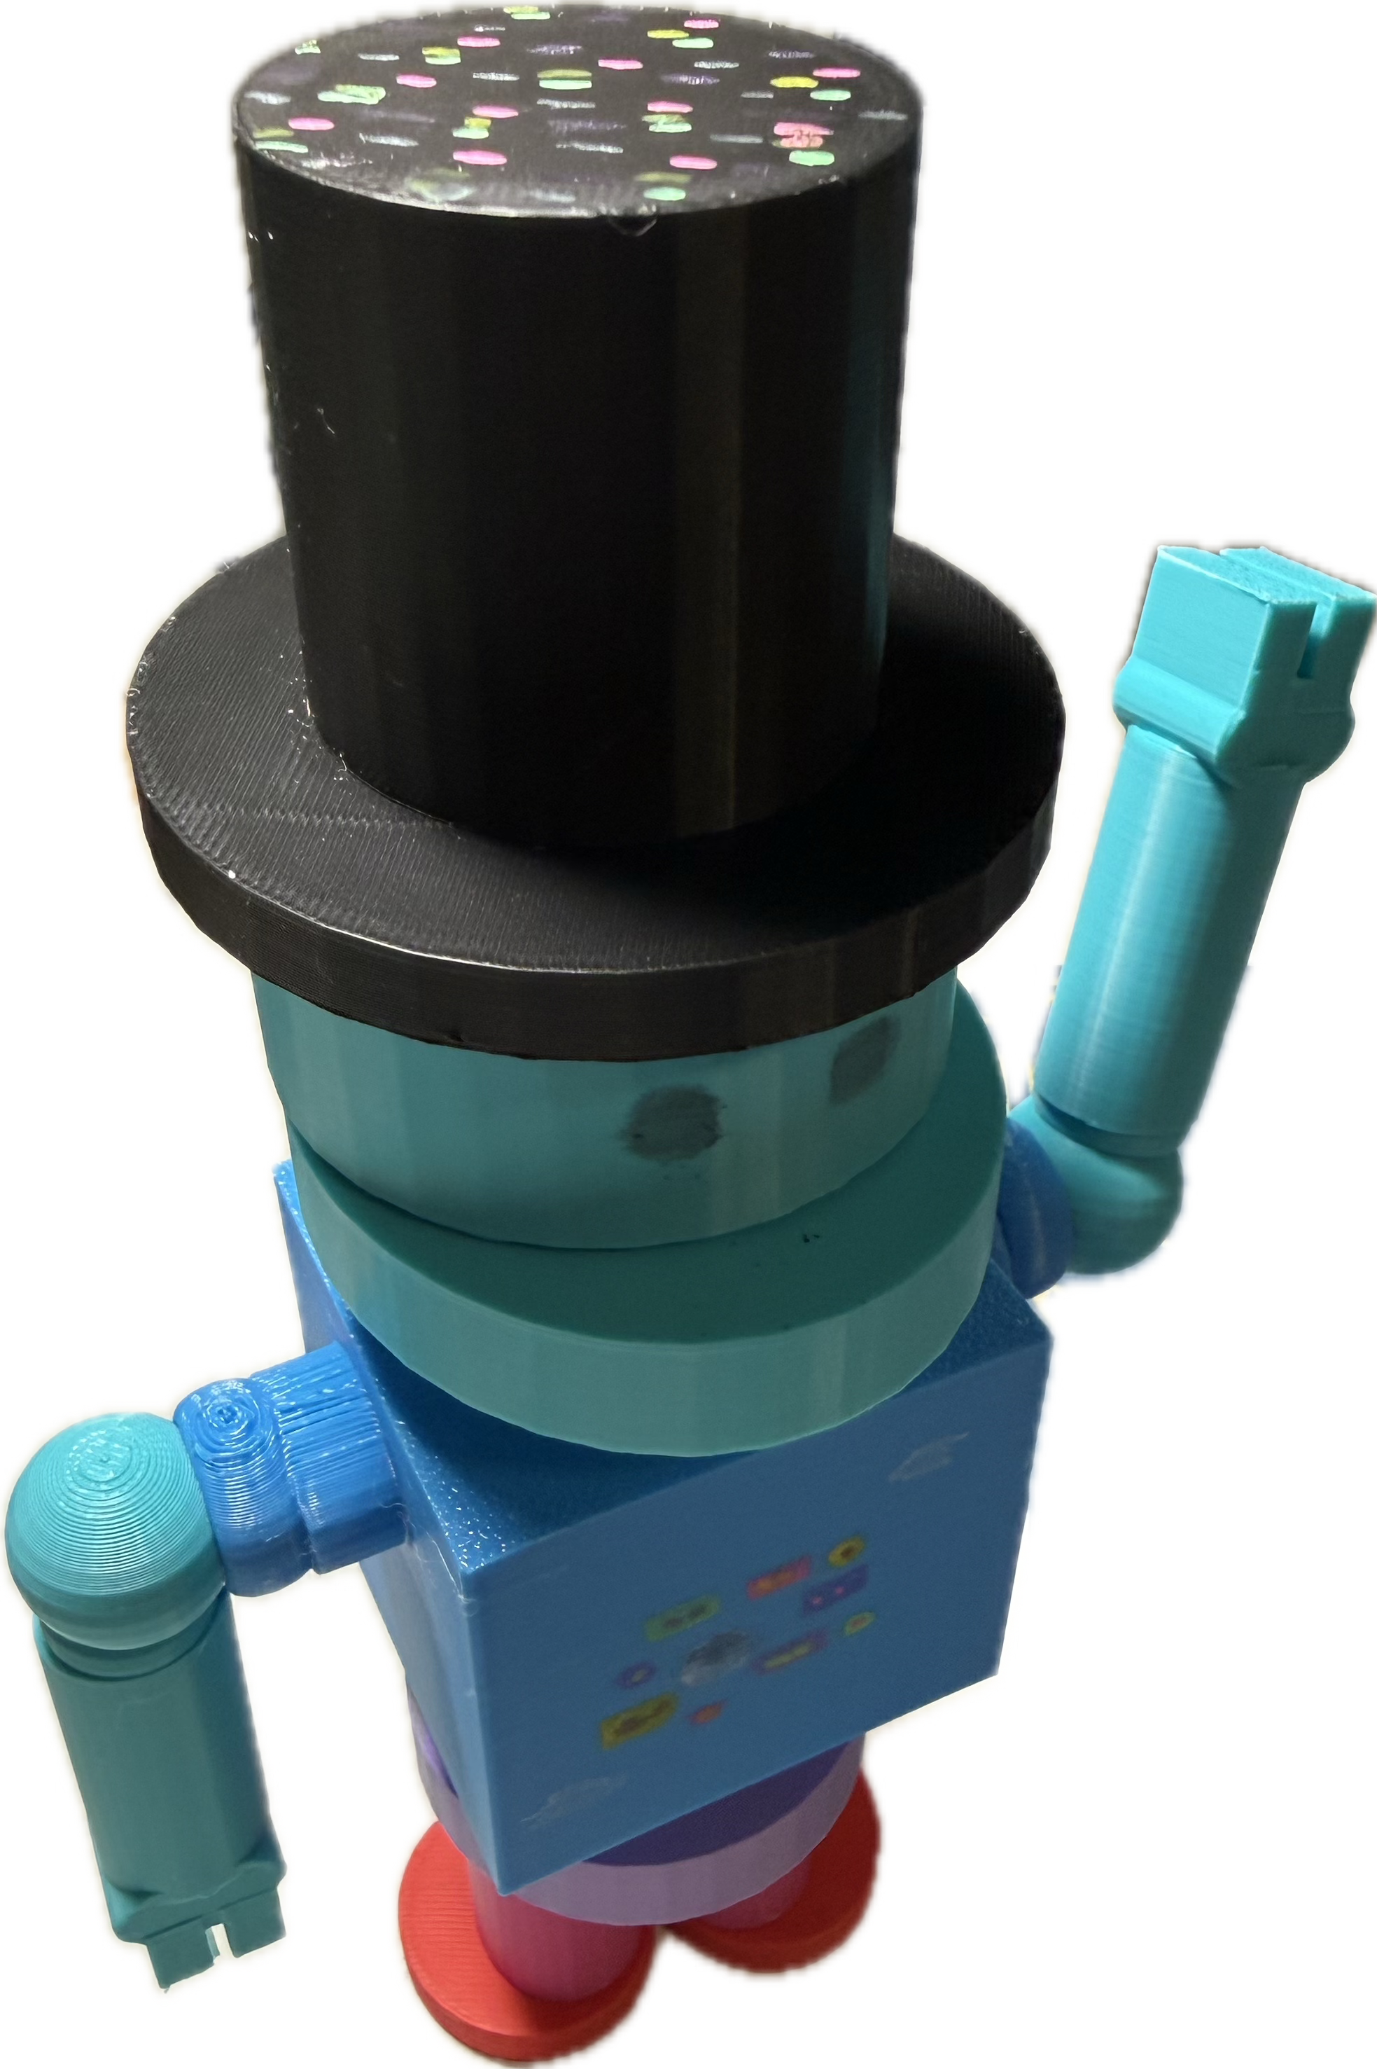
This Robot is my fellow friend Melo ,he is 3d printed by my 3dprinter Printeroma. I have been sending my dad some stl files for each different body/Robot part. When there were identical pieces like the arms, legs, and feet, I only store one of those pieces, then I send it to my dad and he prints it. We only need one of them because they are the same. An important part of this process is knowing how to export the item, at first, I had no idea where and what to press and called my dad, and he told me, once I know I kept sending to him each day, slowly he started printing every piece. Little adjustment were made and we came to my final pipsqueak Melo!

