Slide 1
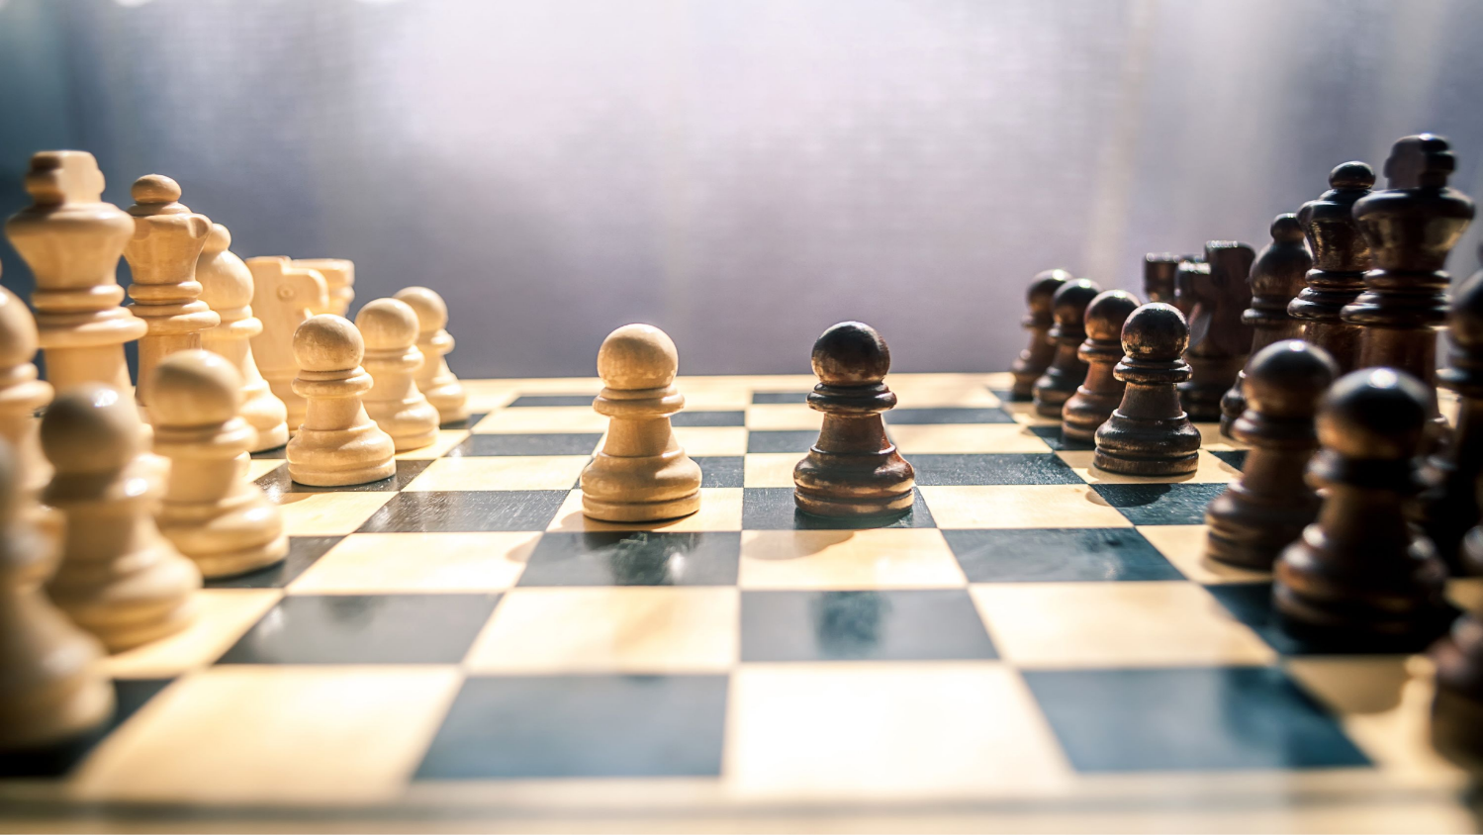
Chess
Chess
By George

Slide 2
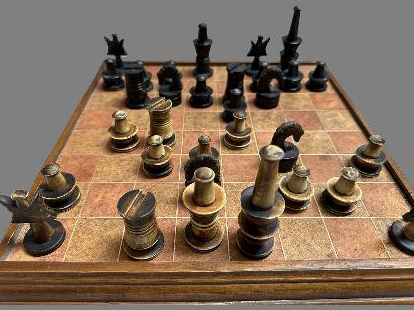
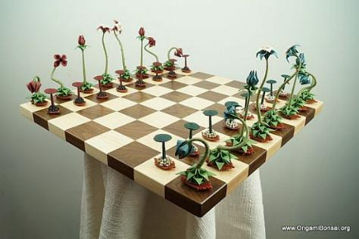
Problem
Mission
Chess is starting to get boring because the pieces hasn't
changed since late 15th-century
And the pieces has strict way of moving
Is to recreate the chess the chess pieces and how they move

Slide 3
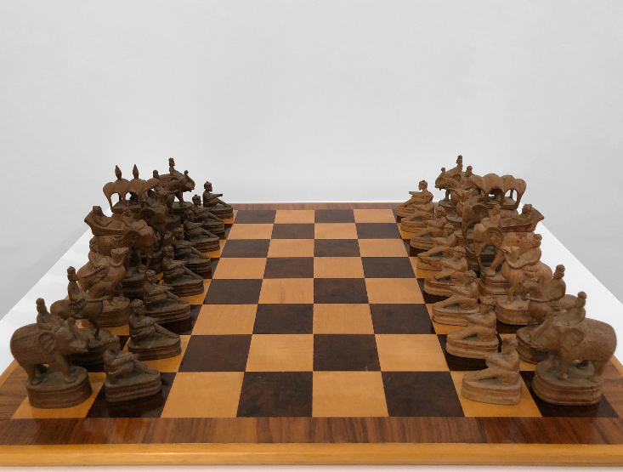
Research
Chess is believed to have been invented
in India during the Gupta Empire around the 6th century AD. Its earliest predecessor was a game called chaturanga, which represented the four branches of the ancient Indian military: infantry, cavalry, elephants, and chariots.

Slide 4
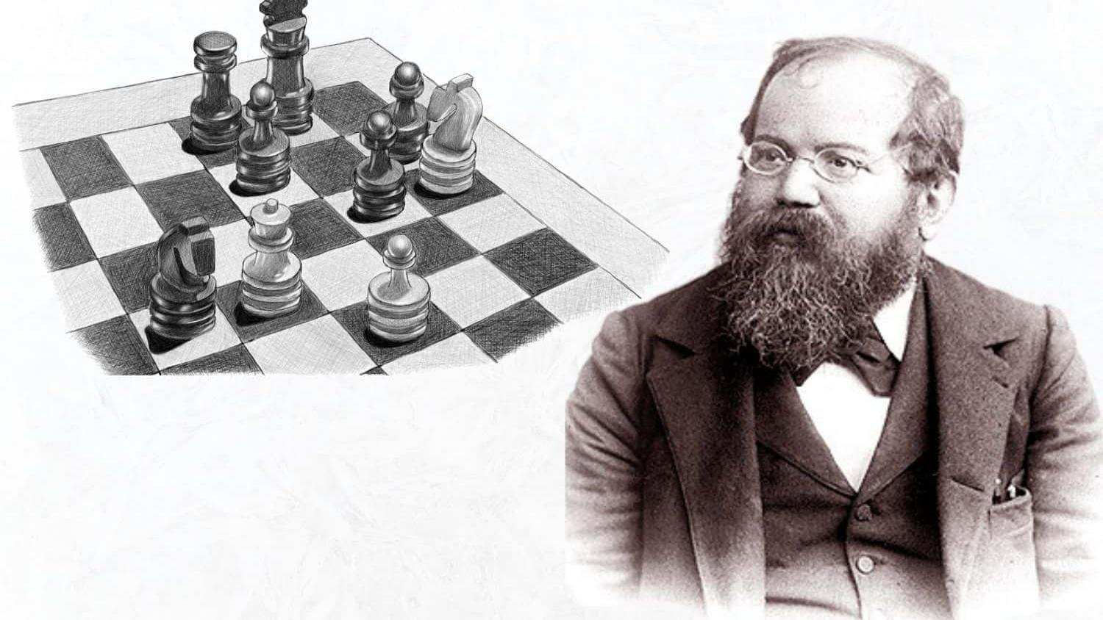
Research
Standardization: Chess rules began in the 1400s but became fully standardized in the 1800s as competitive tournaments grew, leading to the first official World Chess Championship in 1886 won by Wilhelm Steinitz.
Wilhelm Steinitz
Origin Era: In the late 1400s, chess rules changed— the weak ferz became the powerful Queen, and the Bishop gained long-range movement.
Key Contributor: Ruy López de Segura helped analyze and spread these new rules in the 1500s.
“Father” of Modern Chess: Wilhelm Steinitz developed the positional and strategic ideas that shape modern chess play. ♟️

Slide 5
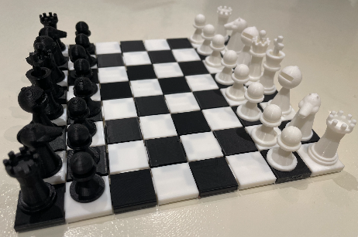
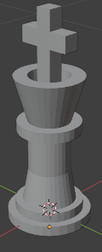
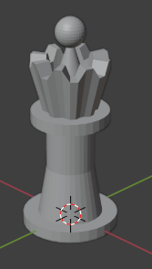
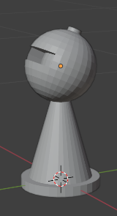
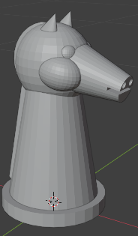
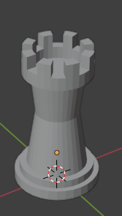
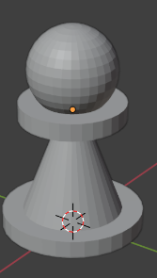
The Pieces
All together
King
Queen
Bishop
Knight
Castle
Pawn

Slide 6
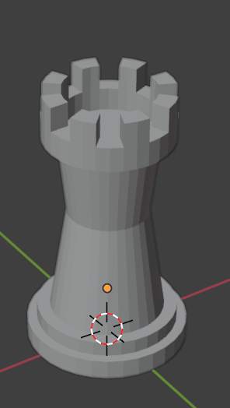
Next Steps
create a 3d model of a castle themed box to hold the pieces and the board

