Slide 1
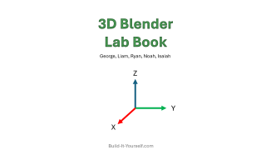
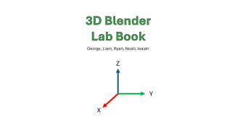
3D Blender
Lab Book
George, Liam, Ryan, Noah, Isaiah
Z
Y
X
Build-It-Yourself.com

Slide 2
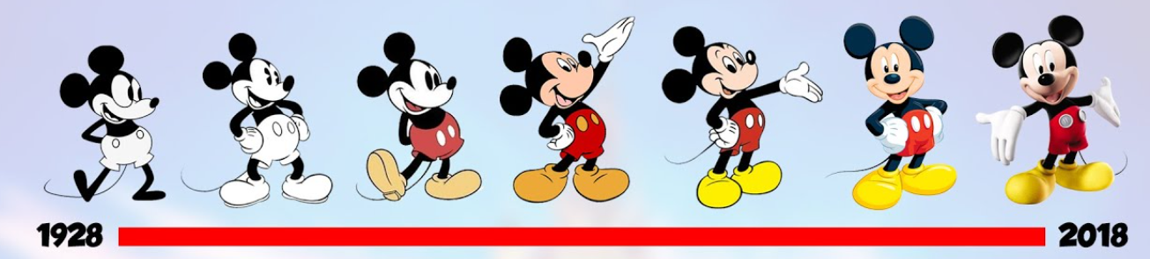
Problem
2D is soooooo yesterday
Mission
Learn to think and express your ideas in 3D
Build-It-Yourself.com

Slide 3
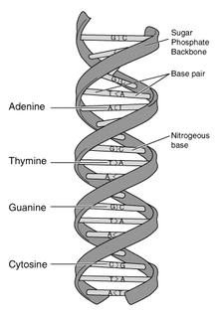
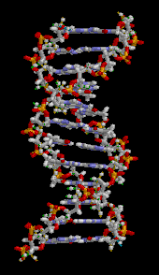
Research
Examples where 3D graphics can make us smarter and safer
2D vs. 3D
Build-It-Yourself.com

Slide 4
Geometry
2D 3D
Y
Square
Y
Cube
X
X
Circle
Sphere
Z
Triangle
Cone
Build-It-Yourself.com

Slide 5
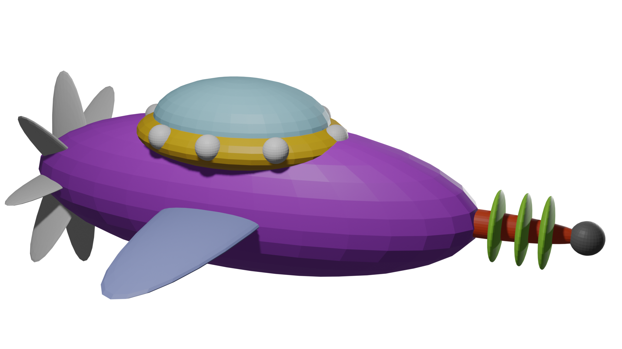
Build a rocket ship using spheres
Build-It-Yourself.com

Slide 6

Build-It-Yourself.com

Slide 7
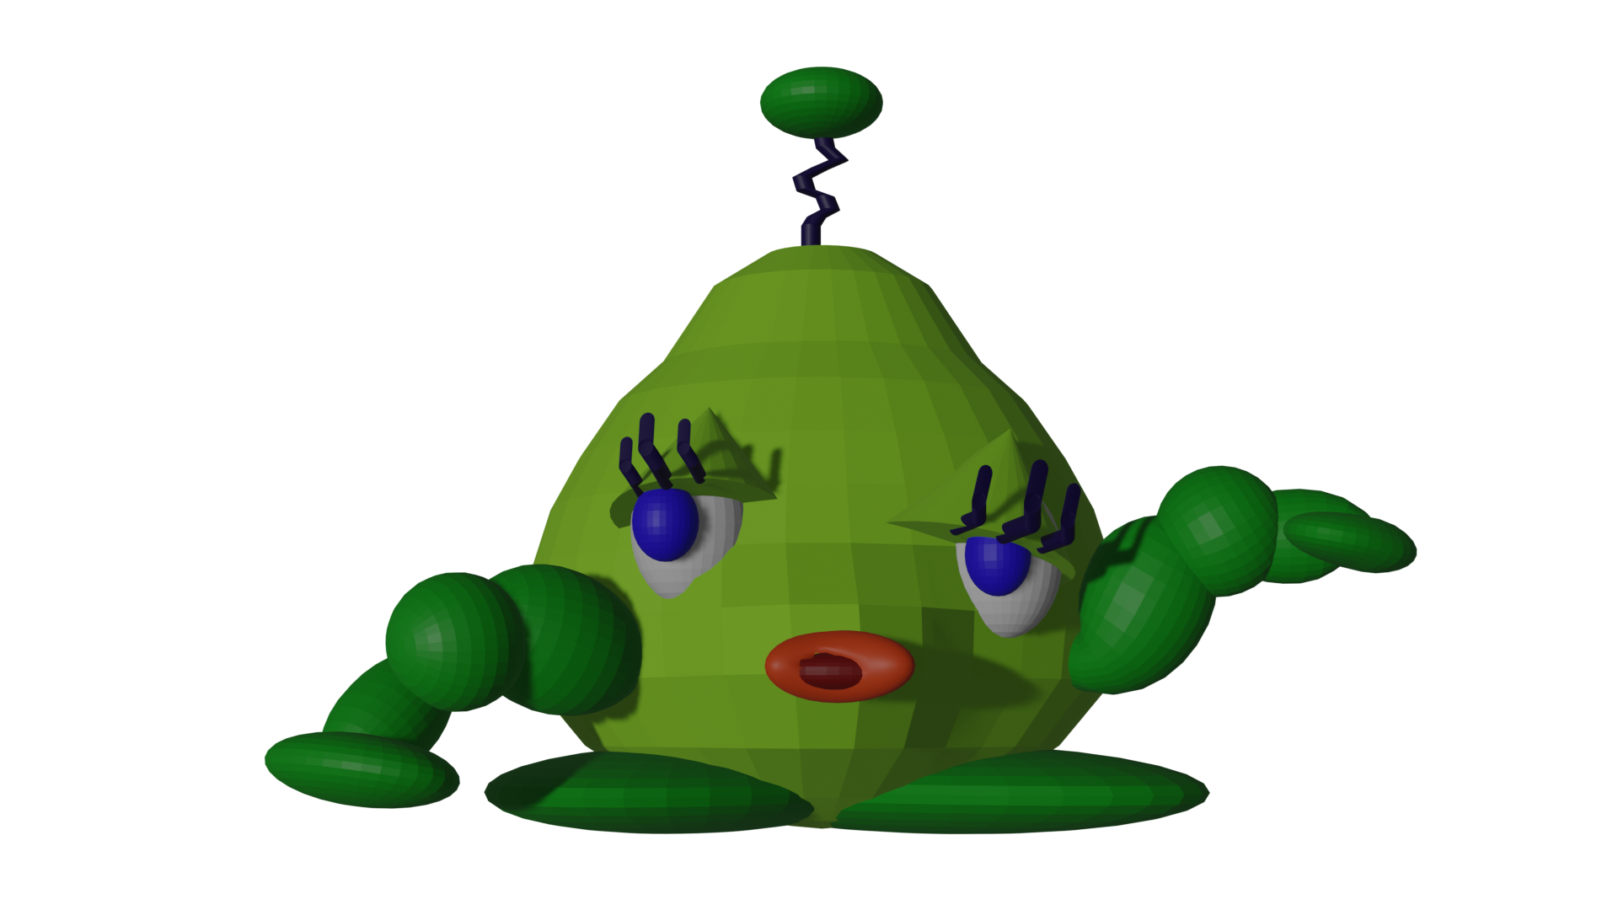
Sculpting in the EDIT mode
Build-It-Yourself.com

Slide 8
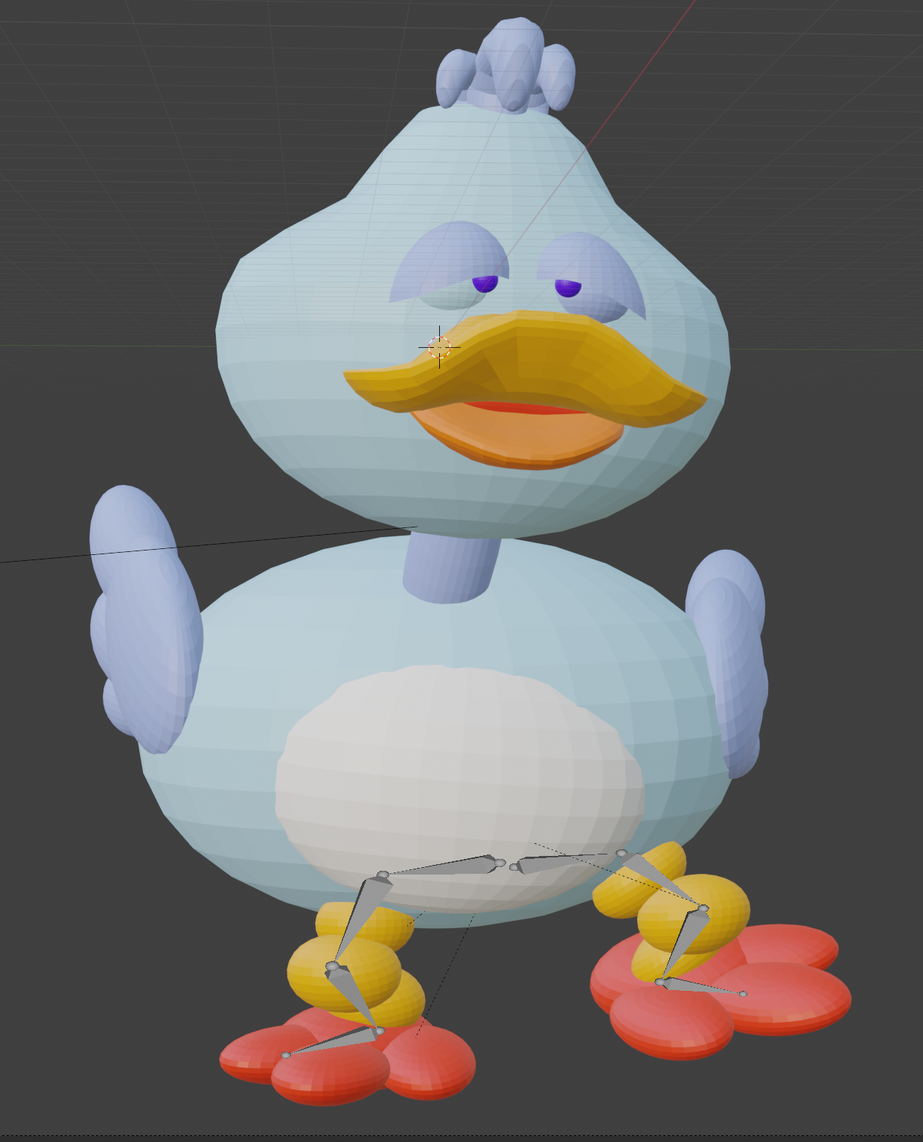

Animate Your Designs
Armatures
parenting to skin vertacies
Build-It-Yourself.com

Slide 9
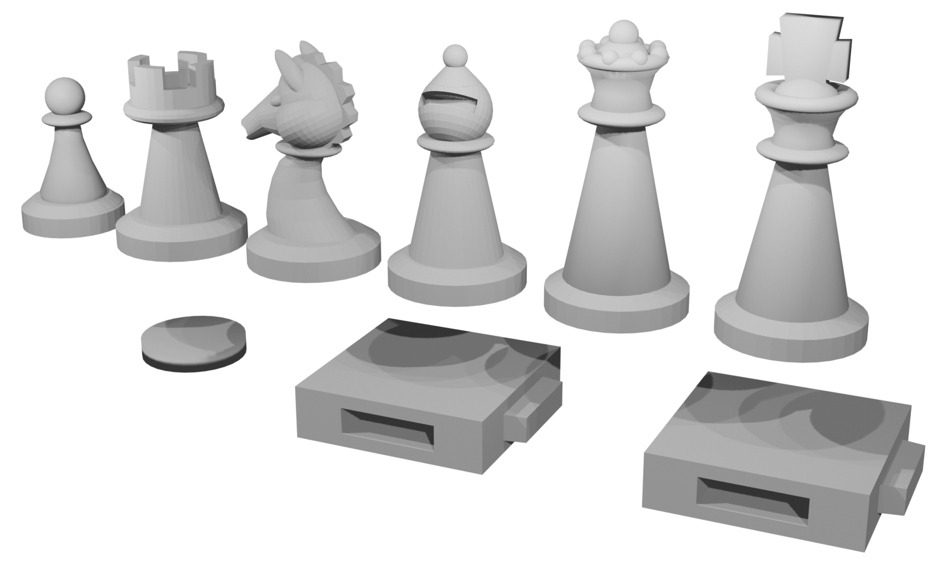
Industrial Design
Build-It-Yourself.com

Slide 10
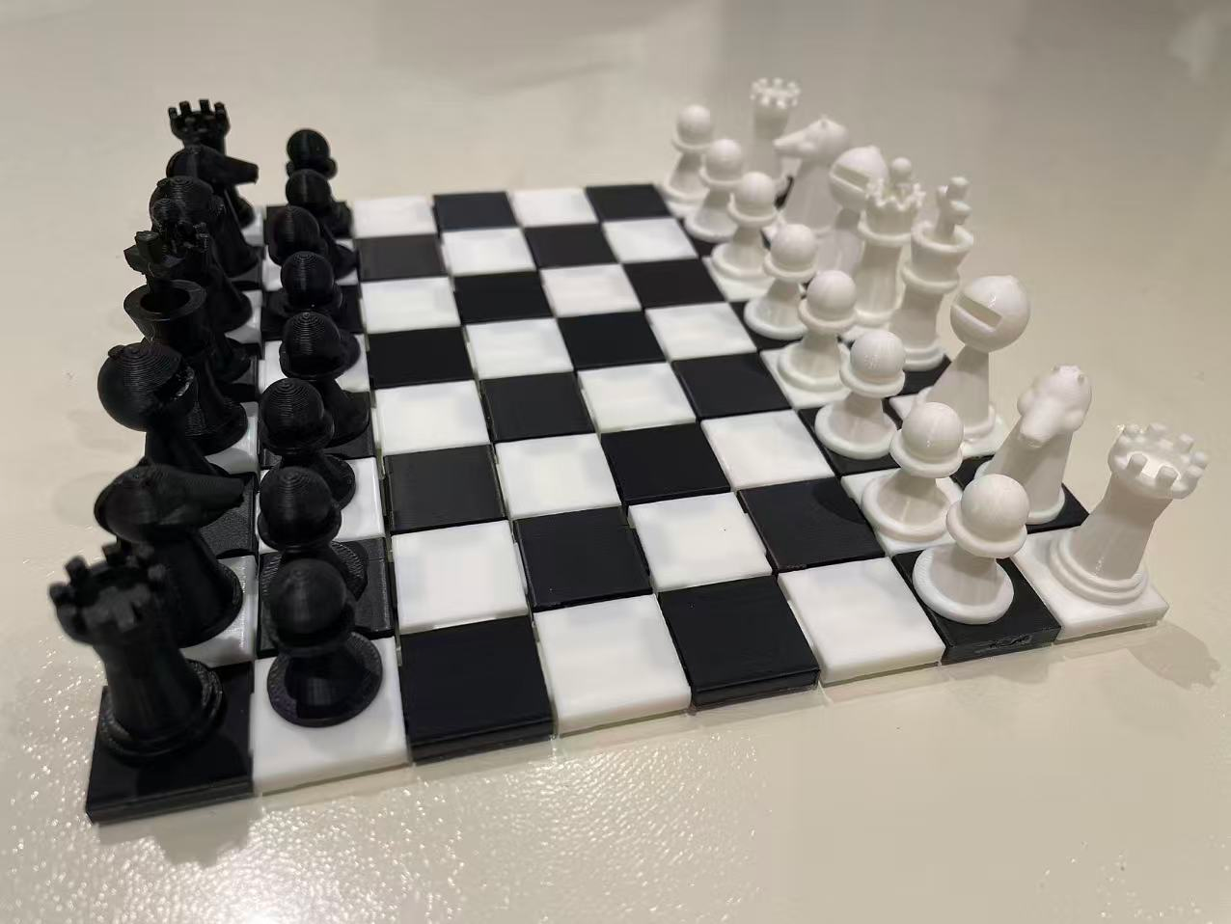
3D Printing
Ryan’s Solution
Build-It-Yourself.com

