Slide 1
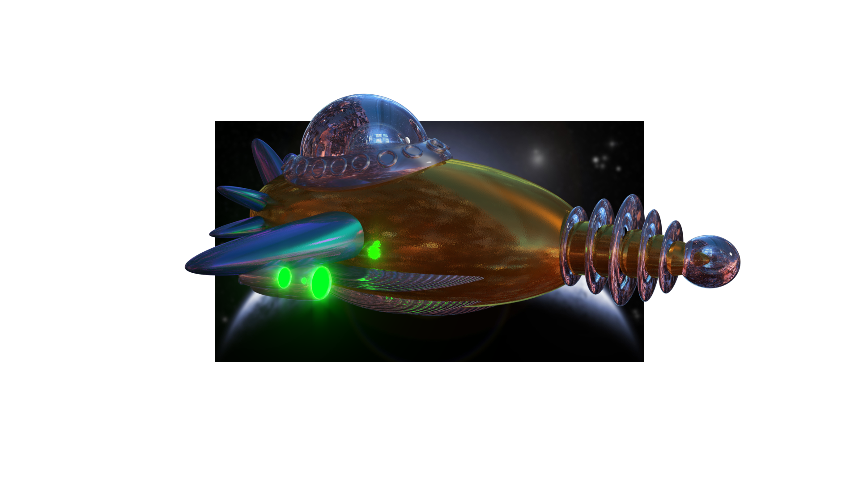
3D Graphics
LAB BOOK
Julian, Brent & John

Slide 2
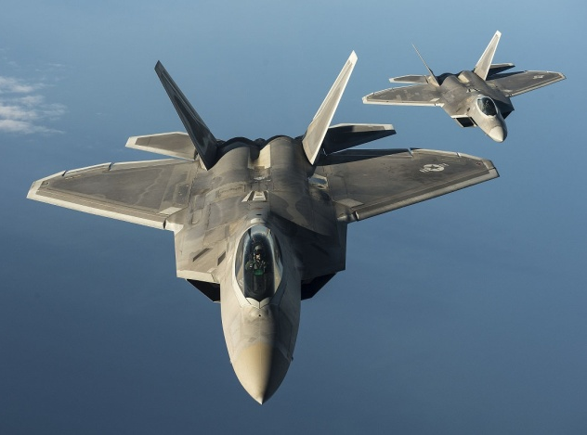
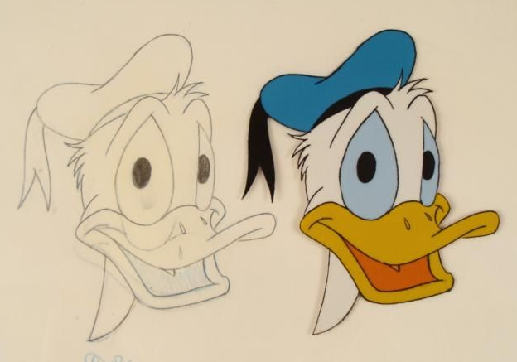
The Problem!
1) Reality can be expensive and dangerous.
2) 2D animations are very expensive and limiting.
2D is soooo yesterday!
Photo airforcetimes.com
Vintage Disney Drawing Cell

Slide 3
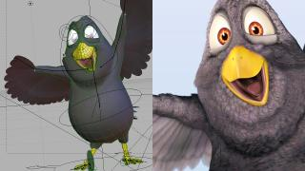
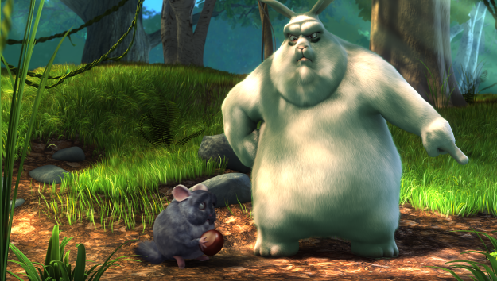
The Mission!
Learn to think and express ideas in
3 dimensions!

Slide 4
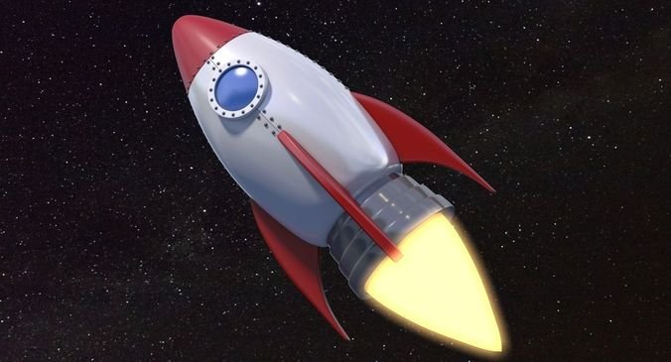
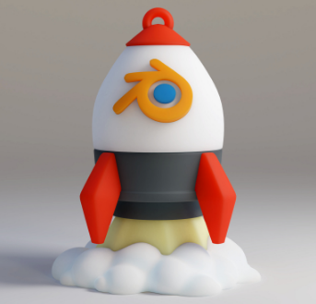
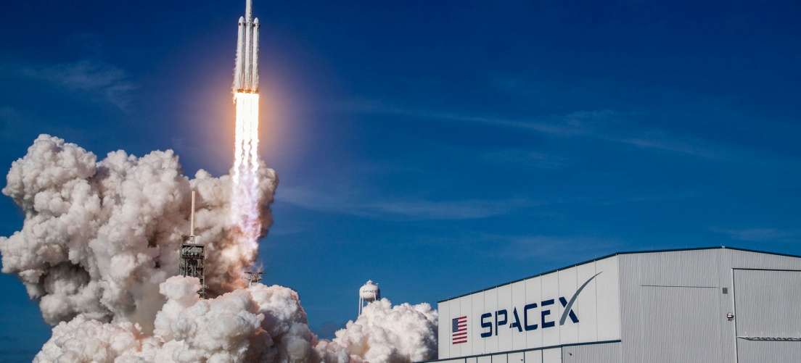
Research
Way cool inspiration!

Slide 5
Problem Solving Tricks
#1 Focus - Identify the problem and set goals.
#2 Research - Don’t re-invent the wheel.
#3 Teamwork – Share ideas.
#4 Simplify - Break your solution into simple parts.
#5 Document - Keep a lab book.

Slide 6
Presenting Ideas
Ugly
Inconsistent
Out of bounds
Average
Boring
In bounds
Way Cool !!!
Creative order
3rd dimension

Slide 7
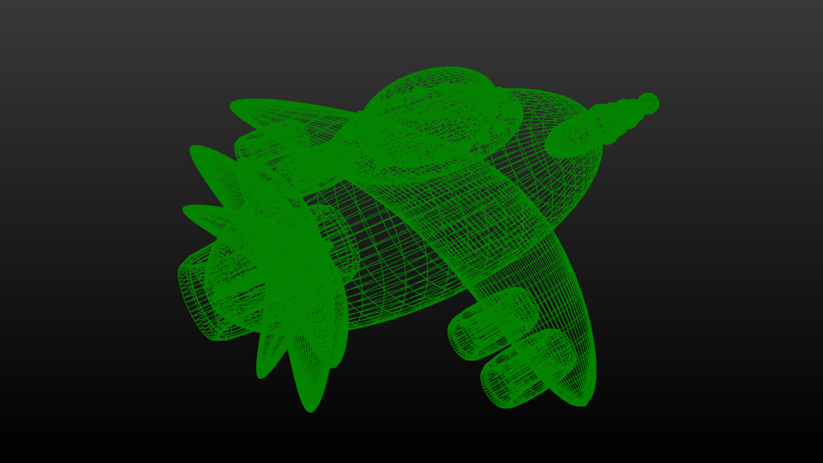
Rocket Model Wireframe

Slide 8
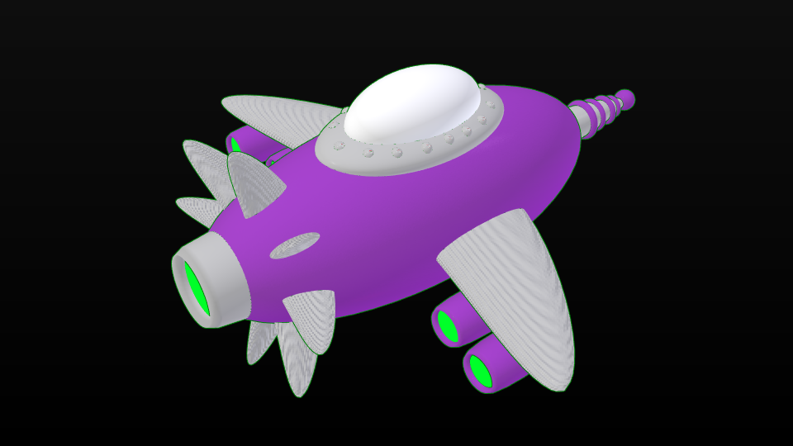
Rocket Model Solid/Clay

Slide 9
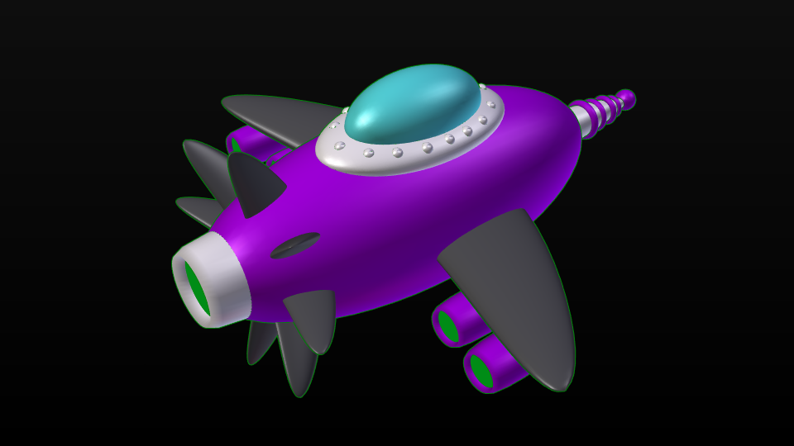
Rocket Model Materials

Slide 10
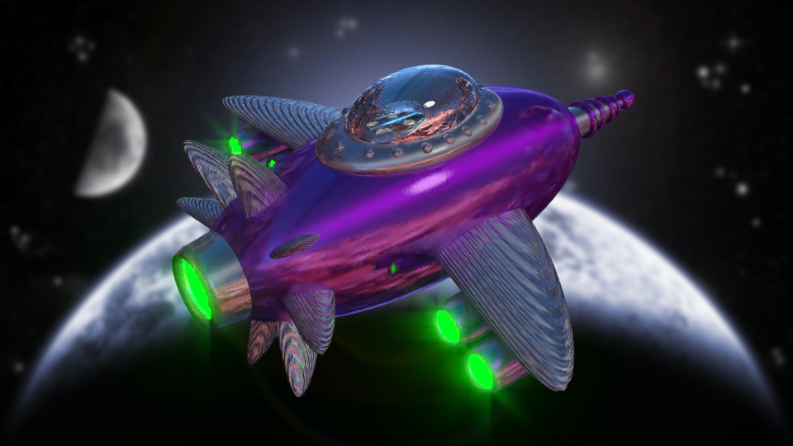
Rocket Model Final Render

Slide 11
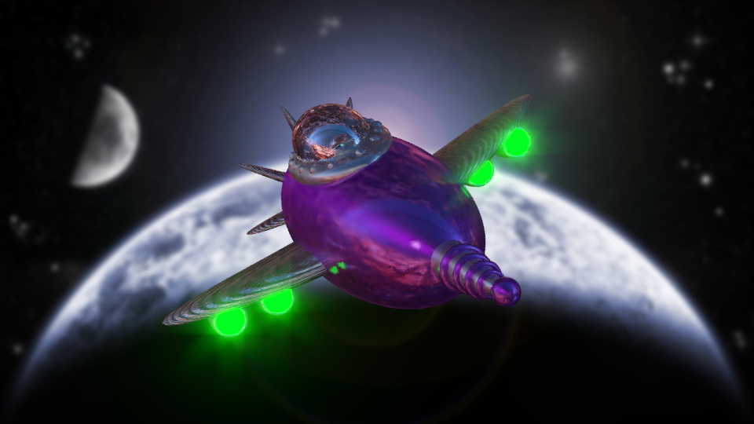
Rocket Model Final Render

Slide 12
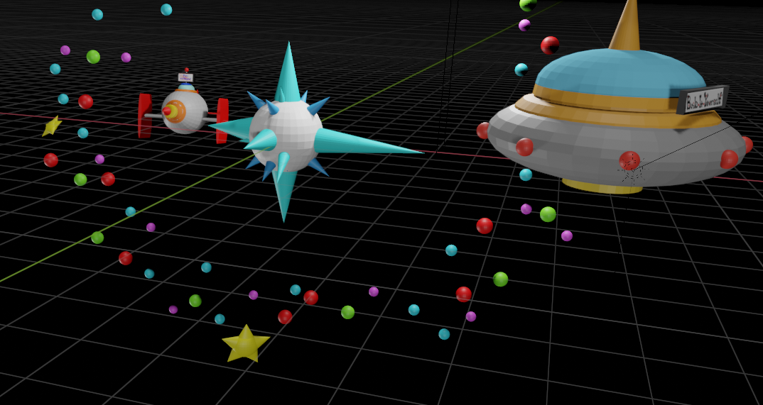
Space Scene Animation
https://youtu.be/X0dvySoVEsk

Slide 13
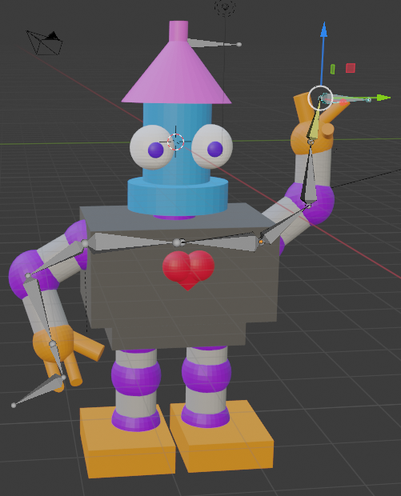
Character Animation

Slide 14
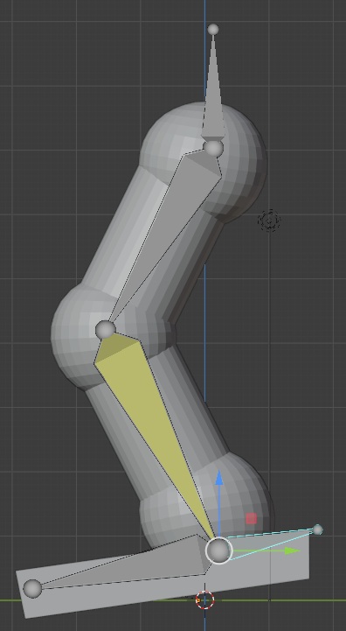
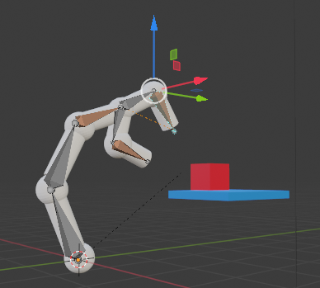
Character Animation
https://youtu.be/e7a_x_r_Yis

Slide 15
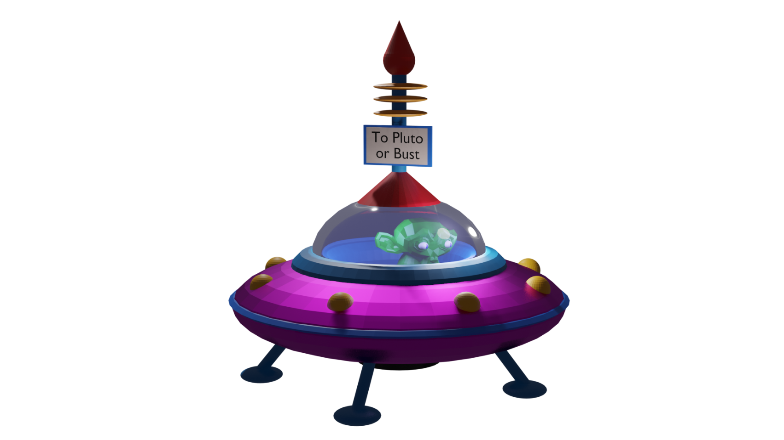
Transparency

Slide 16
What is the Metaverse?
Definition:
Benefit:
Danger:
The Metaverse is …
Could enable …
Could cause …

Slide 17
Character Animation
Parent Child
https://www.youtube.com/watch?v=GS452KMVWKA
Bones
https://www.youtube.com/watch?v=ZmiZ6VkSJBE

