Slide 1
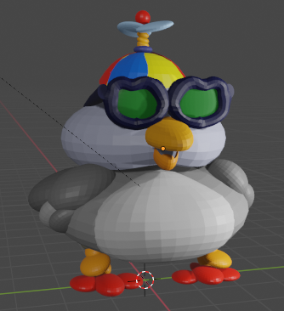
Blender 3D 102
Character Animation
Notes:
Welcome to the build it yourself 3D graphics laboratory! We will be building 3D rocketships!

Slide 2
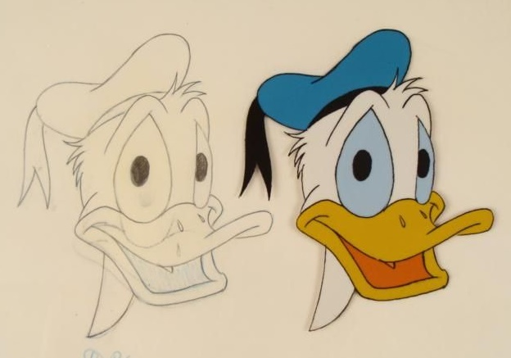
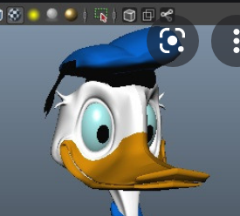
The Problem
2D drawings are boooooring.
2D is soooooo yesterday!
Vintage Disney Drawing Cell
Notes:
Training people for difficult situations like fighting fires, flying jets or performing surgery is expensive and dangerous. 2D animations and expensive, time consuming and limiting.

Slide 3
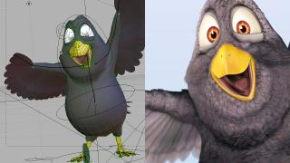
The Mission
Learn to think and express ideas in
3 dimensions!
Notes:
Learn to think in 3D so you can help pioneer the future of games, movies and simulations!

Slide 4
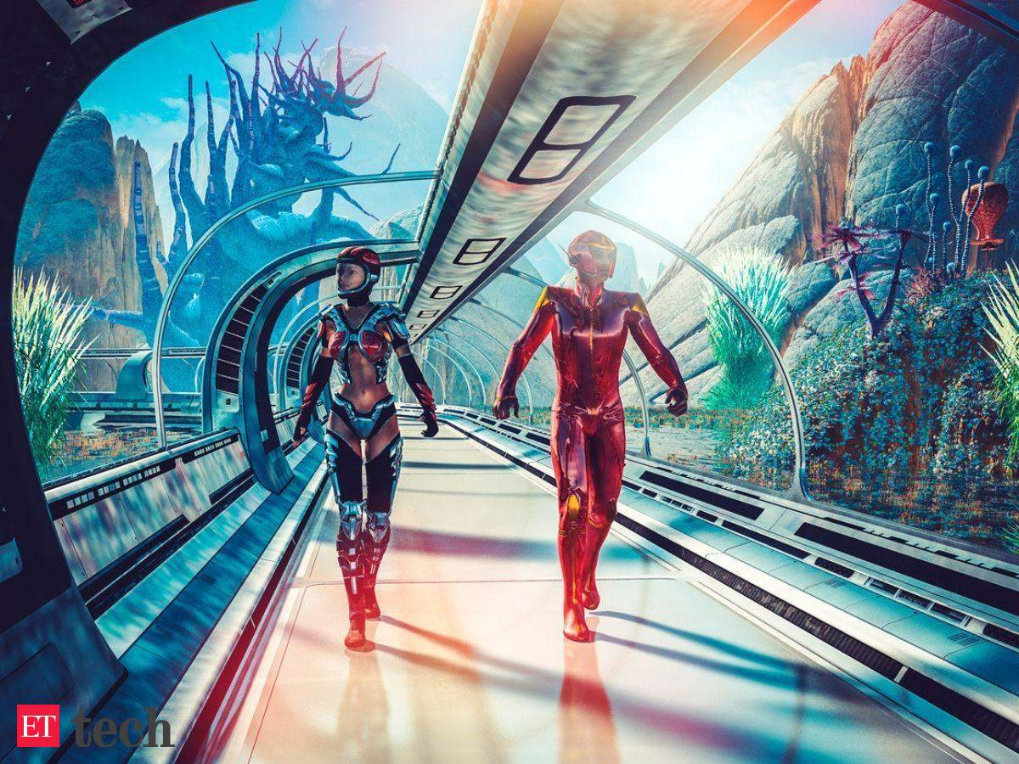
Research
How will 3D graphics impact the Metaverse?
What are the pros and cons of the Metaverse?
Notes:
Research some way cool examples of 3D graphics and animations. Think of your favorite game and movie characters.
Can you think of any jobs where people might use 3D graphics or simulations?

Slide 5
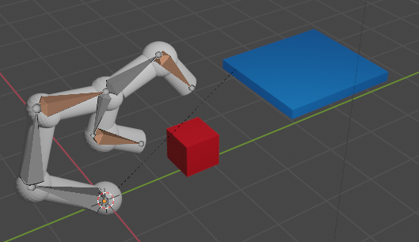
Project Plan and Skills Needed
Project Plan:
Document your ideas in a PPT lab book.
Create a 3D animated character.
Present your project.
Skills Needed:
PowerPoint Guru
Problem Solver
Master Designer
Modular Constructor
Hot Shot Programmer
3D Designer
Notes:
These are the parts of the project we will be making. These are the skills you will learn.

Slide 6
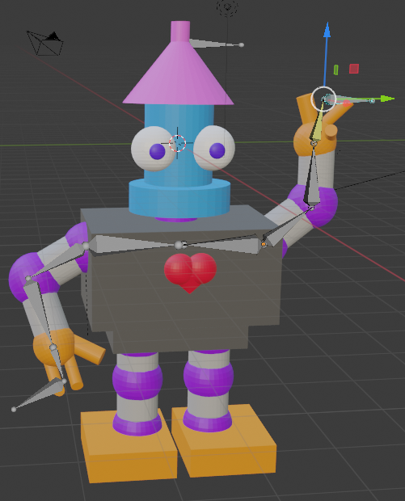
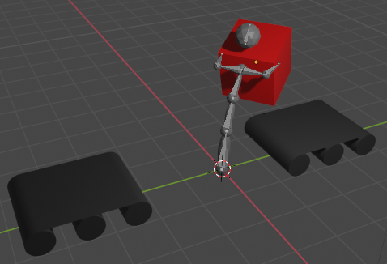
Hall of Fame
Notes:
These are graphics others have made. Are they way cool? What do you like about them?

Slide 7
Coaching Notes

Slide 8
3D Blender Tricks We Will Learn
Blender 101
View and position objects. (x,y,z axis)
Build a complex designs by manipulating objects
Copy, duplicate, mirror objects
Join and disconnect objects
Change center of rotation
Color and texture objects
Position lights
Animate a group of objects.
Render images with transparent backgrounds
Research 3D graphics applications.
Blender 102
Build a complex designs by manipulating points, edges, and faces.
Add points, slices
Create armatures with inverse kinematics constraints and a control bone.
View armatures in front of meshes
Make text signs, edit text, and convert text to meshes.
Add backgrounds
Make objects transparent
Set camera view
Render videos with transparent backgrounds
Convert animation to file formats for YouTube
Notes:
These are graphics others have made. Are they way cool? What do you like about them?

Slide 9
What we should know
How to think in 3D
How to communicate ideas visually
Benefits of modular construction
Proper naming conventions
Lingo of the pros! (render, materials, textures, resolution…)
Advanced Projects:
Turn your animation into a GIF
Create short animation to mp4
Write a story around your animated character
Notes:
Have kids who get ahead try some advanced challenges or help teach the workshops!

Slide 10
Agenda
Wkshp 1 Set up lab book
Research 3D animation applications
Design an animated character
Integrate objects
Wkshp 2,3 Design an animated character
3D simulation applications in the Metaverse
Edit mode (vertex, edge, face)
Proportional editing
Wkshp 4 Color a character
Textures
linking and unlinking colors
Coloring faces
Wkshp 5 Create an armature to pick up and move a box
Wkshp 6 Create a skeleton and parent with character
Wkshp 7 Create an animation
Render animation
Convert to file formats for YouTube
Wkshp 8 Present Project
Post on Invention Universe
Notes:
Have kids who get ahead try some advanced challenges or help teach the workshops!

