Slide 1
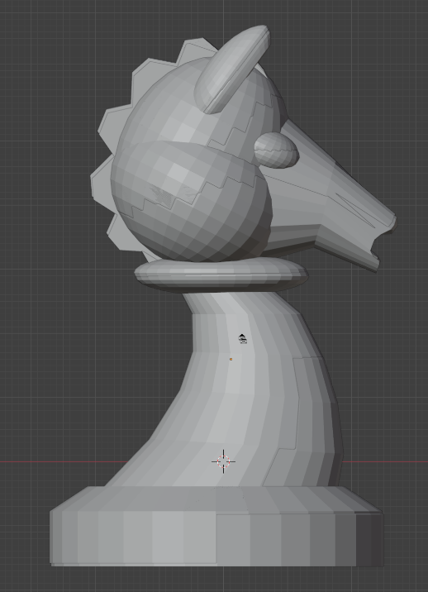
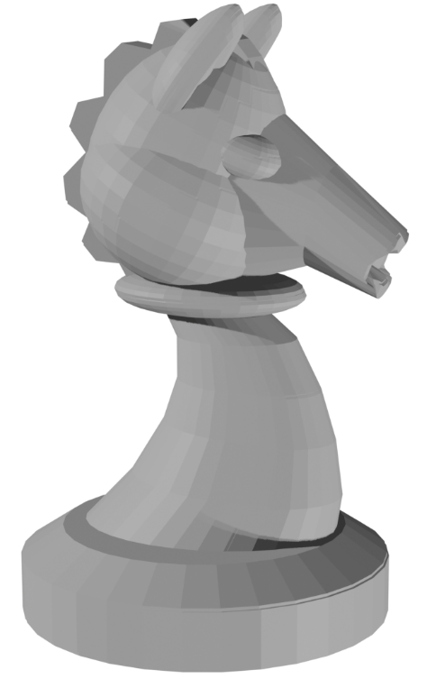
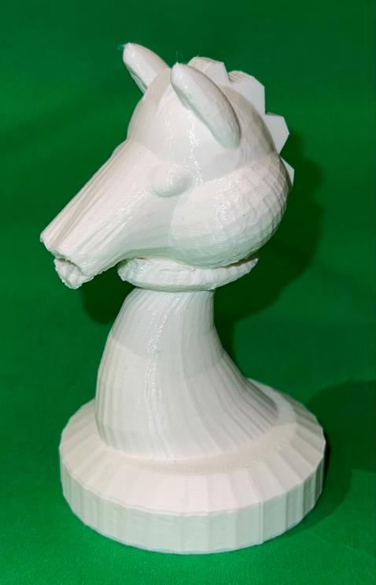
3D Industrial Design & Prototyping
Build-It-Yourself.com

Slide 2
Problem:
When building complex, expensive projects, a prototype of model is usually required to flush out problems before the project is built.
Mission:
Prototype a chess set including 32 black and white pieces and a 64 square board which demonstrates both creativity and accuracy.
Build-It-Yourself.com

Slide 3
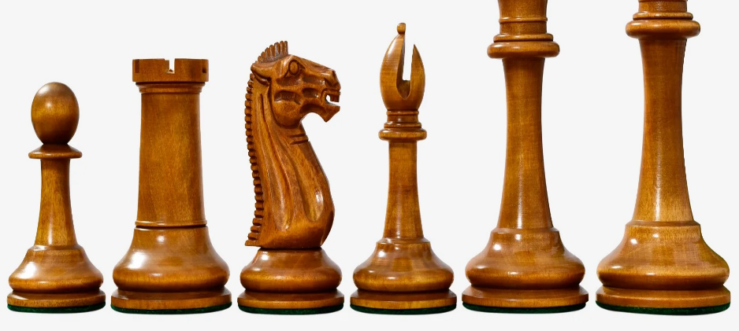
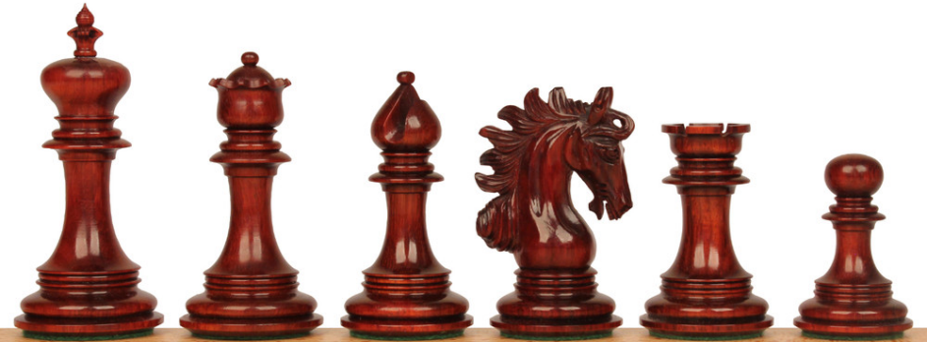
Research - Chess Pieces
Build-It-Yourself.com

Slide 4
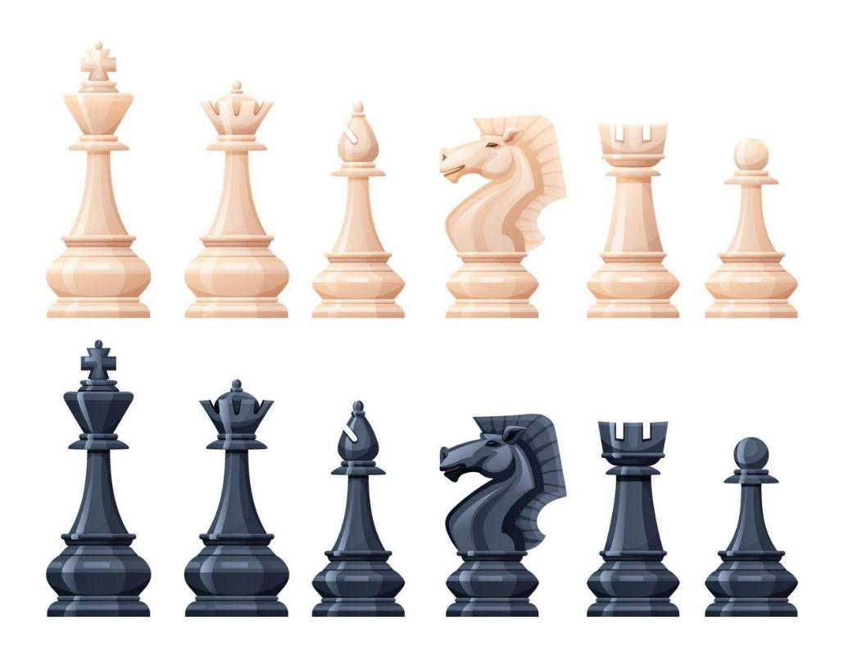
Research - Chess Pieces
Build-It-Yourself.com

Slide 5
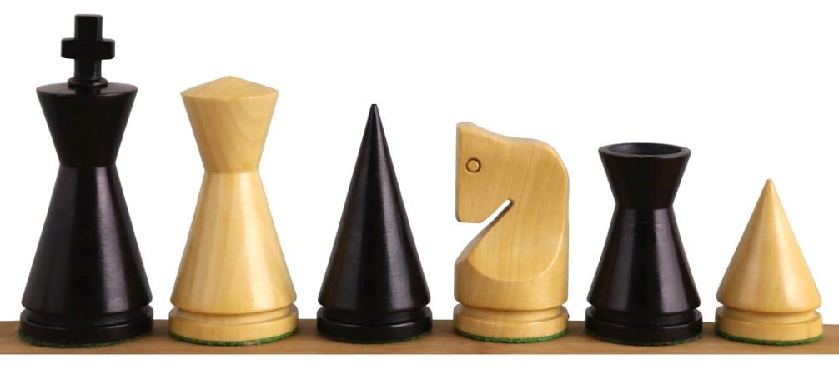
Research - Chess Pieces
Build-It-Yourself.com

Slide 6
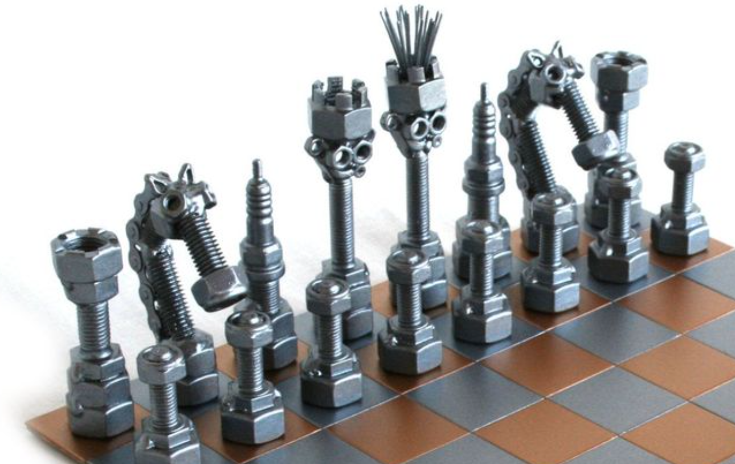
Research - Chess Pieces
Build-It-Yourself.com

Slide 7
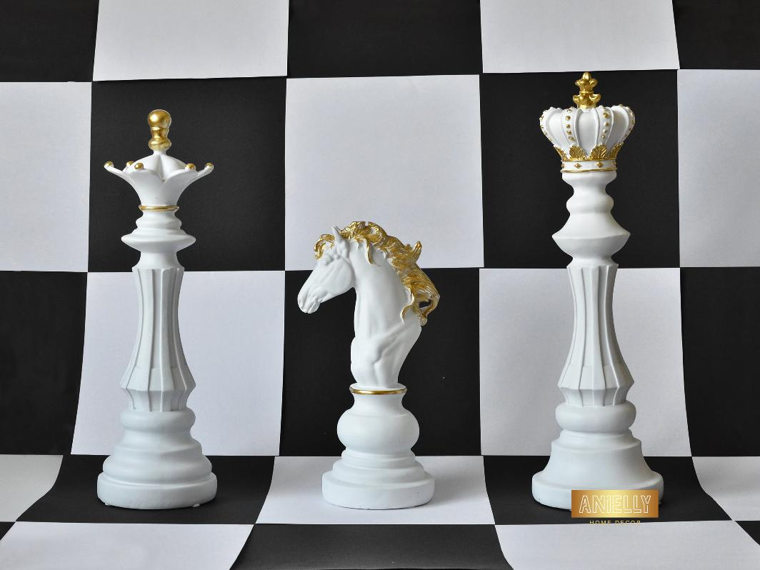
Research - Chess Pieces
Build-It-Yourself.com

Slide 8
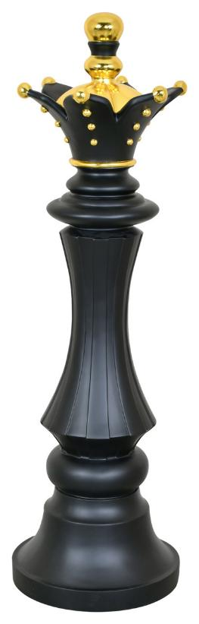

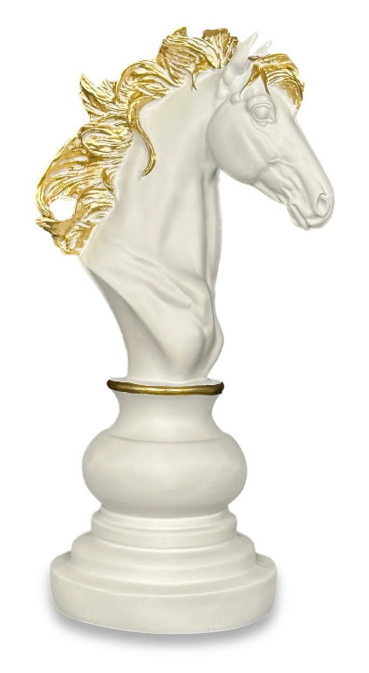
Research - Chess Pieces
Build-It-Yourself.com

Slide 9
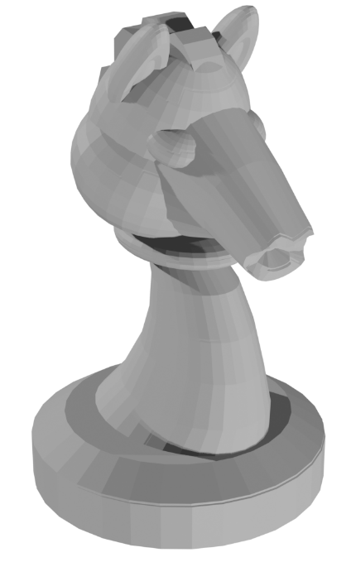
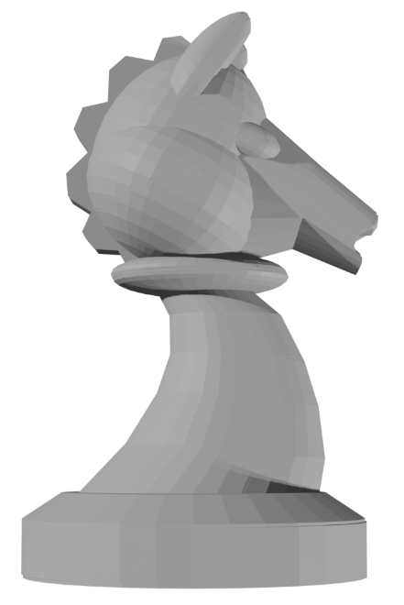
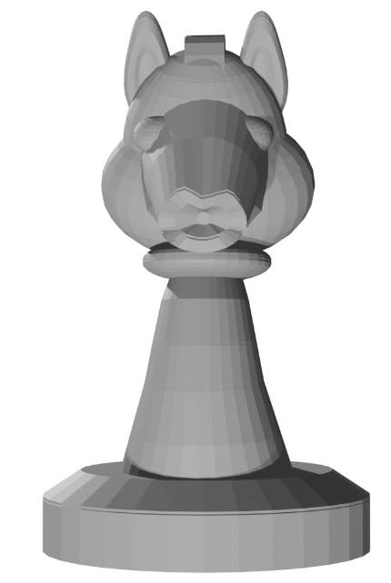
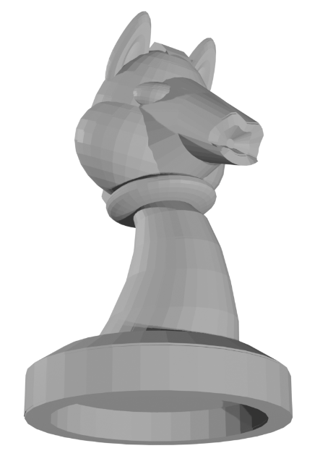
Chess Horse Design
Build-It-Yourself.com

Slide 10
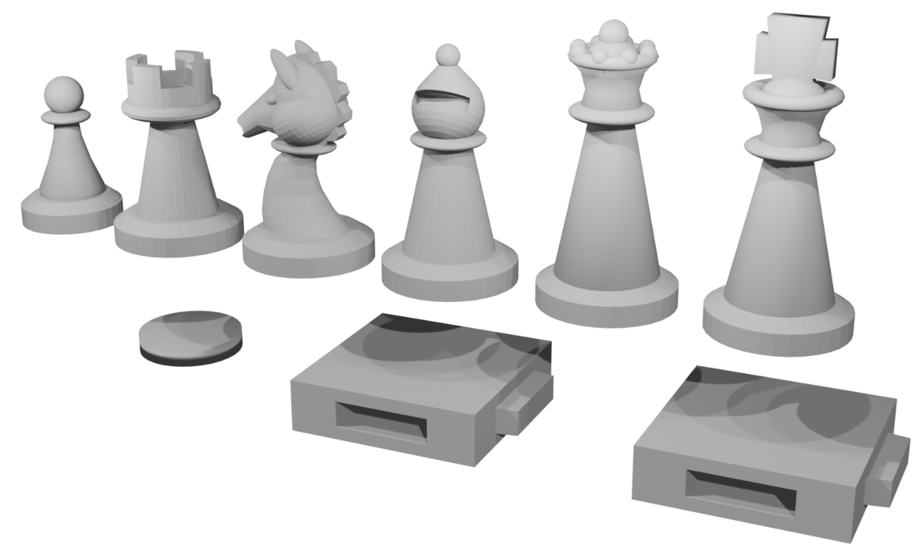
Piece Design
Build-It-Yourself.com

Slide 11
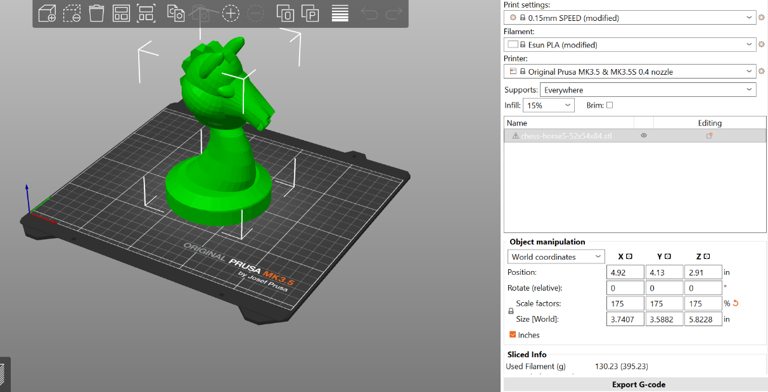

3D Printing
Print 96 pieces. (32 white squares, 32 black squares, 8 white pawns, 8 black pawns, 2 white castles, 2 black castles, 2 white horses, 2 black horses, 2 white bishops, 2 black bishops, 1 white queen, 1 black queen, 1 white king, 1 black king)
Build-It-Yourself.com

Slide 12
Printing 3D Blender Files
How do you export a Blender file for 3D printing?
Export Blender file to STL format.
Import STL to 3D printer driver app. (Purser Slicer)
Configure for specific printer, filament, scale, support, density, …
Create G-code file that will control the printer nozzle.
How large should the Blender file be to print a 3 inch model?
Scale in the process of creating a printer G-code file from and STL file
Where are 3D printing services?
Many online services.
Cambridge Public Library
Build-It-Yourself.com

Slide 13
Printing 3D Blender Files
How much does it cost?
$500 – 64 squares+32 pieces at an online 3D Print Service
$200 - $2000 for a home 3D printer
Original Prusa MK3.5S .4mm nozzle is $1,500 (Cambridge Public Library)
Filament for a 2” chess piece <$2.
High maintenance cost to get 10,000+ printing hours
How long does it take to print?
3-8 hours per piece 3-5 inches tall.
Build-It-Yourself.com

Slide 14
Printing 3D Blender Files
If you convert a Blender default cube to an STL file, how big will 3D printer make it? in Inches?
CoPilot: How to Scale the Blender Cube for 3D Printing
Decide your target size
  You want 2 inches per side.
  In millimeters (since slicers use mm): 2\mathrm{\ in}\times 25.4\mathrm{\ mm/in}=50.8\mathrm{\ mm}
  So the cube should be 50.8 mm × 50.8 mm × 50.8 mm.
  Adjust in Blender before export
    Select the cube.
    In the Properties panel → Dimensions, set each axis (X, Y, Z) to 50.8 mm.
    Make sure your Scene Units are set to Metric → Millimeters (this avoids confusion).
  Export to STL
    File → Export → STL.
    Check the Scale option in the export dialog. Leave it at 1.0 if you already set dimensions in mm.
    If your slicer interprets Blender units as mm, it will now read the cube correctly.
  Verify in Slicer
  Import the STL into Cura/PrusaSlicer. Confirm the cube shows as 50.8 mm per side.
  If it doesn’t, apply a scale factor until it matches.
Build-It-Yourself.com

Slide 15
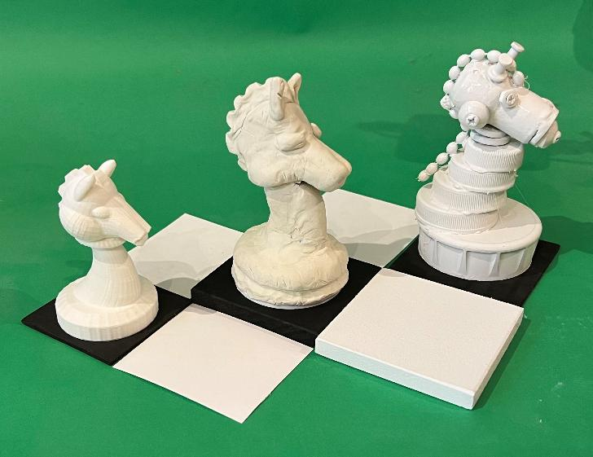
3D Printing vs. Alternative Construction
Year of the Chess Horses.
The 3D model inspired comparing the construction process with alternatives: sculpted horse and another built from premium‑quality junk. It turned into a surprisingly rich exercise—moving up and down the art‑and‑engineering ladder and thinking about the “soul” of an object.
It also reminded me of the challenge we’re wrestling with as a team: finding the wise balance between the latest technology and the hand‑crafted, human touch that gives BIY its character. We want to use powerful tools, but not lose the playfulness, texture, and imagination that make our work feel alive.
Build-It-Yourself.com

Slide 16
If you want to be a chess player you need to talk like one.
Dastardly Deed.
You better brace yourself before I make my next move
Goodbye, Queeny!
Give up?
Build-It-Yourself.com

