Slide 1
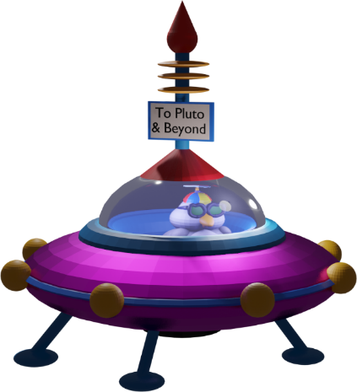
3D Blender 101
Lab Book
2D is sooooo yesterday.
Learn to express your ideas in 3D.
Notes:
Welcome to the Build-It-Yourself Laboratory

Slide 2
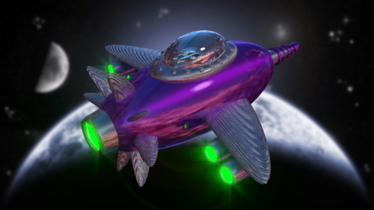
The Problem and Mission
2D is sooooooo yesterday!
Learn to think and express
your ideas in 3 dimensions.
Approved
JG
Date
Apr 2022
Project
Blender 101
Notes:
Before building, a good engineer will define the problem and set goals.
This is an opportunity to talk about:
How technology has made life better
And
How technology has made life worse.

Slide 3
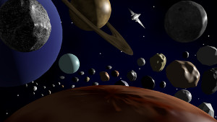
The Problem and Mission
2D is sooooooo yesterday!
Learn to fantasize in 3 dimensions.
Approved
JG
Date
Apr 2022
Project
Blender 101
Notes:
Before building, a good engineer will define the problem and set goals.
This is an opportunity to talk about:
How technology has made life better
And
How technology has made life worse.

Slide 4
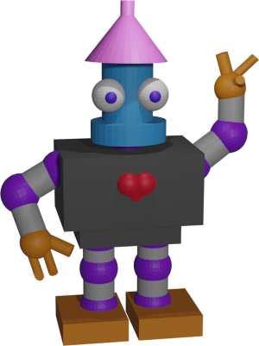
The Problem and Mission
2D is sooooooo yesterday!
Dream in 3 dimensions.
Approved
JG
Date
Apr 2022
Project
Blender 101
Notes:
Before building, a good engineer will define the problem and set goals.
This is an opportunity to talk about:
How technology has made life better
And
How technology has made life worse.

Slide 5
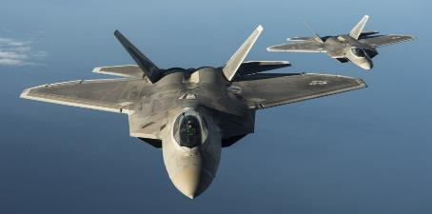
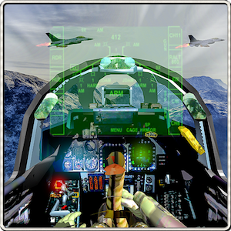
The Problem and Mission
The real world is often dangerous, expensive, and difficult.
Simulate reality in 3D.
Approved
JG
Date
Apr 2022
Project
Blender 101
Notes:
Before building, a good engineer will define the problem and set goals.
This is an opportunity to talk about:
How technology has made life better
And
How technology has made life worse.

Slide 6
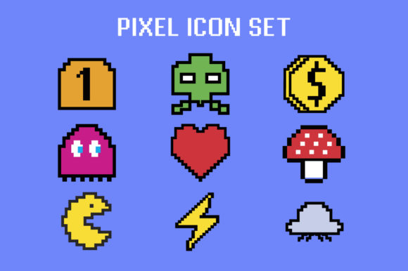
The Problem and Mission
2D computer games are sooooooooo yesterday.
3D computer games are way cool.
Approved
JG
Date
Apr 2022
Project
Blender 101
Notes:
Before building, a good engineer will define the problem and set goals.
This is an opportunity to talk about:
How technology has made life better
And
How technology has made life worse.

Slide 7
Why do humans choose 3D over 2D ?
Which would you rather have?
2 pieces of candy?
or
3 pieces of candy?
Approved
JG
Date
Apr 2022
Project
Blender 101
Notes:
Before building, a good engineer will define the problem and set goals.
This is an opportunity to talk about
being an entrepreneur
the pros and cons of capitalism and socialism.

Slide 8
Which would you rather have?
Y
If you can only think in 2 dimensions, you are missing at least 1/3 of the pleasure.
Which would you rather have,
2 pieces of candy
or 3 pieces?
X
Y
Maximize the pleasure !
Think 3D.
X
Z
Approved
JG
Date
Apr 2022
Project
Blender 101
Notes:
Before building, a good engineer will define the problem and set goals.
This is an opportunity to talk about
being an entrepreneur
the pros and cons of capitalism and socialism.

Slide 9
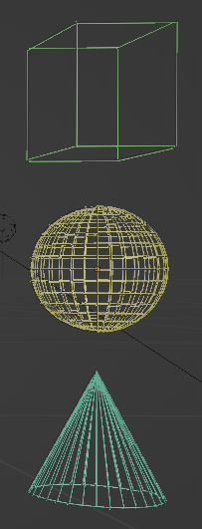
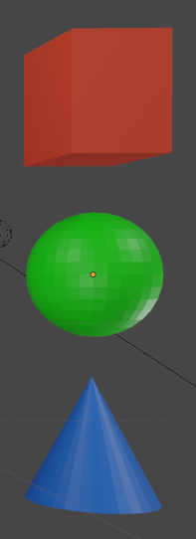
Geometry Solid Geometry
Square
Circle
Triangle
Cube
Sphere
Cone
Approved
JG
Date
Apr 2022
Project
Blender 101
Notes:
Before building, a good engineer will define the problem and set goals.
This is an opportunity to talk about
being an entrepreneur
the pros and cons of capitalism and socialism.

Slide 10
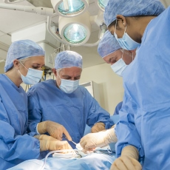
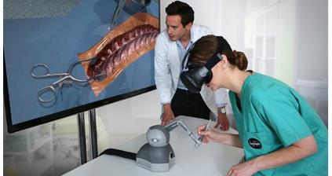
Research
Training for reality can be expensive and dangerous.
3D graphics can help us learn
Quicker
Safer
Cheaper
Approved
JG
Date
Apr 2022
Project
Blender 101
Notes:
Before building, a good engineer will define the problem and set goals.
This is an opportunity to talk about:
How technology has made life better
And
How technology has made life worse.

Slide 11
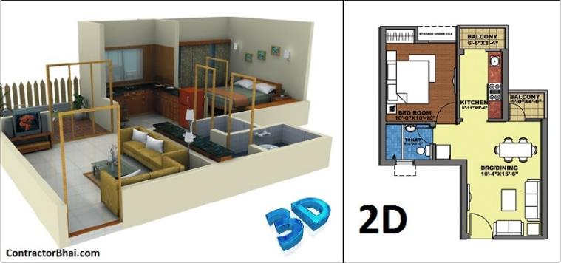
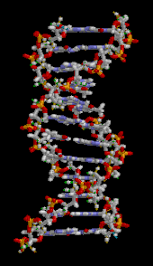
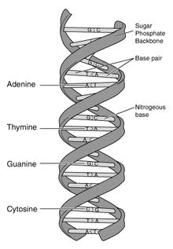
Research
3D models can help you better understand how your design will look.
Or how a complex molecule fits together.
Approved
JG
Date
Apr 2022
Project
Blender 101
Notes:
Before building, a good engineer will define the problem and set goals.
This is an opportunity to talk about:
How technology has made life better
And
How technology has made life worse.

Slide 12
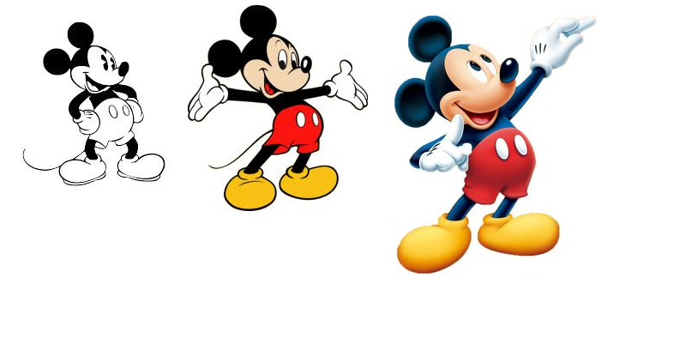
Research
Approved
JG
Date
Apr 2022
Project
Blender 101
Notes:
Before building, a good engineer will define the problem and set goals.
This is an opportunity to talk about:
How technology has made life better
And
How technology has made life worse.

Slide 13
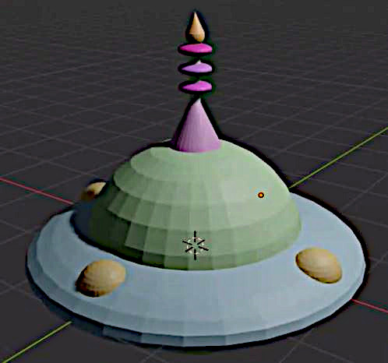
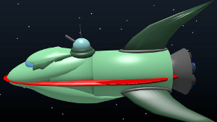
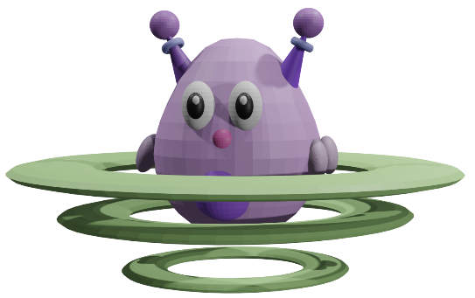
Hall of Fame Solutions
Approved
JG
Date
Apr 2022
Project
Blender 101
Notes:
Inspire ideas and excitement

Slide 14
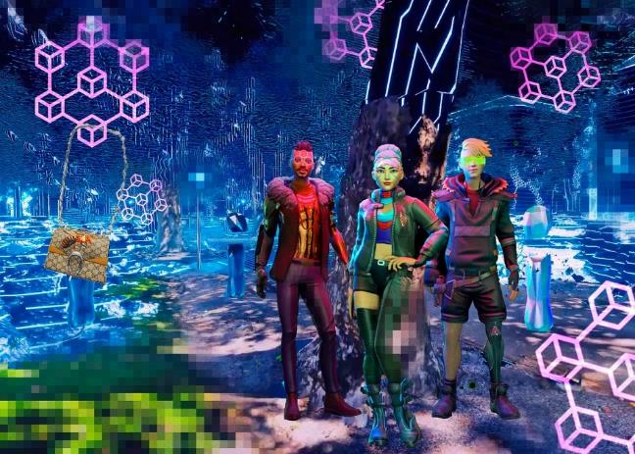
Research
Definition:
Benefits:
Dangers:
The Metaverse is …
Could enable …
Could cause ...
Approved
JG
Date
Apr 2022
Project
Blender 101
Notes:
Before building, a good engineer will define the problem and set goals.
This is an opportunity to talk about:
How technology has made life better
And
How technology has made life worse.

Slide 15
Coaching Notes

Slide 16
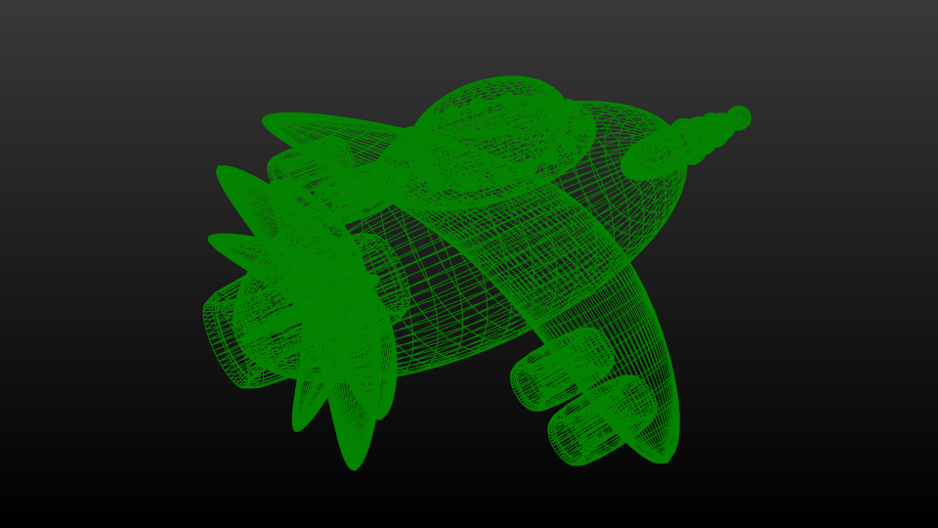
Wireframe
Video Introduction to Blender
https://www.youtube.com/watch?v=jQZMf2zdPLY

Slide 17
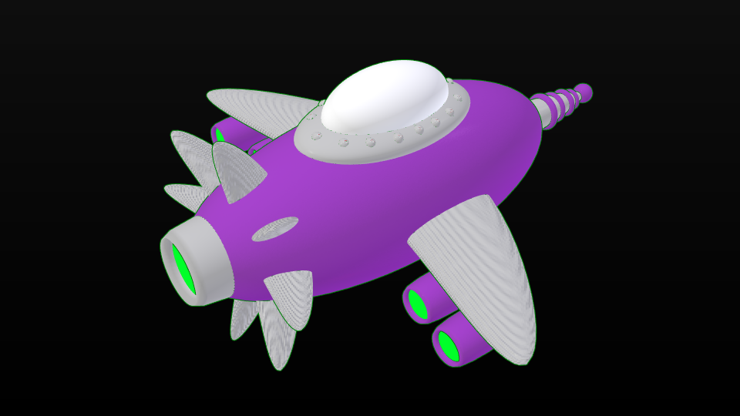
Solid

Slide 18
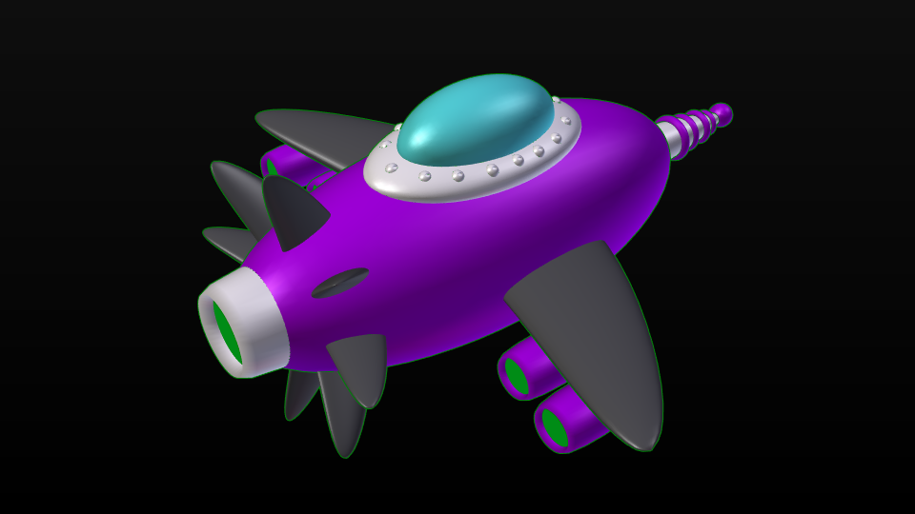
Materials

Slide 19
Render

Slide 20
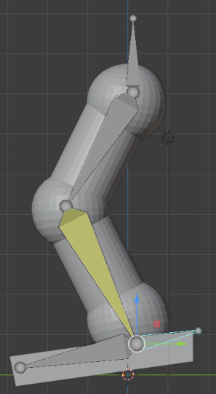
Character Animation
Parent Child
https://www.youtube.com/watch?v=GS452KMVWKA
Bones
https://www.youtube.com/watch?v=ZmiZ6VkSJBE

Slide 21
What you should know
How to think in 3D
How to communicate ideas visually
Benefits of modular construction
Proper naming conventions
Lingo of the pros! (render, materials, textures, resolution…)
Advanced Projects:
Write a story around your space adventure.
Create short animation to mp4.
Create a planet outpost.
Notes:
Invite kids who get ahead try some advanced challenges or help teach the workshops!

Slide 22
3D Blender Tricks We Will Learn
Blender 101
View and position objects. (x,y,z axis)
Build a complex designs by manipulating objects
Copy, duplicate, mirror objects
Join and disconnect objects
Change center of rotation
Color and texture objects
Position lights
Animate a group of objects.
Render images with transparent backgrounds
Research 3D graphics applications.
Blender 102
Build a complex designs by manipulating points, edges, and faces.
Add points, slices
Create armatures with inverse kinematics constraints and a control bone.
View armatures in front of meshes
Make text signs, edit text, and convert text to meshes.
Add backgrounds
Make objects transparent
Set camera view
Render videos with transparent backgrounds
Convert animation to file formats for YouTube

Slide 23
Agenda
Wkshp 1 Intro to 3D Graphics
Doc Problem / Mission
Research spaceships
Make rocket with shapes
View, Add, Move, Color menus
Wkshp 2 Document solid geometry, XYZ axis
Make rocket with spheres
Copy, Mirror, Group, Ungroup
Wkshp 3 Add Rocket Details
Position lamps
Center group of objects for rotation
Wkshp 4 Design Planets
Transparency
Add texture
Add background
Smooth
Wkshp 5 Add lighting
Parent child relationships
Mold, sculpt, and proportional editing
Wkshp 6 Animation
Position Camera
Time line frames
Wkshp 7 Render Animation
Wkshp 8 Present Project
Post on Invention Universe
Transparency
Signs
Edit points, edges, faces
Point density
Slicing objects
Notes:
Invite kids who get ahead try some advanced challenges or help teach the workshops!

Slide 24
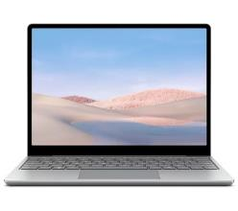
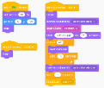
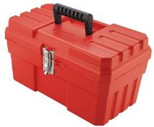
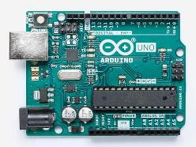
Parts, Tools, Supplies, Software
You'll need:
Blender 3D
https://www.blender.org/
Useful Build-It-Blocks
Add shapes
Color faces
Make transparent glass
Animate scenes
Animate armatures
Design signs
Render images

Slide 25
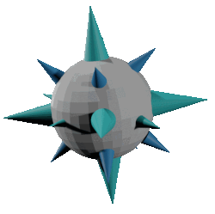
Solutions
Notes:
Blender 101 Challenge: Design a space scene complete with planets, spaceships, aliens, landscape decorations and a laboratory.

Slide 26
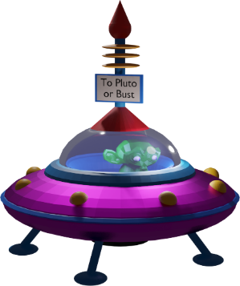
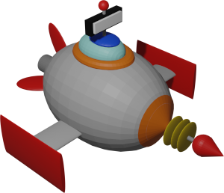
Solutions
Notes:
Blender 101 Challenge: Design a space scene complete with planets, spaceships, aliens, landscape decorations and a laboratory.

Slide 27
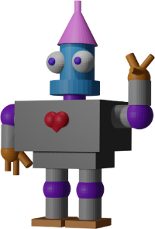
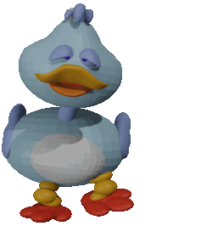
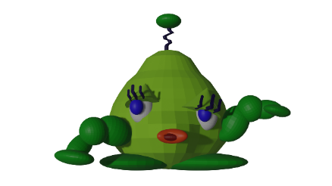
Solutions
Notes:
Blender 101 Challenge: Design a space scene complete with planets, spaceships, aliens, landscape decorations and a laboratory.

Slide 28
Solutions
Notes:
Blender 101 Challenge: Design a space scene complete with planets, spaceships, aliens, landscape decorations and a laboratory.

Slide 29
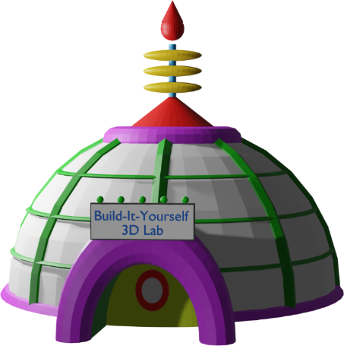
Solutions
Notes:
Blender 101 Challenge: Design a space scene complete with planets, spaceships, aliens, landscape decorations and a laboratory.

