Slide 1
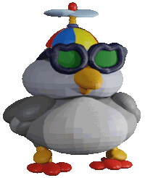
The Wicked Mean Machine
and the Pink Polka Dot Peacenik
From the Build-It-Yourself 3D Laboratory

Slide 2
It was the year 2030 on a particular playground in your ‘hood’ …
From the Build-It-Yourself 3D Laboratory

Slide 3
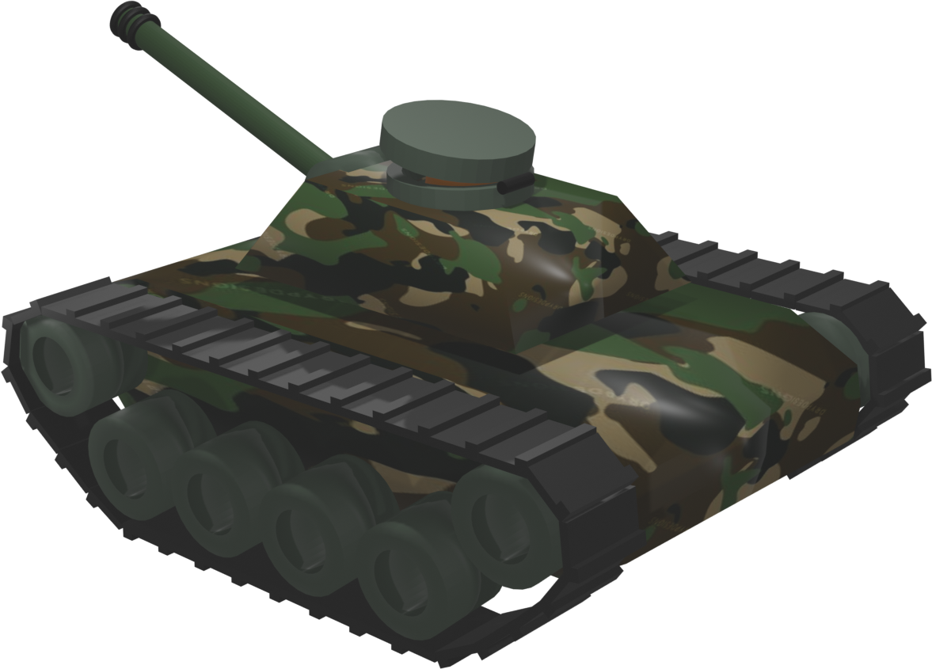
… there roamed a Wicked Mean Machine.
Kill, fire, fake news, and steal your Reece’s Peanut Butter Cups.
From the Build-It-Yourself 3D Laboratory

Slide 4
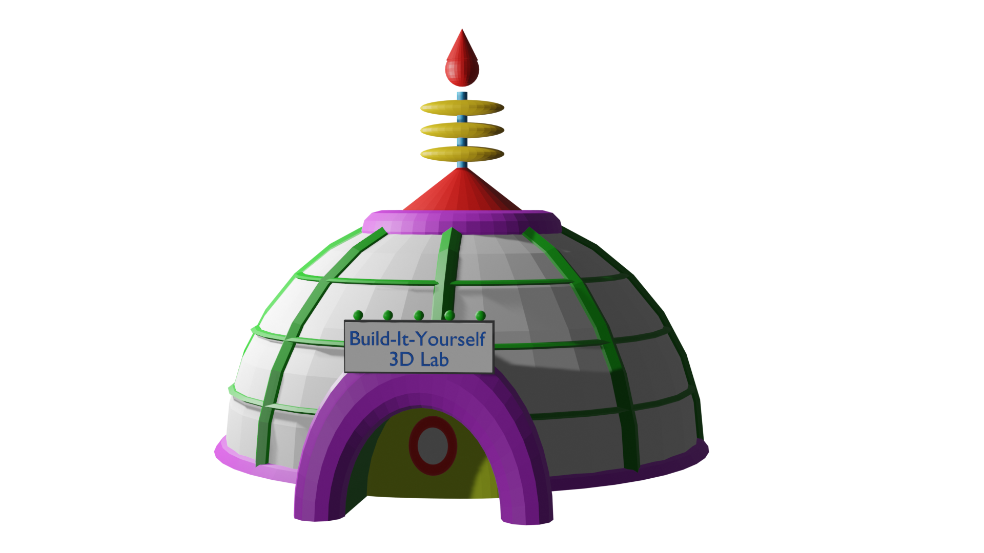
So a team of clever inventors at the Build-It-Yourself Laboratory sprung into action.
The mission:
Build and make love, not destroy and make war!
From the Build-It-Yourself 3D Laboratory

Slide 5
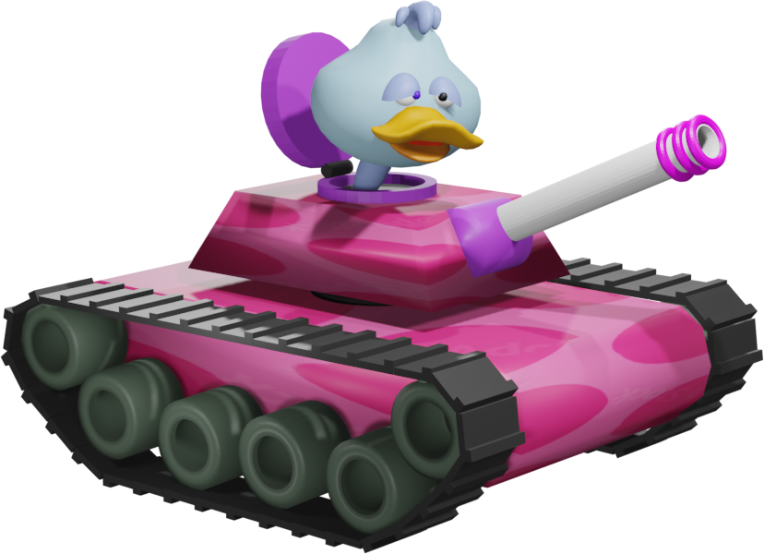
The result:
A Pink Polka Dot Peacenik Machine.
From the Build-It-Yourself 3D Laboratory

Slide 6
An epic faceoff between good and evil. Who would prevail?
From the Build-It-Yourself 3D Laboratory

Slide 7
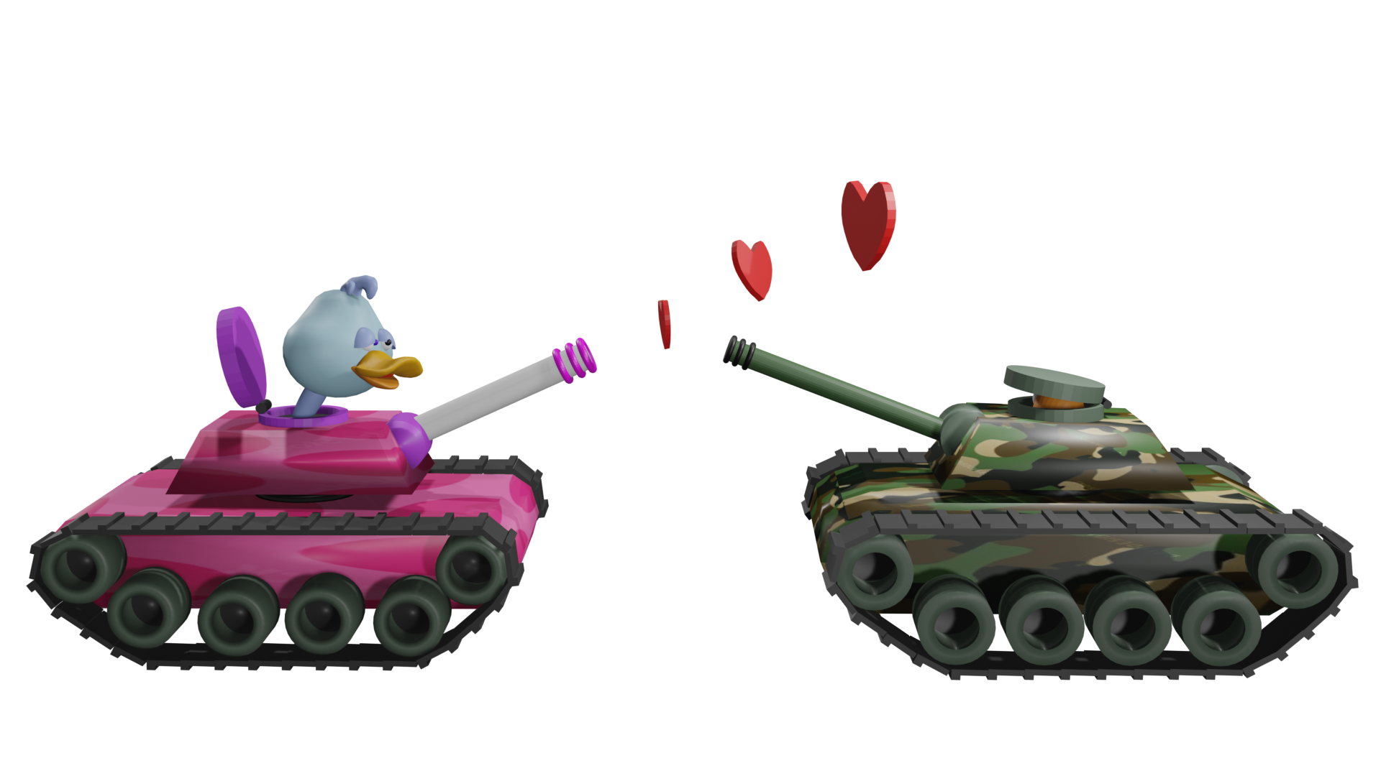
Before the Wicked Mean Machine could unload its nuclear payload, it got smothered with hugs and kisses.
Which would you rather have a punch in the nose
or a friendly hug?
From the Build-It-Yourself 3D Laboratory

Slide 8
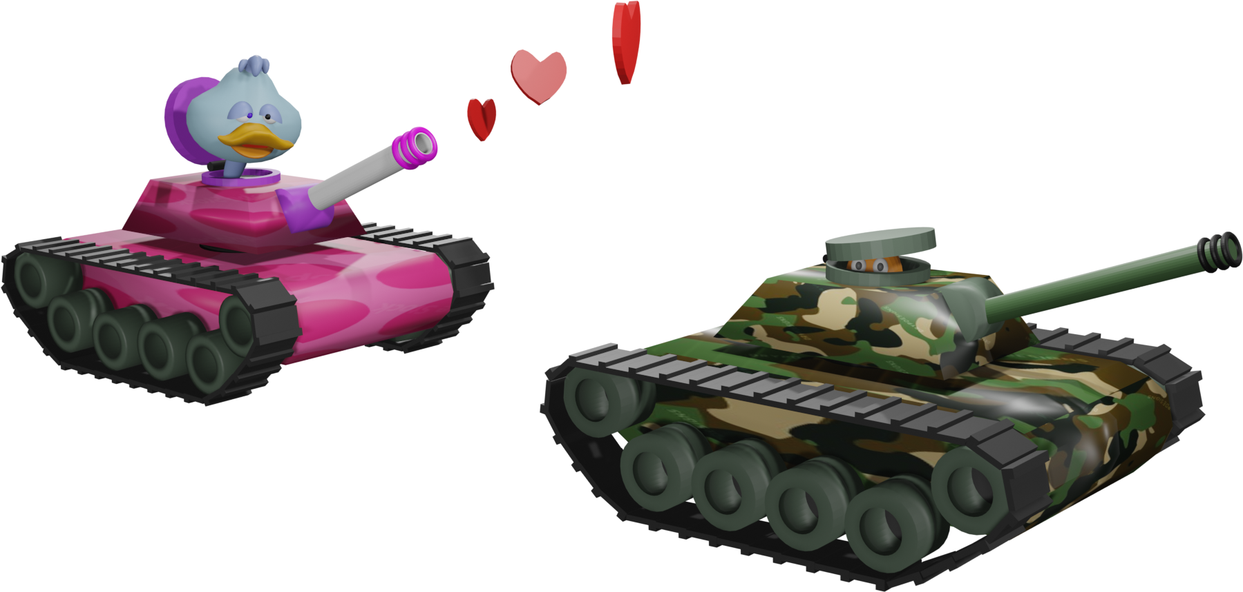
Logic prevails, and so the Wicked Mean Machine and the
Pink Polka Dot Peacenik Machine frolicked in the playground happily ever after.
From the Build-It-Yourself 3D Laboratory

Slide 9
The moral of this adventure:
War mongers are no match for Peace, Love, Building Together
and Reece’s Peanut Butter Cups for all.
Click to watch
From the Build-It-Yourself 3D Laboratory

Slide 10
The End
Until the next episode, Folks …
From the Build-It-Yourself 3D Laboratory

Slide 11
The Wicked Mean Machine and the Pink Polka dot Peacenik
In the year 2030, on a particular playground in your ‘hood’…
there roamed a Wicked Mean Machine.
Kill, fire, fake news, and steal your Reeces’ Peanut Butter Cups.
So a team of clever inventors at the Build-It-Yourself Laboratory sprung into action.
The mission:
Build and make love, not destroy and make war!
The result:
A Pink Polka dot Peacenik Machine.
An epic faceoff between good and evil. Who would prevail?
Before the Wicked Mean Machine could unload its nuclear payload, it got smothered with hugs and kisses. Which would you rather have a punch in the nose or a friendly hug?
Logic prevails, and so the Wicked Mean Machine and the Pink Polka Dot Peacenik Machine frolicked in the playground happily ever after.
The moral of this adventure:
War mongers are no match for Peace, Love, Building together, and Reeces’ Peanut Butter Cups for all.

