Slide 1
Monday Plan
Intro to Catapult Project
Video Intro to Catapults
Intro to BIY
Lab Book Cover
Document Problem/Mission
Document Laws of the Lab
Research
Make targets
www.build-it-yourself.com

Slide 2
Tuesday Plan
Review
Intro to scoreboard
Finish targets
Spoon / toilet paper catapult contest to knock down soldiers, walls, and towers
Document The Art of War 5 principles
Document research
Build and test a cardboard catapult
  Distance competition (video)
  Accuracy competition (video)
www.build-it-yourself.com

Slide 3
Wednesday Plan
Presentation Guidelines
Review (Video 2 teams’ presentations)
Review siege problem/mission
Finish catapults (build cup)
Document catapult physics: 4 factors that determine projectile trajectory
Launch Skittles to reach the castle under seige
Document 5 problem-solving tricks
Organize into 4 teams
Intro to wood catapults
Present and document Tool Rules
Demo sawing
Demo drilling
Cut wood pieces
www.build-it-yourself.com

Slide 4
Thursday Plan
Presentation Guidelines
Review (Video 1’ presentation)
Show Mangonol / Trebuchet Videos
Document 5 problem-solving tricks
Drilling techniques (drill size, splitting wood)
Drill several holes for screw eyes
Drill through thin wood. Put screw into thick wood
Two screws for the vertical piece.
Triangle structures add strength.
Finish wood catapult structure and test.
Document Presenting ideas
Make a team emblem for your catapult (look cool) / Graffiti
www.build-it-yourself.com

Slide 5
Friday Plan
Presentation Guidelines
Review (Video 1’ presentation)
Document what you learned
Take team pictures
Fill water bags
Test and Compete 5,3,2,1 Skittle rewards for distance and accuracy. Three tries.
Reward Ceremony
www.build-it-yourself.com

Slide 6
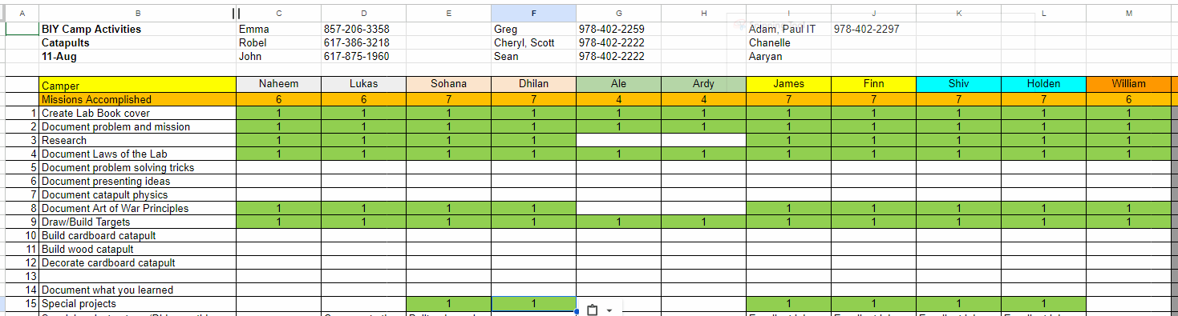
Score Board
www.build-it-yourself.com

Slide 7
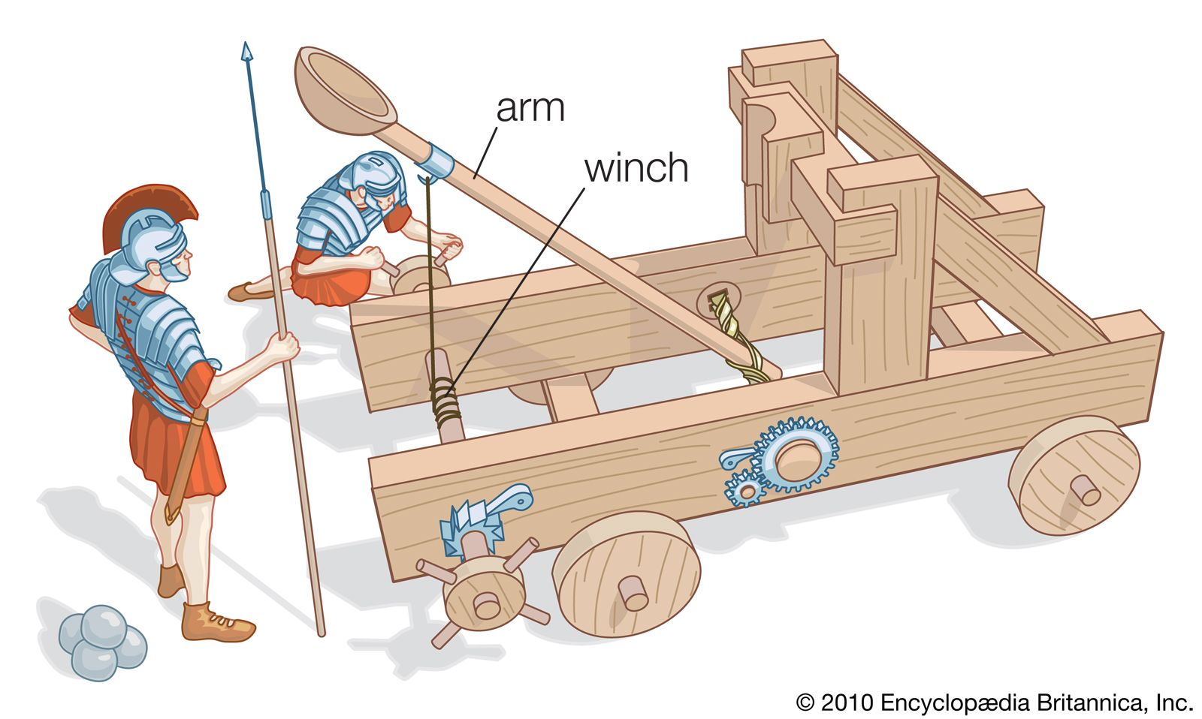
Catapults
Lab Book
Aaryan, Emma, Robel, Ryan and John
www.build-it-yourself.com

Slide 8
Problem
A proper engineer should start with a clear, concise, dramatic statement of the problem and mission before building.
You may use AI tools to help you write and illustrate a compelling statement of the problem and mission.
Document a Harry Potter-like storyline.
Then we will be in a good position to build.
Write a 50-word description of an evil castle that taxed the hard-working citizens to death.
Mission
Add a 50-word description of an engineer who built a catapult to destroy the castle.
Draw pictures of the evil castle and a steampunk catapult
www.build-it-yourself.com

Slide 9

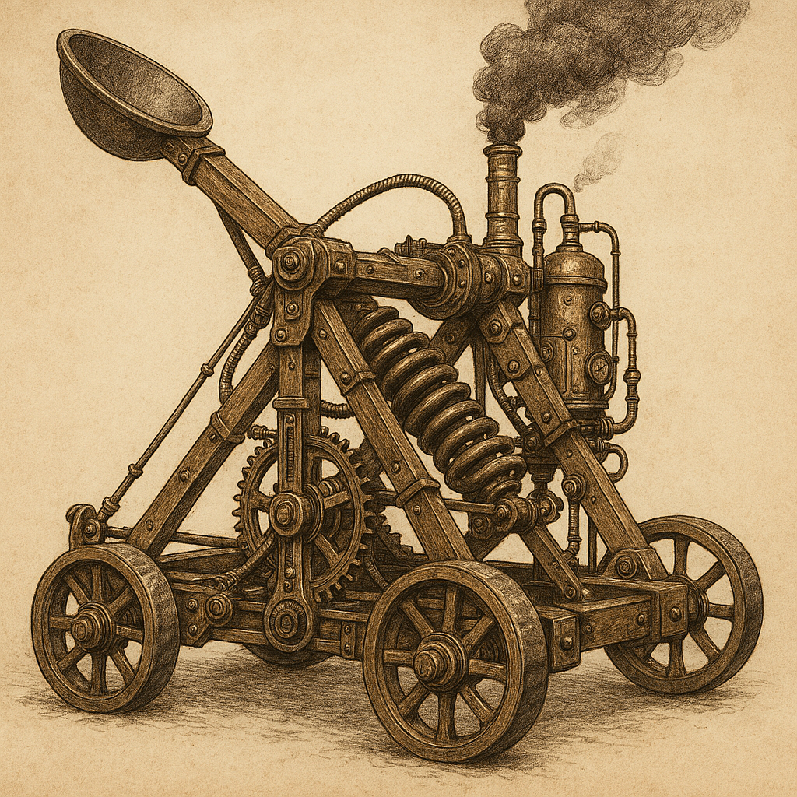
You may use AI tools to help you write and illustrate a clear, concise, compelling statement of the problem and mission.
Problem
Perched atop jagged cliffs, the Blackspire Citadel loomed like a curse. Its iron gates guarded greedy lords who drained the land with crushing taxes. Smoke choked the skies, and starving villagers toiled endlessly below. Gold filled the vaults, but hope had long fled. The castle thrived—on misery and despair.
Mission
In a hidden glen, the rebel engineer Alric forged vengeance from gears and grit. Scarred by loss, he crafted a towering catapult powered by steam and fury. Each bolt he fired carried the weight of the people's suffering. With every creak of wood, justice neared. The castle’s reckoning had begun.
www.build-it-yourself.com

Slide 10

Laws of the BIY Lab
Corollary:
The words,
www.build-it-yourself.com

Slide 11
Laws of the BIY Lab
Respect your teammates.
Respect your lab.
Don’t do dumb stuff.
Corollary:
The words, “I can’t” are forbidden.
www.build-it-yourself.com

Slide 12
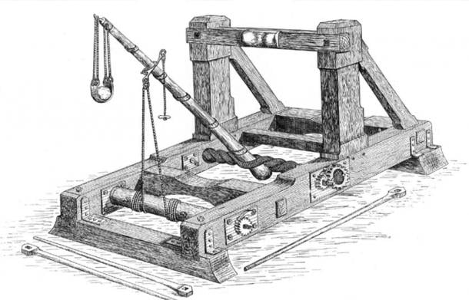
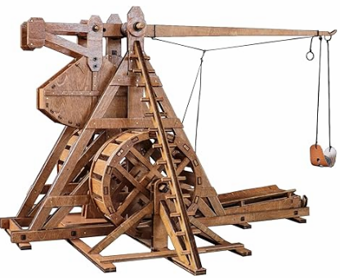
Research

Slide 13
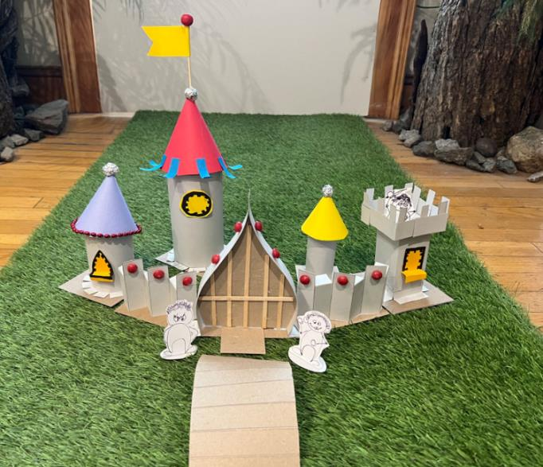
Planning
Draw some soldiers who will set the scale for the battlefield and castle.
Build a model of the castle we want to destroy.
Build a catapult to knock down enemy soldiers, castle walls, and castle towers.
www.build-it-yourself.com

Slide 14
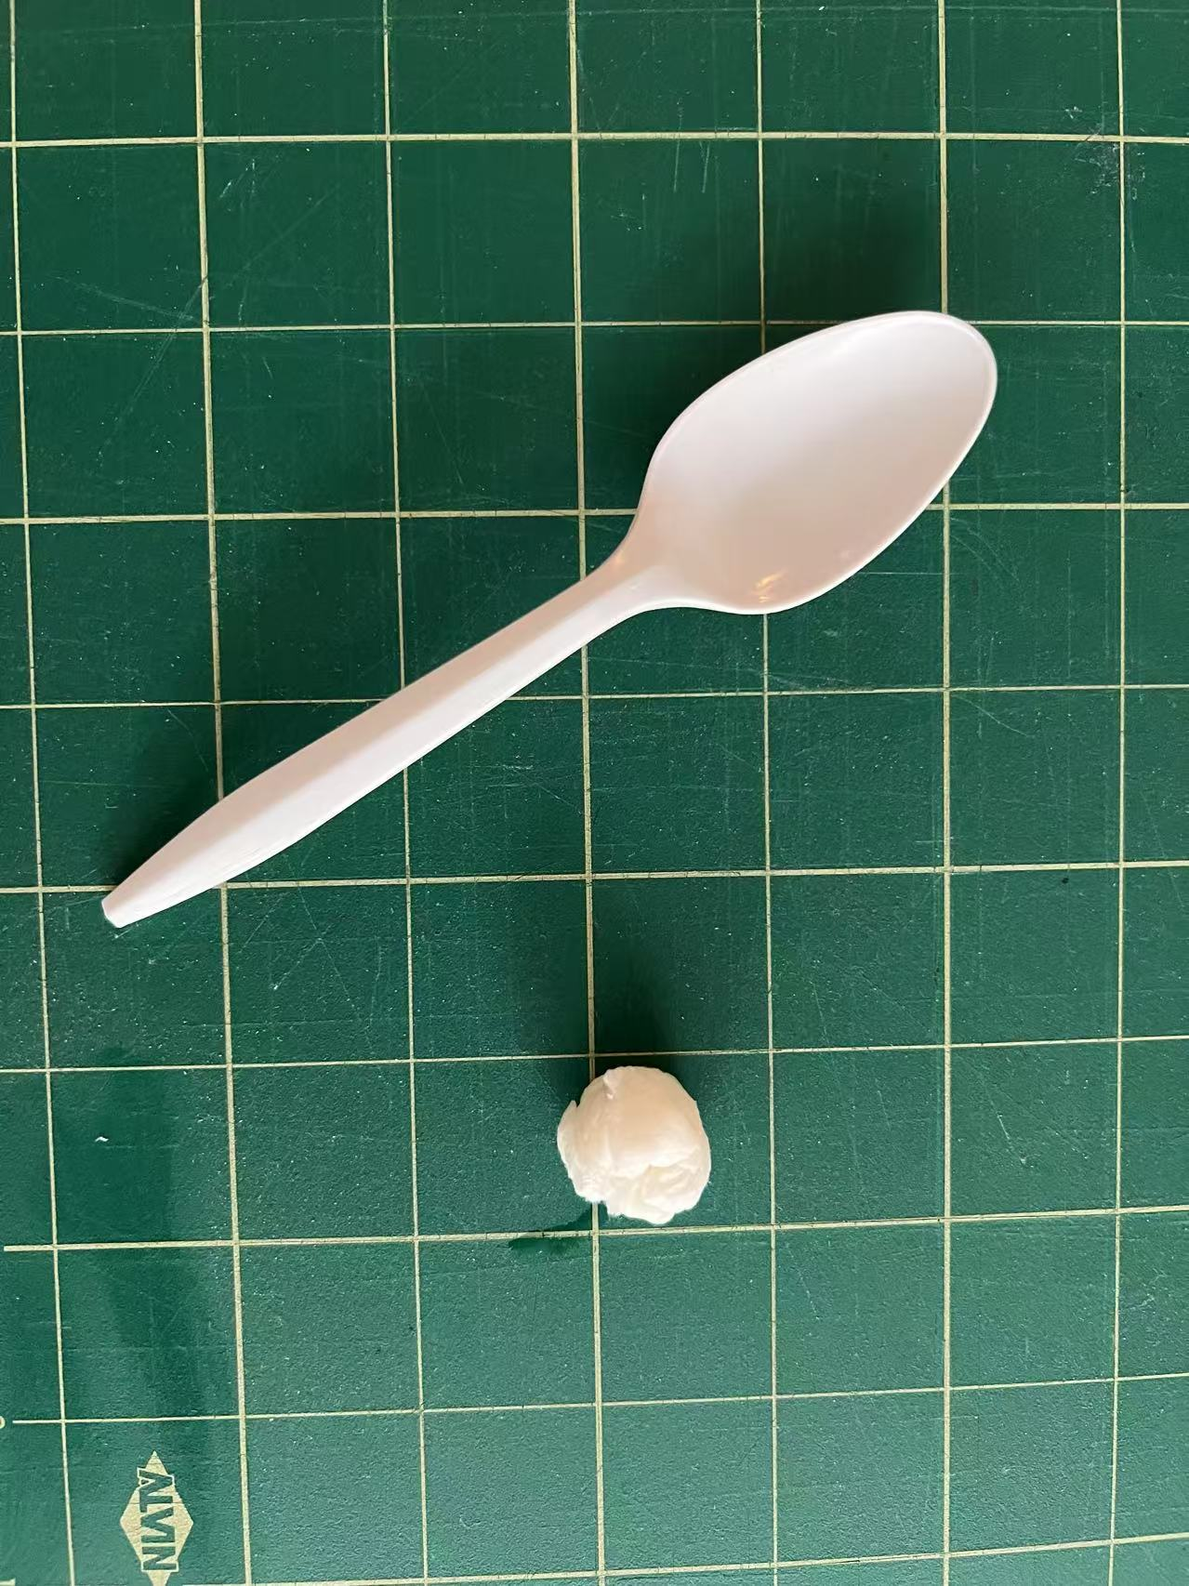
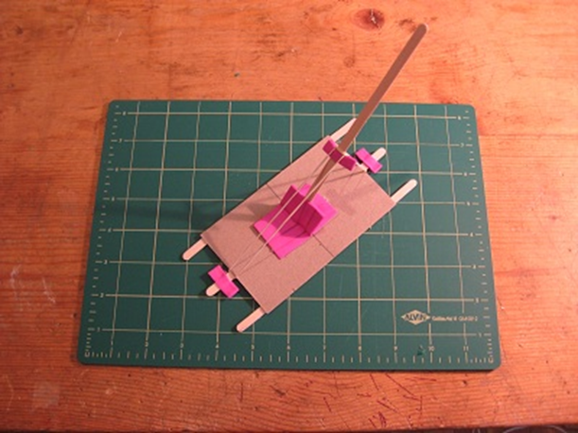
Solutions
Spring Spoon Catapult
With toilet paper spit ball projectile
Coffee Stirrer Stick Rubber Band Catapult
www.build-it-yourself.com

Slide 15
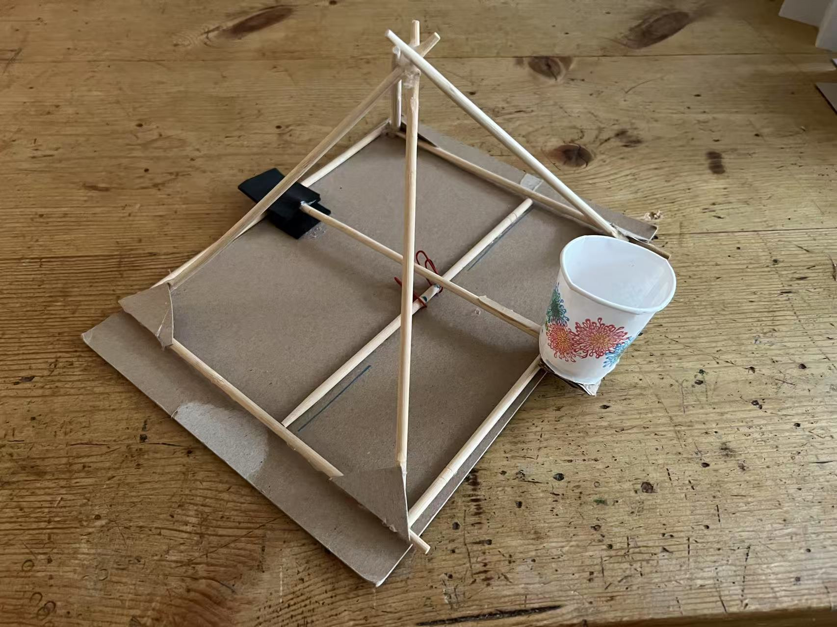
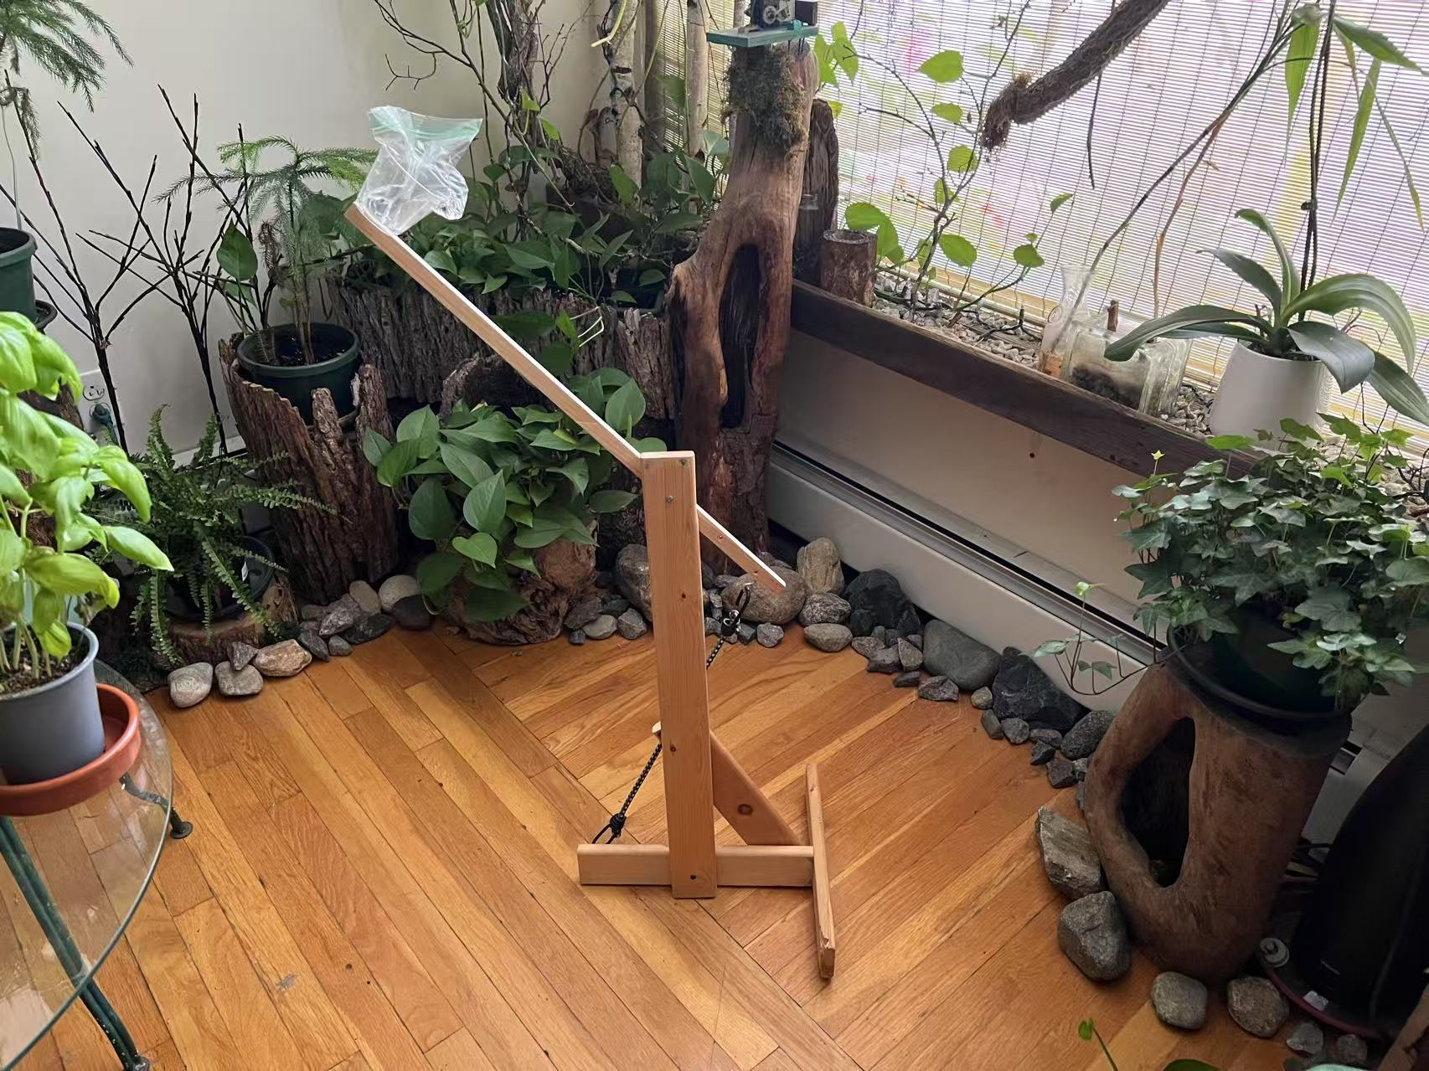
Solutions
Your own catapult design
Wood Catapult
www.build-it-yourself.com

Slide 16
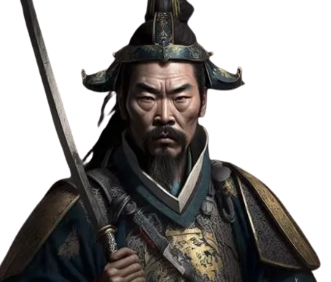
Art of War
1. Avoid Fighting When You Can
2. Think Before You Act
3. Know Yourself and Others
4. Be Clever, Not Just Strong
5. Adapt to Change

Slide 17
Art of War
From Sun Tzu’s “The art of war”:
1. Think Before You Act
Plan ahead! Thinking things through helps you make better choices.
2. Avoid Fighting When You Can
The supreme art of war is to subdue the enemy without fighting.
Solving problems peacefully is better than arguing or fighting.
3. Know Yourself and Others
If you know the enemy and know yourself, you need not fear the result of a hundred battles.
Understand your own strengths and feelings—and try to understand others too.

Slide 18
Art of War
From Sun Tzu’s “The art of war”:
4. Be Clever, Not Just Strong
In war, the way is to avoid what is strong and to strike at what is weak.
Use your brain more than your muscles. Smart thinking wins the day!
5. Adapt to Change
Water shapes its course according to the nature of the ground.”
Be flexible! If things don’t go your way, adjust and try a new plan.

Slide 19
Art of War
From Sun Tzu’s “The art of war”:
Avoid war, but if you must defend your candy …
Be smart.
Be strong.
Look cool.
After the battle … BE KIND!
Long live the most noble knights.

Slide 20
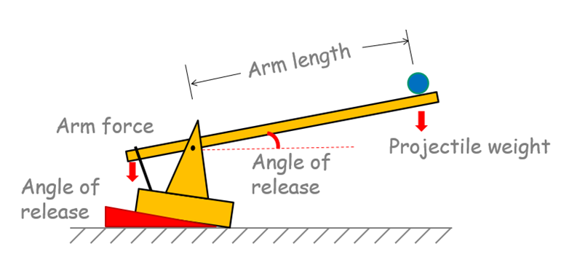
Catapult Physics:
Projectile Trajectory
Arm force
Arm length. Leverage
Angle of release
Projectile weight
www.build-it-yourself.com

Slide 21

Problem Solving Tricks
Define problem and mission
Research
Teamwork
Break solution into simple parts
Document
www.build-it-yourself.com

Slide 22
Presenting Ideas
Ugly
Average
Awesome, way cool, Supercalifragisistic
www.build-it-yourself.com

Slide 23

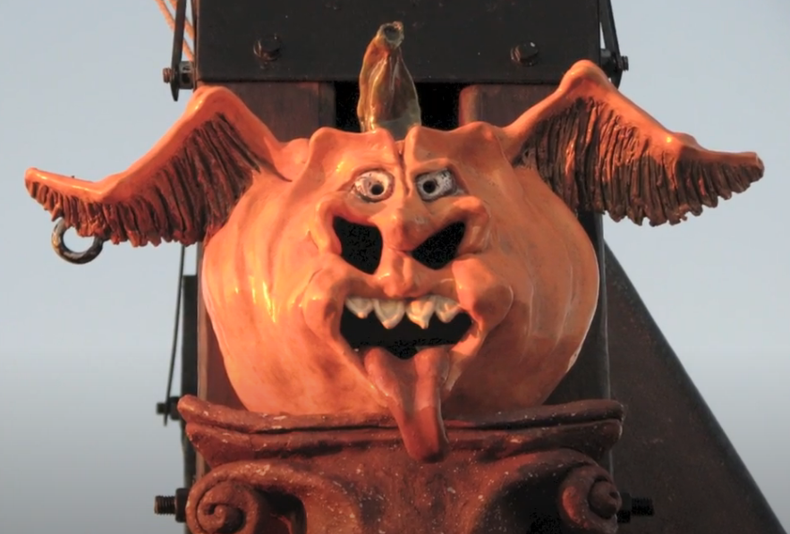
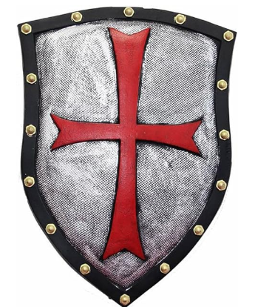

Emblems:
www.build-it-yourself.com

Slide 24
3 Graffiti Attributes
Colorful
Unusual shapes
3D
Readable
eamwork
www.build-it-yourself.com

Slide 25
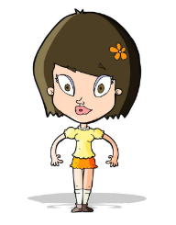

Valuable Tricks Learned
Or most fun things you did
How to make a PowerPoint Lab Book.
The words, “I can’t” are forbidden at Build-It-Yourself.
Research and plan before you build.
Physics of Catapult Engineering
www.build-it-yourself.com

Slide 26
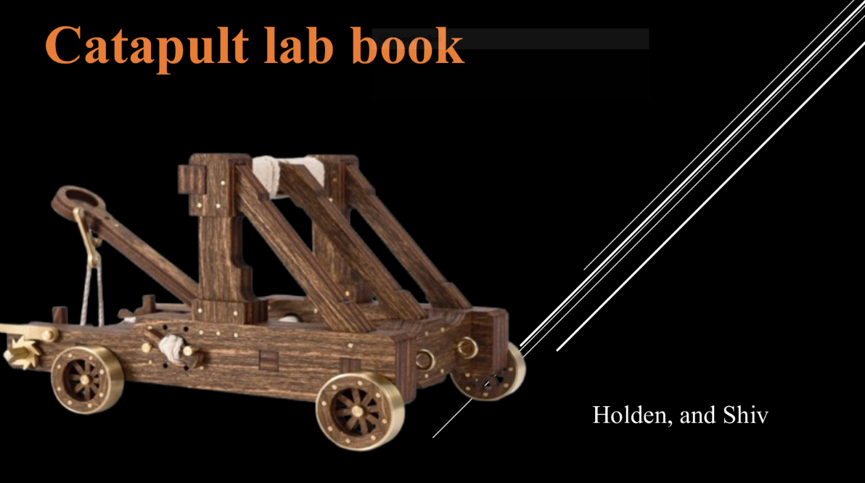
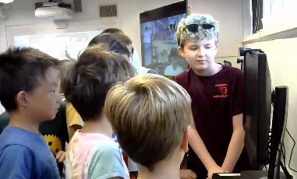
Presentation Guidelines:
Focus on key problem/mission message.
Tell a story. Don’t read.
Teamwork. Take turns presenting.
5 min limit (warning at 4 min)
Think 30 seconds per slide.
www.build-it-yourself.com

Slide 27
Workshop Leader Notes

Slide 28
Videos
Mangonel Siege Artillery
https://www.youtube.com/watch?v=yi4p8ZR4n28
Perier Siege Artillery
https://www.youtube.com/watch?v=wfzFnLOpZYM
English Trebuchet Replica
https://www.youtube.com/watch?v=pR26RMI9T8c
Largest Trebuchet
https://www.youtube.com/watch?v=RN18I-RBVm4
Pumpkin Chucker
https://www.youtube.com/watch?v=qC6RJxFEMfY
Sun Tzu: The Art of War
https://www.youtube.com/watch?v=aF2pCff3ocg
www.build-it-yourself.com

Slide 29
Agenda
Day 1
Introduce BIY.
Intro to Forts with videos.
Document Laws of the Lab.
Create Lab Book cover and problem/mission.
Research castles.
Build model towers.
Intro to Game Board.
Day 2
Review.
Show castle videos.
Present ‘Presenting Ideas.’
Finish model castle walls and towers.
Present tool and material rules.
Document rules of engagement.
Start building a 6 foot tower.
Show and tell.
Update game board.
Day 3
Review.
Present ‘Problem Solving Tricks’
Present tower and wall-building tricks.
Build towers and walls.
Document materials needed.
Show and tell.
Update game board.
Day 4
Present Lab Books.
Present ‘Presenting Ideas’
Research helmets
Build forts, helmets, shields, flags.
Show and tell.
Update game board.
Day 5
What did you learn?
Set up forts and start the battle.
Video record presentations.
Update game board.
Award ceremony.
www.build-it-yourself.com

Slide 30
Tips
File naming conventions:
  Descriptive file names
  Lower case letters
  Use ‘-’ between words, Not ‘_’or ‘ ‘
lab-book-racer-chubbi-melany-emma-kyle.pptx
2.
www.build-it-yourself.com

