Slide 1

Catapult Engineering
Creative Technology Laboratory

Slide 2

The Problem
Catapult Engineering
The evil, vile, scurrilous Dark Shadow have laid siege to our home base. Our people do not have the soda and candy they need.
Build-It-Yourself.com

Slide 3

The Mission
Catapult Engineering
Build a catapult to launch candy over the heads of the Dark Shadow so our people will have all the candy they need.
Build-It-Yourself.com

Slide 4
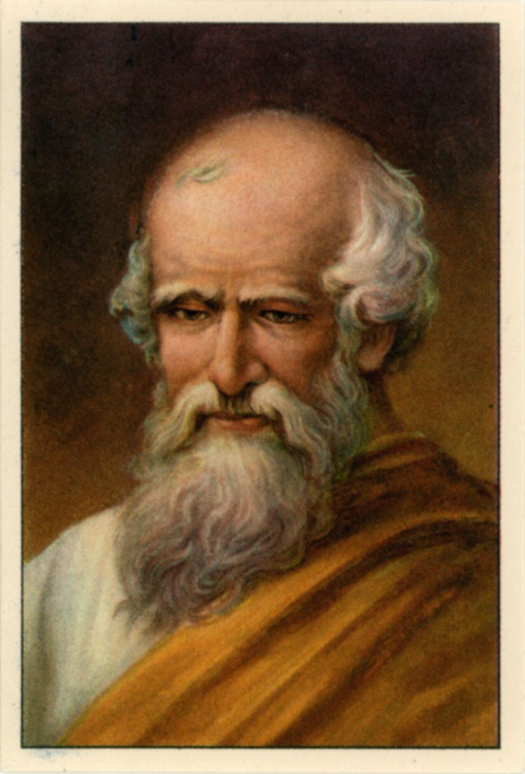
Research
Catapult Engineering
Archimedes is often credited with inventing the catapult around 200BC
He invented the screw to remove water in a ship’s hull.
He measured the mass per volume of the king’s gold crown.
“Give me a lever long enough and a place to mount a fulcrum, a place to stand and I will move the earth.”
Build-It-Yourself.com

Slide 5
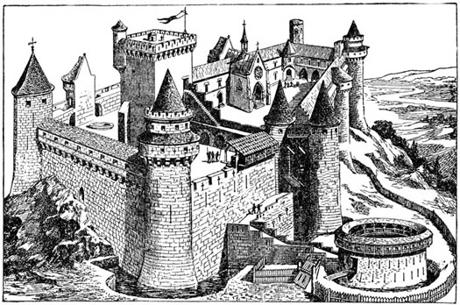
Research
Catapult Engineering
Medieval times (fifth to fifteenth centuries) were full of wars between kingdoms.
Build-It-Yourself.com

Slide 6
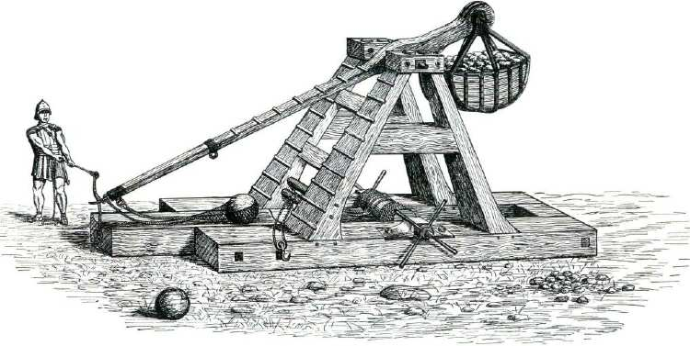
Research
Catapult Engineering
The counterweight trebuchet appeared in both Christian and Muslim lands around the Mediterranean in the 12th century. It could fling projectiles weighing up to 350 pounds (160 kg) at or into enemy fortifications.
Build-It-Yourself.com

Slide 7
Catapult Engineering
Research Videos
Mangonel Siege Artillery
https://www.youtube.com/watch?v=yi4p8ZR4n28
Perier Siege Artillery
https://www.youtube.com/watch?v=wfzFnLOpZYM
English Trebuchet Replica
https://www.youtube.com/watch?v=pR26RMI9T8c
Largest Trebuchet
https://www.youtube.com/watch?v=RN18I-RBVm4
Pumpkin Chucker
https://www.youtube.com/watch?v=qC6RJxFEMfY
Build-It-Yourself.com

Slide 8
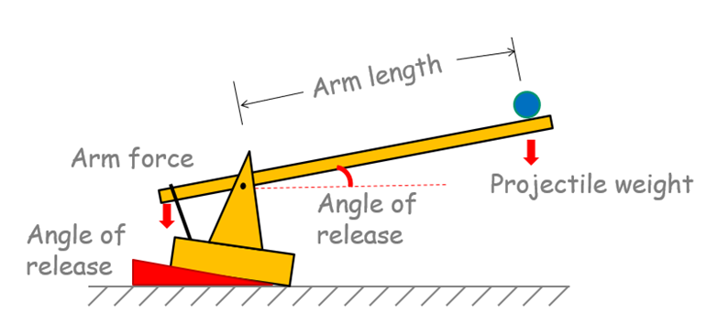
Catapult Engineering
Catapult Distance
Projectile Trajectory
Arm force
Arm length. Leverage
Angle of release
Projectile weight
Build-It-Yourself.com

Slide 9
Catapult Engineering
Catapult Distance
Function of:
Arm length
Projectile weight
Arm force
Angle of release
Build-It-Yourself.com

Slide 10

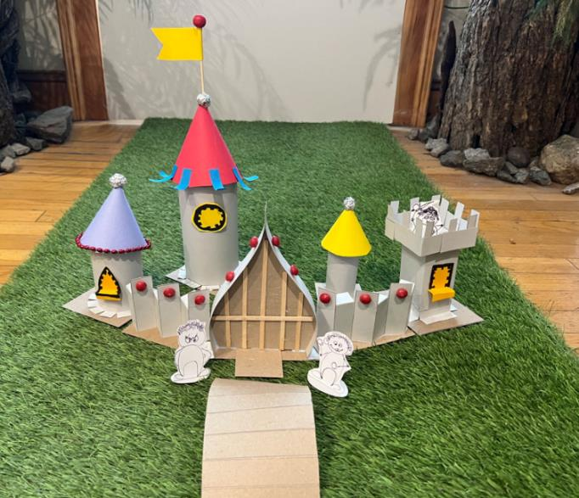
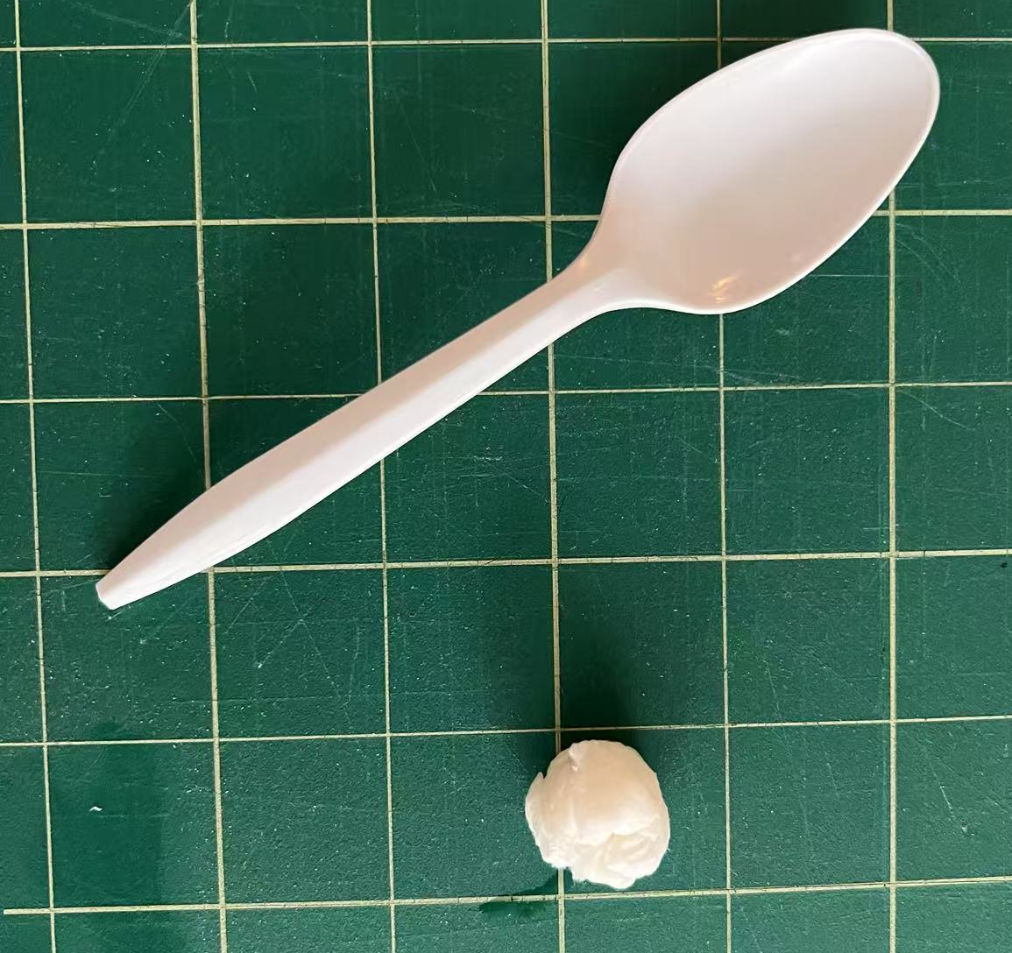
Catapult Engineering
Hall of Fame Solutions
Spoon / Toilet Paper Catapult
Draw some soldiers who will set the scale for the battlefield and castle.
Build a model of the castle we want to destroy.
Build a catapult to knock down enemy soldiers, castle walls, and castle towers.
Build-It-Yourself.com

Slide 11
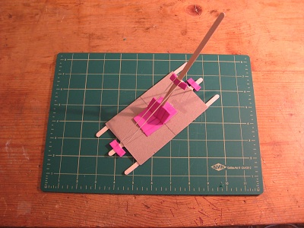
Catapult Engineering
Hall of Fame Solutions
Sling shot catapult made from cardboard, straws, coffee stirrer sticks and rubber bands
https://youtu.be/_5CPbH9kkDI
Build-It-Yourself.com

Slide 12
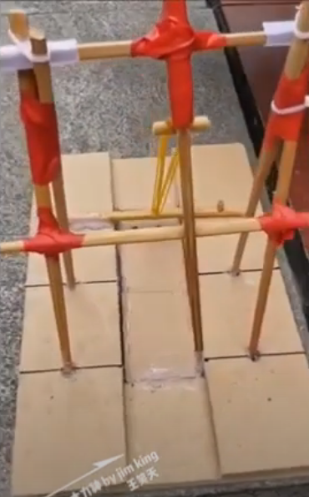
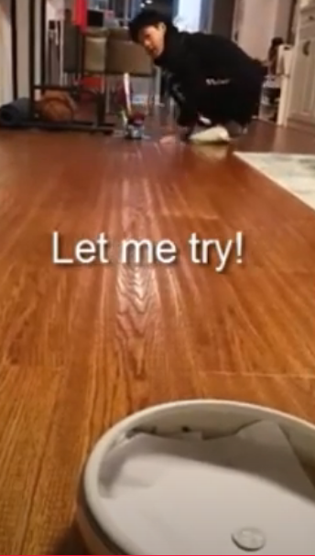
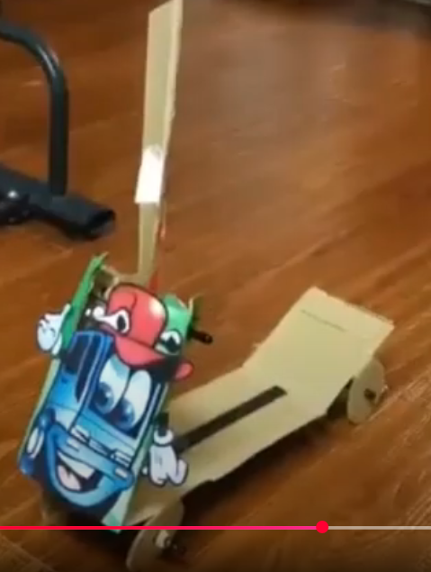
Catapult Engineering
Hall of Fame Solutions
Catapults made from premium quality junk.
https://www.youtube.com/watch?v=gXTVrDMbKyM
Build-It-Yourself.com

Slide 13
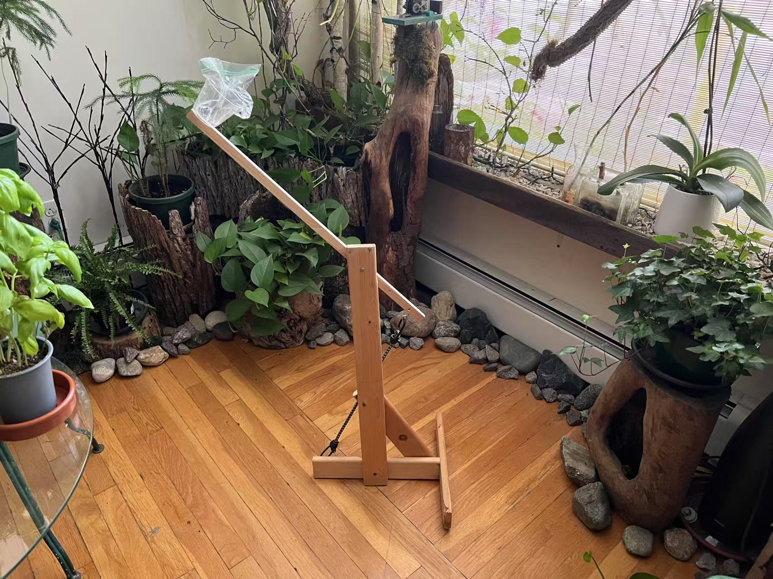
Catapult Engineering
Hall of Fame Solutions
Wood / Bunji Chord Catapult
Build-It-Yourself.com

Slide 14
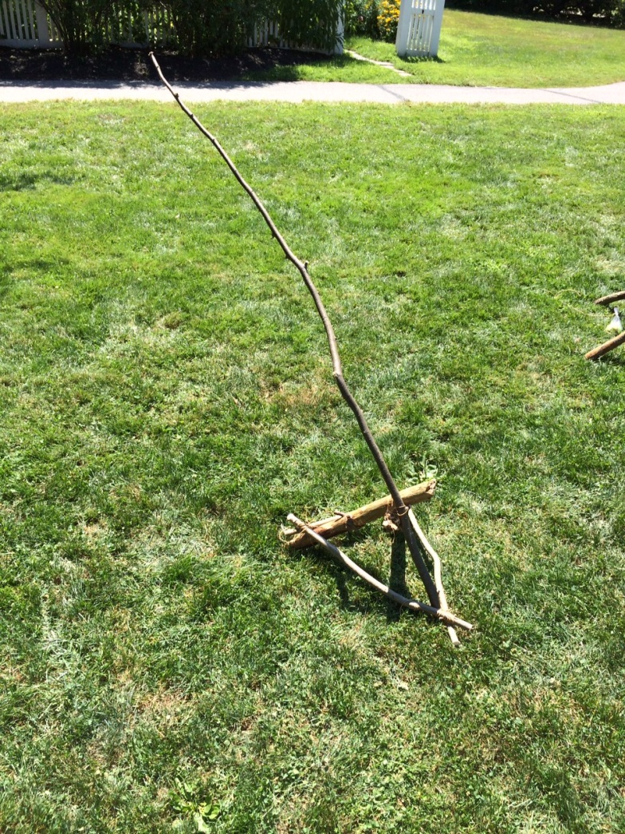
Catapult Engineering
Hall of Fame Solutions
A slingshot catapult made from green branches cut from the woods.
Build-It-Yourself.com

Slide 15
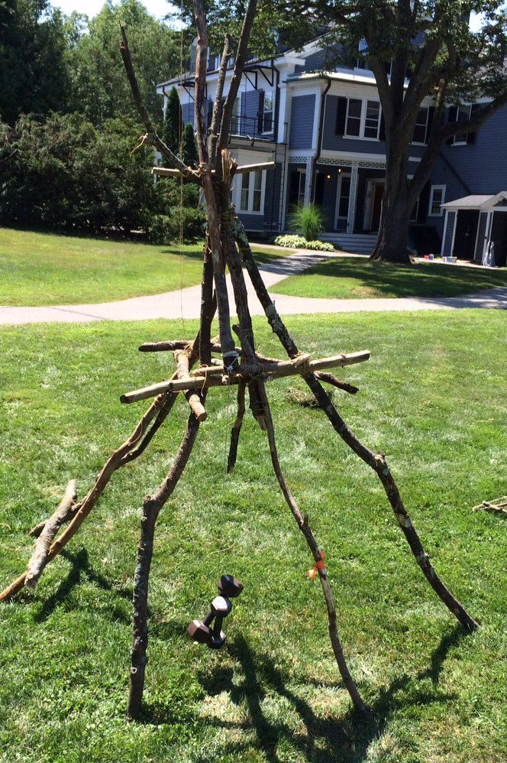
Catapult Engineering
Hall of Fame Solutions
The trebuchet catapult was made from branches cut from the woods.
Build-It-Yourself.com

Slide 16
Catapult Engineering
Project Plan
Lab Book
Problem / Mission
View catapult videos
Document research
Build castle tower targets
Test spoon catapults
Build cardboard, coffee stirrer stick, rubber band catapult
Test cardbpard catapults
Document factors that determine distance
Present and document ‘problem solving tricks’
Build wood catapult
Run distance and accuracy tests
Document ‘presenting ideas’
Decorate catapult
14. Present your lab book.
Build-It-Yourself.com

Slide 17
Catapult Engineering
Bunji Catapult Plans
Build-It-Yourself.com

Slide 18
Catapult Engineering
Bunji Catapult Plans
Catapult arm
X4 Screw
Eyes
Structure
X10 1.5” screws
Bunji
Cord
2” Bolt/Nut
Projectile
Water Bag
Cup
Build-It-Yourself.com

Slide 19
Catapult Engineering
Bunji Catapult Plans
Catapult arm
Bunji
Chord
Cock / Release chord
Build-It-Yourself.com

Slide 20
Catapult Engineering
Bunji Catapult Plans
Build-It-Yourself.com

Slide 21
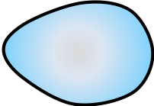
Catapult Engineering
Trebuchet Plans
Arm stop
Catapult arm
Bucket of rocks
weight
Trigger
Projectile
Structure
Build-It-Yourself.com

Slide 22
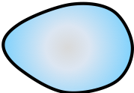
Catapult Engineering
Trebuchet Plans
Side View
Front View

Slide 23
Catapult Engineering
Trebuchet Plans
Catapult arm
Arm stop
Trigger
Structure
Bucket of rocks
weight
Rope
Projectile
Build-It-Yourself.com

