Slide 1

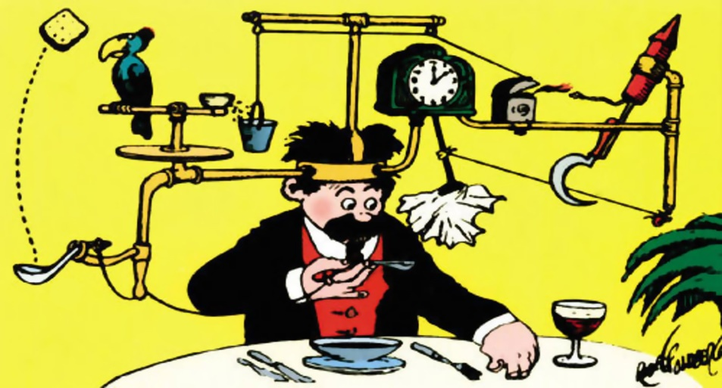
Chain Reaction Contraptions
“Teamwork makes the dream work!”
Notes:
Welcome to the build-it-yourself chain reaction laboratory where teamwork makes the dream work!

Slide 2

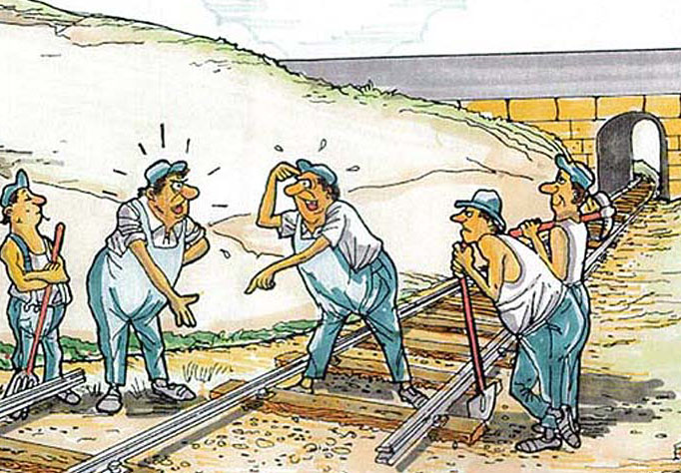
Define the problem and mission
The Problem
Teamwork is important to solve big problems. But some people are lousy at teamwork.
Your Mission
Build a chain reaction machine that demonstrates team work to deliver candy.
Notes:
Problem:
It takes teamwork to do really important things like go to the moon, win the World Cup, invent medicines, and especially make candy!
But some people don’t believe in working together.
Mission:
Build a Chain Reaction Contraption that demonstrates teamwork to do something really important.
At the end of the chain reaction, your machine must deliver candy to the world!

Slide 3
Research
Rube Goldberg Machines from Japan
https://www.youtube.com/watch?v=8iEjwa6JZg4
https://www.youtube.com/watch?v=wVP5zVHGSYo
https://www.youtube.com/watch?v=kwedBdWIRuQ
https://www.youtube.com/watch?v=k0B1hgP1tlE
https://www.youtube.com/watch?v=wvH55b_6So4
Honda Ad
http://www.youtube.com/watch?v=FGngcQb_0qg
There are no computer graphics or digital tricks in the film. Everything you see really happened in real time exactly as you see it.
The film took 606 takes. On the first 605 takes, something, usually very minor, didn't work. They would then have to set the whole thing up again.
The crew spent weeks shooting night and day. The film cost six million dollars and took three months to complete including a full engineering of the sequence.
Build-It-Yourself Contraptions
https://www.youtube.com/watch?v=tOKo7LSDReA
https://www.youtube.com/watch?v=JxG6vTIgfmo

Slide 4
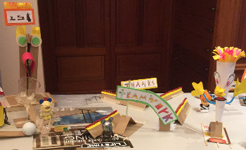
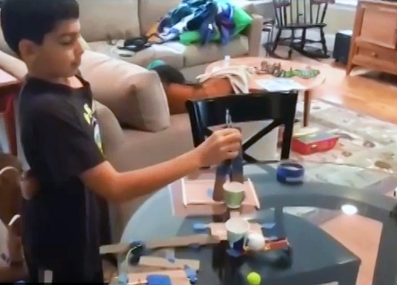
Hall of Fame
This Candy Delivery Machine was built by Salvador from Xalapa, Mexico. Salvador added many cool critters along the spillway and his graffiti signs rock!
Watch it in action.
Ben's Candy Delivery Machine is masterfully built. It meets our rigorous quality assurance measure: 9 successes out of 10 tries.
Watch it in action.
Notes:
What actual kids have built!
More videos next page
Also our swizzorblotz machine from our intro is example that can be used. Video posted:
On our mission page under hall of fame
Direct video link: https://www.youtube.com/watch?v=EyWb1U1epZM&list=UUh48IssVb95iYeJfHF9SJIw

Slide 5
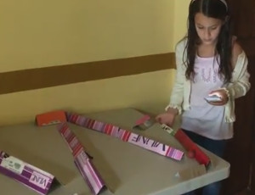
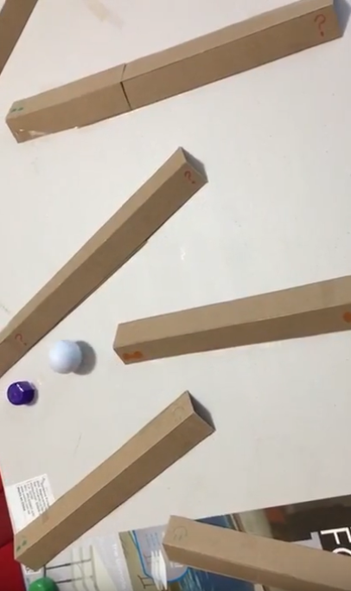
Hall of Fame
Montserrat conquered the challenge ... build a spillway that makes a ball roll down the table in more than 30 seconds.
Watch it in action.
Sophia conquered the challenge ... build a spillway that makes a ball roll down the table in more than 30 seconds.
Watch it in action.
Notes:
Also our swizzorblotz machine from our intro is example that can be used. Video posted:
On our mission page under hall of fame
Direct video link: https://www.youtube.com/watch?v=EyWb1U1epZM&list=UUh48IssVb95iYeJfHF9SJIw

Slide 6
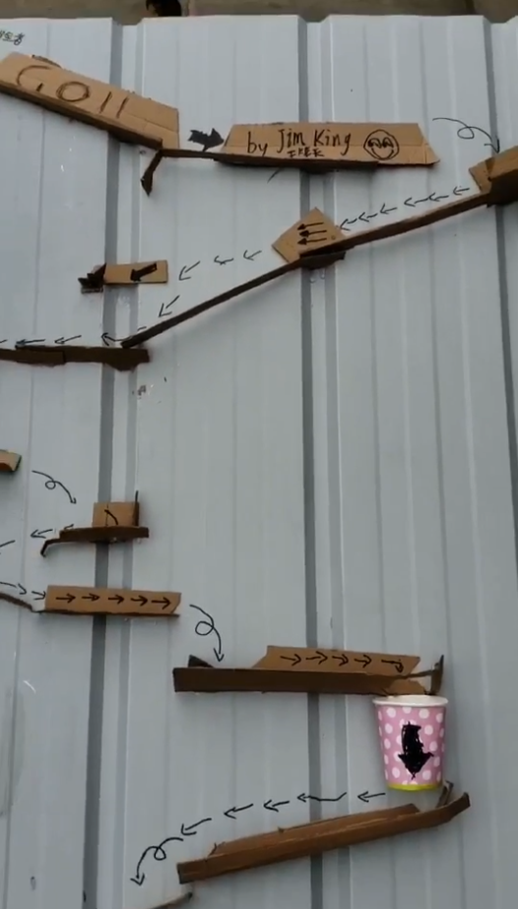
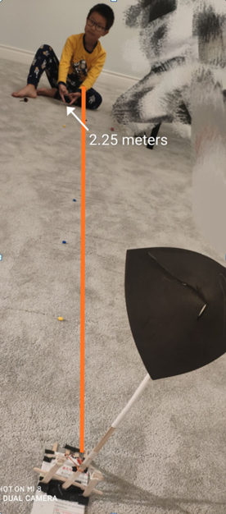
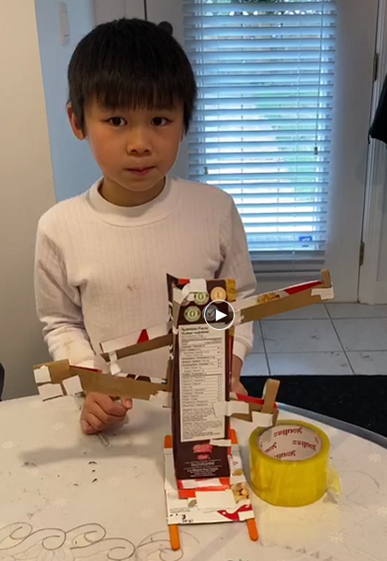
Hall of Fame Results:

Slide 7
Break Mission Into Simple Parts
Module: Bumpers
Velocity equation:
Velocity = distance / time
Notes:
Module for ball to roll on to delay is from going fast. What simple machine is this?

Slide 8
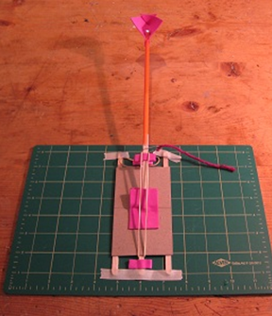
Break Mission Into Simple Parts
Module: Catapult
Trajectory variables:
Weight of projectile
Length of arm
Force pulling arm
Angle of release
Notes:
Module for candy to be delivered. What simple machine is this?

Slide 9
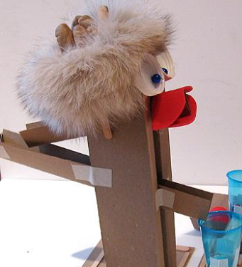
Break Mission Into Simple Parts
Module: Coin Spill Way
Notes:
Module for coin to be collects. What simple machine is this?

Slide 10
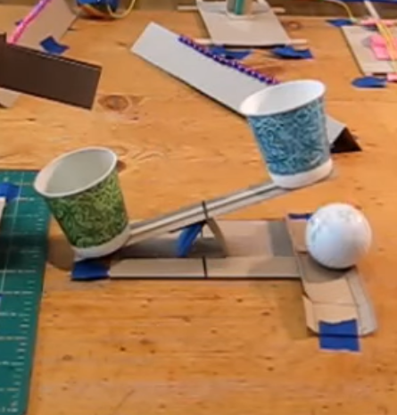
Break Mission Into Simple Parts
Module: Coin Sensor/Trigger
Module: Ramp
Lever equation
W1 x L1 = W2 x L2
If W1 x L1 > W2 x L2 … What happens?
Notes:
Module that releases the ball when a coin is collected. What simple machines are these?
There is the trigger that is a lever, acts like a seesaw. The weight of the coin forces one side down.
The other module is a ramp. The ball is blocked by the cup on the right until a coin is collected.

Slide 11
Presentation
Look Good
Decorate our modules!
-make cool characters
-draw signs the way
-use many and shapes
-be neat and organized
A good idea that looks ugly …
may not get the attention it deserves!
way-cool
colors

Slide 12
Break Mission Into Simple Parts
Module: Graffiti Sign
eamwork
odular
uilding
Notes:
Module is a sign. This can be attached to the catapult, coin spillway, or another part of the chain reaction contraption. Emphasize art and it’s importance in drawing attention. Typically created in power point unless time is short.
Lesson: Graffiti is under lessons page on Build-It-Yourself.com
https://build-it-yourself.com/s-lessons/index-lessons.php
Look Good!
Decorate our modules!
-make cool characters
-draw signs the way cool way
-use many colors and shapes
-be neat and organized
A good idea that looks ugly …
may not get the attention it deserves!

Slide 13
Presentation
You Get Points For:
Slowest bumper solution
Furthest candy catapult throw
Most number of modules used in your contraption
Best looking as voted by your peers
Teamwork! Working together and sharing ideas

Slide 14
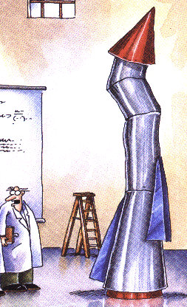
Agenda
Plan and design.
Build modules.
Document results.
Connect each team’s component.
Test the chain.
Take pictures for the website.
Present project to the world.
There’s a lot to do! If we don’t work together,
then neither will our machines work together!

Slide 15
Presentation
Modules
Modular construction is BIG!
Break your solution into simple motion and structural modules.
You may find instructions for useful modules in Build-It-Blocks.

Slide 16
Presentation
Trick Summary
Focus on the problem and the mission.
Teamwork!
Build the ‘way cool’ way.
Build and test one module at a time.
Test and improve.
Notes:
Keep the problem and the mission in mind when building
Practice TEAMWORK. Help each other out.
Cut and fold the ‘way cool way.’ This will make your inventions stronger and more reliable. And cool looking inventions will attract more attention.
Build and test one section of your bumper machine before you work on the second and third sections. Practice modular construction.
Don’t give up. Remember Thomas Edison.

Slide 17
Appendix Lessons
Simple machines
Velocity formula
Lever formula
Catapult physics

Slide 18
What we should know
How to work as a team
Benefits of modular construction
How to present you ideas
Advanced Projects:
Design graffiti signs
Build more elaborate modules
Create a video

Slide 19
Simple Machines
Lever
Pulley
Inclined
Plane
Load
Load
Force
Force
Load
Force
Wheel & Axel
Screw
Wedge
Load
Load
Load
Force
Force
Force
Notes:
There are 6 basic simple machines; the lever, the wheel and axle, the inclined plane, the wedge, the pulley, and the screw.

Slide 20
Simple Machines
Lever
Pulley
Build-It-Blocks modules are designed using combinations of simple machines.
Lever (Coin Sensor Seesaw, Catapult)
Inclined plane (Coin spillway, Table)
Wheel + Axle
Wedge
Pulley (Catapult trigger)
Screw
Load
Force
Load
Force
Inclined
Plane
Load
Wedge
Force
Load
Force
Wheel & Axel
Screw
Load
Load
Force
Force
Notes:
There are 6 basic simple machines; the lever, the wheel and axle, the inclined plane, the wedge, the pulley, and the screw.

Slide 21
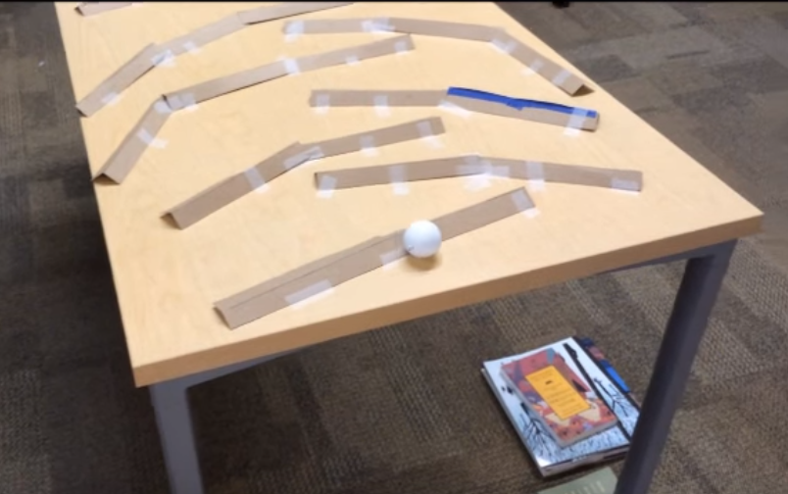
Motion
Who can roll the ball down the table with the slowest velocity?
How do you describe motion in math?
6 feet
Notes:
The bumper project is an example of the inclined plane and the wheel and axel simple machines.

Slide 22
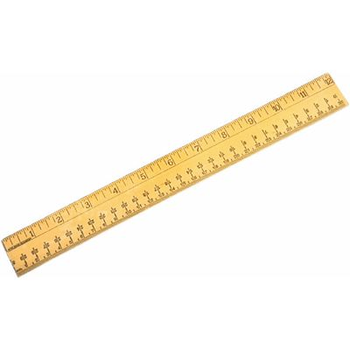
Motion
Who can roll the ball down the table with the slowest velocity?
How do you describe motion in math?
Distance = ????
Distance
Notes:
The bumper project is an example of the inclined plane and the wheel and axel simple machines.

Slide 23
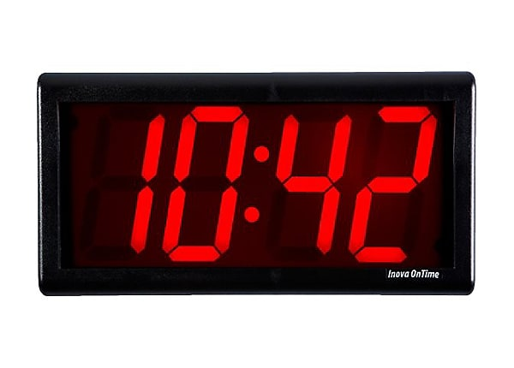
Motion
Who can roll the ball down the table with the slowest velocity?
How do you describe motion in math?
Time = ????
Distance
Time
Notes:
The bumper project is an example of the inclined plane and the wheel and axel simple machines.

Slide 24
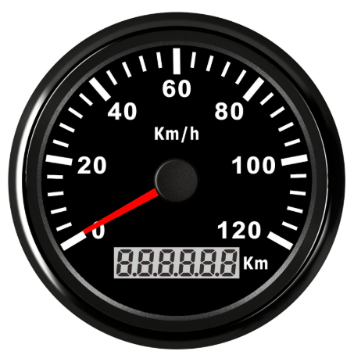
Motion
Who can roll the ball down the table with the slowest velocity?
How do you describe motion in math?
Speed or
Velocity = kilometers per hour
Velocity = Distance / Time
V =
Distance
Time
Velocity
D
T
Notes:
The bumper project is an example of the inclined plane and the wheel and axel simple machines.

Slide 25
Motion
Who can roll the ball down the table with the slowest velocity?
How do you describe motion in math?
Acceleration
What is the formula that describes Acceleration?
Distance
Time
Velocity
Acceleration
Notes:
The bumper project is an example of the inclined plane and the wheel and axel simple machines.

Slide 26
Math and Physics
Who can roll the ball down the table with the slowest velocity?
How do you describe motion in math?
Math and Physics
How can we use the ball rolling down a table through a maze of bumpers to help teach math and physics concepts?
Distance
Time
Velocity
Acceleration
Converting Units
Forces
Gravity / Friction
Statistics
Algebra
Trigonometry
Geometry
Calculus
Notes:
The bumper project is an example of the inclined plane and the wheel and axel simple machines.

Slide 27
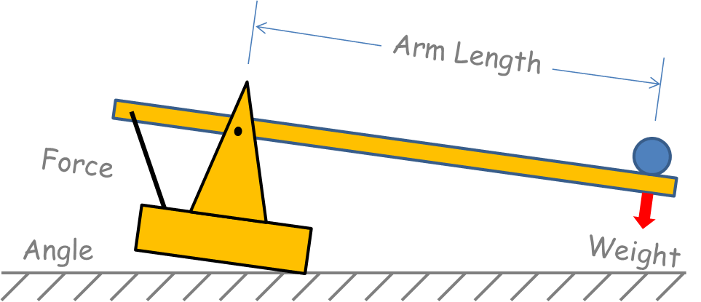
Catapult Distance
Catapult distance is a function of:
Weight
Force
Arm Length
Release angle
Notes:
This slide is to show kids the logic behind the launch distance a catapult can achieve. They can use the basics to troubleshoot their contraption.

Slide 28
Catapult Distance
Who can throw candy the farthest?
Catapult distance is a function of:
Weight
Force
Arm Length
Release angle
X = (F1 x L1) / L2
How can you expand a lesson plan around this?
BIY Work
School Work
L1
L2
X
F1
Notes:
The catapult is an example of the Lever Simple Machine

Slide 29
Lever Engineering
Force x Distance
F1 x D1 = F2 x D2
F1
F2
D1
D2
Fulcrum
www.Build-It-Yourself.com

Slide 30
Lever Engineering
Force x Distance
F1 x D1 = F2 x D2
F1
D1
F2
D2
Imagine …
3 oranges are on one side of the scale
2 feet away from the fulcrum.
To balance the scale, how far away from the fulcrum must you put 2 oranges?
i.e. solve the F1 x D1 = F2 x D2 formula for D2
Fulcrum
www.Build-It-Yourself.com

Slide 31
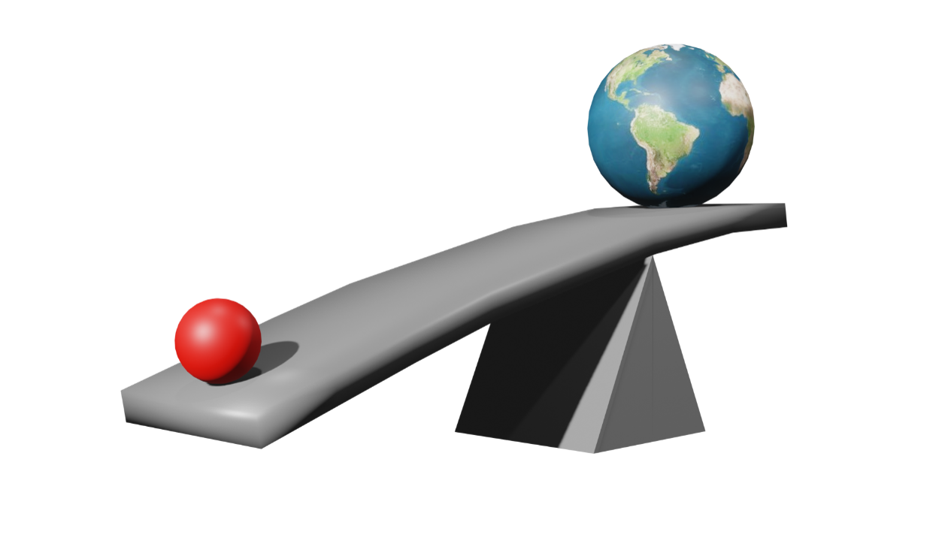
Lever Engineering
Force x Distance
F1 x D1 = F2 x D2
“Give me a long enough lever and a place to stand and I can move the Earth.”
Archimedes
www.Build-It-Yourself.com

Slide 32
Lever Engineering
Work = Force x Distance Moved
Input = Output
Work1 = Work2
F1 x D1 = F2 x D2
F2
F1
D2
D1
Work In = Work Out relates to the conservation of energy theory. Energy in a system cannot be created or destroyed.
Even when you create nuclear energy!
Fulcrum
www.Build-It-Yourself.com

