Slide 1

Digital-music
Norman

Slide 2
Three componets of a music video
Lyrics
music-melody-rythem
graphics

Slide 3
Lyrics
Lego | Build | Inspire
Letsgo | filled | fire
echo | chill | require
demo | skilled | wire

Slide 4
Main idea
Problem
Are you tired of bland, boring, repetitive music? Would you rather create something groundbreaking, far out that rings your bells, tickles your fancy, flips your jacks?
Mission
Today, with the invention of music mixing software, mash-up music is IN! Your mission is to use Audacity and create your own mash-up tune that will become the next number one hit on the billboard charts.

Slide 5
Music video message
Problem
When we build with Lego we need to brainstorm ideas
Mission
Design a music video to inspire people to build Lego

Slide 6
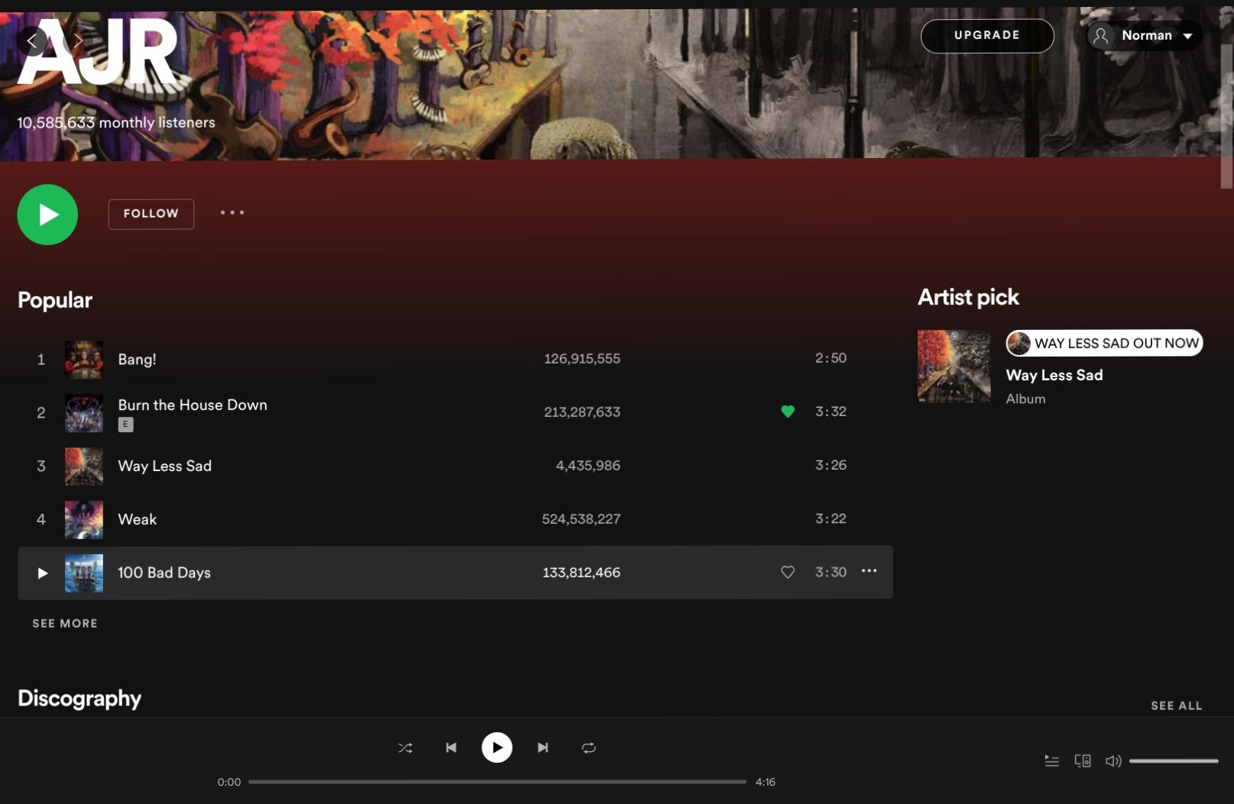
My favorite artist is AJR I like AJR becouse the graphics inspire me

Slide 7
reserch
Steinway Alma Tadema
The 2002 White House Christmas card features this piano. The world's most expensive grand piano sold at auction is a specially designed D-274 named Steinway Alma Tadema; it sold for $1.2 million in 1997 at Christie's in London, breaking Steinway's own 1997 price record of $390,000.
What is the most expesive piano in the world?
=
The first true piano was invented almost entirely by one man—Bartolomeo Cristofori (1655–1731) of Padua, who had been appointed in 1688 to the Florentine court of Grand Prince Ferdinando de' Medici to care for its harpsichords and eventually for its entire collection of musical instruments.
Who is the creater of the piano?
=
Even in the used market, Steinways cost more than any other top-tier piano. It is partially because of the name. Also, the quality, the workmanship, and the materials are all top-notch.
Why is Steinway & Sons Model D piano so expesive?
=

Slide 8
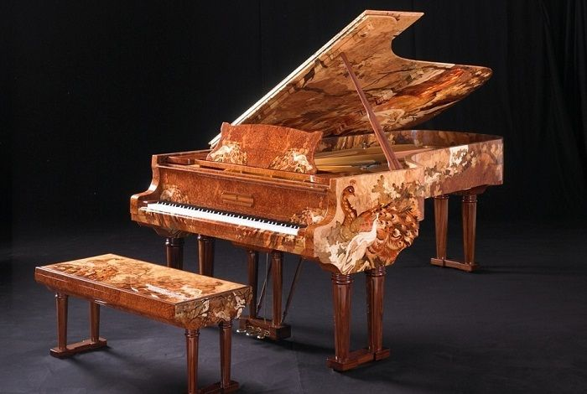
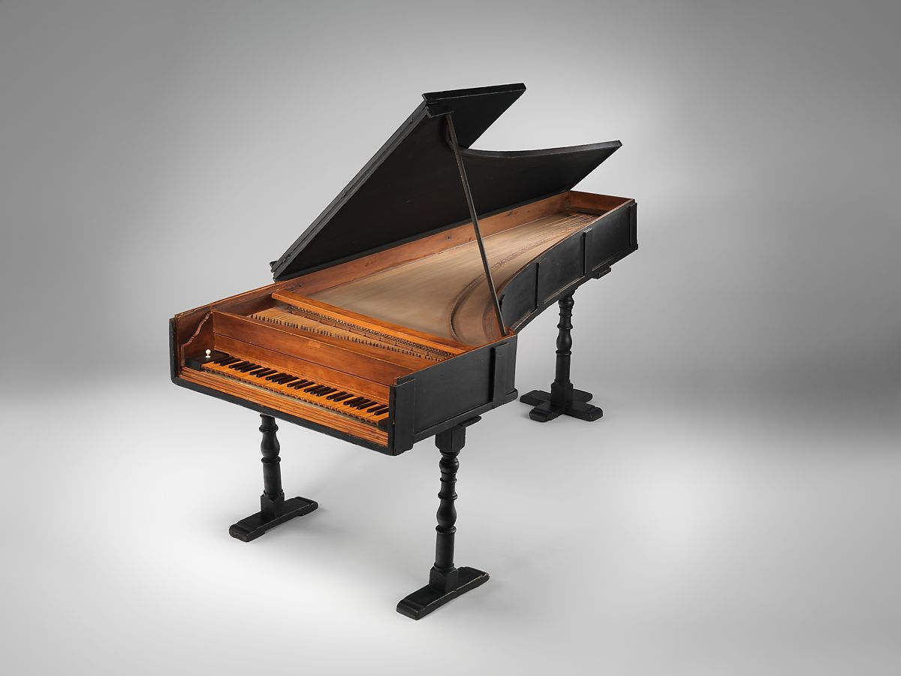
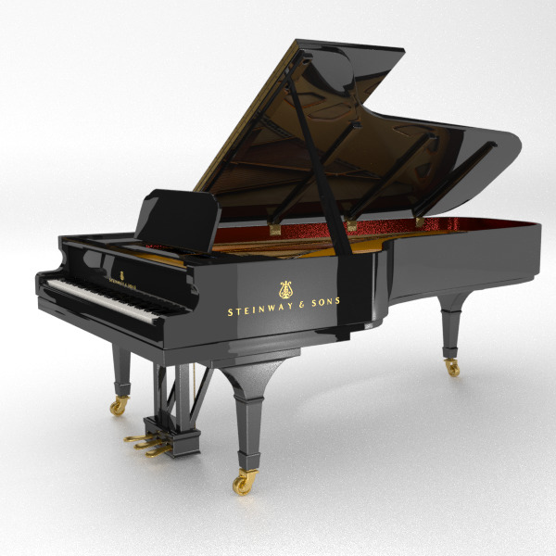
images
What is the most expesive piano in the world?
Who is the creater of the piano?
Why is Steinway & Sons Model D piano so expesive?

