Slide 1
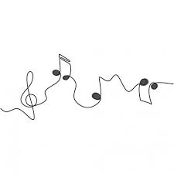

MUSIC LAB BOOK

Slide 2
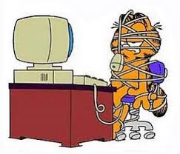
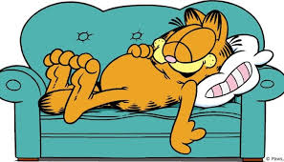
PROBLEM:
People are stressed and don't know how to relax and pamper themselves.
MISSION:
Produce a music video that will relax and help others.

Slide 3
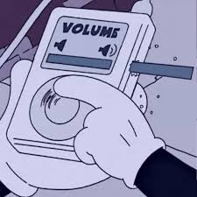
RESEARCH
Music have a profound effect on your emotions and body. Faster music helps to make you feel more alert and concentrate better, slower music quiets your mind and relaxes your muscles, making you feel soothed while releasing the stress of the day.

Slide 4

LYRICS
Today could be a better day
And in the end you will take a break
There were long days, heartbreaking times
Mistakes I could fix, but didn’t really try
But I know if I could have the strength to guide me on the way
I would lead me home and I'll be there to stay
Just calm yourself a bit and take a breath
I wanna keep myself
Out of the mess I've made
I'm going to try one last time
Yeah maybe I will try one last time.

Slide 5
LYRICS
Today could be your day to shine
Show the whole world how you spark
And better things will come to your life
No shame, be fierce, blow their minds
I know that living this way can be hard
But you will get through, just take your time
You should slow down and relax

Slide 6
LYRICS
I gotta keep myself out of the mess I've made
I'm gonna try one last time
I gotta keep myself out of the darkness
I'm gonna try one last time
Maybe ill try one last time
Today could be a better day
And in the end you will take a break
There were long days heart breaking times
Mistakes I could fix but didn’t really try.
-Xime E

Slide 7
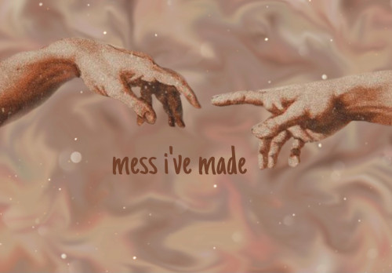
COVER

Slide 8
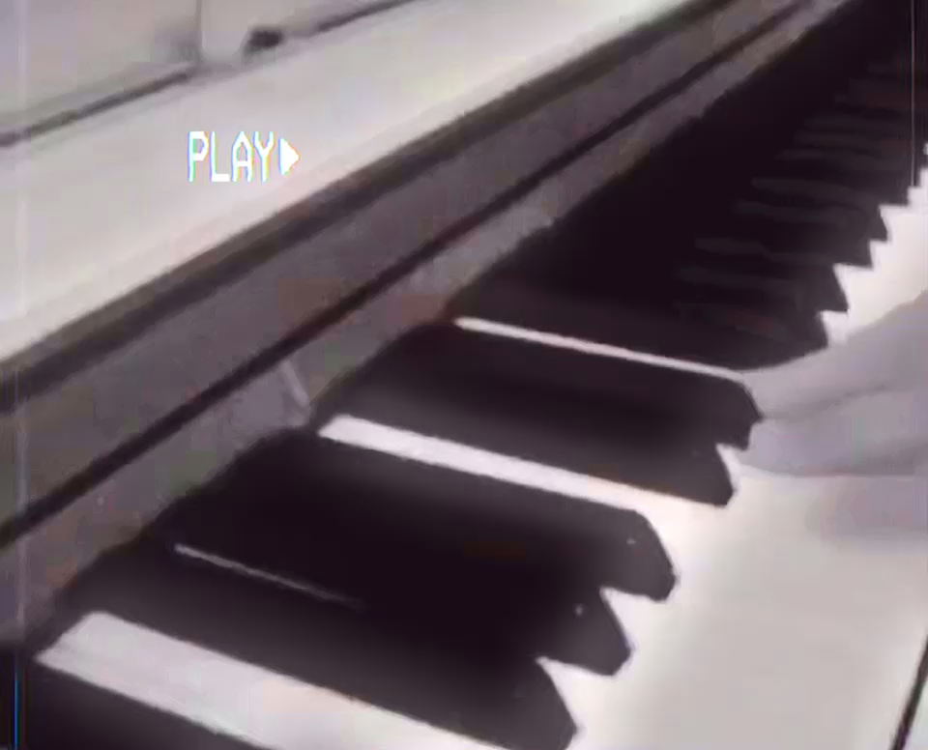

Slide 9
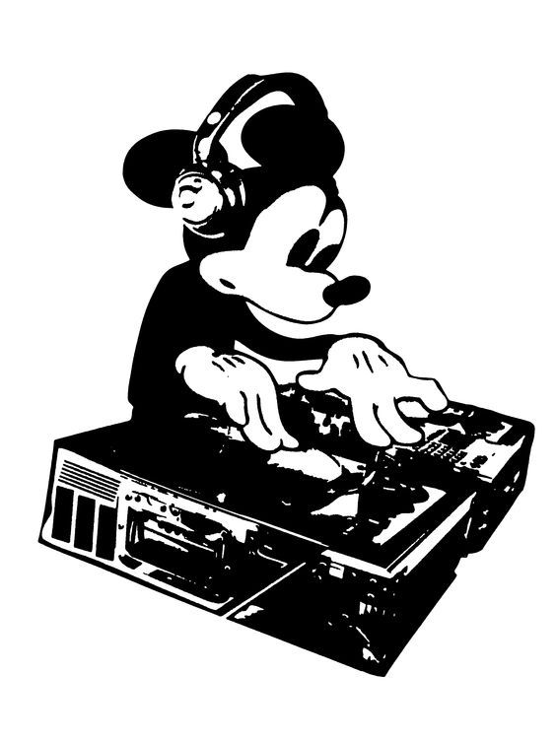
HIP HOP
Come up with the theme for the song.
Come up with the "story" of your lyrics.
Get to know your beat.
Write a catchy hook or chorus.
Figure out how many bars you have to rap on.
Understand rhyme inside and out.
Organize your lines into a rhyme scheme.

