Slide 1


Computer Music
Notes:
Welcome to the BIY Laboratory …
Where Art and Technology Rule.

Slide 2
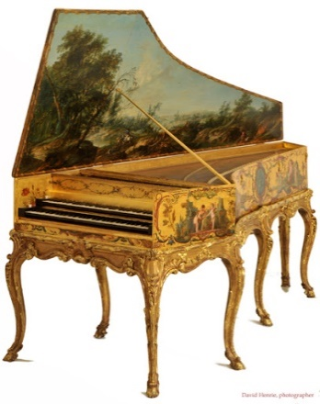
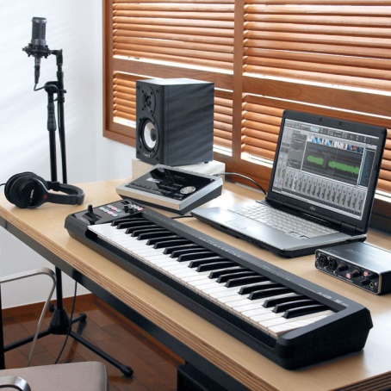
Computer Music
The Problem
Sometimes the quality of our tools and instruments can limit the possibilities.
The Mission
Use modern tools to create a new kind of music.

Slide 3
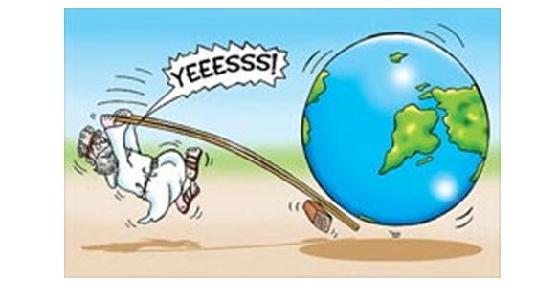
Computer Music
Machines
Mechanical Advantage
Archimedes said,
“With the right tool, you can move the earth!”

Slide 4

Computer Music
Curiosity / Research
What is the history of music?
Why do humans make music?
What musician inspires you the most and why?
What musical instrument is the most valuable? Beautiful? Popular?
What is good and bad about AI music?
Or research your own question?

Slide 5
Computer Music
Research Attributes:
The question must be clear and precise.
Integrate multiple credible sources and perspectives.
Conclusions must be logical.

Slide 6
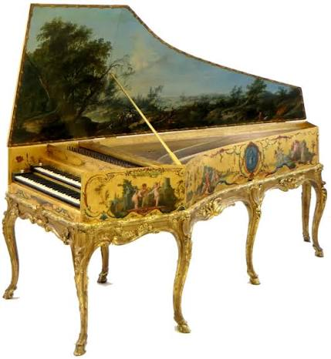
Computer Music
Research:
Beautiful harpsichord
800+ hours to build

Slide 7
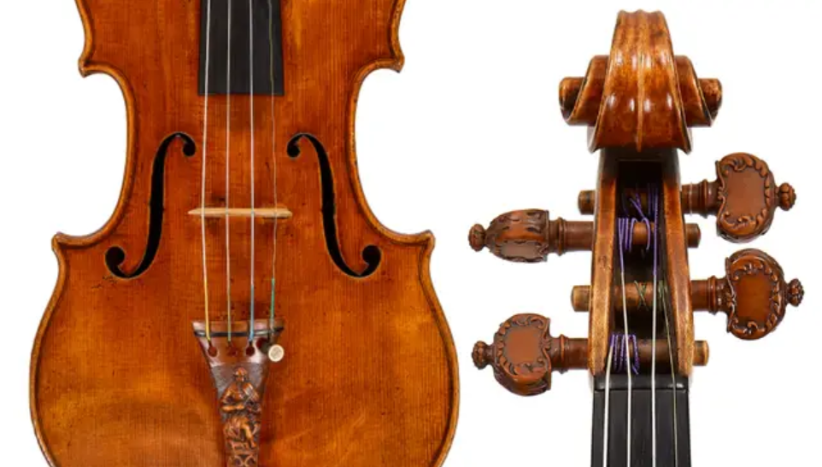
Computer Music
Research:
Valuable Stradivari violin
400+ hours to build
$30 million

Slide 8


Computer Music
Ugly, monkey, music
Complete randomness
Logical music
Tempo
Time Signature - Beats per measure
Scale
https://scratch.mit.edu/projects/482262360/editor/

Slide 9
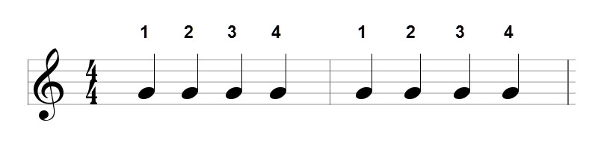
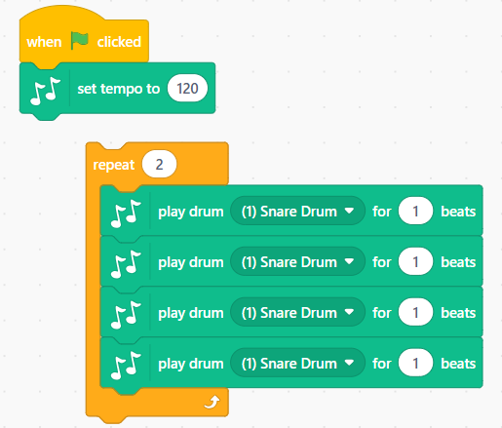
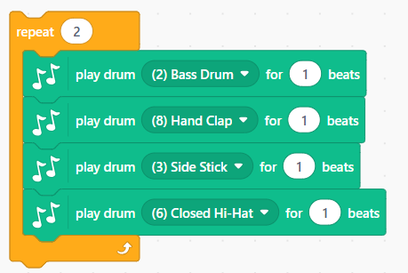
Computer Music
4/4 Time Rhythm
Make the 1st beat louder than the others to signal the start of a measure.
Play four ¼ notes or beats per measure.

Slide 10
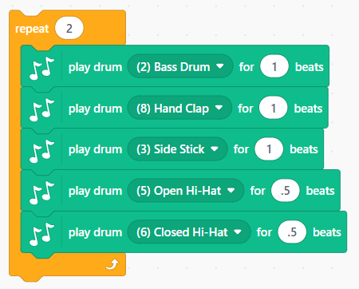
Computer Music
4/4 Time Rhythm
Let’s add some 1/8 notes to make the rhythm more interesting.

Slide 11
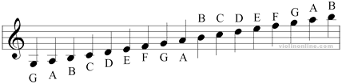
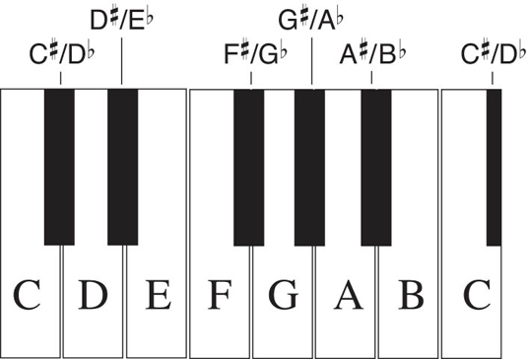
Computer Music
Music notation
C D E F G A B

Slide 12
Computer Music
Music notation
C D E F G A B
C E G – C chord
F A C – F chord
G B D – G chord

Slide 13
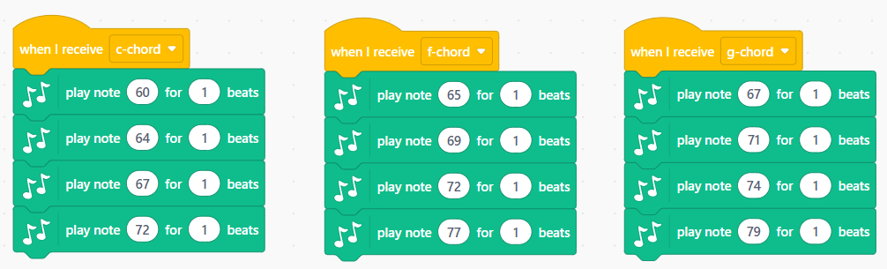
Computer Music
C Chord
C E G
C Chord
FAC
G Chord
GBD

Slide 14
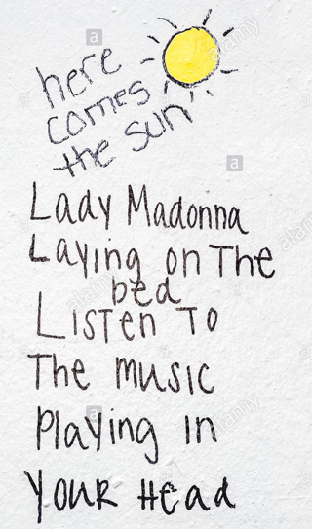
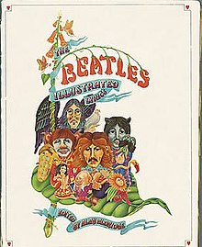


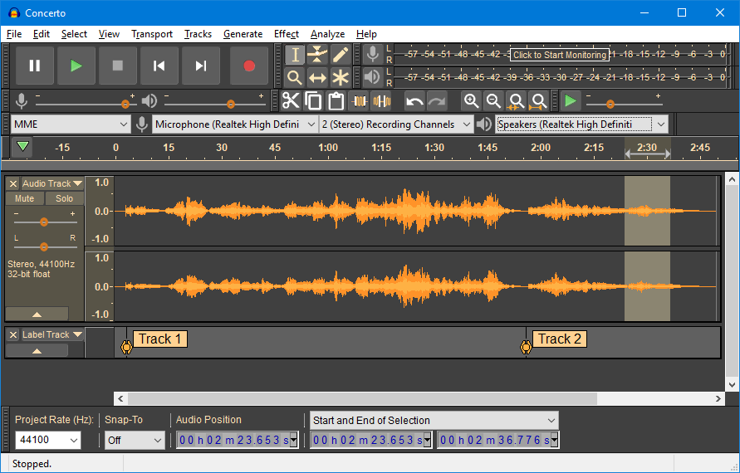
Music Video Components
Message
Lyrics (story or poem)
  Verses
  Chorus
Music
  Rhythm
  Melody
Graphics
Integration
https://scratch.mit.edu/projects/1350656604/editor/

Slide 15
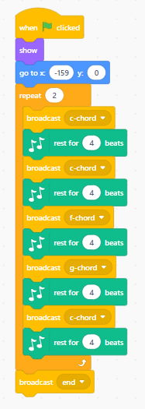

Computer Music
The importance of a conductor, director, or controller

Slide 16
Message and Lyrics
Make people laugh:
Bad jokes
Oh how I love them
Bad jokes
Can’t get enough of them
Oh, Oh, Oh Wee
Bad jokes for me.
Tell a joke

Slide 17

Music
Make people laugh:
Bad jokes
Oh how I love them
Bad jokes
Can’t get enough of them
Oh, Oh, Oh Wee
Bad jokes for me.
Tell a joke
C C7
F Fm Gm
C C7
G7
C Dm7 D G7
C G7 C G7
Tell a joke

Slide 18

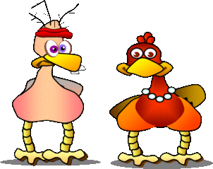

Graphics

Slide 19
Bad jokes
Oh how I love ‘em

Slide 20
Bad jokes
Can’t get enough of ‘em

Slide 21
Graphics
Oh, Oh, Oh Wee
Bad jokes for me.

Slide 22
I got one …

Slide 23
Why do ducks fly south for the winter?

Slide 24
Because it would take way too long to walk.
Oh Oh Oh Wee
Bad Jokes for me.

Slide 25
Computer Music Tools
Music Video Tools:
PowerPoint
Scratch https://scratch.mit.edu/
OpenShot https://www.openshot.org/
Filmora https://filmora.wondershare.com/es/
Audacity https://www.audacityteam.org/
iMovie https://www.apple.com/imovie/
MovieMaker https://www.videowinsoft.com/
VoiceMod https://www.voicemod.net/iPhone
Sonu https://suno.com/
iPhone

Slide 26
Music Video Lesson Plan
Big picture:
Goal (message to be delivered)
Lyrics
Beat
Melody,
Graphics, Animation
Integration
State message
Research and critique favorite music video
Write lyrics (key words, poetry, …
Document time signature, tempo, rhythm
Document Scale.
Code ugly vs way cool rifs in Scratch
Merge music tracks
Specify graphics
Merge music with graphics
Present

Slide 27
Music Video Lesson Plan
Monday
Introductions
Lab guidelines
Start lab books
Problem Mission
Code drum rhythm beats
Tuesday
Review
Code notes
Write song theme
Write lyrics
Add lyrics to code
Wednesday
Review
Presenting Ideas
Problem Solving Tricks
Design video animations
Thursday
Review
Introduce variables
Introduce random numbers
Code your Rock’n Robot to compose unique music
Friday
Outline 3-minute presentation script
Rehearse 3-minute presentations
Video record your presentation and Scratch project

Slide 28
Scratch Accounts
build-aaa Lucas
RobotSushi1
build-bbb William
RobotSushi1
build-ccc Devin
RobotSushi1
build-ddd Asher
RobotSushi1
build-eee Helius
RobotSushi1
build-fff Theo
RobotSushi1

