Slide 1
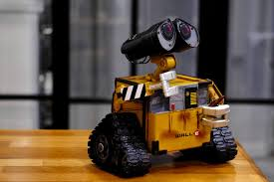
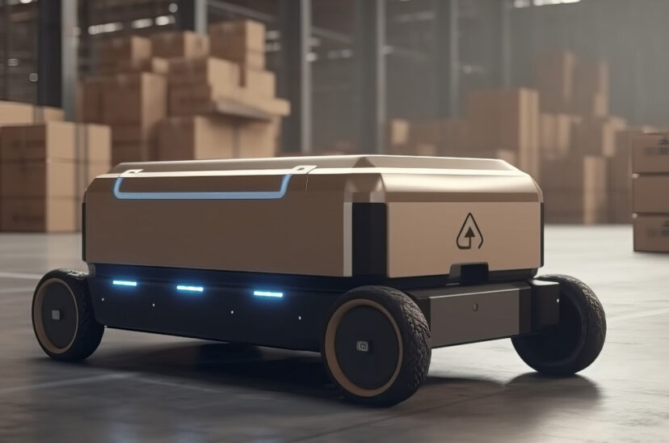
Robot Door Greeter Lab Book
Ían Pale

Slide 2
Problem
Having unfriendly neighbors can make
Life miserable
Mission
Build a robotic door greeter that makes
Neighbors want to be friends.
The more Friends you have the happier you will be.

Slide 3
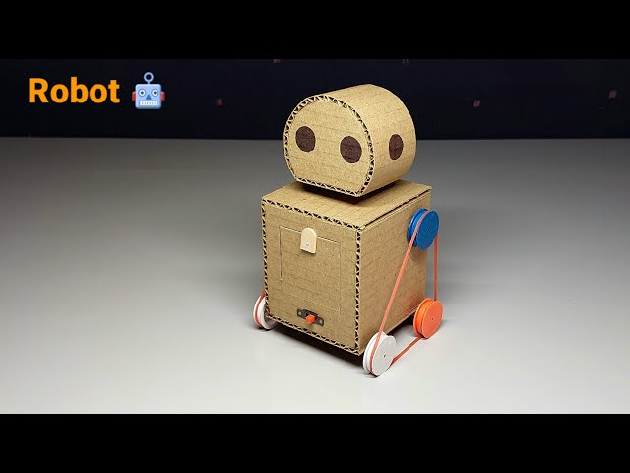
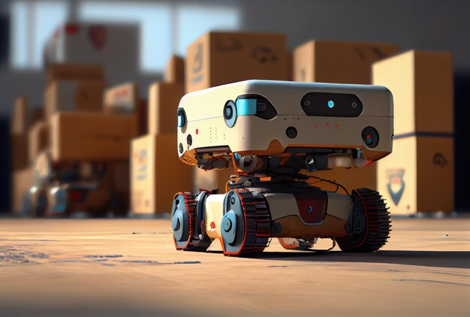
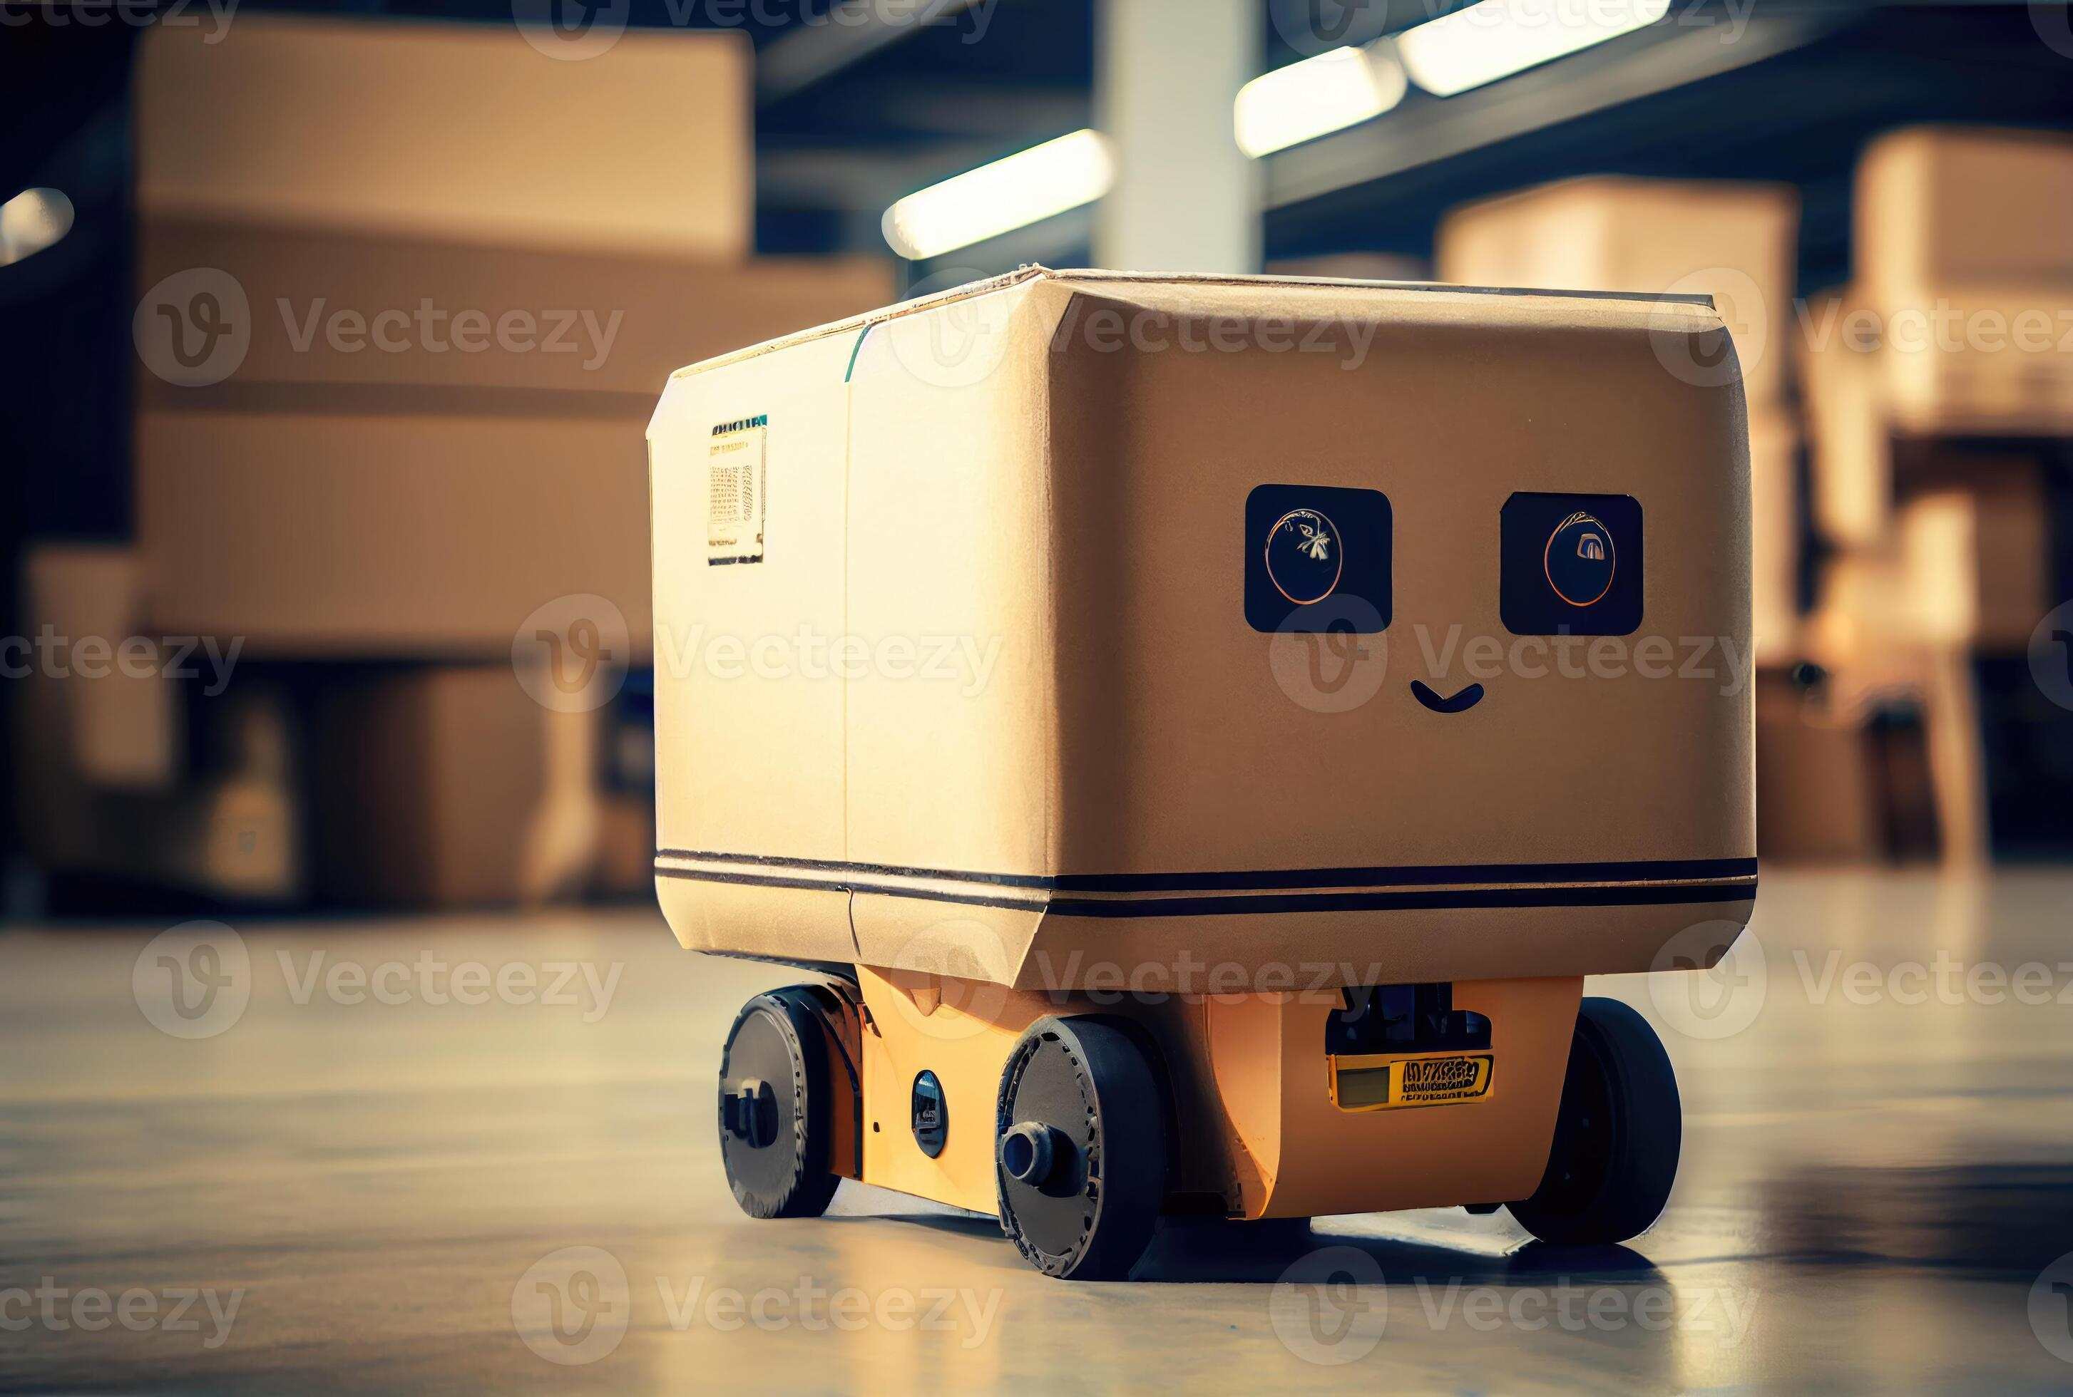
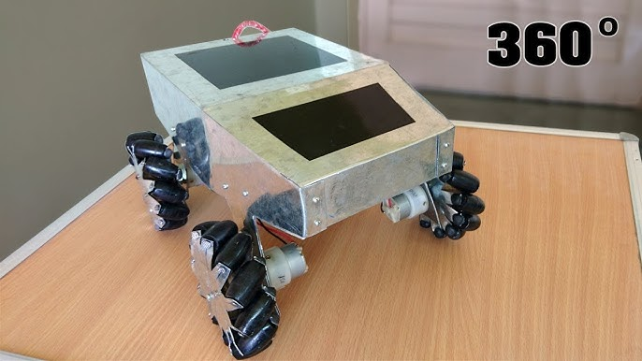
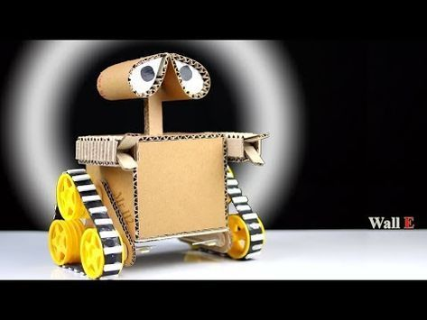
Research

Slide 4
Door Greeter Jokes
¿Qué le dice un techo a otro techo? R=te echo de menos
¿Para qué va una caja al gimnasio? R=para hacerse caja fuerte
¿Qué le dice un podador a otro podador? R=nos vemos cuando podamos

Slide 5
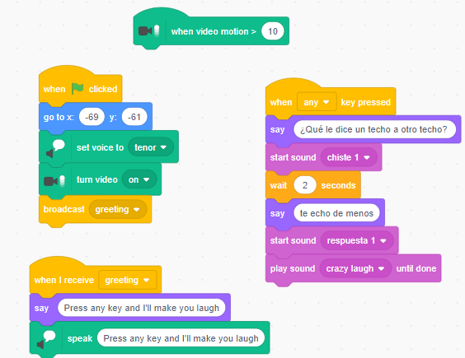
Scratch CODEs

Slide 6
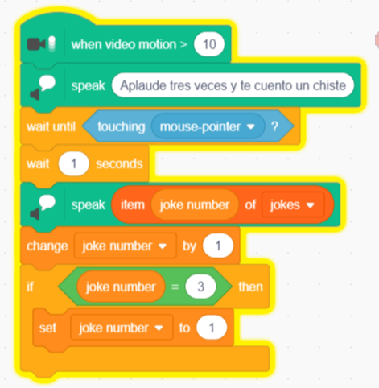
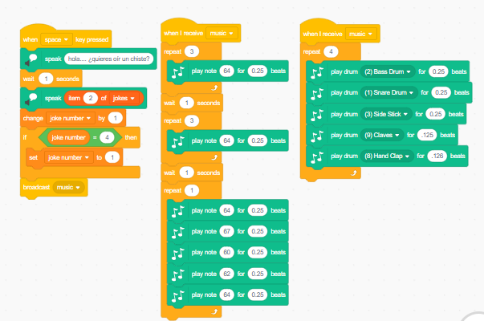

Slide 7
Video script
Hello! My name is Ían Pale and I want to introduce my robot called “BlueBits”
I made it because sometimes we have unfriendly neighbors and they make our life miserable.
So our mission was to build a robotic door greeter that makes neighbors happier and friendlier. Because the more Friends you have the happier you will be.
So, as you can see, my robot is quite good looking but also very smart because when the door opens, he will greete you by telling some jokes. In this ocassion, I decided to put the jokes in spanish ‘cause I live in Mexico.
Now, let me explain and show you how it works.
First, you have to applause thrice and it will tell you a joke.
Then, if you want to listen to the rest of the jokes you will have to repeat the same action.
And also, it can tell you the jokes and play some music after.
Well, that would be everything from me and Bluebits. I hope you had liked it.
Thank you and see you next time!

Slide 8
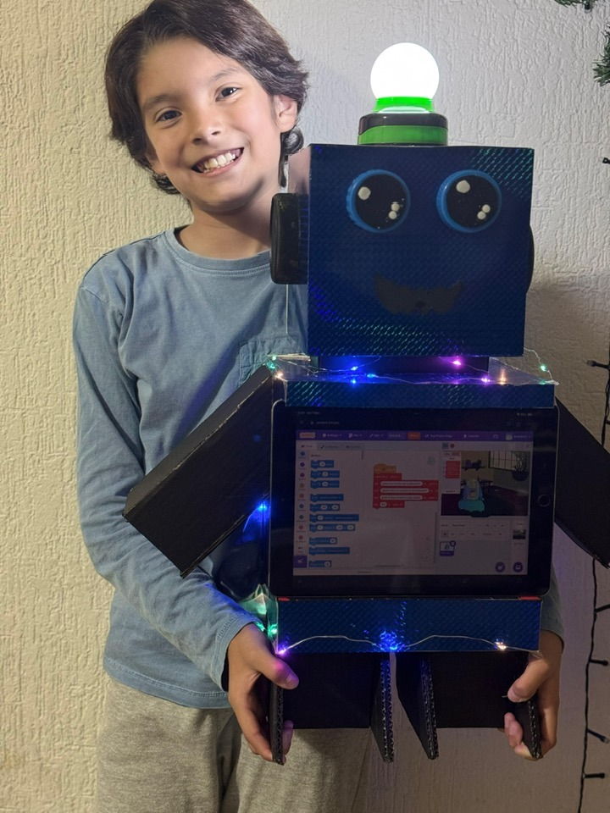
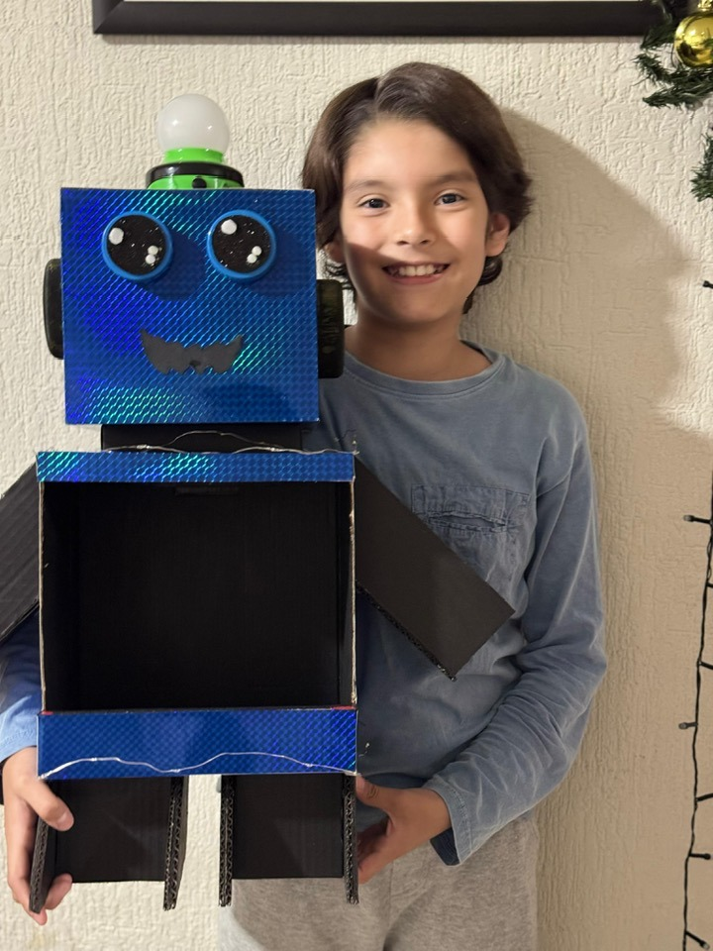
Robot door greeter structure

