Slide 1
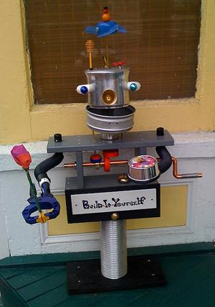
Robot Door Greeter Lab Book
Hazel, John
Build-It-Yourself

Slide 2
Problem
Having unfriendly neighbors can make life miserable.
Mission
Build a robotic door greeter that makes neighbors want to play with you and your robot pal.
The more friends you have, the happier you will be.
Build-It-Yourself

Slide 3
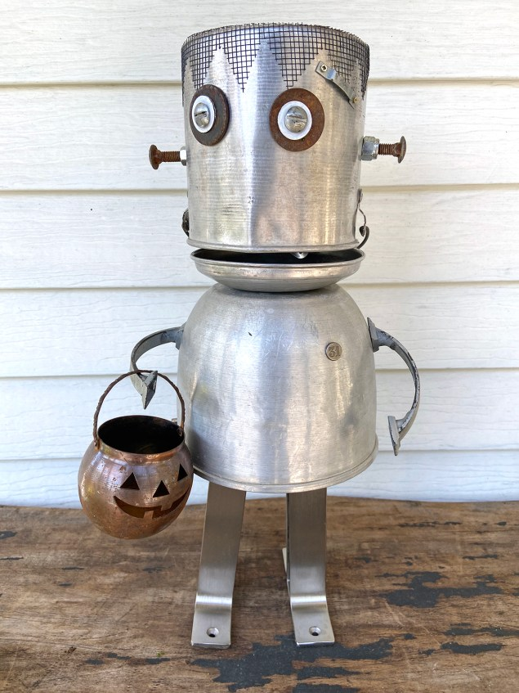
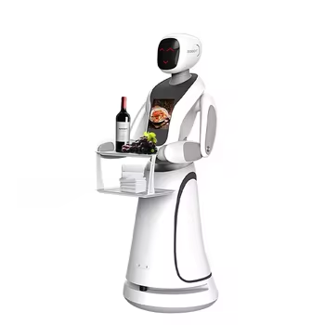
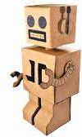
Research
Build-It-Yourself

Slide 4
Door Greeter Jokes
Why do ducks fly south for the winter.
Because it would take way too long to walk!
What do you call pigs playing computer games?
Hogging the computer!
Why do chickens lay eggs?
Because they would break if they dropped them.
Build-It-Yourself

Slide 5
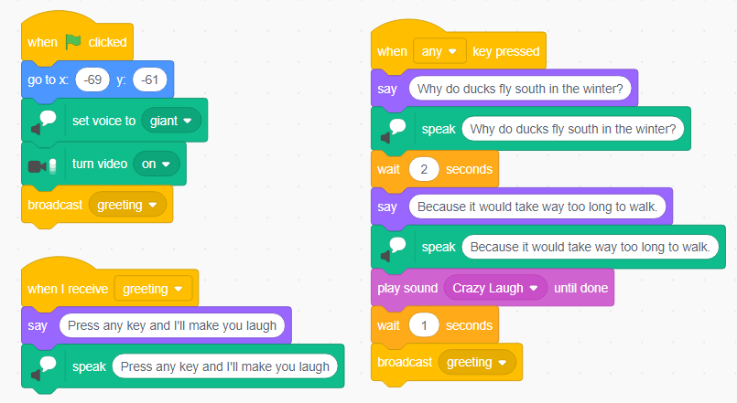
Scratch Code
Tell the same joke every time someone enters your room and presses a key.
Build-It-Yourself

Slide 6
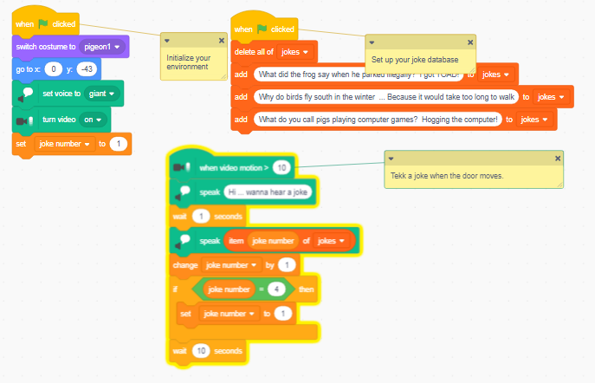
Scratch Code
Tell a different joke every time someone enters your room.
Detect when someone enters your room by setting your camera to detect motion.
https://scratch.mit.edu/projects/1082509547/editor
Build-It-Yourself

Slide 7
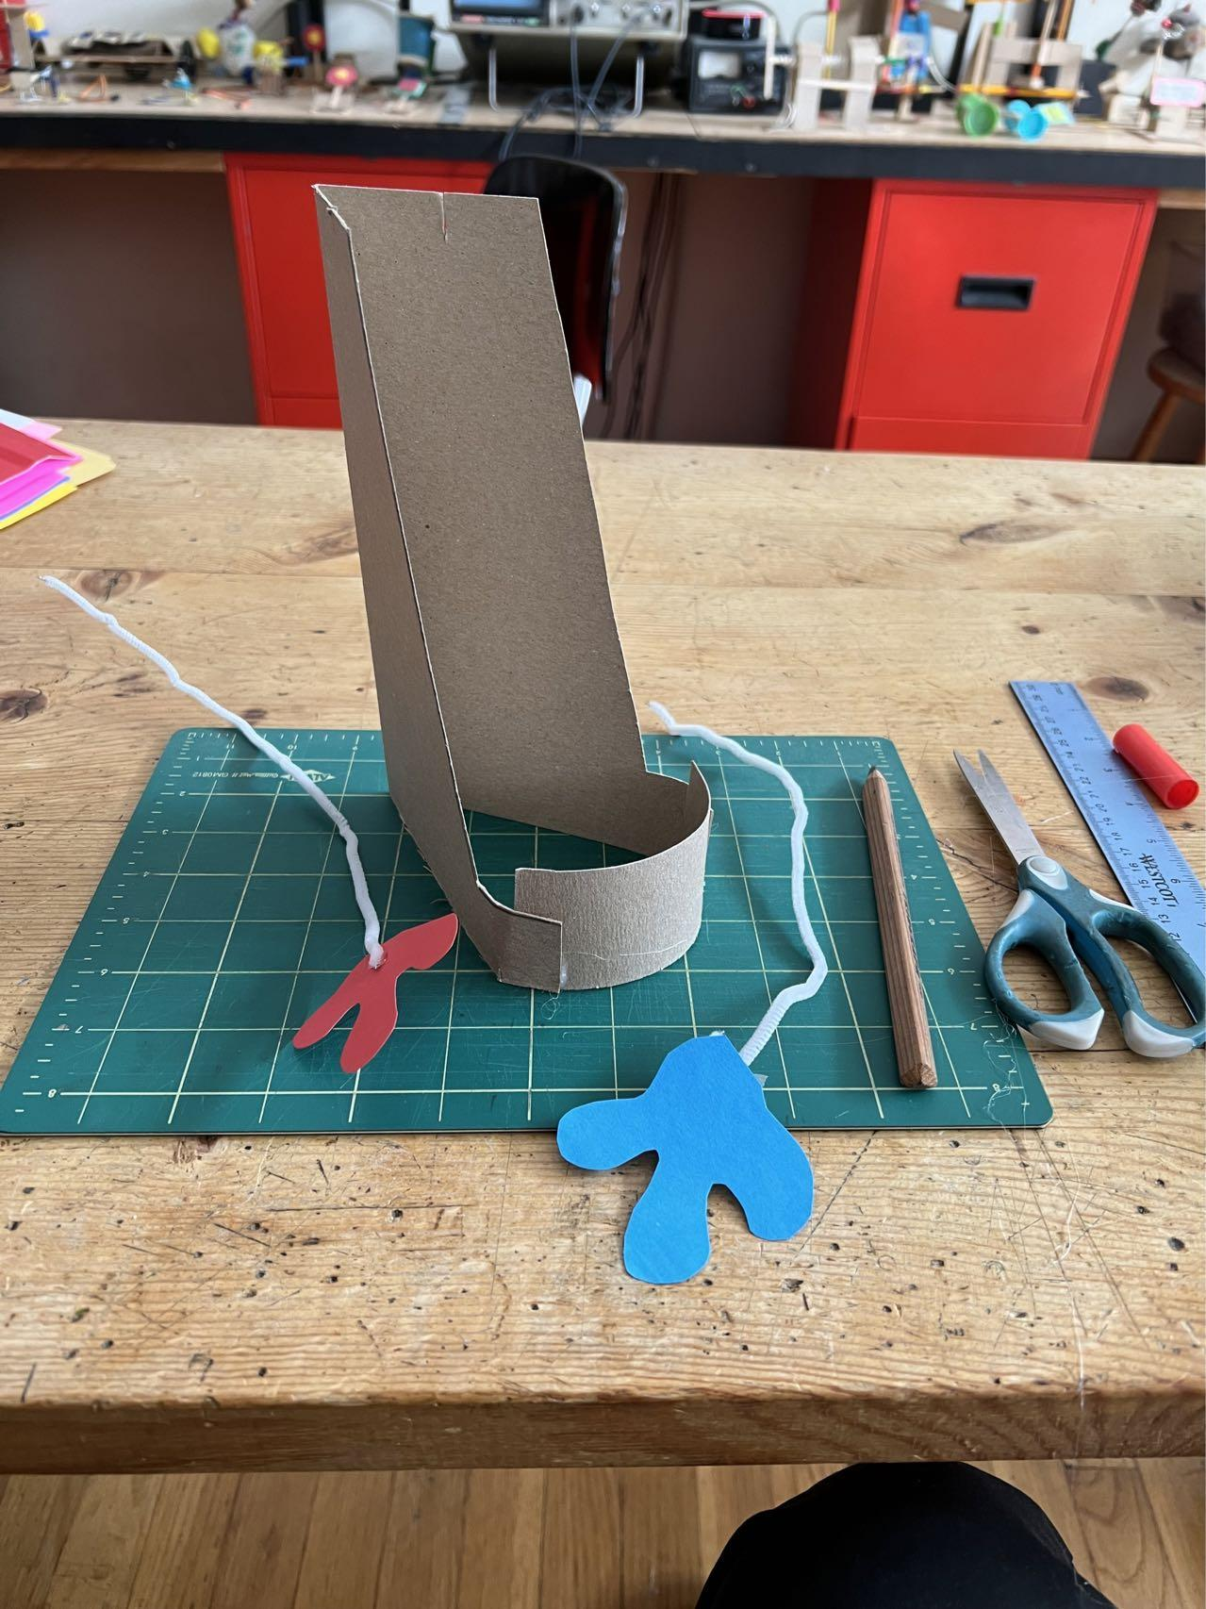
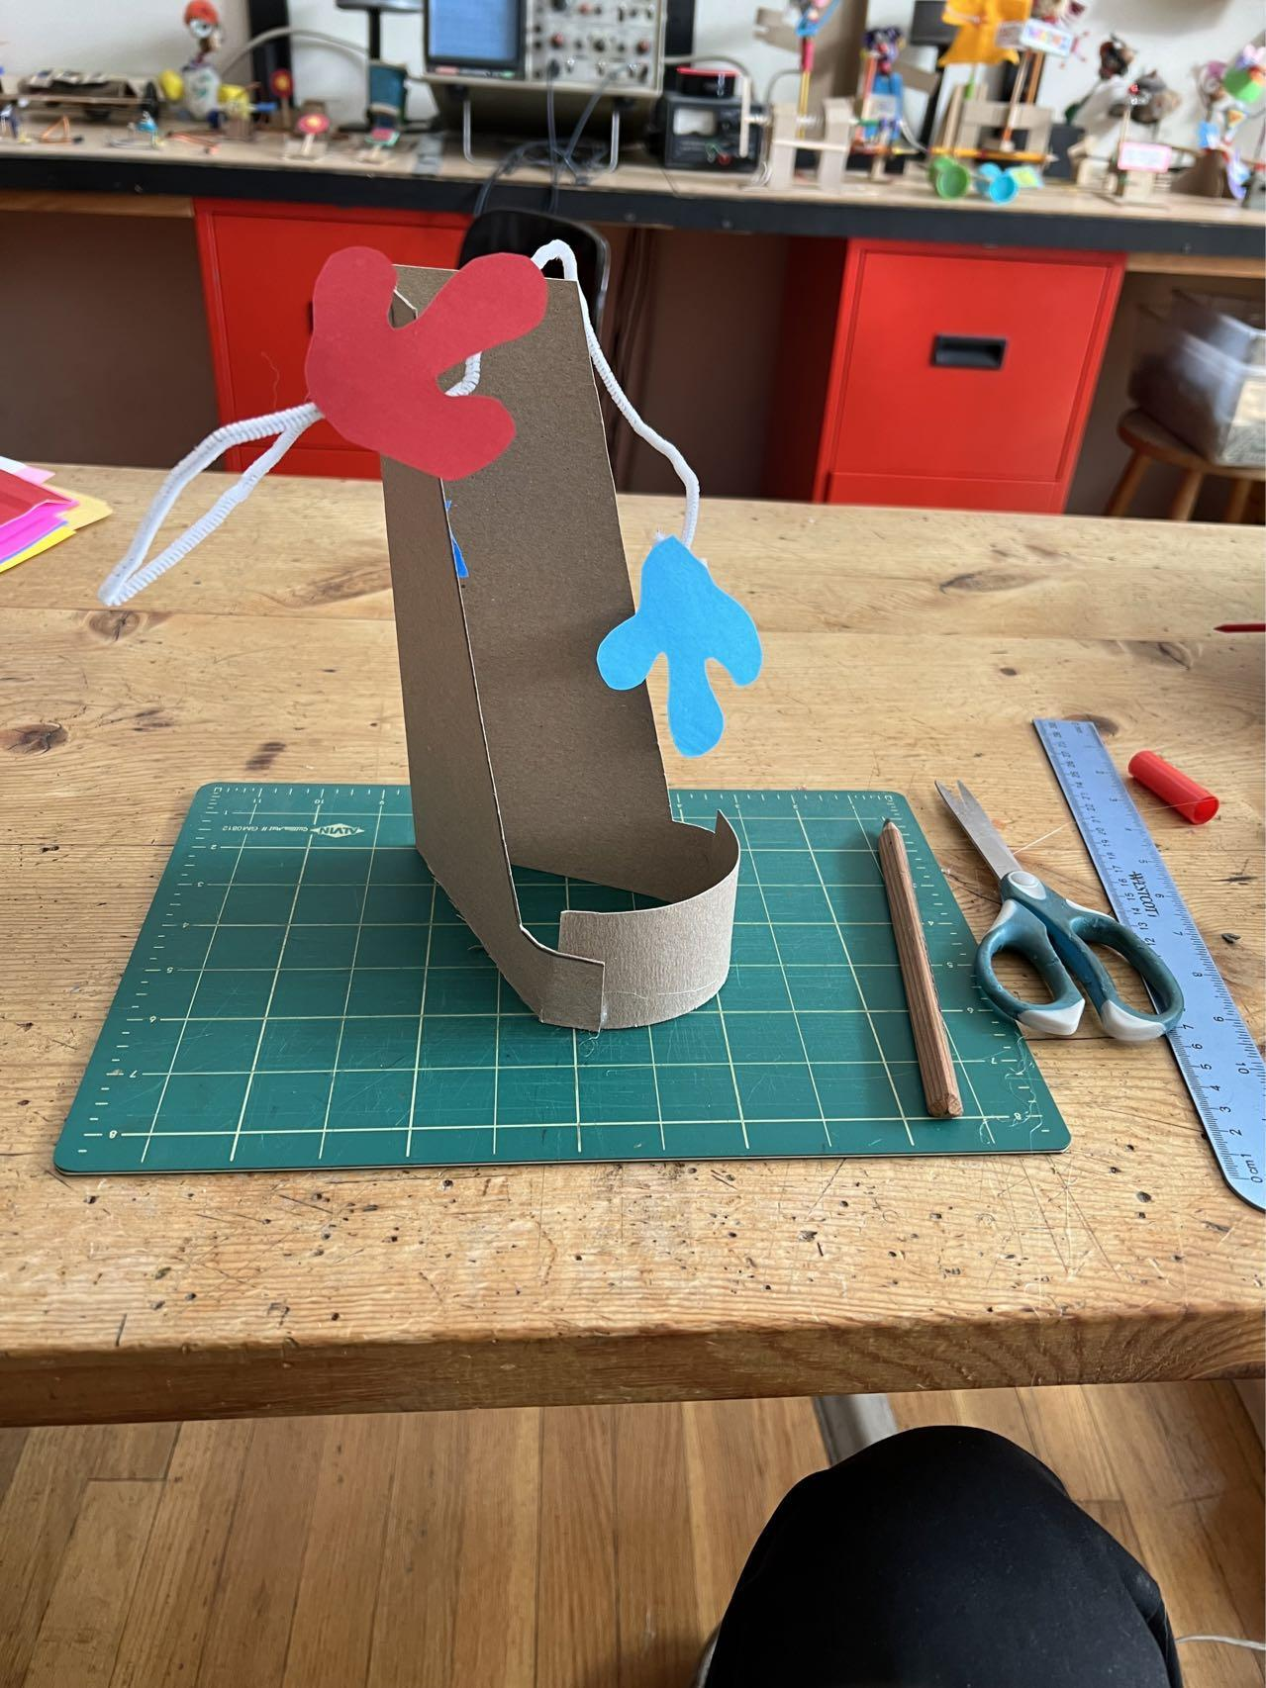
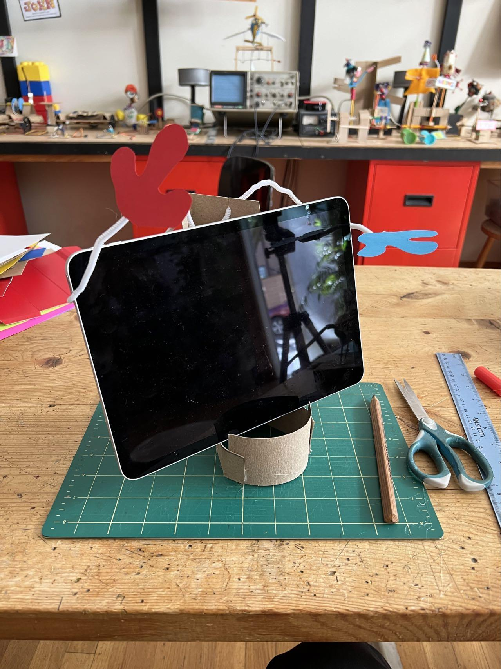
Robot Door Greeter Structure
Build-It-Yourself

Slide 8
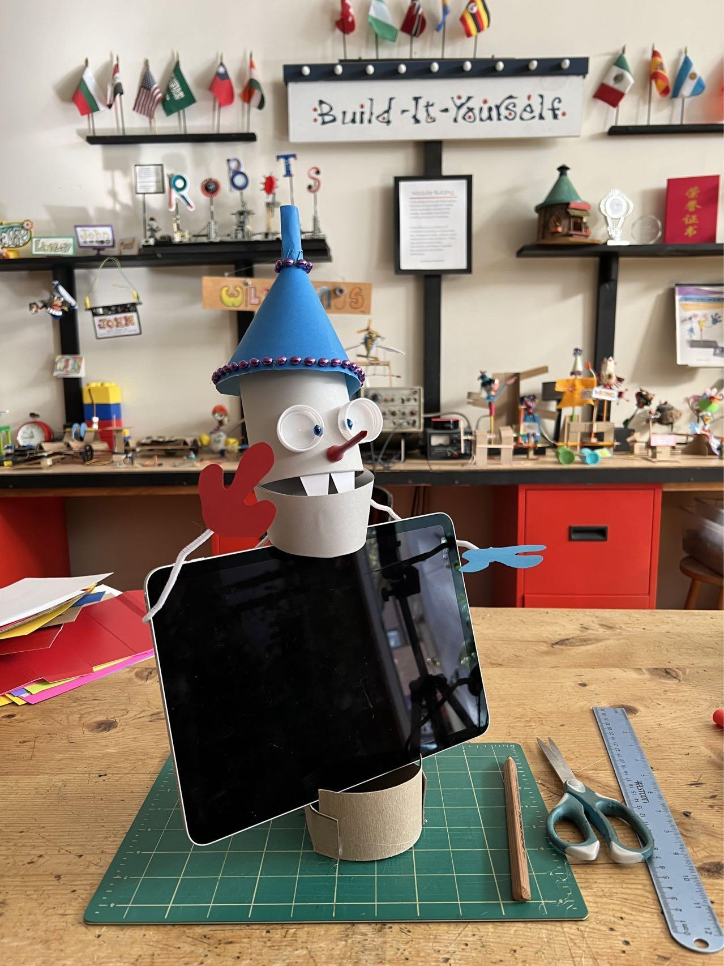
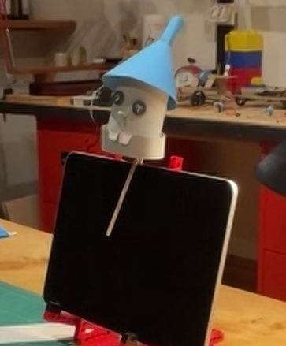
Robot Head
Build-It-Yourself

Slide 9
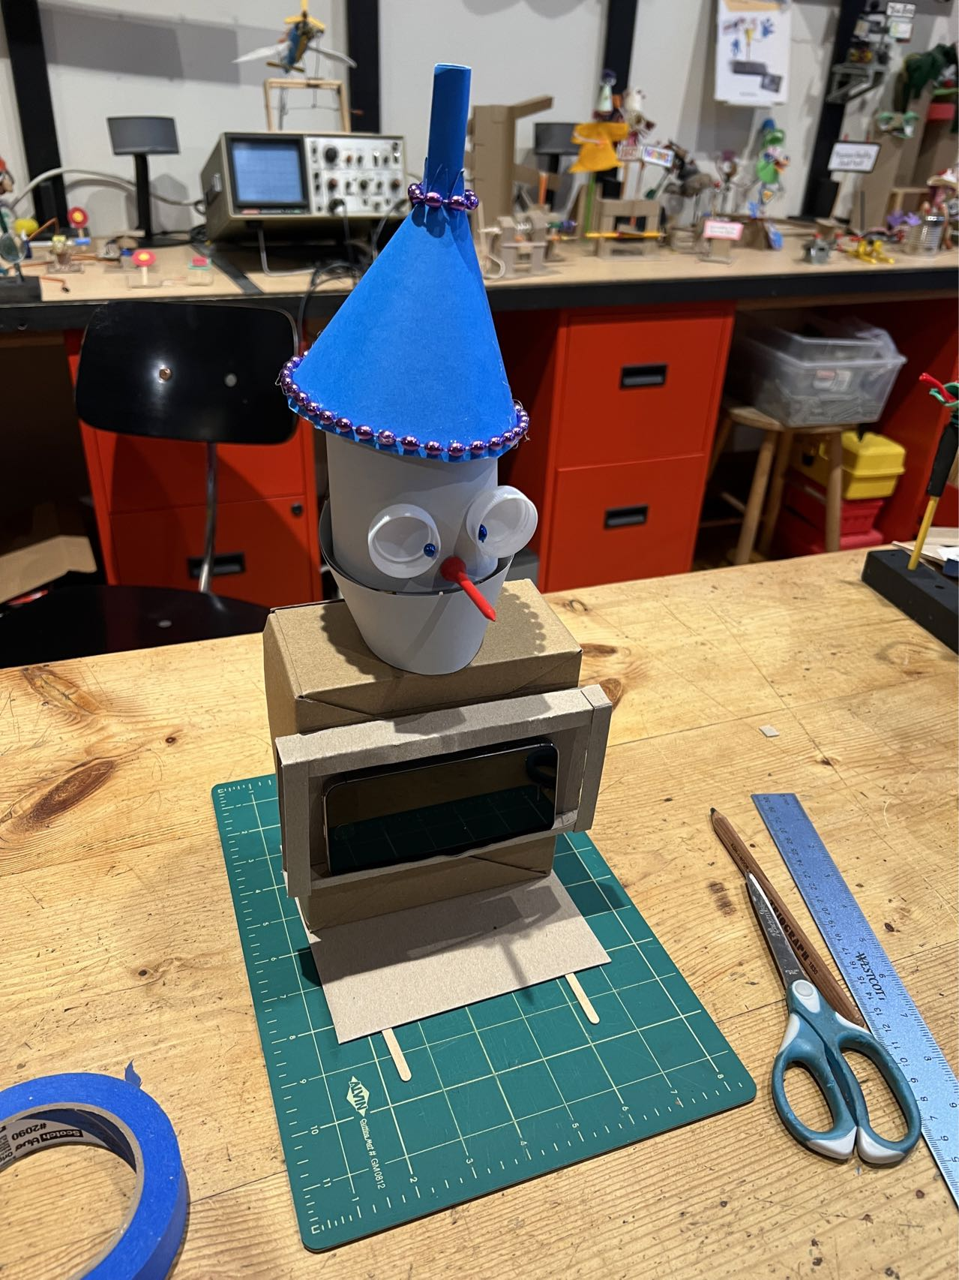
Cell phone mounted on a box
Build-It-Yourself

Slide 10
Candy
Spillway
Spillway
Robot
Candy
Lever
Lever stop
Pivot or Fulcrum
Door Handle
String
Rubberband
Door
Cardboard
Platform

Slide 11
Candy
Spillway

Slide 12
Candy
Spillway

Slide 13
Candy
Spillway

Slide 14
Candy
Spillway

Slide 15
Candy
Spillway
0000

Slide 16
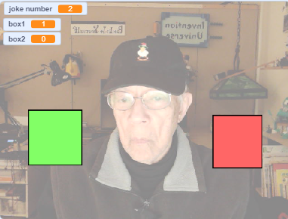
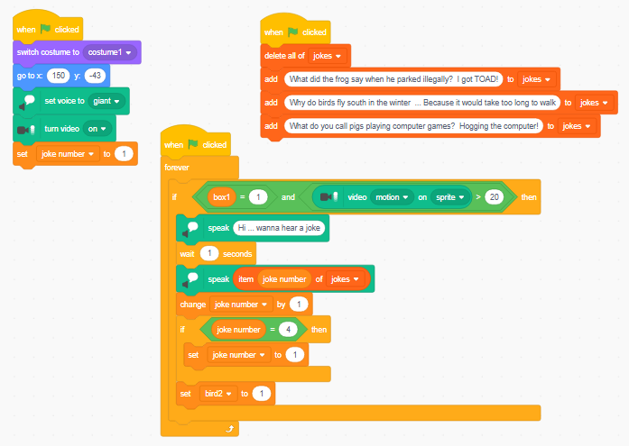
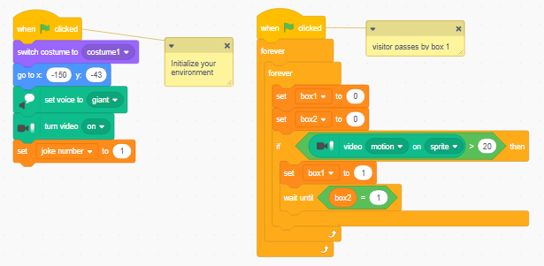
Scratch Code
Tell a different joke when ever someone is walking past you. i.e. They pass the green square and then they pass the red square.
This is the mother of all smart robots!
https://scratch.mit.edu/projects/1096251022/editor
Red Box Sprite
Green Box Sprite
Build-It-Yourself

