Slide 1
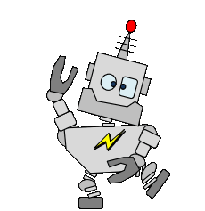
911 Calling all robots!
We have a problem.
Why should we be AI fluent?
Notes:
Welcome to the Build-It-Yourself Laboratory, where dreams turn into toys.

Slide 2
The Problem:
How can we prepare the next generation of builders and leaders to solve the nasty problems past generations have left them?
Pollution
Disease
Prejudices and wars
Economic woes
Notes:
How can we prepare the next generation of builders and leaders to solve the nasty problems past generations have left them?
Pollution
Disease
Prejudices and Wars
Economic woes

Slide 3
The Mission:
Inspire and guide kids to build and use new tools wisely.
Enable kids from different cultures to build together.
Notes:
With the right tool, you can move the earth.
Nothing important happens without teamwork.

Slide 4
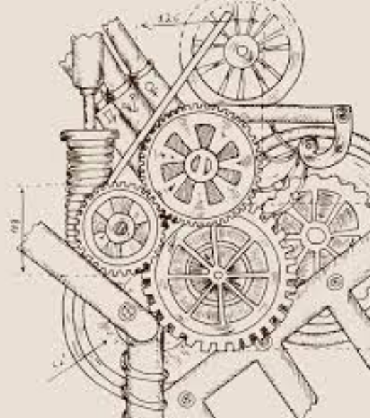
Strategy: Art should lead Technology A-STEM
Notes:
The ARTS, including history, social science, philosophy, art, music, and poetry, should drive technology.

Slide 5
Questions:
What skills will we need in an AI world?
How do you introduce powerful but dangerous tools?
Notes:
What questions should we ask?
Tomorrow’s skills:
1) Communication skills
2) Teamwork skills
3) Socratic method
4) Ethics
5) First principles
How do you introduce powerful but dangerous tools?
1) Through parents.
2) Must pass your driver’s written and road test.

Slide 6
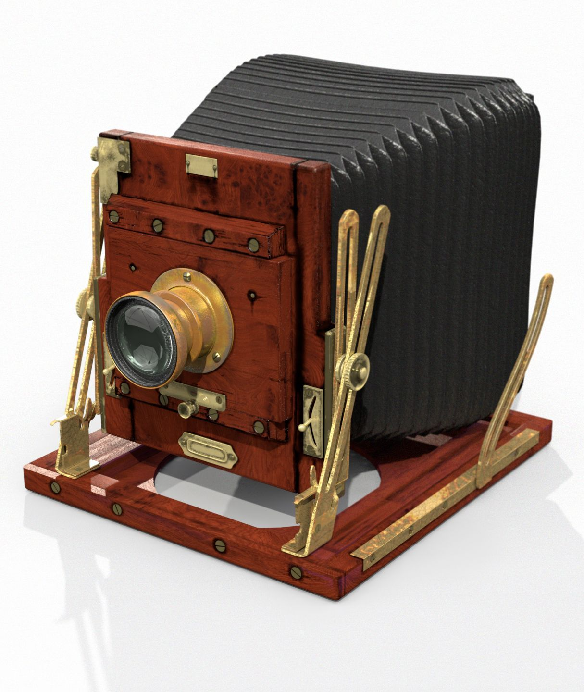
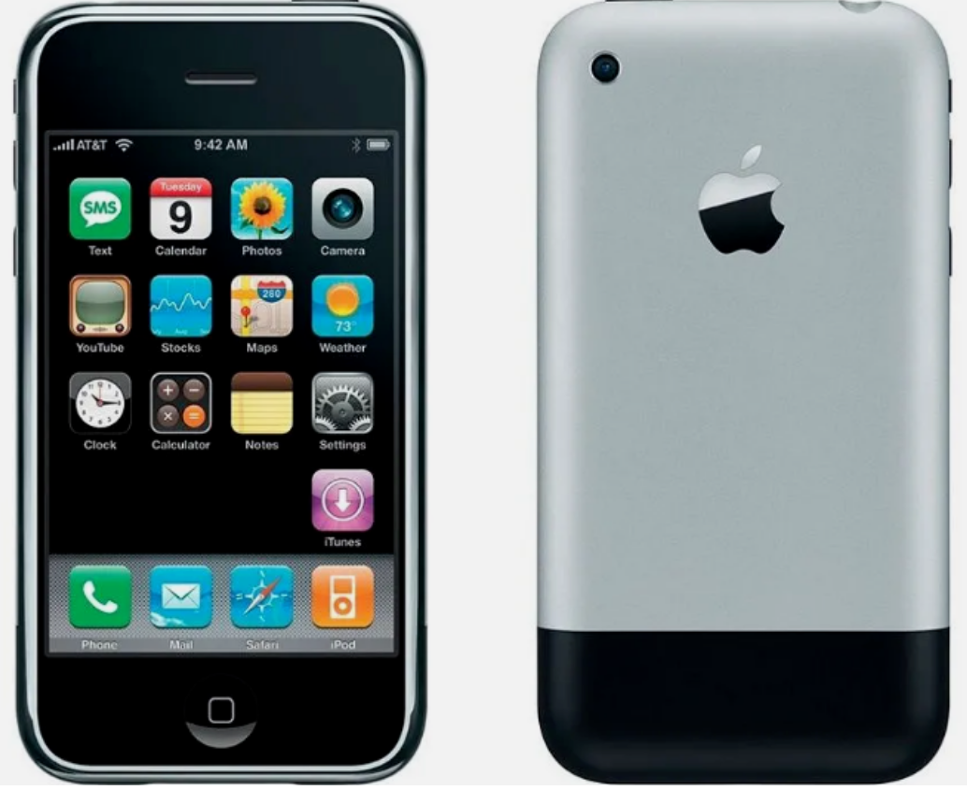
Goal: Inspire and guide kids 8-12 to use AI tools wisely.
101: History of Tools
Document the Problem and Mission.
What is the definition of Artificial Intelligence?
Research examples of AI tools
Document technology ethics:
How did tools like the printing press and camera impact society?
What is plagiarism?
What is an AI hallucination?
What are the attributes of a question or prompt that gets a useful answer?
What are 3 ways to make a robot smart?
Code Scratch to talk to a smart AI robot.
Notes:
Did these tools do more harm than good at enabling humans to communicate new ways of thinking?

Slide 7
Goal: Inspire and guide kids 8-12 to use AI tools wisely.
102: Use AI tools to tell a story
Document the Problem and Mission.
What are the attributes of famous stories?
Write the goals and context of your story about a smart robot.
Write a story example.
Use AI tool Bing/ChatGPT to enhance your story.
Summarize what you learned from Bing/ChatGPT.
Code an animated Scratch video that makes your story go viral.
Notes:
Can a smart robot be creative?
Can a smart robot teach us new ways of writing?

Slide 8
Goal: Inspire and guide kids 8-12 to use AI tools wisely.
103: Teach a smart AI robot to draw.
Document the Problem and Mission.
What is creativity, and why is it important?
Research attributes of famous modern, abstract art?
Code Scratch to teach a smart AI robot how to draw a ‘creative’ picture.
Use feedback to improve the smart AI robot’s drawing skills.
Introduce your smart artist robot to the world.
Notes:
Can a smart robot be creative?
Can a smart robot teach us new ways of drawing?

Slide 9
Goal: Inspire and guide kids 8-12 to use AI tools wisely.
104: Teach a smart AI robot to compose music.
Document the Problem and Mission.
What is creativity, and why is it important?
Research attributes of famous music composers?
Document music concepts: Timing and Scales.
Code Scratch to teach a smart AI robot how to compose unique music.
Use feedback to improve the smart AI robot’s music skills.
Introduce your smart musician robot to the world.
Notes:
Can a smart robot be creative?
Can a smart robot teach us new ways of composiing music?

Slide 10
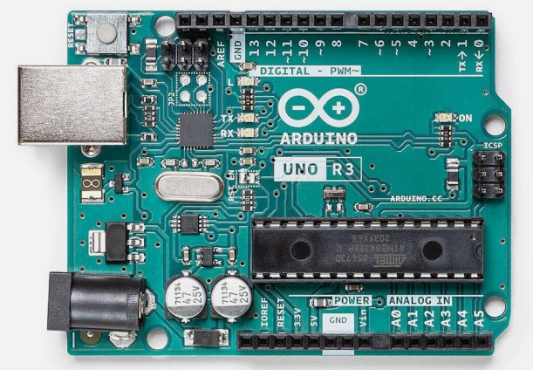
Goal: Inspire and guide kids 8-12 to use AI tools wisely.
105: Build a smart AI alarm clock.
Intro to Computer Science and Electronics.
In development
Document the Problem and Mission.
Document project planning process.
Research Inputs, Outputs, Processing, Feedback.
Specify a smart AI robot alarm clock.
Plan clever human/machine communication.
Document programming primitives.
Test how long it takes to execute computer commands.
Code a timer and test how accurate it is.
What are the pros and cons of Scratch, Python, C++, Java, JavaScript?
Code Scratch and ??? to make an accurate, talking alarm clock.
Introduce your smart AI robot alarm clock to the world.
What are the limitations of AI computers?
Notes:
Can a smart robot be creative?
How can we integrate AI concepts to build the mother of all alarm clocks?

Slide 11
Concord Academy Notes
https://www.youtube.com/watch?v=t9gmyvf7JYo
Prompt with context
Customize your experience:
Tell chat who it is and who you are. (Customized learning)
Give personal examples.
Ask for steps. goal, outline, draft, edit draft
Filter hallucinations.
Be suspicious.
Check multiple times and multiple tools (Bing, Bard, Chat) to verify the accuracy
ChatGPT is offline. Bing uses ChatGPT + online resources. Ask Bing for references.
Projects
Write or improve a story
solve a problem
make a test
Give students a model prompt and challenge to change prompt to get different results.
Ask students to analyze the answer.
Benefits
Eliminate a teacher’s repetitive busy work.
Customize content quickly.
Democratize education.

