Slide 1
Emojii BIY Lab book
By Ale sandoval

Slide 2
Problem
The problema is that many people doesn´t know how to express their feelings.
Mission
The mission is to design and draw cool ideas that can express all our feelings.

Slide 4
Happy

Slide 5
Ways to acomplish the mission:
Ugly
Average
Cool

Slide 6
Grumpy

Slide 7
Doc

Slide 8
Dopey

Slide 9
Bashful

Slide 10
Sneeze

Slide 11
Sleepy

Slide 12
Crazy in love

Slide 13
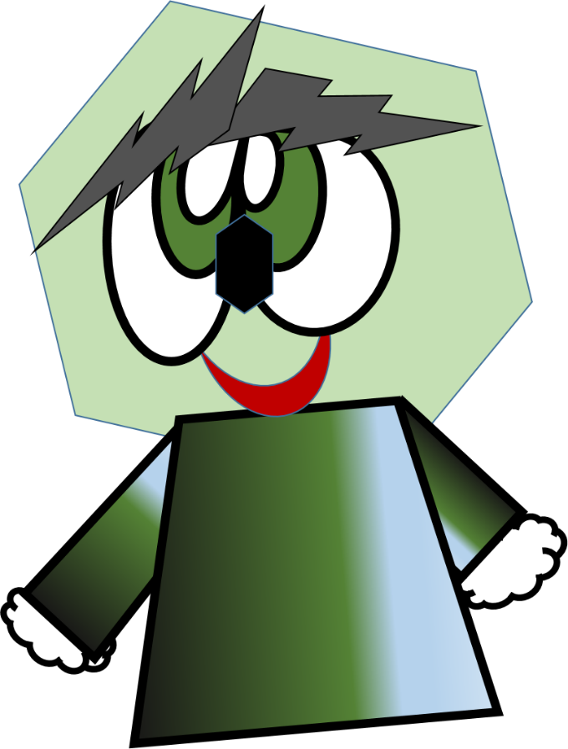

Slide 14
“Feed your brain by building yourself”

Slide 16
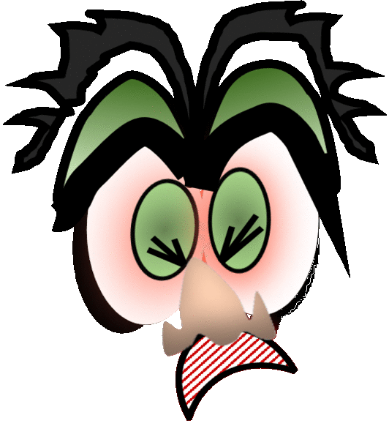
“Breathe and try again, no matter how many times”

Slide 18
“When are crazy in love at learning
times and excuses go fly away”

Slide 20
MAKE A SMILE AND DACE :D
☺

Slide 21
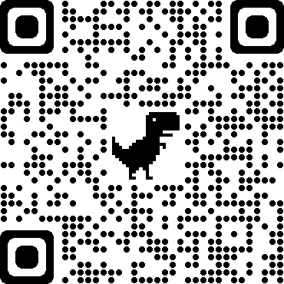
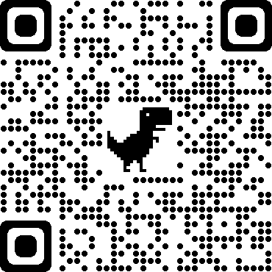
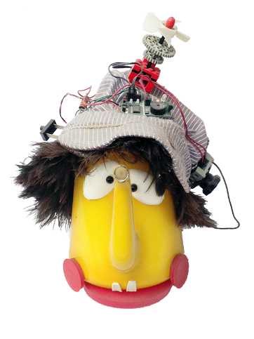
Special thank you to our oustanding guide.
https://gifmaker.me/
https://www.myspacegens.com/handler.php?gen=animatedimage

