Slide 1

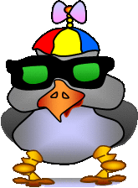
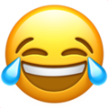
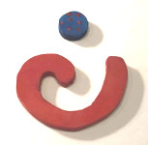
The Future of Emojis
“This is technical!”
：”-）
1982
2011
2018
2020
Notes:
Future of emojis- can wear， can move， ？？、

Slide 2

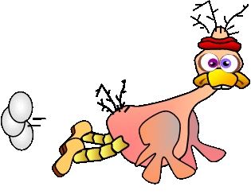
The Problem
“A picture is worth 1000 words!”
It is easy to misunderstand people when we explain complex ideas behind the screens without seeing each other.
“Hard work”
Notes:
It is widely agreed by researchers that animal languages are not as complex as human language. But they are still communicating effectively because they invent a lot of body language (think about the bee dance!) to express their feelings.
However, it is so easy to get into fight when we do texting language because it is difficult to guess the real meaning behind just with several lines of words.
Communicating ideas clearly, concisely and convincingly is super important and super difficult.
----------
The animal world and societies evolve in part based on their ability to communicate and collaborate.

Slide 3
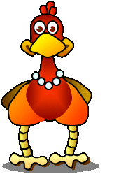
The Mission
Make way cool emojis!
Create an efficient way to communicate better with our friends and families!
“Let’s dance!”
Notes:
Calling for cool Emojis to enhance our expression in the cyber age！
We don‘t want fight, a cool emoji could help us communicate better with our friends and families.
as the world becomes increasingly digital and increasingly globalized, emoji will become important tools for translation and communication
https://www.wired.com/story/guide-emoji/

Slide 4
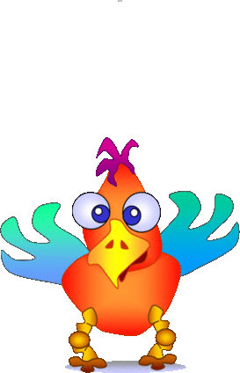
Project Plan and Skills Needed
Document the problem and mission.
Research Symbols with Lexicon meaning.(not sure about this phrase)
Understand the mechanism of communication.
Brainstorm and plan your solutions.
Build solutions.
Test and edit solutions.
Present your solutions in an animated Scratch story.
Skills Needed:
PowerPoint Guru
Problem Solver
Master Designer
Communicator
“I’m excited!”

Slide 5
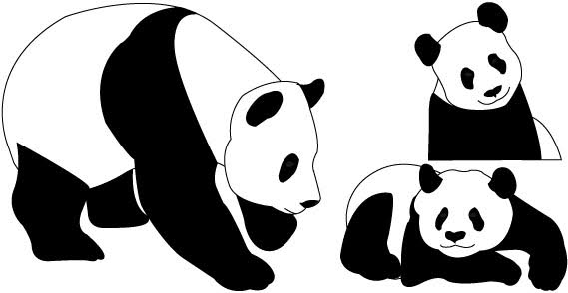
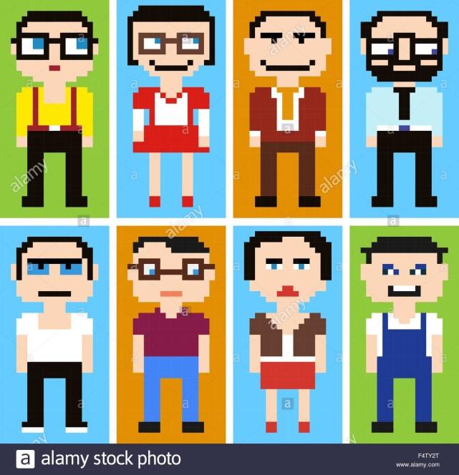
What you will learn
Visual Communication
Vector Graphics
Pixel Graphics
Cartooning
Grafitti
Animated GIFs

Slide 6
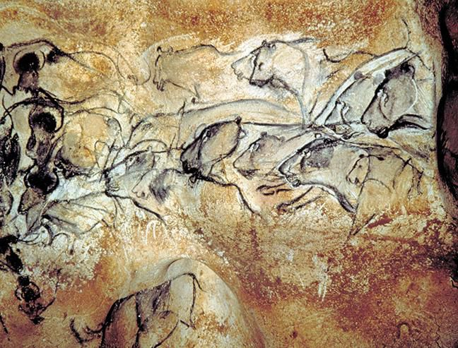
Research
The spectacular lions and rhinos of Chauvet Cave, in southeastern France, are commonly thought to be around 30,000 to 32,000 years old.

Slide 7
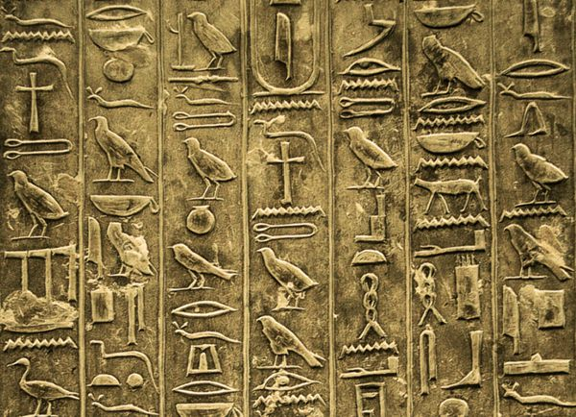
Research-Symbols with Lexicon meaning
Hieroglyphics are the word pictures that represent the images and sounds of the Ancient Egyptian language.
There are two basic types of hieroglyphs: Ideograms and Phonograms. Often the same image can be both an ideogram and a phonogram.
Ideograms are images that depict the object they represent. For example the image of a mouth can represent the word 'mouth'.
Phonograms are images that represent the sounds of the Ancient Egyptian language, just like our alphabet represents the sound of our language. For example, the image of a mouth can also represent the sound 'R'.

Slide 8
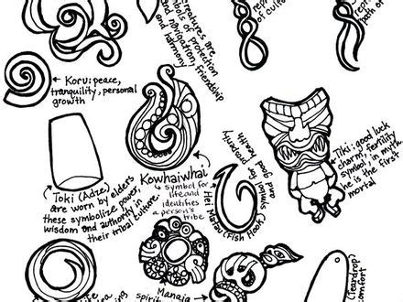
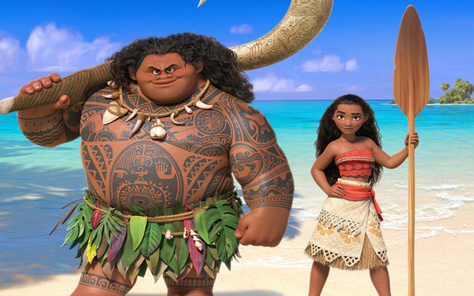
Research
Maori Koru Symbol
The koru (Māori for "loop") is a spiral shape based on the appearance of a new unfurling silver fern frond. It is an integral symbol in Māori art, carving and tattooing, where it symbolises new life, growth, strength and peace.

Slide 9
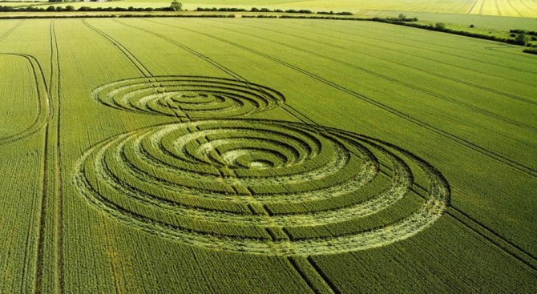
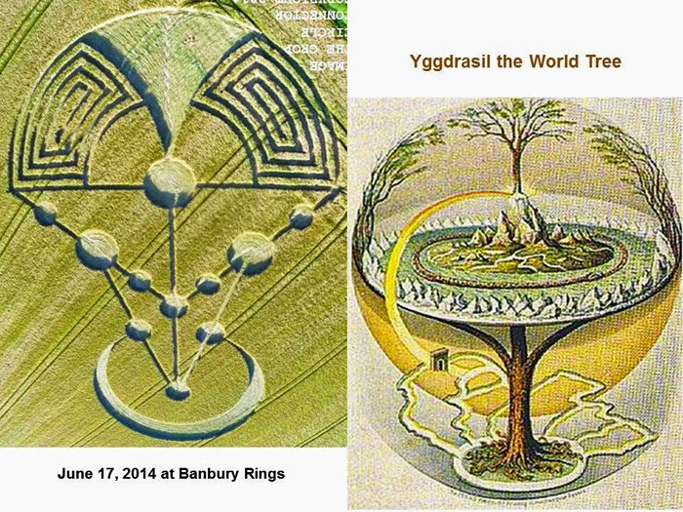
Research
Crop circles-mysterious patterns in fields crop up overnight

Slide 10
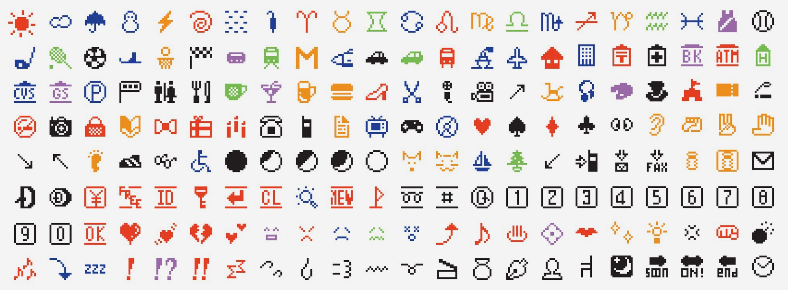
Research
The first emoji-1999
:-)
:-(
Notes:
https://www.cnn.com/style/article/emoji-shigetaka-kurita-standards-manual/index.html

Slide 11
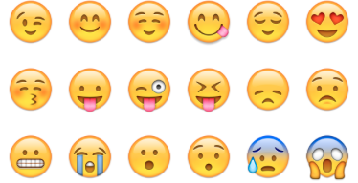
Research
Modern EMOJIs- emoji lexicon needs
We can do better !!!
Emoji book- Can you read it？
https://mitpress.mit.edu/books/book-ground

Slide 12
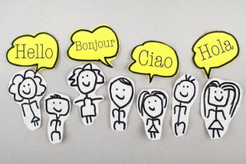



The secret mechanism of communication
Our meanings, both animals and humans, undertake different forms☺.
We are the sculptors who invent a particular perceivable shape to a particular idea in our mind.
The forms of “Hi”
Body language- the motion https://www.youtube.com/watch?v=QB44Vddoi-w
Verbal language-the sound
Written language- the written text
Visual language-the Emoji or a picture
The idea of “Hi”
Now, make your own version of “HI”!
Notes:
Both animals and humans uses a lots of signs to express meanings.
Lexicon meaning

Slide 13
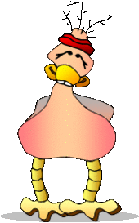
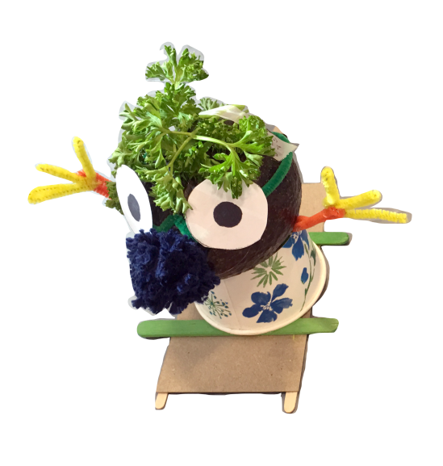
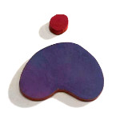

Hall of “Looking for Peace” emoji
Standard
BIY
Abstract
Physical
(́◉◞౪◟◉‵)
Emoticon
“Peace, love and barbeque ribs.”
See-No-Evil Monkey
Notes:
https://www.emojimeanings.net/list-animals-nature-whatsapp
See-No-Evil Monkey
Monkey with two hands in front of its eyes. Closes its eyes to the world so as not to see anything bad or cruel, or is embarrassed. Mizaru is one of the three wise monkeys. In a sense, ignoring bad things.

Slide 14
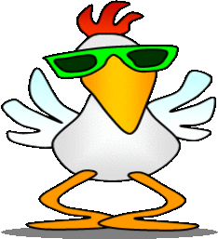
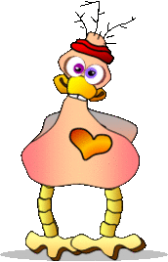

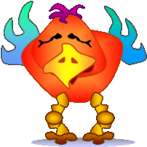
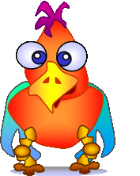
Hall of Fame
“Be cool!”
“Peace, love and barbeque ribs.”
“Love it.”
“Epic fail”
“That’s funny.”
“Hey there.”

Slide 15

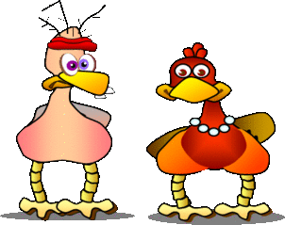
Hall of Fame
“That’s geeky.”
“Wicked Smart”
“OK … Agreed”
“Let’s dance!”
“Teamwork”
“Hard work!”

Slide 16
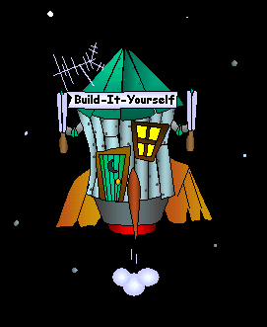
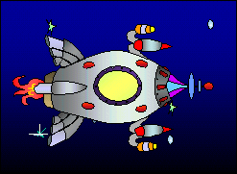
Hall of Fame
“To the planet Pluto and beyond.”
“Going in style”
“Luxury Limo”
“???”
“???”
“???”
“???”

Slide 17
Break Designs Into Simple Parts
Eyes
Head
Nose
Mouth
Hair
Measures of Success
Make big eyes
Exaggerate
Use unusual shapes.

Slide 18
Then integrate the shapes
Eyes
Head
Nose
Mouth
Hair
Measures of Success
Make big eyes
Exaggerate
Use unusual shapes.

Slide 19
Emoji animation
Myspace gif maker
Gifmaker.me
“I’m scared!”

Slide 20
Emoji animation
Myspace gif maker
Gifmaker.me
“I’m scared!”

Slide 21
Emoji Story Board
Start
Introduction
When Where
Stage
Who
Nerd Bird
Stage
Display
Nerd Bird
Who
Art Bird
Stage
Display
Art Bird
What
Problem
Stage
Display
Art Bird
What
Mission
Stage
Animate
Birds
End

Slide 22
What we should know
How to think outside the box.
How to make people react.
Basic graphic design principles.
How to make and animated GIF with transparent background.
How to communicate clearly, concisely and convincingly.
Advanced Projects:
Design animated graffiti words.
Make selfie photos of facial expressions.
Research the history of cave drawings
Write a Scratch animated, interactive, movie about your emojis.
Submit your proposal to Unicode Emoji（https://unicode.org/emoji/proposals.html）
researchers from the Johns Hopkins Bloomberg School of Public Health and the Bill & Melinda Gates Foundation proposed an emoji mosquito as a way to better describe mosquito-borne illnesses like malaria and Zika.

Slide 23
How ambitious are you?
Research the history of communicating graphically.
Make a list of emotions you would like to have in your personal emoji library and then design cartoons that expresses those emotions.
Animate your emojis.
Use PowerPoint special effects to make your emojis 3D.
Design abstract emojis.
Save your emojis as PNGs.
Save your emojis as animated GIFs.
Upload your emojis to WeChat.
Write and produce an Emoji movie.
“To the planet Pluto and beyond.”

Slide 24
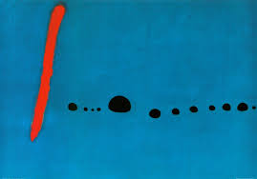
Art Dreams from Abstract Shapes
Miro

Slide 25
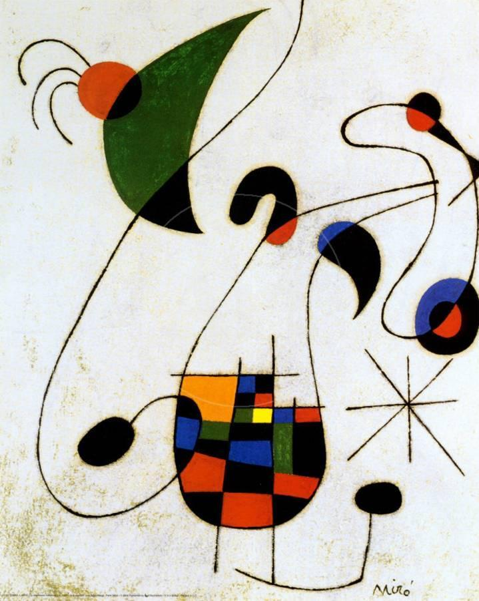
Art Dreams from Abstract Shapes
Miro

Slide 26
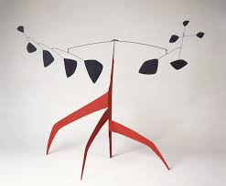
Art Dreams from Abstract Shapes
Calder

Slide 27
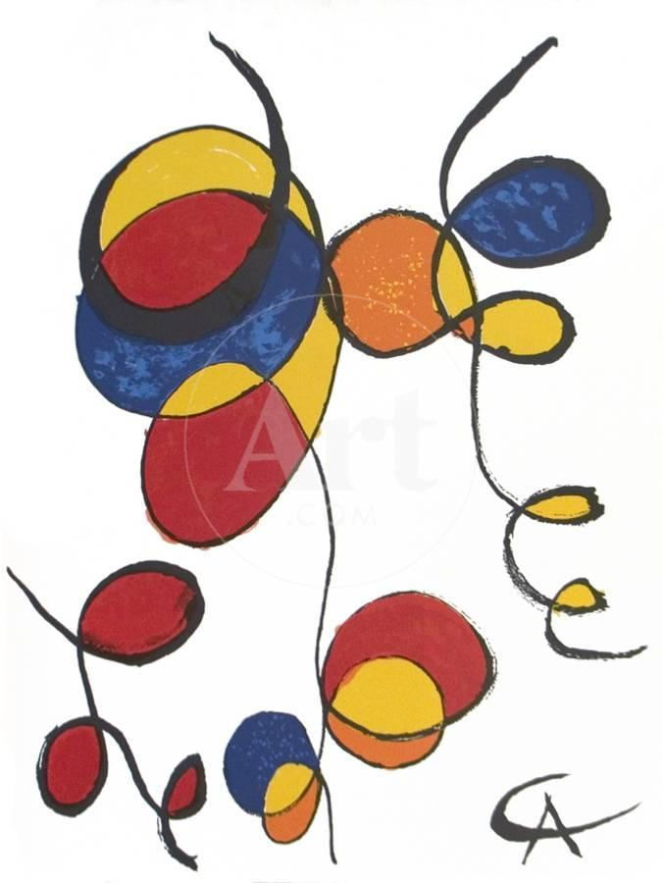
Art Dreams from Abstract Shapes
Calder

Slide 28
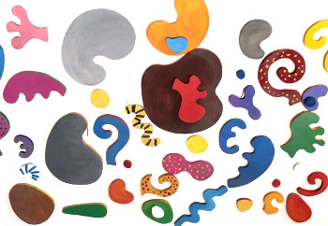
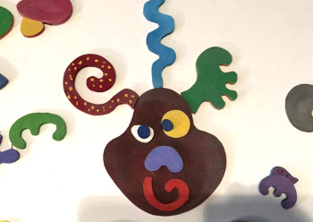
Emojis from abstract physical shapes

Slide 29
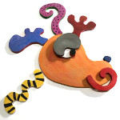

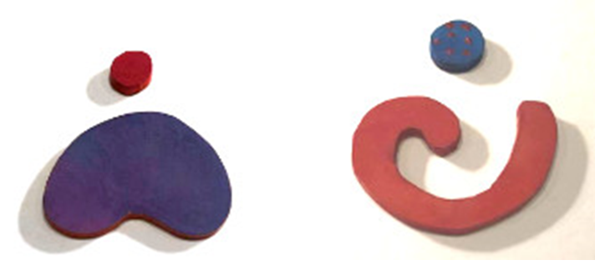
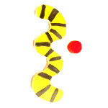
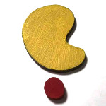
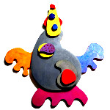
Emojis from abstract physical shapes
Cute
Huh?
Sad
Happy
Turned On
Let’s go!
Let’s dance!
Yes

Slide 30
Emojis from abstract physical shapes

Slide 33
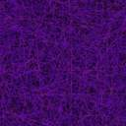





Small parts

Slide 34

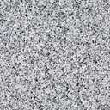


Linear parts

Slide 35
Angry
Happy
Sad

Slide 36

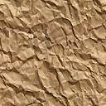

Surfaces

Slide 37
3D parts

